Slide 1
ETS-6 Updates
Thomas Jonsson
WIMAS-2 meeting, 30 September

Slide 2
New code parameters in ETS-Init
Background:
New code parameters for ETS-Init were suggested 23/9
There are natural extensions to the new CPs
What’s new:
Implement two interpretative modes
All states interpretative
Total density is interpretative, while the states a given by a coronal distribution
Concentrations
Versus both electrons and ions
Concentrations can be used both as an initial condition, an equation, a boundary condition
Options for starting profiles depend on the selected computation-mode

Slide 3
ETS-Init: Ion settings
Note: Specifying the concentration can be very useful for modelling e.g. ICRH with minority species.

Slide 4
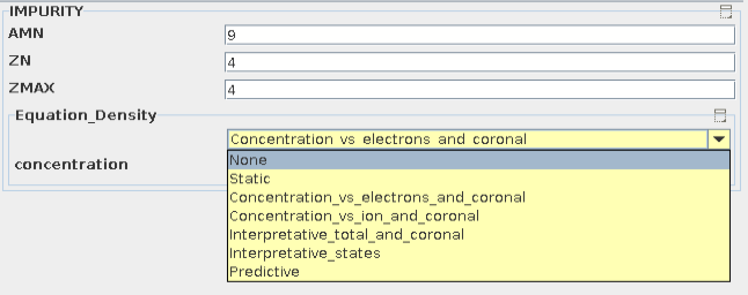
ETS-Init: Impurity settings

Slide 5
ETS-Init: Impurity settings, concentration-equations

Slide 6
ETS-Init: Impurity settings, interpretative-equations

Slide 7
ETS-Init: Impurity settings, static-equations

Slide 8
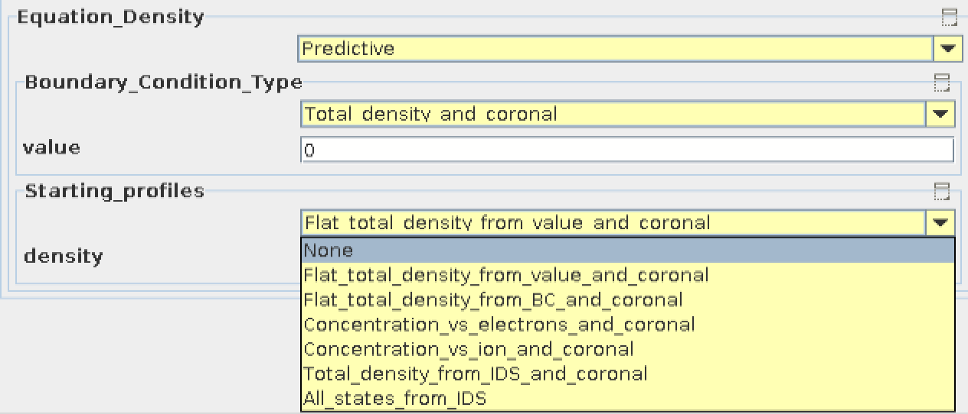
ETS-Init: Impurity settings, Predictive-equations 1 (2)

Slide 9
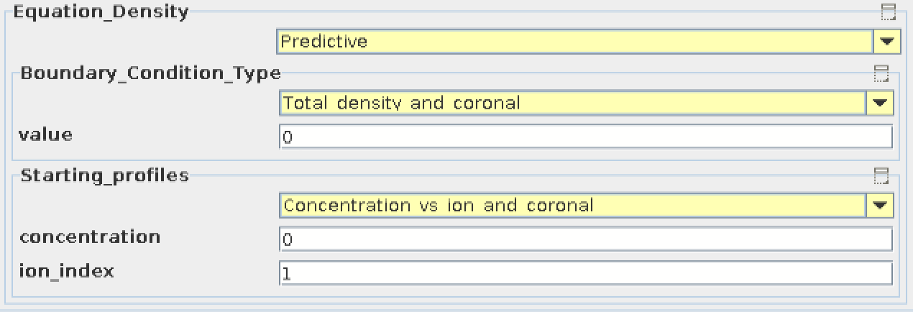
ETS-Init: Impurity settings, Predictive-equations 2 (2)

Slide 10
EQInput: Select pressure-source
NEW
User documentation

