Slide 1
FP9 Information meeting
Tony Donné
FP9 Information meeting | 19 October 2020

Slide 2
Programme - Monday 19 October
No | Items | Start | End | Time | Who
1 | Introduction: Programmatic & governance aspects | 13:00 | 13:50 | 00:35 + 00:15 questions | Tony Donné
2 | Fusion Science Department Programme | 13:50 | 14:15 | 00:15 + 00:10 questions | Volker Naulin
3 | WP PWIE (Plasma Wall Interaction & Exhaust) | 14:15 | 14:40 | 00:15 + 00:10 questions | Sebastijan Brezinsek
 | Break | 14:40 | 14:55 | 00:15
4 | WP PrIO (Preparation of ITER Operation) | 14:55 | 15:25 | 00:20 + 00:10 questions | Xavier Litaudon
5 | WP JT-60SA | 15:25 | 15:50 | 00:15 + 00:10 questions | Carlo Sozzi
6 | WP W7X | 15:50 | 16:15 | 00:15 + 00:10 questions | Andreas Dinklage
 | Break | 16:15 | 16:30 | 00:15
6 | WP TE (Tokamak Exploitation) | 16:30 | 17:10 | 00:20 + 00:20 questions | Emmanuel Joffrin
7 | DEMO Physics | 17:10 | 17:40 | 00:20 + 00:10 questions | Volker Naulin for Hartmut Zohm
8 | Questions to the FSD PLs and TFLs | 17:40 | 18:00 | 00:20 questions | All
 | Adjourn | 18:00

Slide 3
Programme - Tuesday 20 October
No | Items | Start | End | Time | Who
1 | Fusion Technology Department Programme | 13:00 | 14:20 | 00:50 + 00:30 questions | Gianfranco Federici
2 | DEMO Project Organisation Highlights | 14:20 | 15:00 | 00:30 + 00:10 questions | Christoph Baylard
 | Break | 15:00 | 15:10 | 00:10
3 | DEMO Work Breakdown Structure | 15:10 | 15:45 | 00:20 + 00:15 questions | Alice Beaumont
4 | WPDES (Design Activity) Call | 15:45 | 16:10 | 00:10 + 00:15 questions | Alice Beaumont
 | Break | 16:10 | 16:20 | 00:10
5 | Involvement of industry | 16:20 | 16:50 | 00:15 + 00:15 questions
6 | Calls for Participation (timetable and format) | 16:50 | 17:25 | 00:10 + 00:25 questions | Botond Meszaros
7 | Questions to the FTD PLs | 17:25 | 18:00 | 00:35 questions | All
 | Adjourn | 18:00

Slide 4
Position of the United Kingdom

Slide 5
This talk
Position of the UK
Budget and actions to come to a reduced proposal
Time line
Organisational changes in EUROfusion
Work packages under PMU

Slide 6
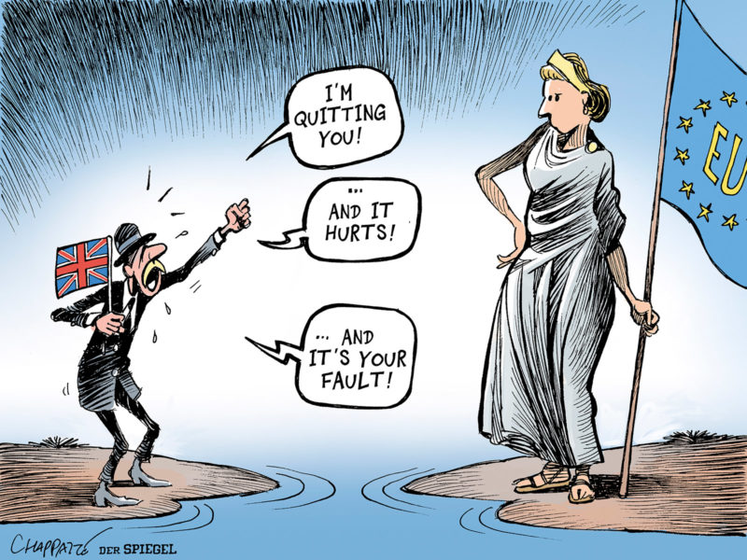
United Kingdom
The UK is an important partner in the EUROfusion programme
It would be ideal if the UK succeeds to become Associate partner to Euratom (similar to CH)
Then everything stays more or less the same
However, the UK contribution needs to be balanced
If this is not possible, we continue working with the UK as International Partner to IPP

Slide 7
United Kingdom – two options
Option 1: UK Associates to Euratom
Option 2: UK International Partner to IPP
EUROfusion reimburses ~100 M€ to UK in 5 years
UK contributes ~100 M€
to Euratom for 5 years
UK collaborates with EUROfusion and reimburses its own activities and staff by ~100 M€ in 5 years
Commission contribution to EUROfusion doesn’t include budget for the UK
Commission channels the UK contribution to EUROfusion
Nothing changes and we continue to collaborate as now
Basically the same work plan as in option 1, but the UK is responsible for its own activities

Slide 8
Budget and actions to come to a reduced proposal

Slide 9
FP9 proposal – based on the priorities of the European Fusion Roadmap
Short-term
Medium-term
Long-term
Research on present and planned facilities, analysis and modelling
ITER
First plasma
Full performance
Commence
construction
Fusion Power Plants
Consistent
concept
Electricity
production
DEMO
Material research facilities IFMIF/DONES
Stellarator as fusion plant?
Lower cost through concept improvements and innovations
Milestone

Slide 10
Roadmap priorities for FP9
Based on the achievements during Horizon 2020, the pan-European effort towards fusion electricity foresees a crucial step forward in the development of the Roadmap during Horizon Europe, with the following high-level objectives:
1. Construct and commission ITER – this objective is the responsibility of ITER IO and the Domestic Agencies;
2. Secure the success of future ITER operation via preparation and early experiments;
3. Lay the foundation of a DEMO fusion power plant (DEMO Conceptual Design Activity);
4. Finalise the design and construct a fusion spectrum neutron source (IFMIF-DONES) – this objective is not fully in the hands of EUROfusion;
5. Advance the stellarator as an alternate approach to power plants;
6. Prepare the ITER and DEMO generations of scientists, engineers and operators;
7. Promote innovation and European industry competitiveness in fusion technology and beyond.

Slide 11
Remarks from the FP8 evaluation panel report
In the latter stages of Horizon 2020 the Consortium should put more emphasis on the transition to a DEMO and a technology programme, and this should be better reflected in the budget allocation for these activities.
It is important to understand that fusion must from now on have an adequate project orientation, especially on DEMO development paths, which means that only those results that are relevant for the goal should be further pursued. Other avenues, even if scientifically of interest in themselves, should be dropped from continued programme support.
The Panel would like to emphasise that, even though the DEMO programme is at a definition stage, these activities will need to be expanded in due time to reach the level of ambition presented by the Roadmap.

Slide 12
Let’s talk about the budget
The latest version of the FP9 proposal is the one distributed to GA in July:
Budget plan (as of 02.09.2020): Total resources 1,439.03M€
Shortly before the GA we were informed about the budget cut:
Euratom budget (cut 17.5%): EC resources 562.00M€
Therefore we should now target a proposal with a lower budget (562/0.55 + 5%):
Target EUROfusion: Total resources 1,072.91M€

Slide 13
Main actions towards a reduced proposal
Remove the UK (including JET) from the budget proposal
As at this point we will not have certainty on an Associate Membership of the UK.
We will keep the UK in the written proposal, but we need to clearly mark their contributions and have the UK budget separated

Slide 14
Brexit correction – all numbers are in total resources
UK resources taken out from the budget plan (212.6M€)
JET Enhancements 5.580M€
PEX MAST-I 2.983M€
PEX MAST-II 13.143M€
MAST-U Operation 16.896M€
JET Operation 161.354M€
RM-PHMTF Facility 9.651M€
RM-HPTF Facility 3.040M€
Note 1: scientific exploitation of MAST and JET is still in the work programme
Note 2: JET is still operated for most of 2021 under NJOC contract

Slide 15
Main actions towards a reduced proposal
Remove the UK (including JET) from the budget proposal
As at this point we will not have certainty on an Associate Membership of the UK.
We will keep the UK in the written proposal, but we need to clearly mark their contributions and have the UK budget separated
Correct for COVID delays
Shifting some deliverables from FP8 (~27 M€) into FP9, means that the FP9 activities can only start a little later
Note that we still need to have an FP8 AWP21-22 and reporting + amendment of Grant Agreement
Critically review all elements in the proposal w.r.t. their importance for ITER operation and DEMO design (i.e. the main roadmap goals)
Take out elements that do not align with the main priorities
Details in the FSD and FTD presentations

Slide 16
Revised 2021-2025 Budget Plan
Getting to a budget and funding rates that match the EC contribution and the 55% funding rate is not an easy task
Important in this exercise is also that all Beneficiaries will have a budget that is reasonably in line with the countries’ contribution to Euratom

Slide 17
Next steps
Adapting FP9 plan as well as funding rules to make them compatible with the budget provided by the Commission
Checking the approximate budget that goes to individual countries to see whether nobody has to perish
If so, try to help the labs to convert to activities that are aligned with the priorities of the roadmap
We are now working since 2014 with the fusion roadmap as guideline. I would expect that there has been already sufficient time for adapting
Negotiate with the UK on their contributions to the WP21-25
Adapting the text of the FP9 proposal (clearly earmarking UK activities/deliverables)

Slide 18
Time line

Slide 19
Time line
28 Sep: Bureau agrees with approach towards reduced proposal
19-20 Oct: Information meeting to the Beneficiaries
Mid Nov: Call for participation prepared by PLs and TFLs
Mid Dec: Deadline of call for participation
Early Feb: Extra-ordinary GA to approve FP9 proposal
<Mid Jan: Discussion of PMPs in PBs; PLs and TFLs submit WP21-25 to PMU

Slide 20
Organisational changes

Slide 21
Towards a new governance – 1/2
Management assessment by Ernst & Young (2016)
Too many scientists in the PMU
Not enough Project Management experience
Project Leaders are in general not properly supported by their home labs
Concept of Lead Beneficiaries in which Project Leaders are supported by a Project Support Office
A Project Management Office under the Programme Manager
Reducing the size of the Fusion Science and Technology Departments

Slide 22
Towards a new governance – 2/2
Many of the people to work in PMU from 2021 onwards have been selected
Programme Manager
Senior Advisor
Fusion Science Department
Fusion Technology Department
Administration Department
Secretariat
Legal Advisor
Intern. Collaboration Officer
Communication Office
Training and Education Officer
Project Management Office
DEMO Central Team
Local Project Support in the Lead Beneficiaries
New office to coordinate the Project Management aspects with the PSOs
Project Support Office
Slimmed down depts with limited number of high-level scientists
Coordinator Unit
New group with ~20-25 FTE engineers/ Scientists

Slide 23
Towards modified work packages
EUROfusion Programme Management
International Collaborations
Fusion Science
Fusion Technology
Administration
Communication
DEMO Design
Early Neutron Source
Prospective R&D
ENS
PRD
BB
BoP
DC
DES
DIV
HCD
MAG
MAT
PES
RM
SAE
TFV
Tokamak & Stellarator Exploitation
Theory & Simulation
Plasma Wall Interaction and Exhaust
TE
SA
W7X
PrIO
AC
PWIE
Enabling Research
ENR
TT
PMU
COMM
SES
Training and Education
TRED
This is not an organigram!

Slide 24
Work Packages under PMU

Slide 25
Work packages directly under PMU
Training & Education
EUROfusion Researcher & Engineering Grants (See next slide)
Education
Will be continued but calculation of contribution to each Beneficiary needs to be simplified
Volume smaller as the UK will go out
Question is whether we want to continue to fund IFE related PhD work (up to 10%)
Technology Transfer (FUTTA
will be continued as in FP8
Enabling Research (embedded in Fusion Science Department)
will be continued as in FP8, but with smaller budget (as part moves into TSVV tasks)
Four selection boards for the different categories – no external referees
Advanced Computing Hubs (under Fusion Science Department)
Selection with involvement of E-TASC Scientific Board

Slide 26
Grant programme
EUROfusion Engineering Grants
Return of experience from FP8 shows that there is a shortage of skills in tokamak systems and plant design, nuclear design integration and safety.
Concentrate Training of Engineers around a number of well defined projects/ facilities
Align to HR needs of ITER project and DEMO Central Team
This gives the grantees a higher chance to stay in fusion after their grant is finished
Grants are not used to fill present gaps in work packages but are focused on a proper management of knowledge
By creating networks it will become easier to also involve engineers from small laboratories.
Since still preparation is needed, next call will be in spring 2021, for grants starting in 2022
EUROfusion Researcher Grants
Programme will be continued as in FP8 with ~10 grants per year
Next call in November for grants starting from 1-7-2021 onwards
For the first call we envisage ~15 grants

