Slide 1


FTD Work Plan in FP9
Information Meeting with the Beneficiaries
G. Federici
Contributions of the FTD Team is acknowledged
The contents of this document cannot be reproduced without prior permission of the authors.

Slide 2

Outline
Context: DEMO in the EU Fusion Roadmap
  Lessons learnt during the DEMO pre-CD phase
  Main Achievements
  G1 Process
Status: DEMO Charter Proposal in FP9
  Changes and Improvements
  An Agile Design Methodology: DCT/ WPDES
  Implementation of a focussed technology maturation plan
  Organization/governance aspects (➔ Christophe Baylard)
  Plan: Plan beyond 2020 and input to the beneficiaries to help prepare CfP
  For DEMO see (➔ Alice Beaumont: PEP WPs; WBS WPDES).
  PRD, ENS, non-DEMO DIV.

Slide 3
FTD – 4 Programmatic Areas in FP9
DEMO conceptual design
Support to the realisation of IFMIF-DONES
Support the development of the W-divertor for the Italian DTT Tokamak as well as for JT-60SA and W7-X
Coordination of longer-term, prospective R&D, aimed at developing viable advanced technologies, physics scenarios and materials for future fusion power plants.

Slide 4
Main lessons learnt during the DEMO pre-CD phase
Still large plasma physics uncertainties that impact the design - Off-normal transients are design drivers
Integration of multiple design drivers across different systems, i.e. understand the spatial/physical integration aspects Blanket remote maintenance
Many systems interdependencies and interfaces with key nuclear systems: e.g., PHTS/PCS
Shortage of engineering skills. Inefficient design iterations. Lack of central management and design authority. Design teams work together, but no overarching guide
Transitions from a traditional R&D mind-set to a more-system thinking approach.
Commitment of the EU Fusion Labs is essential to succeed.

Slide 5
Main Achievements
A more systems oriented approach
Rationalization of blanket design and R&D and change EU TBM/TBS options (+ WCLL)
Early attention to industrial feasibility, costs, nuclear safety and licensing
A technology maturation plan by embedding ITER / F4E and industry experience
Embed more industry and expand international collaboration to fill critical gaps
Refocus the physics R&D for DEMO (ELMs-free plasma scenario, low disruptivity, etc.)
Training of young engineers in critical areas to overcome lack of skills
Implement a process to assess/ validate progress through Gate Reviews

Slide 6

Gate : Project Oversight
Measure progress from different perspectives and recommend future directions
Specifically:
Ensure the project is aligned with the strategic objectives of the roadmap
Bring all stakeholders on board and get them updated on the program
Review the progress and provide feedback
Ensure that the activities ate performed utilizing reasonable procedures and practices.
Review resource utilization and validate commitment for future needs.
Review risks and issues and ensure that the overall risk exposure is within acceptable range or provide support in terms of risk response
Decide on the continuation of the project to the next phase, based on current progress, and the organization’s current strategy
Gate Process

Slide 7
Staged-design approach for DEMO
The implementation relies on a number of Gate Reviews
G1
G2
G3
G. Federici et al., “Overview of the DEMO design-staged approach in Europe”, (2019) Nucl. Fusion 59 066013. https://doi.org/10.1088/1741-4326/ab1178.
Transition from the pre-Concept Design to the Concept Design Phase is marked by a Gate (G1) in Nov. 2020.
Currently, it is assumed that the CDP is divided in two parts: a concept selection phase, followed by a concept verification phase.
An intermediate gate (G2), in the middle of the concept design phase, is presently planned for 2024.

Slide 8
G1 Gate Steps
Step 1:
Reviews held 4/5/20 – 17/6/20 according to schedule
Panel reports have been received
WPs developed a recommendation register
Minor amendments are made to the dossiers according to the recommendations.
Step 2:
Reviews held 7 – 16/9/20
Second review of CS & PC held alongside
Panel reports have been received
Step 3:
Gate held 19 – 25/11/20
Dossier submission to the Gate Panel: 16/10/20.

Slide 9
Work Packages
WP | Review Panel reports | Recommendation Register | Project Execution Plan | ERICA Register
BB | https://idm.euro-fusion.org/?uid=2NQX8Y | https://idm.euro-fusion.org/?uid=2NM59D | https://idm.euro-fusion.org/?uid=2P6W3D | https://idm.euro-fusion.org/?uid=2NT5TB
BOP | https://idm.euro-fusion.org/?uid=2P8Z6F | https://idm.euro-fusion.org/?uid=2NMWE7 | https://idm.euro-fusion.org/?uid=2N8TGR | https://idm.euro-fusion.org/?uid=2NVQ34
DC | https://idm.euro-fusion.org/?uid=2PDDSH | https://idm.euro-fusion.org/?uid=2PBUT5 | https://idm.euro-fusion.org/?uid=2P97Z2 | https://idm.euro-fusion.org/?uid=2PC9Z5
DIV | https://idm.euro-fusion.org/?uid=2P32U3 | https://idm.euro-fusion.org/?uid=2N26N3 | https://idm.euro-fusion.org/?uid=2NEB92 | https://idm.euro-fusion.org/?uid=2PBB46
HCD | https://idm.euro-fusion.org/?uid=2PDSZY | https://idm.euro-fusion.org/?uid=2PD2LG | https://idm.euro-fusion.org/?uid=2PCTZL | https://idm.euro-fusion.org/?uid=2PCC73
MAG | https://idm.euro-fusion.org/?uid=2PBC2V | https://idm.euro-fusion.org/?uid=2P7TEQ | https://idm.euro-fusion.org/?uid=2NTVQU | https://idm.euro-fusion.org/?uid=2NRXEX
MAT | https://idm.euro-fusion.org/?uid=2PDB5W | https://idm.euro-fusion.org/?uid=2NX8W2 | https://idm.euro-fusion.org/?uid=2NPQTP | https://idm.euro-fusion.org/?uid=2P672K
PES | https://idm.euro-fusion.org/?uid=2NVPMK | https://idm.euro-fusion.org/?uid=2PBEUZ | https://idm.euro-fusion.org/?uid=2NV5NM | https://idm.euro-fusion.org/?uid=2NJFE7
RM | https://idm.euro-fusion.org/?uid=2P5SJA | https://idm.euro-fusion.org/?uid=2NJK7N | https://idm.euro-fusion.org/?uid=2MN7X3 | https://idm.euro-fusion.org/?uid=2MT2BM
SAE | https://idm.euro-fusion.org/?uid=2P9ERG | https://idm.euro-fusion.org/?uid=2N6GBX | https://idm.euro-fusion.org/?uid=2NYXSJ | https://idm.euro-fusion.org/?uid=2P49PZ
TFV | https://idm.euro-fusion.org/?uid=2P4F4A | https://idm.euro-fusion.org/?uid=2MM8DE | https://idm.euro-fusion.org/?uid=2NYW97 | https://idm.euro-fusion.org/?uid=2PBLHE

Slide 10
KDIIs
KDII | KDII Review Panel Report | KDII Recommendation Register
KDII #1 Protection of first wall | https://idm.euro-fusion.org/?uid=2PCBCE | https://idm.euro-fusion.org/?uid=2NT7TU
KDII #2 Blanket Auxiliary Systems | https://idm.euro-fusion.org/?uid=2NSAFX | https://idm.euro-fusion.org/?uid=2P6PFZ
KDII #3 Design integration risks arising from advanced magnetic divertor configurations | https://idm.euro-fusion.org/?uid=2PD458 | https://idm.euro-fusion.org/?uid=2P7LW6
KDII #4 – Blanket RH | https://idm.euro-fusion.org/?uid=2P7SFG | https://idm.euro-fusion.org/?uid=2PBZQT
KDII #5 – PCS options | https://idm.euro-fusion.org/?uid=2NXYRK | https://idm.euro-fusion.org/?uid=2NVHZ3
KDII #6 - Integrated design of tokamak building concepts incl. ex-vessel maintenance | https://idm.euro-fusion.org/?uid=2NR5AC | https://idm.euro-fusion.org/?uid=2PDADJ
KDII #7 - Pumping concepts based on tritium direct recirculation | https://idm.euro-fusion.org/?uid=2NSNEA | https://idm.euro-fusion.org/?uid=2PE45U
KDII #8 – DEMO plasma scenario | https://idm.euro-fusion.org/?uid=2P46UG | https://idm.euro-fusion.org/?uid=2NVZ2S

Slide 11
Outline
Context: DEMO in the EU Fusion Roadmap
  Lessons learnt during the DEMO pre-CD phase
  Main Achievements
  G1 Process
Status: DEMO Charter Proposal in FP9
  Changes and Improvements
  An Agile Design Methodology: DCT/ WPDES
  Implementation of a focussed technology maturation plan
  Organization/governance aspects (➔ Christophe Baylard)
  Plan: Plan beyond 2020 and input to the beneficiaries to help prepare CfP
  For DEMO see (➔ Alice Beaumont: PEP WPs; WBS WPDES).
  PRD, ENS, non-DEMO DIV.

Slide 12
Lesson learned from the Previous Phase
What are the Issues?
High degree of complex system interdependencies
What is needed ?
What is proposed?
For 1, 2, 3 and 4: new WP (WPDES) including a central team composed of senior engineers in charge of the plant architecture and of the system design of critical systems working in a agile manner
For 5: slight modification of the governance with CCB1 core (see governance)
For 6: a very strong DEMO Physic Lead
For 6 and 7: organization of the whole project in 2 legs (System Design and Technology R&D) and considering plasma as a system
Multiple design drivers across different systems
Design dealing with large uncertainties (physics/ technology)
Inefficient design iterations
Shortage of skills in system design, plant architecture and nuclear design integration
Lack of central management and design authority
Design teams work together, but no overarching guide
1. Very experienced individuals with technical skills and competence
2. Operational flexibility
3. Evolutionary characters
4. Rapid design cycle that would allow evaluation of different options for down-selection.
5. Design Authority
6. Strong link with physics
7. Better coordination and steer of the R&D
See Slides about DCT + WPDES (A. Beaumont)
See Slides DEMO governance in FP9 (C. Baylard)

Slide 13
Summary of Change and improvements
A reinforced DEMO Central Team assisted by a dedicated work-package
Extend the Scope of Work of the DEMO Central team
Setup an agile project organization with an incremental design approach
Strengthen the DEMO governance and introduce a DEMO Design Authority
A revised articulation between R&D and system design
Plasma is now considered as a system
Strengthen SE and PM culture and enforce procedures
→ See presentation Christophe Baylard: organisation and governance aspects
DCT+WPDES: in charge of the plant architecture and the architecture of the critical systems

Slide 14
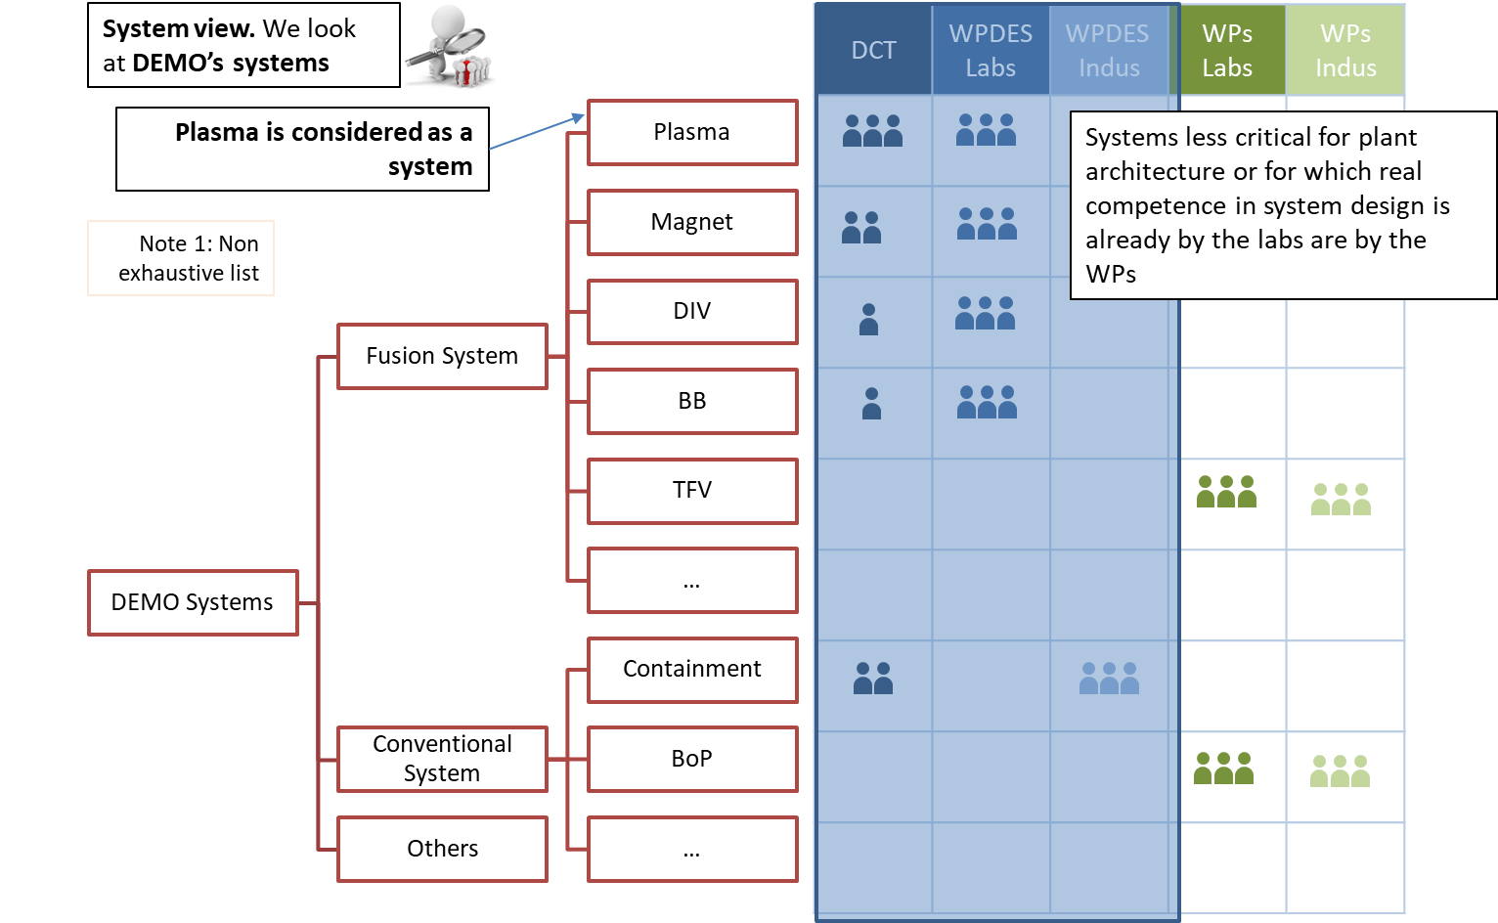
A dedicated design assist Work Package
→ See presentation Christophe Baylard: organisation and governance aspects

Slide 15
A dedicated design assist Work Package
Crucial support to the DCT will be provided by a dedicated work package, WPDES.
WPDES consists of a set of activities, in support to and directed by the DCT, to be executed in the appropriate EU fusion laboratories, universities and industry (FWC).
Mainly conceptual design tasks such as (non-exhaustive list):
  Plant Architecture: cross-functional integration, maintenance, nuclear integration and safety functional architecture and plant layout
  System design of critical fusions systems: includes the plasma system, containment structures and others (architecture driving systems such as Magnet, Breeding Blanket, Divertor)
  Maintenance strategy inside the bio shield including the remote maintenance concept design
The DCT will also need support from the EU fusion laboratories and industry in project management and system engineering, and potentially other disciplines.
Incentive: 80% funding rate + Overheads.
Short execution cycles
Calls for specific profiles (➔ Alice Beaumont)

Slide 16
WPDES
Cost category | Budget 2021-25 | Examples
Manpower (Eng/ Phys: ~70%/30%) | >200 ppy@ higher reimbursement (+15ppy – 3 ppy/y Task ADC eng)) | Physics studies and simulations Engineering analyses (struct./ EM / CFD / neutronics) System design Remote maintenance integration Systems engineering
Equipment and other G&S | 2M€ (tbc) (>2021) | Stiction/ bonding experiments in vacuum under electric current Concrete with Boron fibre BB segment mechanical attachment mock-up others
Industry (LTP + subcontracting) | ~5M€ (tbc) (>2021) | Support engineering analyses Development of port closure plate sealing concept Conceptual design of the Vacuum Vessel including small scale mockup Design office services to support the central team Cryogenic plant and cryo-distribution systems
EC Industry Framework | 7,5M€ | DEMO complex civil design & SSC layout, selected buildings & systems Plant systems & geometrical integration services Cost estimation services Safety & licensing support Maintenance strategy concept inside bioshield

Slide 17

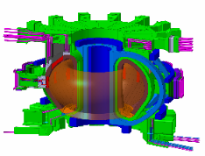
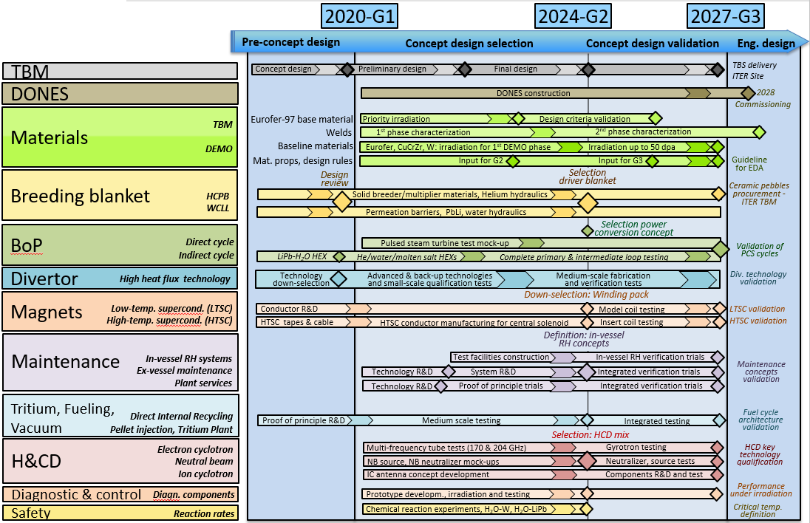
Implementation of a focussed technology maturation plan
Prioritize R&D within a multi-year Technology Maturation Plan (TMP)
Critical technology elements (CTEs) have been identified for all systems
TRAs by Independent Expert Panels, including IO, F4E experts and industry

Slide 18
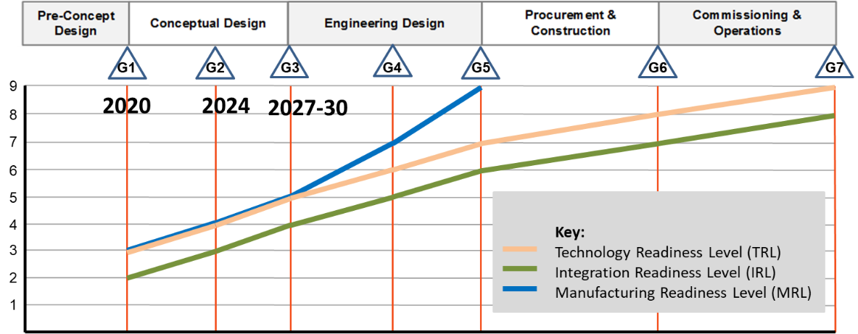
Technology Readiness Assessment (by independent experts)
In FP9 we plan to conduct systematic technology readiness assessments (TRAs) with regular frequency throughout the next phase. It is a normal element of the system engineering process and relies on data generated during the course of technology or system development

Slide 19
Establish Technology Hubs
enable best use of relevant existing and new technology facilities.
foster collaboration, integration among the laboratories, and training.
offset the risk of concentration of specific technological skills in only one lab in favour of more distributed knowledge and capabilities.
increase the visibility of the involved laboratories.

Slide 20
Three categories of facilities are proposed:
1) Technology Hub facilities
    Facilities essential for design maturation and validation, enabling timely down-selection, and decision making for a sound DEMO conceptual design.
    Facility open to the community
    Intensive use by EUROfusion > 30% of total available time
→Higher funding rate (tbd)
Existing facilities: e.g., MAG: Sultan, EDIPO; BB: Heloka, Maple-U, Chimera; DIV: Gladis, Hades, TFV: DIPAK, H3AT; HCD: Falcon and Fulgor.; MAT: PIE.
New facilities to be build or substantial upgrade of existing ones
DEMO specific; very limited/ no applications in other fields.
E.g., BB WL, Heloka Upgrade; RM test rigs.
→ Concept of Pilot Plant applies. Reimbursement (tbd) % investment rather than depreciation
2) Neutron Irradiation facilities
→ Same funding rates as Technology Hubs Facilities
3) Baseline facilities
Other facilities that do not meet the criteria above
→ Standard funding rates

Slide 21
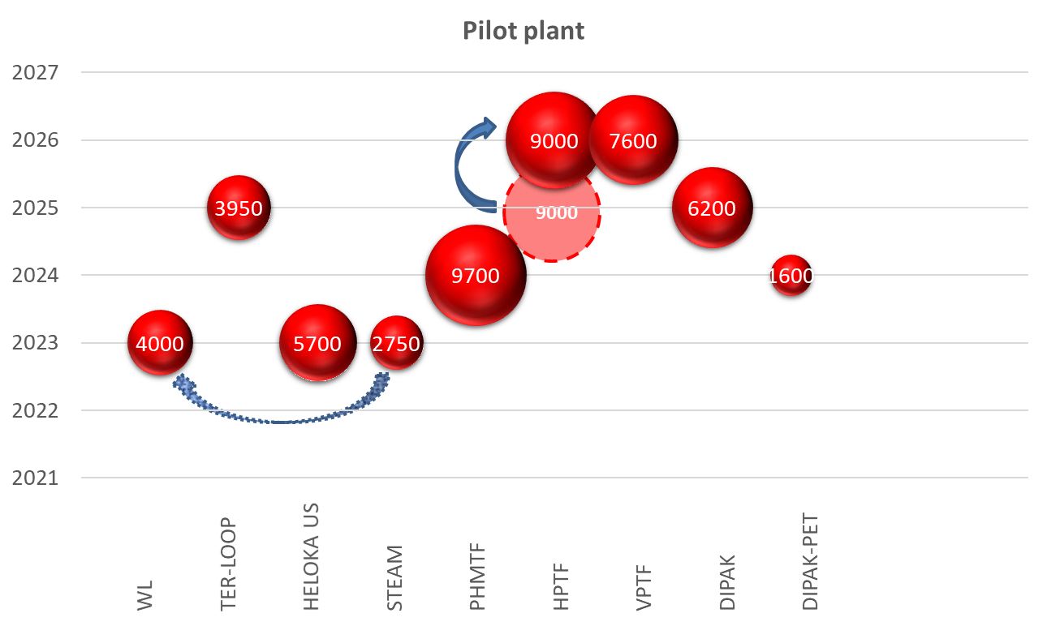
FTD Pilot Plants
Pilot plants (k€)– per WP (2021-2027)
Pilot plants – scheduled start of operation

Slide 22
Assessment of the schedule of devices/facilities to be constructed in FP9 with financial implications on FTD
As part of the effort to identify areas of potential budget savings in FP9, an assessment is being undertaken by EUROfusion to review the schedule of a number of devices/facilities to be constructed in FP9 with financial implications on FTD (i.e., DONES, IDTT, new technology facilities).
DONES*: Panel: Chair - Derek Stork (external expert), Ulrich Fischer (external expert), Paola Batistoni, Richard Kamendje (PMU representative) Proponents: A. Ibarra and DONES Team
I-DTT**: Panel: Chair - Maurizio Gasparotto (external expert), Guenter Janeschitz (external expert), Rudi Neu, Francesco Maviglia (PMU representative).Proponents: DTT Team (Paola Batistoni, Gianmario Polli, Raffaele Albanese)
New Technology Facilities: Panel: Chair - Maurizio Gasparotto (external expert), Guenter Janeschitz (external expert), Milan Zmitko (F4E), Jean Pierre Friconneau (CEA), + Botond Meszaros and Alessandro Spagnuolo (PMU representatives). Proponents: L. Boccaccini, L. Barucca, C. Day, A. Loving and representatives of involved labs (i.e, Paola Batistoni, Pietro Agostini, Klaus Hesch, E. Surrey, Rob Buckingham )
These assessments are foreseen to be completed by end of October in time to finalise the Work Plan proposal.

Slide 23
Outline
Context: DEMO in the EU Fusion Roadmap
  Lessons learnt during the DEMO pre-CD phase
  Main Achievements
  G1 Process
Status: DEMO Charter Proposal in FP9
  Changes and Improvements
  An Agile Design Methodology: DCT/ WPDES
  Implementation of a focussed technology maturation plan
  Organization/governance aspects (➔ Christophe Baylard)
  Plan: Plan beyond 2020 and input to the beneficiaries to help prepare CfP
  For DEMO see (➔ Alice Beaumont: PEP WPs; WBS WPDES).
  PRD, ENS, non-DEMO DIV.

Slide 24
WPPRD: Framework
Helium-cooled divertor
Heat-pipe concept development
PSA isotope separation experiments
Li enrichment
Support for PRD-NBI
HTS characterisation
HTS winding pack development / magnet concept
DCLL/HCLL MHD of liquid materials, T extraction,
permeation barriers, FCIs
Concept development, interface reqs
Development of materials in support of e.g. divertor concepts
Manufacturing, characterisation and HHF testing
Routes to scale-up of production
ODS fabrication and manufacturing optimisation
Testing and characterisation
Ab initio radiation damage modelling
Dislocation dynamics
Multi-scale modelling → macroscopic property changes
Post-DEMO: high efficiency EC, NBI, long-pulse support, IC
NBI for DEMO (risk-mitigation → review at G2)
IC for DEMO (risk-mitigation → review at G2)
Speed-up of conceptual development cycle
Systems failure modelling
FPP design space exploration
Parameterised model development for e.g. magnets
Remote maintenance and divertor concepts
Integrated FPP design space exploration
Task coordinator needed
PFC development, characterisation, and HHF testing
Module development for COMPASS-U
Prototype module development for DTT
Task coordinator needed

Slide 25

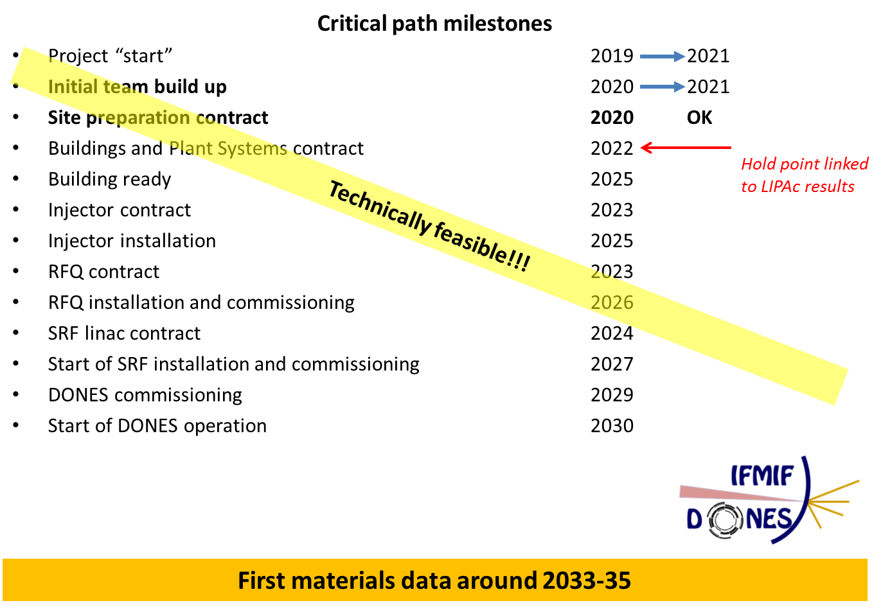
WPENS: Framework
It is assumed that DONES Construction phase is started in the early 20s in Granada (Spain)
There will be a Project Team in charge of the Construction Phase
EUROfusion role is focused on:
  completing the engineering design of the different systems of the facility
  in providing support to the Project Team in transversal activities with a long-term impact
  preparation of the operation phase including developing operational expertise
Key external milestones
Title (short description) | Date
DONES Construction Phase Start | 31/12/2021
Positive results from LIPAc | 31/12/2022
Environmental Permit Granted | 31/12/2022

Slide 26
WPENS: Objectives
To complete the engineering design of DONES, to be transferred (system-by-system) to the Project Team in charge of the construction of the facility
Prototyping and qualification of systems and components required for the DONES construction
Support to LIPAc operation in order to get operation feedback and develop (and integrate in the design) operational expertise for DONES
Develop engineering activities with focus on transversal activities with impact on long-term aspects of DONES including operation (safety, neutronics, maintenance, remote handling, RAMI -reliability, availability, maintainability and inspectability- analysis, control, ….)
Project Integration (including complete requirements identification and management,
complete interfaces definition and management, CAD integration,…) as well as definition
and implementation of a proper quality system (if this activity is not taken by PT or others)
Support to licensing and permitting processes and CODA planning (if this activity is not taken by PT or others)

Slide 27
WPENS: Activities & Milestones
D
3
6
D
5
D
3
4
2
1
D
D
Planned Grant Milestone Planned Grant Deliverable
D

Slide 28
I-DTT: Expenditure & EF contribution
TOTAL RESOURCES | 2020 | 2021 | 2022 | 2023 | 2024 | 2025 | 2026 | 2027 | TOTAL
Proper divertor prototype (M€) |  | 0.0 | 0.0 | 11.0 | 15.0 | 5.0 |  |  | 31.0
Other components (M€) |  | 0.0 | 8.0 | 16.5 | 10.5 | 2.0 |  |  | 36.9
manpower (ppy) |  | 50.5 | 41.2 | 29.0 | 61.8 | 47.7 |  |  | 230.1
TOTAL EXPENDITURE | 2020 | 2021 | 2022 | 2023 | 2024 | 2025 | 2026 | 2027 |  | TOTAL+OH
Proper divertor prototype + OH (M€) |  | 0.0 | 0.0 | 13.8 | 18.8 | 6.3 |  |  |  | 38.8
Other components + OH (M€) |  | 0.0 | 10.0 | 20.6 | 13.1 | 2.5 |  |  |  | 46.1
manpower + OH (ppy) |  | 5.1 | 4.1 | 2.9 | 6.2 | 4.8 |  |  |  | 23.0
TOTAL (including OH) |  | 5.1 | 14.1 | 37.2 | 38.0 | 13.5 |  |  |  | 107.9
ELIGIBLE COSTS | 2020 | 2021 | 2022 | 2023 | 2024 | 2025 | 2026 | 2027 |  | TOTAL+OH
Proper divertor prototype + OH (M€) |  | 0.0 | 0.0 | 13.8 | 18.8 | 6.3 |  |  |  | 38.8
Other components + OH (M€) |  |  |  |  |  | 1.8 | 1.8 | 1.8 |  | 5.5
manpower + OH (ppy) |  | 5.1 | 4.1 | 2.9 | 6.2 | 4.8 |  |  |  | 23.0
TOTAL including OH (M€) |  | 5.1 | 4.1 | 16.7 | 24.9 | 12.9 | 1.8 | 1.8 |  | 67.3
PROPOSED EF CONTRIBUTION | 2020 | 2021 | 2022 | 2023 | 2024 | 2025 | 2026 | 2027 |  | TOTAL+OH
Proper divertor prototype + OH (M€) |  | 0.0 | 0.0 | 13.8 | 18.8 | 6.3 |  |  |  | 38.8
Other components + OH (M€) |  |  |  |  |  | 1.8 | 1.8 | 1.8 |  | 5.5
manpower + OH (ppy) |  | 2.5 | 2.1 | 1.5 | 3.1 | 2.4 |  |  |  | 11.5
TOTAL including OH (M€) |  | 2.5 | 2.1 | 15.2 | 21.8 | 10.5 | 1.8 | 1.8 |  | 55.8
1) Proper divertor prototype: PFC + Cassette
2) Other components: Pumping, RH of divertor system, Cooling, Divertor Diagnostics, In-vessel coils + power supplies, Codac, First Wall, Vacuum Vessel
3) Manpower: Design and analysis, R&D qualification & testing, assembly + installation
Approved by General Assembly

Slide 29
W7-X
W7-X Milestones
2023 DIV.W-M01 W7-X Release W Target Element Design
2024 DIV.W-M02 W7-X W-Divertor concept complete
2026 DIV.W-M03 W7-X W-Divertor PFC prototype complete
2027 DIV.W-M04 Final report on W7-X W-Divertor PFC development

Slide 30
JT60-SA
JT-60SA Milestones
2021 DIV.J-M01 JT-60SA C-target concept complete
2023 DIV.J-M02 JT-60SA W-target element complete
2024 DIV.J-M03 JT-60SA C-divertor PFC fabrication / HHF testing complete
2025 DIV.J-M04 JT-60SA W-Divertor cassette development finalized
2025 DIV.J-M05 JT-60SA W-PFC and cassette prototype development and testing complete
2027 DIV.J-M06 JT-60SA C-divertor PFC fabrication / HHF testing complete

Slide 31
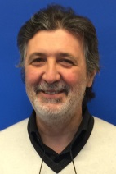

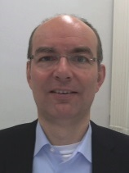
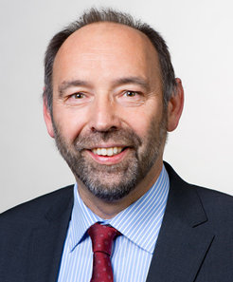
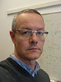
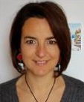
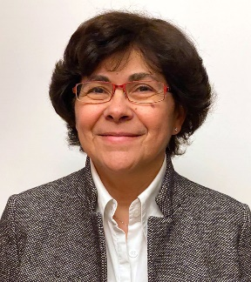
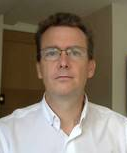
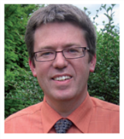
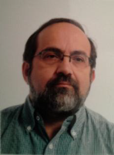
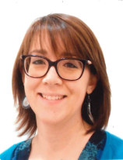
FTD PLs
WPBB | WPBOP | WPDC | WPDIV | WPHCD | WPMAG | WPMAT
WPES | WPRM | WPSAE | WPTFV | WPENS | WPPRD | WPSES

Slide 32
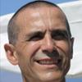
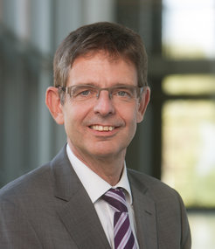
DCT High Level Structure (Draft)
?

Slide 33
FTD PLs Coordinates
Breeding Blanket | WPBB | lorenzo.boccaccini@kit.edu
Balance of Plant | WPBOP | Luciana.Barucca@ann.ansaldoenergia.com
Diagnostic & Control | WPDC | w.biel@fz-juelich.de
Divertor | WPDIV | Rudolf.Neu@ipp.mpg.de
Heating & Current drive systems | WPHCD | jean-philippe.hogge@epfl.ch
Magnet systems | WPMAG | valentina.corato@enea.it
Materials | WPMAT | g.pintsuk@fz-juelich.de
Plant Electrical Systems | WPPES | elena.gaio@igi.cnr.itES
Remote Maintenance | WPRM | Oliver.Crofts@ukaea.uk
Safety | WPSAE | mariateresa.porfiri@enea.it
Tritium, Fuelling & Vacuum systems | WPTFV | christian.day@kit.edu
Early Neutron Sources | WPENS | angel.ibarra@ciemat.es
Prospective R&D | WPPRD | Richard.Kembleton@euro-fusion.org
Socio-Economic Studies | WPSES | chiara.bustreo@igi.cnr.it
DCT design Assist | WPDES | gianfranco.federici@euro-fusion.org; hartmut.zohm@ipp.mpg

Slide 34

Priorities beyond 2020
Establish a DEMO Central Team capable of more rapid design cycles for evaluation of design directions.
Strengthen nuclear design integration and a nuclear safety culture during design phases
Refocus the physics R&D for DEMO towards developing an attractive and robust reference plasma scenario (no-ELMs, low disruptivity, etc.)
Develop improved modelling tools to address critical physics and engineering issues
A focussed multi-year Technology R&D Maturation Plan (TMP) to address major risks: breeding blanket, material R&D and qualification; Remote Maintenance, etc.
Continue TRAs by embedding external independent experts (incl IO and F4E) + industry
Improve project management culture
Bring Industry into the design process
Expand training of young engineers from Universities
Consolidate international collaborations to fill critical gaps

