Slide 1
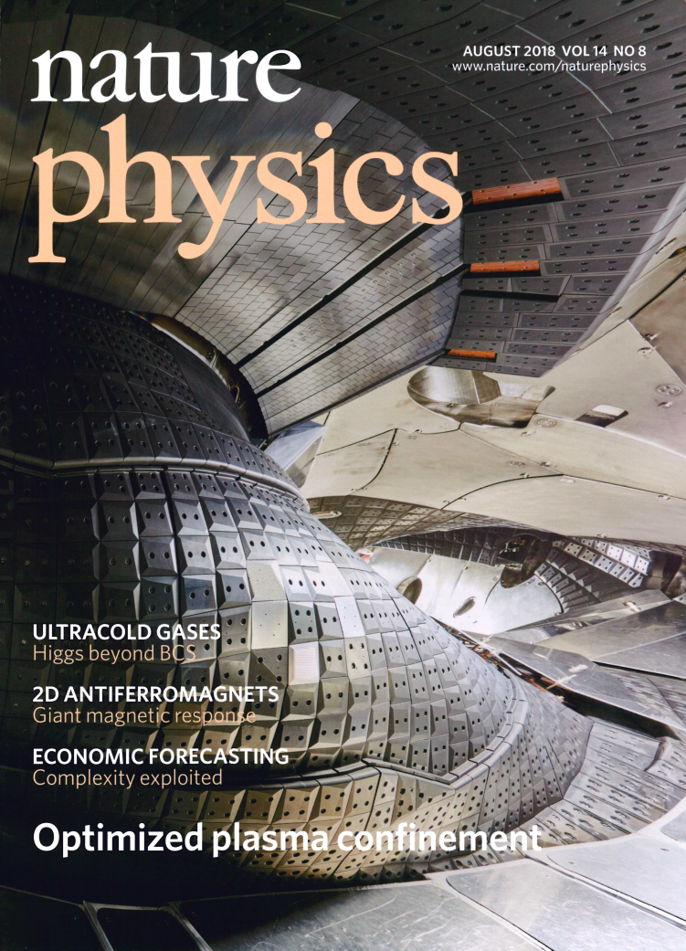
WPW7-X in Horizon Europe
Goals, Opportunities and
Required Competences
A. Dinklage (TFL)
A. Alonso (DTFL)
I. Calvo (DTFL)
S. Moseev (Host Coordinator)
Contact: eurofusion-wpw7x@ipp.mpg.de
W7-X Team Repository: https://indico.euro-fusion.org/category/111/

Slide 2
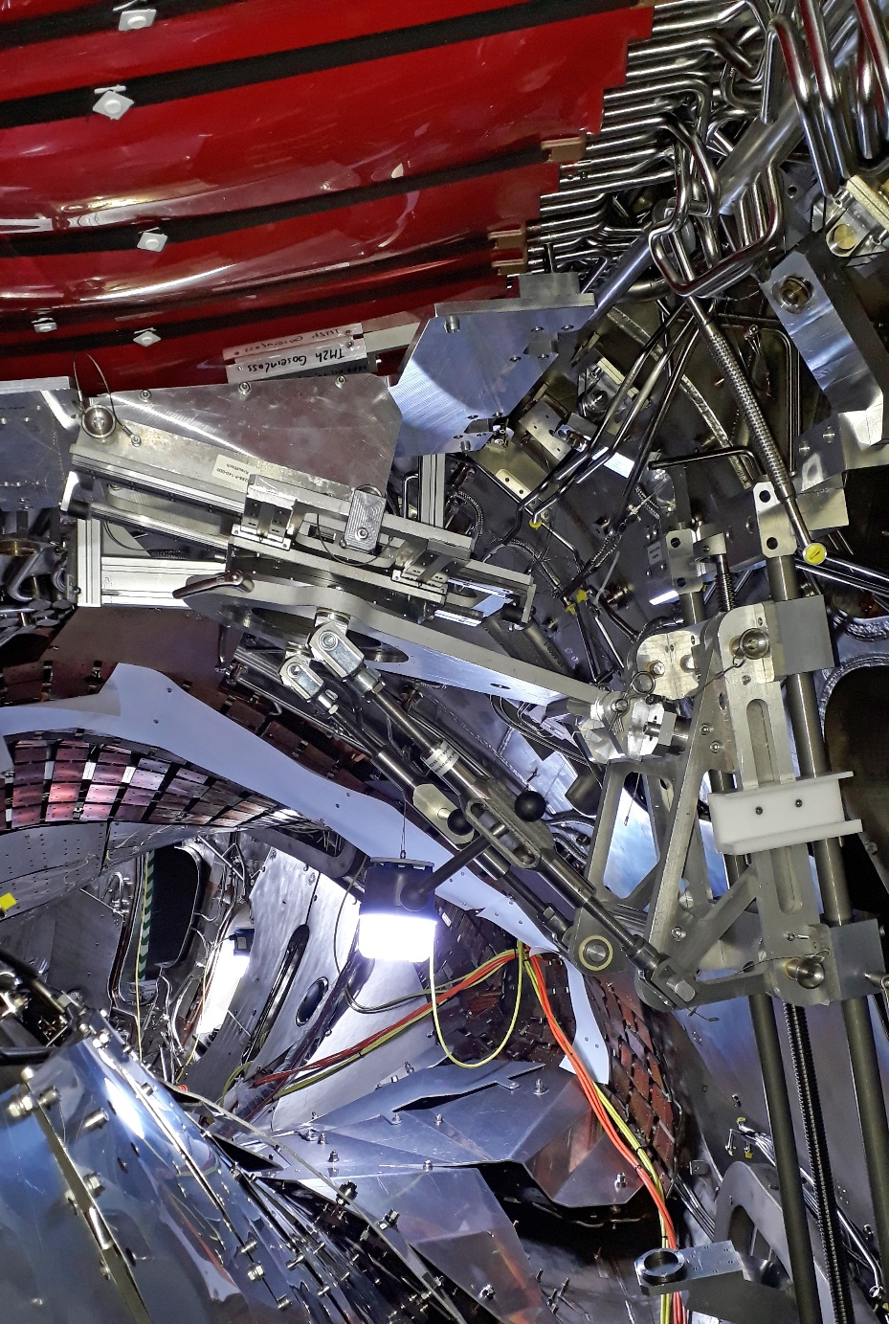
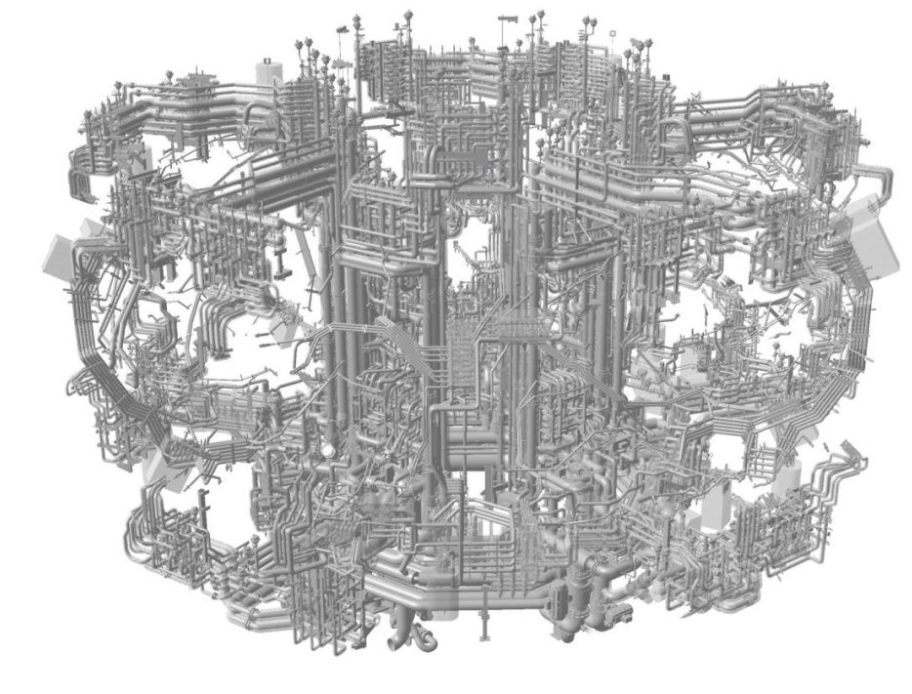
Latest news: W7-X completion is progressing.
Plasma operation planned after summer 2022.
In vessel works in W7-X
CAD view of the W7-X
water manifolds for
actively cooled plasma facing components
(9.10. 2020, © J. Liebich, B. Kemnitz, IPP)

Slide 3
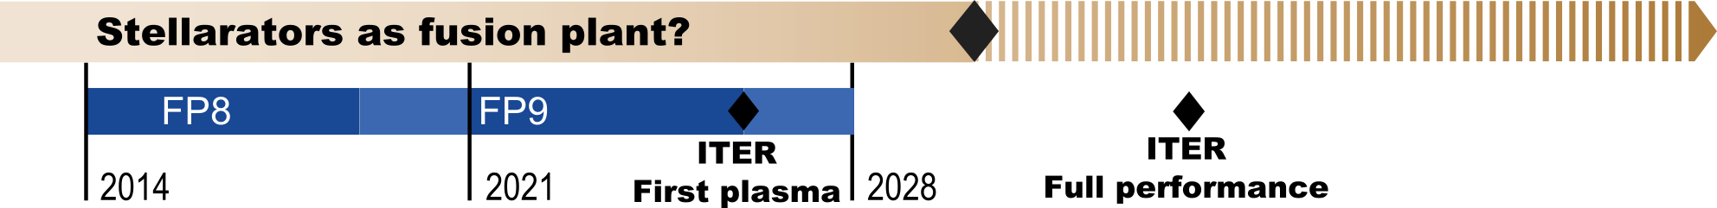
Roadmap Mission 8: Stellarator
… advance the stellarator as an
alternative approach to fusion power plants
HELIAS
Decision Point
…
Completion and start of scientific exploitation of the W7-X experiment
validating the energy and particle confinement of optimised stellarators and qualifying the island divertor.
Lay down the physics and engineering basis for HELIAS
for the assessment of optimised stellarators as an alternative line in magnetic confinement fusion.
✓

Slide 4
How to bring the stellarator to maturity?
HELIAS
W7-X
WP W7-X
Int. Collaborations
ITER
demonstrate
optimization & SSO
sound
3D technology
theory and
modelling
WPW7X/TSVV
3D-engineering
& technology
FTD-PRD
reliable
predictions
DEMO

Slide 5
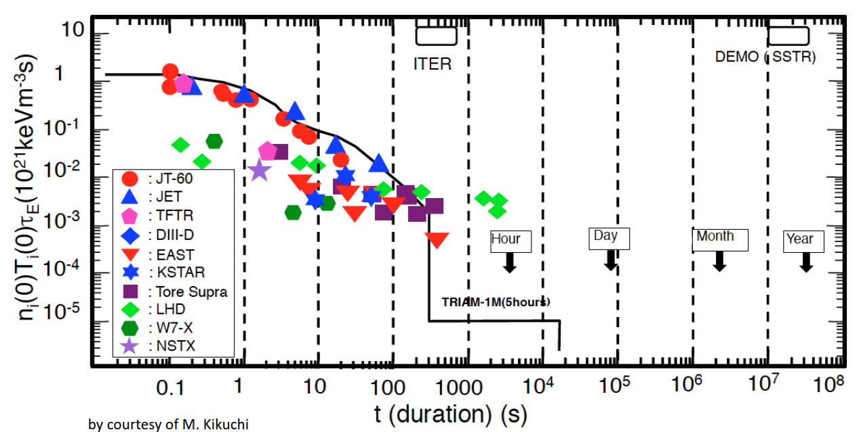
Where did we start and where do we plan to go?
Fusion progress in terms of technology (pulse lengths) and physics (triple product)
W7-X OP2
?
W7-X
pulse #1
© M. Kikuchi w/ adaptions
Target in Horizon Europe: high-performance, steady-state operation
to qualify key elements of stellarators as a viable way for fusion electricity.
Notes:
(explain x, y Kikuchi)
W7-X is sufficient large to operate reactor like at relevant collisionalities and beta …
The scientific plot is: way from day zero to were we hope to go
The outstaning relevance for Horizon Europe is to
high-performance, steady-state operation
to qualify key elements of stellarators as a viable option for fusion electricity.
What did we achieve in Horizon 2020?
Where did it start?
The Kikuchi plot shows the progress in OP1.2w/ uncooled PFCs on a glimpse: High-performance, but transient discharges were achieved getting close to conditions relevant to test optimization of neoclassical energy confinement. Long pulse up to 100s were conducted (limited by technical safety limits). And 30s detached discharges provided a potential route to long pulse operation at high heating power and high density. All these achievements were conducted in order to prepare the phase with an actively cooled device in OP2.
The scientific reception of earlier results provided a good reflection of achieved results in many publications.

Slide 6
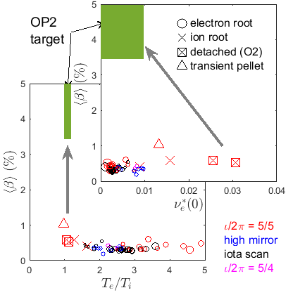
Where do we stand after three campaigns?
First Campaigns of W7-X: significant progress in terms of performance and pulse length
The OP2 Challenge
W7-X OP2
OP1.2
OP1.1
OP1.2
W7-X
A. Dinklage et al., 28th IAEA FEC (2021)
T. Sunn Pedersen et al, Phys. Plasmas 24 (2017) 055503
R.C. Wolf et al., APS 2018, submitted (adapted from M. Kikuchi)
T. Sunn Pedersen et al, PPCF 61 (2019) 014035
Results from the first campaigns of W7-X confirmed several or optimization criteria.
The achieved performance was good but still a way to reactor-relevance.
Technical limitations are due to heating and stabilization of good confinement required.
Notes:
The Kikuchi plot shows the progress in OP1.2w/ uncooled PFCs on a glimpse: High-performance, but transient discharges were achieved getting close to conditions relevant to test optimization of neoclassical energy confinement. Long pulse up to 100s were conducted (limited by technical safety limits). And 30s detached discharges provided a potential route to long pulse operation at high heating power and high density. All these achievements were conducted in order to prepare the phase with an actively cooled device in OP2.
The scientific reception of earlier results provided a good reflection of achieved results in many publications.

Slide 7
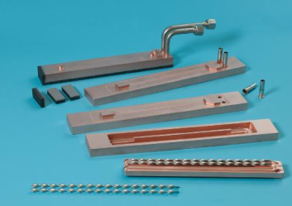
Actions required to arrive in time.
decision
HELIAS reactor relevant plasmas
high-performance: nTτ
high density and T_{i} ~ T_{e},
high beta (nT), low ν∗
metallic
wall OP
fast-ion generation and
3D confinement
MHD at high β
Modelling and predictive scenarios
3d turbulence & neoclassics at high n
tungsten divertor concept (&more?)
3d impurity transport and control
configuration dependencies
of optimization & FPP physics basis
theory driven exploitation: understanding for predictions
particle transport in ion-root conditions/high n
TSVV on 3D-turbulence, burning plasmas and stellarator optimization
qualification of safe divertor scenarios
X3 start-up scenarios
active control (density, …)
for reactor-like scenarios
fully-cooled divertor
ECH/ICH/NBI upgrades
cw pellet fuelling
SSO (30 min) & technology
heating upgrades
and qualification
Water-cooled PFCs:
the high-heat-flux divertor
W7-X shutdown 2018 ~ 22:
actively cooled PFCs/commisioning of water-cooling
ECRH/ICRH wall conditioning
Notes:
…
How to get from the technical pre-conditions to the required progress in the scientifc readiness for the stellaratro assessement?
….
What is EUROfusions specifc role in this set of actions? A general answer is to take leadership in key questions and to use the strenghts of distributed expertise in Europe

Slide 8
High-level planning W7-X and resource requests
year | main activity: experiment & theory/modelling
2021 | Campaign prep., FP8 Enh. Projects, modelling heating upgrades
2022 | *OP2.1: enhancement projects, divertor exhaust, stellarator optimization
2023 | *OP2.2: heating, fast ion generation, transport, heating/FI generation modelling
2024 | *OP2.3: optimization, high-β, 3D gyrokinetics
2025 | *OP2.4: high-power, long-pulse operation, concept optimization
2026 | *OP2.5: high performance operation and scenarios
2027 | OP2.6: ? metallic PFCs upgrades?
*campaigns (OPs) are planned to run after summer (OP2.5 spring) with a pre-plasma and a plasma phase (~14 weeks in total)
sequence of actions is subject to adaptions to optimize the scientifc exploitation
For your information:
2021: 1450 PMs for preparatory work 204PM TSVV and have been proposed
by the beneficiaries of WPS1 (2020: 1291PM) and WPS2 (2020: 141PM)

Slide 9
Synergies and Opportunies
FTD - WPPRD implements HELIAS engineering activities
  Support by HELIAS physics basis and experiments on W7-X
FTD - WPHCD
  Reliable (RAMI) high-power gyrotrons
FSD - WPTE, JT60SA, PWIE, JET: fostering European leadership in fields of key expertise
  metallic wall and 3D modelling
  safe steady-state operation: surveillance and fast control
  steady-state technology: hardening
  fast-ions: physics and diagnostics
International Collaborations
  ITPA and ITER IO: specific scientific (e.g. EMC3-EIRENE) and diagnostics/technological support (e.g. LaB6 pressure gauges, stray-radiation tests)
  IEA TCP-SH: participation in the LHD and Heliotron-J experiments
  DoE laboratories: collaboration on diagnostics and theory

Slide 10
Implementation and the way forward
Clear and straightforward plan to address the Mission 8 objectives to reach the Roadmap goals: timeline is success oriented to make the stellarator a serious alternative option to fusion electricity.
COVID led to shifts: preparatory work brought forward, campaigns shifted (~1 yr) but with successively increasing fraction of EUROfusion machine time to keep the required pace.
W7-X will be exploited in the one-team/one-program approach.
2021 will focus on campaign preparation prioritized along the scientific objectives of the campaigns in Horizon Europe

Slide 11
Appendix

Slide 12
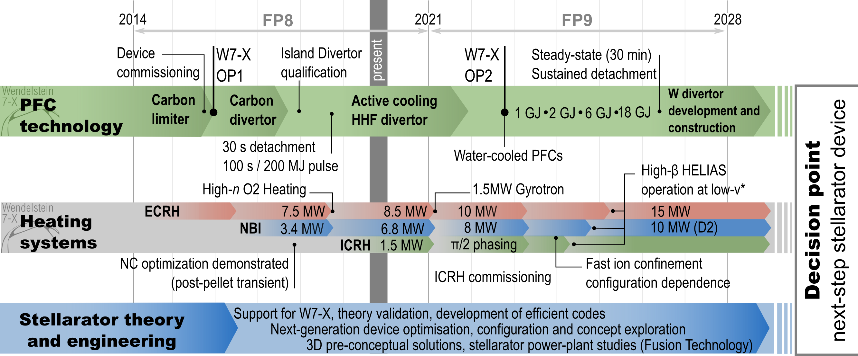
Mission 8: a coarse timeline of FP8 and FP9
DINKLAGE, ALONSO, CALVO, MOSEEV | WPW7X in FP9 | EUROfusion Info Meeting to the Beneficiaries | VC - 19. Oct. 2020| Page 12/11

Slide 13
Scientific objectives
Fast Ion Scenarios
Steady-State Fuelling/Wall Conditioning
Strike-Line Control by ECCD
High-Density ECH Heating
Turbulence and Mitigation Scenarios
Divertor Detachment
Divertor Pumping
Performance Limitations
Enhanced confinement modes
Preparation of metallic wall operation (w/ WPWIE)
DINKLAGE, ALONSO, CALVO, MOSEEV | WPW7X in FP9 | EUROfusion Info Meeting to the Beneficiaries | VC - 19. Oct. 2020| Page 13/11

Slide 14
Roadmap Mission 8: Stellarator
Milestone: Decision point on the stellarator line
Scope
  Assess the prospect of optimised stellarators as FPP (no show-stoppers).
  Decision on next-step device (burning plasma stellarator?).
Input required
  HELIAS optimisation assessed in W7-X.
  Physics models/codes for reliable extrapolations.
  Pre-conceptual solutions for critical stellarator reactor tech.
Notes:
Check wording with Felix ( Conceptual solutions?) and Andreas
Points:
Decision point – what needs to be on the table? What are the possible outcomes of the decision?
From FP8 to FP9

Slide 15


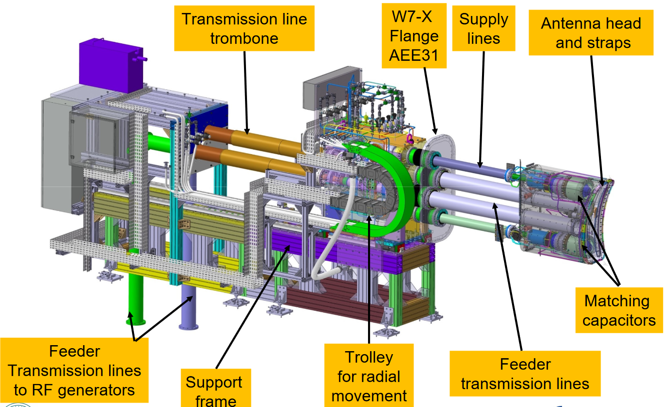
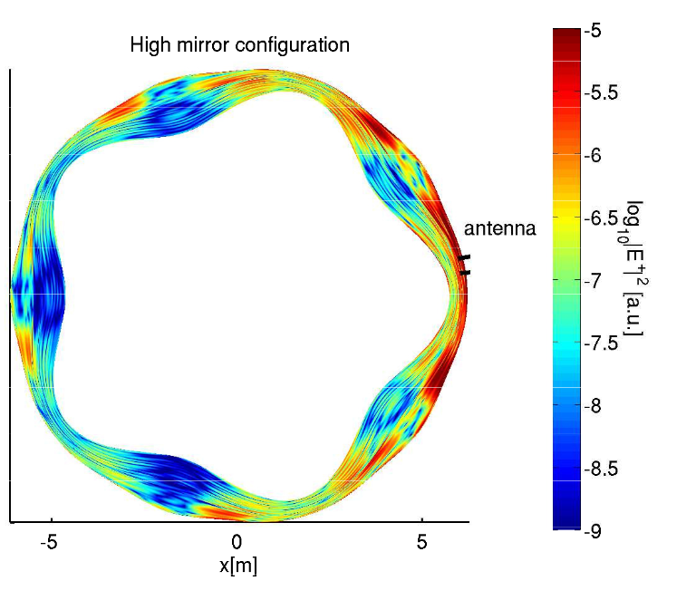
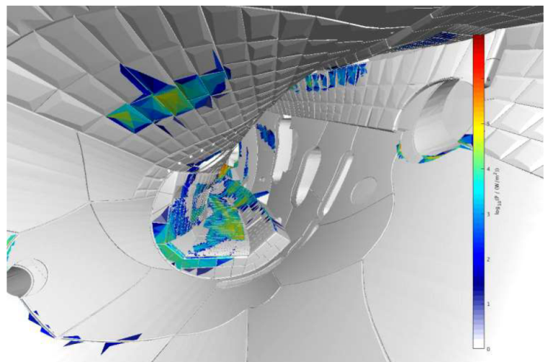


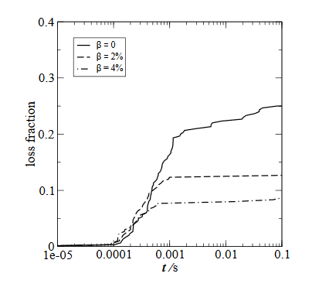
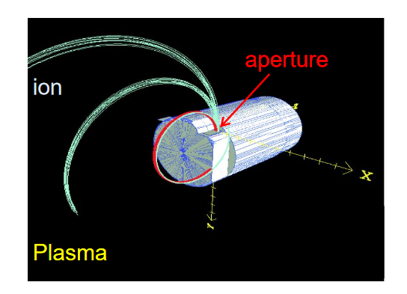
Synergies: fast-ion program on W7-X
Reasons for European leadership
Notes:
It is clearly unique that EUROfusion as a consortium has all elements to from teams of leading expertise.
I hope that you found this example convincing and we have had more examples in WPS1.
But the relevant qeustion at the end of the day is – does it pay off and how can we ensure that Roadmap relevant work is conducted at a level sufficient for the goals of the Europena programm?
This brings me to aspects I feel relevnat on the implmentation leve AND THAT GOES BEYOND the core business of the WP –brings me to cooperation

Slide 16
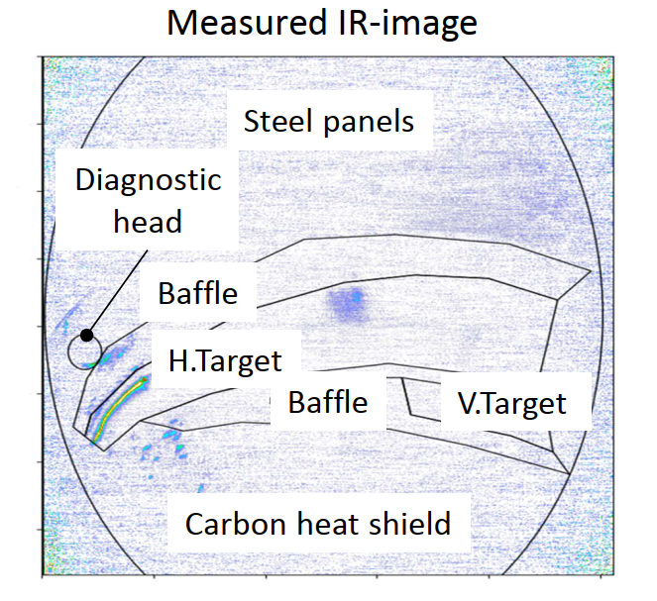
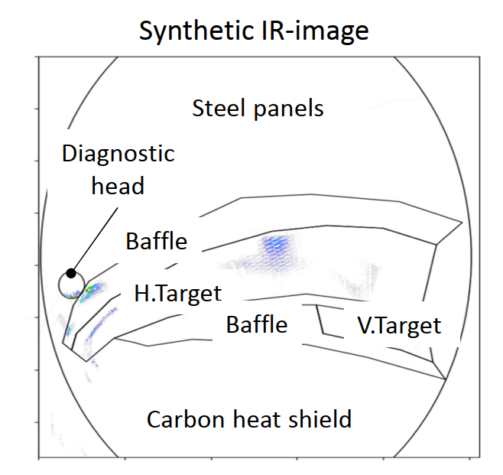
Scenarios: where do fast ions go?
Fast particle loss needs to be understood to optimize α-heating in a reactor
First assessments of NI produced fast ions in line with simulated loss patterns.
Temperature rise in ‚hot‘ spots fairly good reproduced.
S. Äköslompolo et al. (to be published, EPS2019)

Slide 17
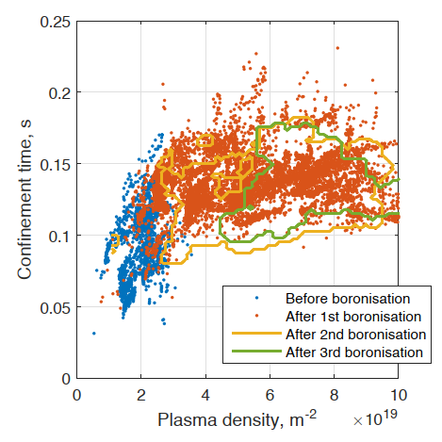
Towards steady-state operation: Fuelling
Long-pulses at high performance require high plasma densities
Steady-state operation (SSO):
good wall conditioning:
boronization
→ density control
core fueling by pellets
(example in a minute)
Good wall conditions reduce O/C and recycling fluxes.
Fuelling works with gas puff and pellets, but pellets may shape the density
Wauters, et al. (to be published)
Brakel et al., IAEA 2018

Slide 18
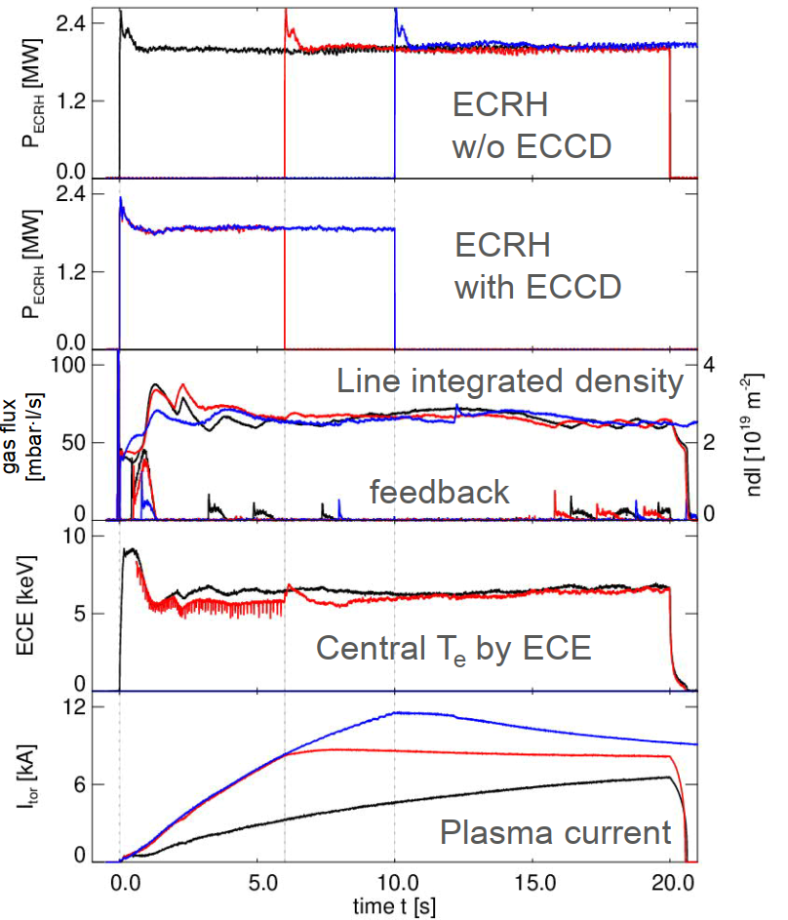
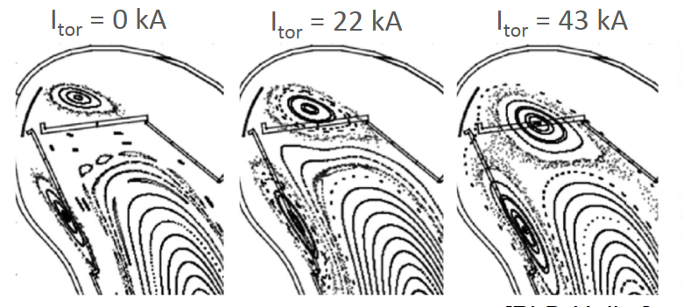
Towards steady-state operation: (small) ECCD
W7-X: low shear with an intentional island for divertor operation
H. Hölbe (Ph.D. thesis)
Divertor operation: island position change when (small) currents evolve
→ co-ECCD applied at the
beginning of the discharge to overcome L/R time O(30s) with strike-line motions
ECCD used as a surgery tool to shape current profiles and
to actively control plasma effects on configuration
Turkin et al. (to be published)
Jakubowski et al. (to be published)

Slide 19
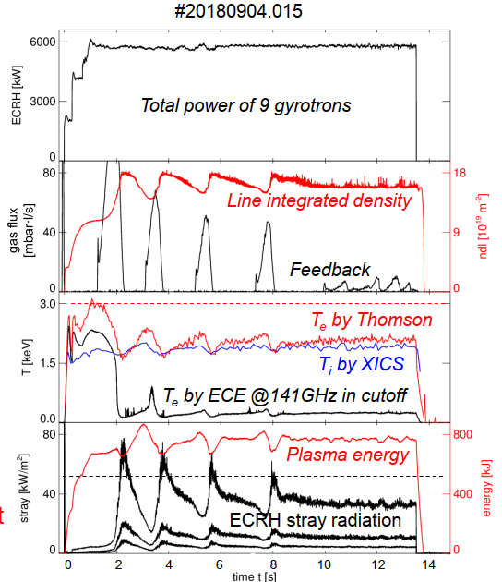
Towards SSO: Heating
Findings from the first campaigns
cw ECR heating restricted by cut-off (1.2x10²⁰m⁻³ for X2 @ 2.5T): O2 scenarios
Steady-state operation (SSO) and high heating power
→ O2 heating
High stray radiation reflect reduced O2 absorption (~n_{e}T_{e}²) at low T_{e}
→ more heating power needed
(higher T_{e} at high density)
Proof-of-principle demonstration for cw ECR heating scenarios
& NBI alone (not shown)
Laqua, Stange, Marsen et al. (to be published)

Slide 20
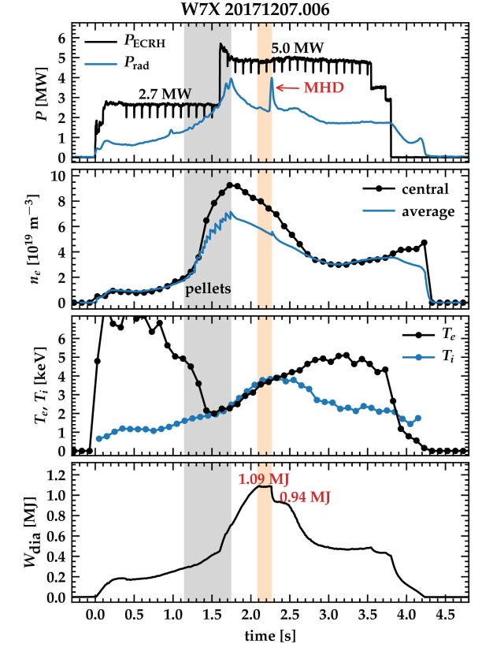
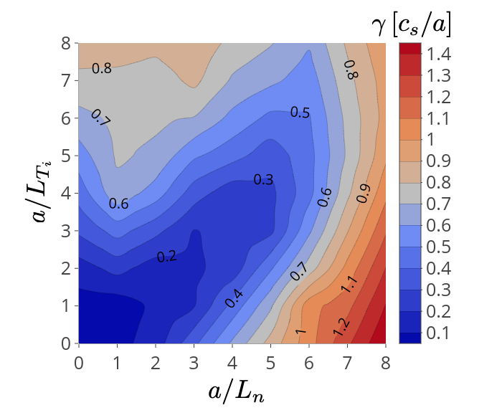
Scenarios: turbulence and profile shaping
Pellet fuelling deposits particles in the plasma core: density peaks
Turbulence: linear growth rates
W7-X high iota
ITG
stability valley
TEM
Alcusson, Xanthopoulos et al.
linear growth rates may favorably depend
on gradient lengths of T_{i} and n (and saturated
fluxes – not shown)
Profile shapes matter. And the configuration.
And b. And T_{e}/T_{i}, And …
Bozhenkov et al., NF2020
Pablant et al. , NF2020
v. Stechow et al. , submitted to PRL

Slide 21
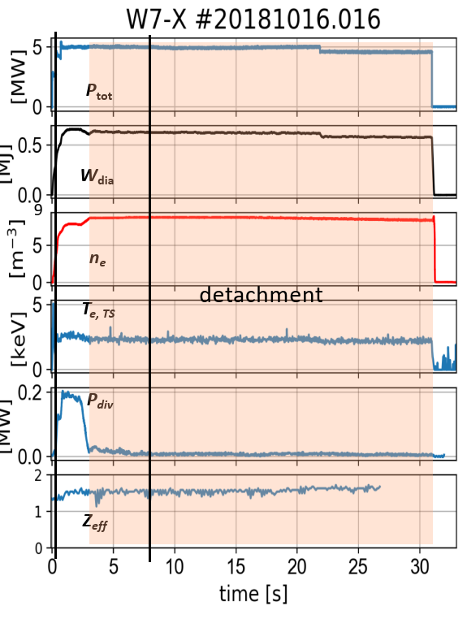
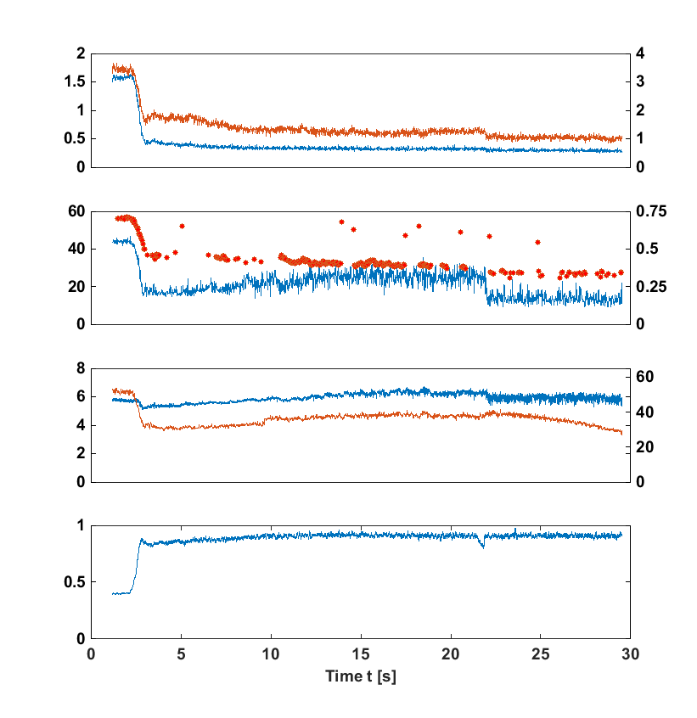
Towards steady-state op.: divertor detachment
Key for steady-state operation is controlled power exhaust
5MW ECRH
feed-back controlled transition
plasma ends as programmed
τ_{E} ~120ms (w/ and w/o detachment)
at low impurity influx (Z_{eff})
fraction of radiated power
Plasma detached; power wideley dissipated by radiation.
good prospects for long pulses at high heating power but improve performance
Sunn-Pedersen et al., (IAEA2018)
Jakubowksi et al, submitted to PRL
Schmitz et al. (EPS 2019)

Slide 22
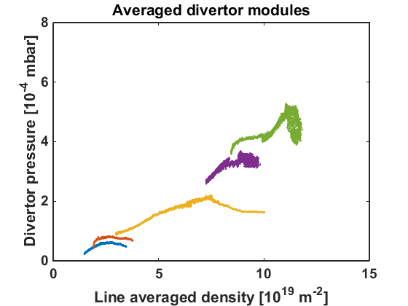
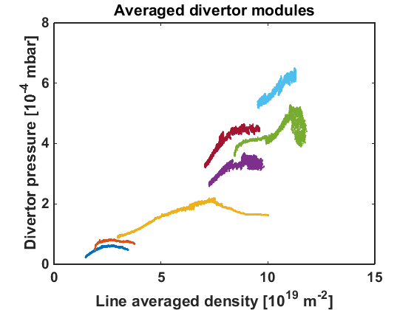
Towards steady-state op.: divertor pumping
Key for steady-state operation is controlled particle exhaust
Averaged neutral particle pressure at pumping gap
Averaged neutral particle pressure at pumping gap
Change of island structure with divertor control coil current I_{cc}
Structure of the magnetic island
Pumping gap
6MW, 2kA ICC
Pumping gap
6MW, post-boronization
3MW, 2kA ICC
6MW, post-boronization
Wall to wall connection length L_{c} [m]
Plasma core domain
Wall to wall connection length L_{c} [m]
2MW, post-boronization
3MW, post-boronization
Plasma core domain
2MW, post-boronization
3MW, post-boronization
I_{cc}=0.0kA
Line integrated density n_{e,l.i.} [10¹⁹ m⁻²]
Line integrated density n_{e,l.i.} [10¹⁹ m⁻²]
Compression sufficient for pumping (global density control)
W7-X island divertor allows to optimize the effectiveness of particle exhaust.
O. Schmitz et al. (EPS 2019)
Feng et al.

Slide 23
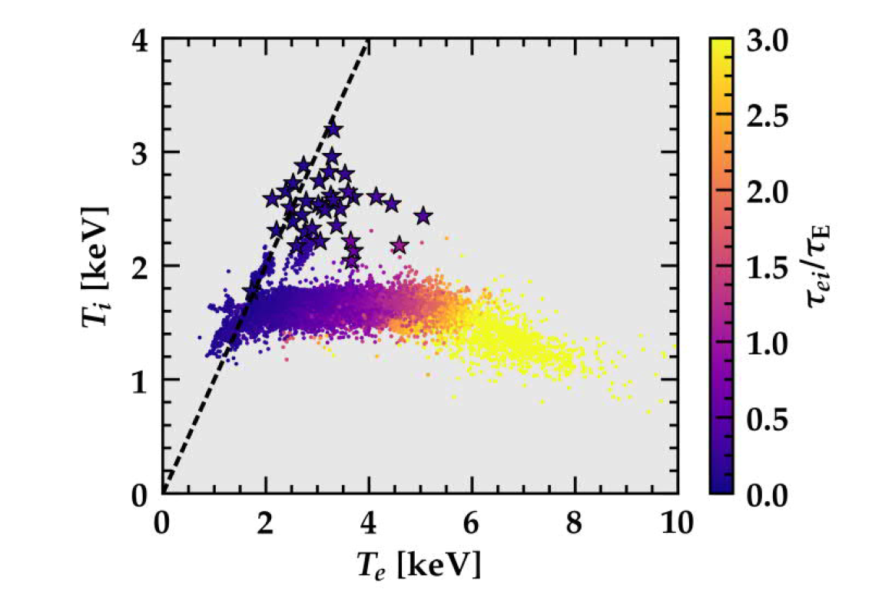
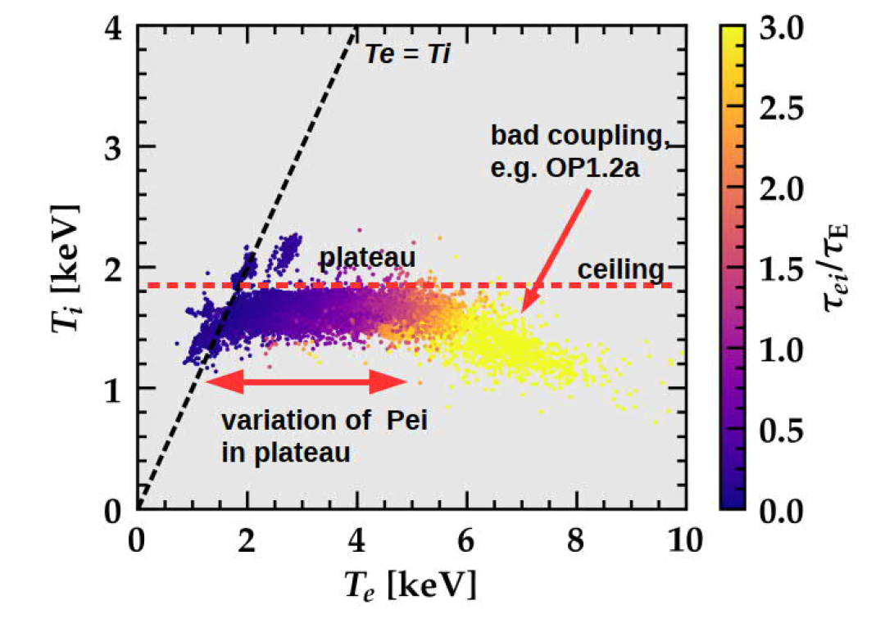
Scenarios: performance limitations?
Ion temperatures in stationary discharges were oberved to be limited
Anomalous transport: critical gradients assumed to cause limitations
Equilibration (and higher T_{i}) was observed w/ L_{n}⁻¹ < 0 (peaked densities)

Slide 24
E-TASC TSVV tasks linked to WPW7X (2 out of 14)
TSVV 12 – Stellarator Optimization
  Develop a new, advanced European stellarator optimization code, based on improved algorithms for enhanced speed and greater scope.
  Generate a number of highly optimized stellarator configurations which could form the basis for future stellarator devices and support the EUROfusion Roadmap decision point on the future of the stellarator line.
TSVV 13 – Stellarator Turbulence Simulation
  Develop, verify, and validate a set of stellarator gyrokinetic codes going beyond the flux tube approach and consistently treating multiple species.
  Simulate W7-X plasmas to explore and optimize the 3D ‘turbulent confinement’
  Validate (and adapt, if needed) these codes for the calculation of turbulent fluxes in tokamaks with broken axisymmetry.
  Use these codes to enhance the basic understanding of microinstabilities and turbulence in stellarators in different types of geometries and plasma conditions.
Also, significant stellarator contribution to TSVV 10 – Physics of Burning Plasmas (linked to WPTE)

