Slide 1
WP-PFC Subproject 3: PWI Processes II: fuel retention, fuel removal and material damage
SP3 Task holders
Narrated by K. Schmid

Slide 2
Content
Tasks & Status in 2020
Report from tasks in SP3
Excerpts from work done within the following activities
SP3.1:Qualification of the impact of seeding gases (Ar and N) on fuel retention and fuel release in W and Be PFCs and mixed layers (ITER+DEMO)
SP3.2:Qualification and modelling of synergistic effects related to hydrogenic fuel retention and He impact. (ITER+DEMO)
SP3.3:Fuel retention and fuel release modelling towards predictions of baking efficiencies in ITER and beyond. (ITER+DEMO)
SP3.4 Quantify the impact of neutron and self-damage on fuel retention in Be and W in combination with seeding species. (ITER+DEMO)
Special topic: Permeation
Summary/Outlook

Slide 3
Tasks & Status in 2020
Association | Task | Name | Done
CEA | Effect of controlled oxidized surfaces on the TPD of deuterium from W. Compare TPD to Y. Ferro DFT calculations | R. Bisson | DONE
CEA | T-Permeation through EUROFER and W-coated EUROFER with the exit side emerged in water | Christian GRISOLIA | PARTIAL
FZJ | Gas driven permeation through W and Steel after pre-exposure to mixed Ar, He, D plasmas Preimplant W and steel foils with Ar/D He/D mixed plasmas | Anne Houben | DONE
FZJ | Influence of seeded (N, Ar, He) plasma exposure on recrystallization of W | Marcin Rasinski | PARTIAL
JSI | Influence of W-oxide on permeation through W layers on Steel | V. Nemanic | DONE
MPG | Determine the intrinsic content of H in EUROFER (Continuation: melt extraction with TDS = ME-QMS) | S. Elgeti | DONE
MPG | Retention in bulk fibre enforced CVD composits | J. Riesch | DONE
MPG | Retention in W-heavy alloys Influence of radidation damage on retention at different temperatures | H. Maier | DONE
ÖAW | Compare retention of D in Be to D in Ar and/or N pre-implanted Be. (in cooperation with FZJ) Compare retention of D in Be to D in simultaneously implanted Ar and D. (in cooperation with FZJ) | Reinhard Stadlmayr | DONE
ÖAW | Investigate retention of D in Be or W by simultaneous TDS and NRA | Reinhard Stadlmayr | DONE
CEA | Bubble formation due to He loading of W in WEST compared to PSI-2 Influence of He bubbles on D retention in W Measure He content by ERDA | E. Bernard | PARTIAL
JSI | Study the influence of simultaneous MeV-He and eV D ions on retention in W | Sabina Markelj | DONE
MPG | Implant He at low energies into e-beam damaged W and investigate He bubble nucleation | Thomas Schwarz-Selinger | NOT-DONE
MPG | Influence of MeV He implantation on W recrystallization and retention of D Continuation from 2019 | J. Bauer | DONE
CEA | Investigate adsorption of H on oxidized W surfaces by DFT | Y. Ferro | DONE
CEA | Extension of MRE codes in order to simulate T permeation through 3D configuration including bubble defects and multicomponents material (W, Steel and W-on-Steel) | Christian Grisolia | DONE
CEA | Modelling by MRE first the He migration in W and He defects creation (vacancies and He nanobubbles). | Christian Grisolia | DONE
IPPLM | TEM analysis of W samples after simultaneous damaging and loading TEM analysis of W samples after He implantation Samples are provided by JSI and IPP Garching | Lukasz Ciupinski | DONE
JSI | Experiments and modeling of the effect of trapped D on damage stabilisation: | Matic Pecovnik | DONE
JSI | Perform isotope exchange experiments to disentangle the different defect types in self-damaged W. Design experiments based on 2019 TESSIM-X modeling results | Matic Pecovnik | DONE
MPG | W-self-damage to defect saturation as function of temperature | Thomas Schwarz-Selinger | DONE
MPG | Damage W single crystals by MeV electrons in order to create isolated Frenkel pairs | Matej Mayer | DONE
23 Tasks in total
5 Partially done

Slide 4
Tasks & Status in 2020
Publications
R. Delaporte-Mathurin et al, "Influence of interface conditions on hydrogen transport studies" Submitted to Nucl. Fusion 2020
S. Markelj et al, "Deuterium transport and retention in the bulk of tungsten containing helium: the effect of helium concentration and microstructure" Nucl. Fusion Vol. 60 (2020) 106029
M. Pecovnik et al, "Effect of D on the evolution of radiation damage in W during high temperature annealing" Nucl. Fusion Vol. 60 (2020) 106028
M. Pecovnik et al, "Effect of D on the creation of displacement damage in tungsten during multiple sequential irradiations with MeV W ions", Submited to J. Nucl. Mat. 2020
A. Houben et al, "Hydrogen permeation and retention in deuterium plasma exposed 316L ITER steel",Submited to Nucl. Mat. Energy 2020
A. Kärcher et al, "Deuterium retention in tungsten fiber-reinforced tungsten composites",Submited to Nucl. Mat. Energy 2020

Slide 5
Reports from tasks in SP3
SP3.1:Qualification of the impact of seeding gases (Ar and N) on fuel retention and fuel release in W and Be PFCs and mixed layers (ITER+DEMO)

Slide 6
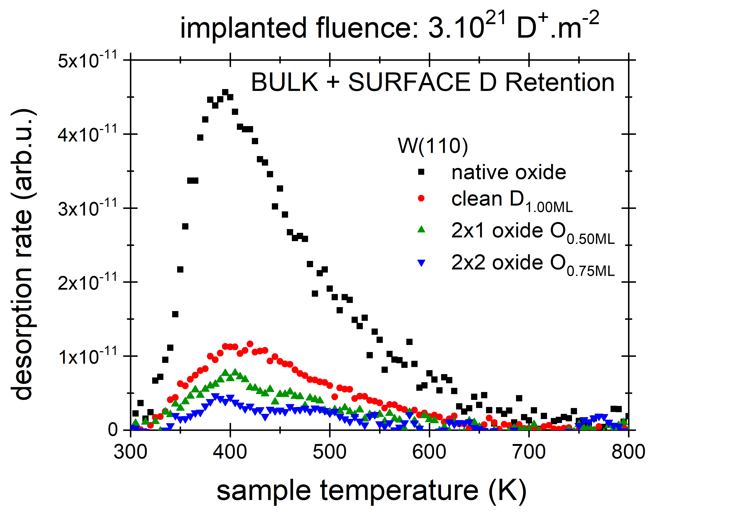
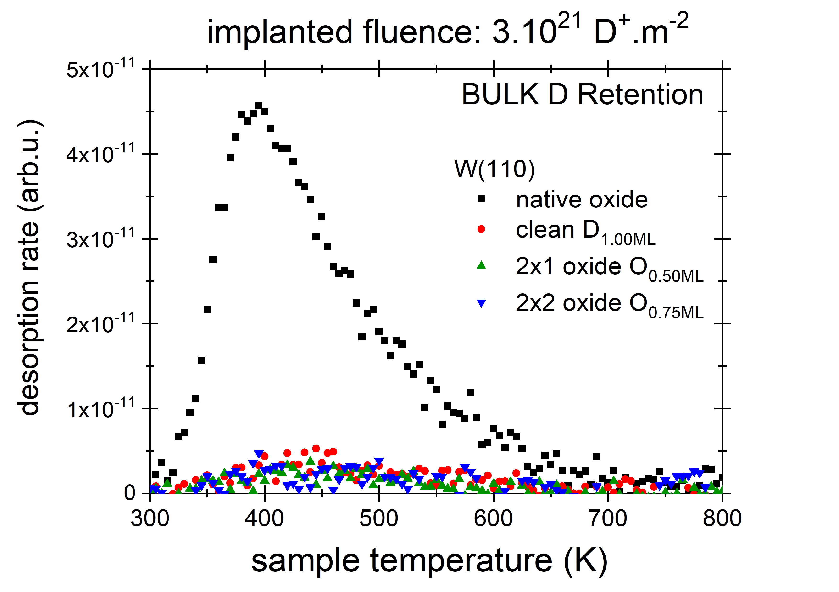
Effect of controlled oxidized surfaces on the TPD of deuterium from W
More O in submonolayer oxide → less D retention
“Native oxide” traps most (C effect?)
Clean surface and submonolayer oxides suppress bulk retention (300K) in single crystal W
1ML=1.10¹⁹ m⁻²
W(110)
“native oxide”
W(110)-(1x1)
clean
W(110)-(2x1)
O_{0.50ML}
W(110)-(2x2)
O_{0.75ML}
C
O
W
PFC.SP3.1: Fuel retention and fuel release in W PFCs and mixed layers (CEA contribution from PIIM/AMU-CNRS)
T. Angot, R. Bisson, A. Dunand, M. Minissale – PIIM/AMU-CNRS
Notes:
TPDs “BULK D Retention“ are determined by subtraction of TPDs “SURFACE D Retention” (not shown) from TPDs “BULK + SURFACE D Retention”

Slide 7
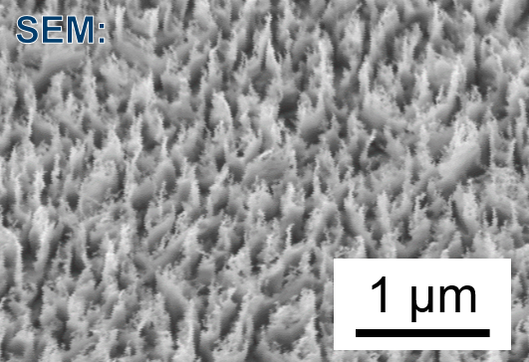
Gas driven permeation through Steels after pre-exposure to D plasma
Influence of plasma exposure on the hydrogen permeation through ITER Grade 316L(N)-IG steel.
Polished steel substrates were exposed at the PSI-2 device with a deuterium plasma (Ion energy: 200 eV), gas-driven permeation and lag-time measurements were performed and compared to unexposed steel.
Result: After annealing in deuterium, the permeation behavior (steady state and lag-time) is similar to unexposed sample -> no influence of surface roughness (see figure) produced by plasma exposure.
Outlook: Permeation measurements on a plasma exposed sample using a steel mask (no tungsten oxide contamination).
Anne Houben, Jana Scheuer

Slide 8
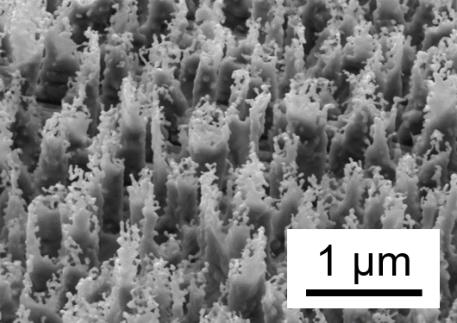
Gas driven permeation meas. through Steels pre-exposed to D plasma
Influence of D plasma exposure on the hydrogen permeation through ITER Grade 316L(N)-IG steel and Eurofer97
PSI-2: 200 eV, 5*10²⁵ ions/m²
SEM:
Polished steel substrates were exposed at the PSI-2 device with a deuterium plasma (Ion energy: 200/70 eV), gas-driven permeation and lag-time measurements were performed and compared to unexposed steel.
Result: 316L: The repetition of the measurement by using a steel mask during exposure confirmed that there is no influence of this surface roughness (see figure) on the permeation -> manuscript; Eurofer97: D plasma exposure are finished, characterization of surface and permeation measurements are underway.
Outlook: different plasma (e.g. D+Ne) -> variation of surface roughness
Anne Houben

Slide 9
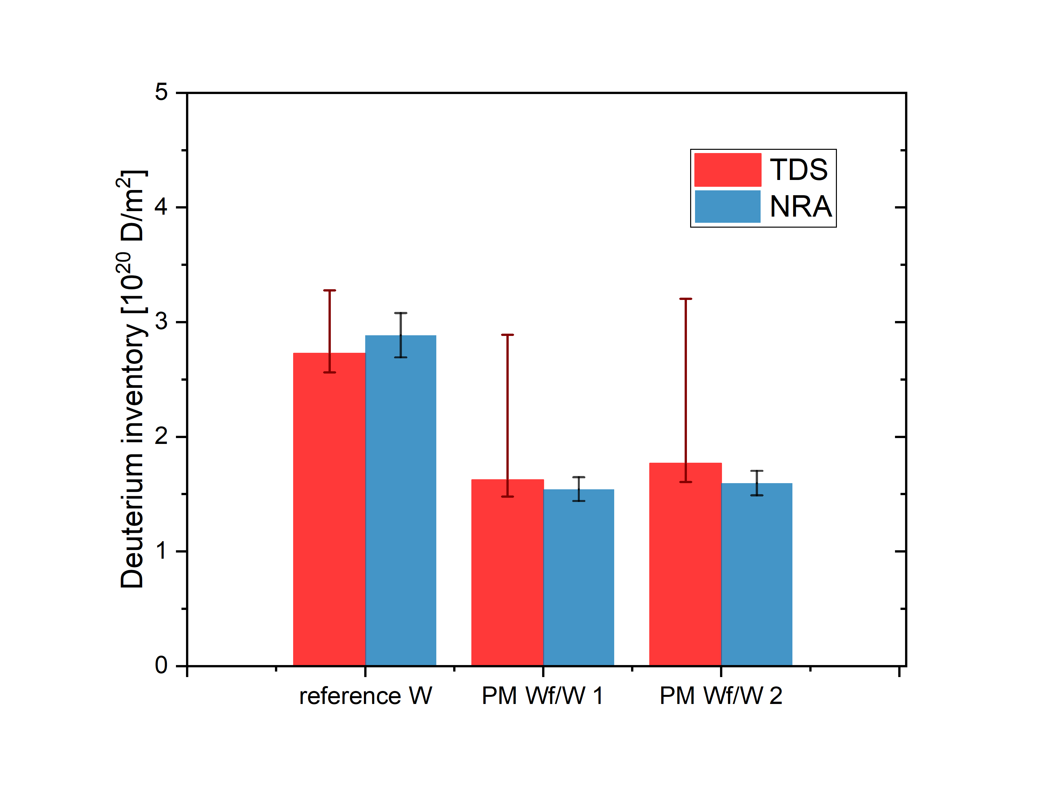
D ion driven retention in bulk powder metallurgical (PM) W_{f}/W
Study of D retention in bulk PM W_{f}/W by gentle plasma loading
D retention in PM W_{f}/W and reference W material
Nuclear reaction analysis (NRA) and thermal desorption spectroscopy (TDS) after D plasma exposure
Scanning electron microscopy imaging and high water signals in TDS indicate open porous structure
Both NRA and TDS measurements show lower D retention in PM W_{f}/W compared to reference W
Next steps:
D retention in PM W_{f}/W containing intact oxide interfaces
D retention in CVD W_{f}/W (matrix consists of chemically deposited W)
Johann Riesch, Annemarie Kärcher
Notes:
Please help me and add some notes here so I can figure out what to say about your slide / work

Slide 10
Ion vs. gas driven permeation
Inlet side
outlet side
Ion flux
Ion driven solute profile
Out-diffusion
P_{Gas}
Gas driven solute profile
Ion beam loading = Bulk source → Out-diffusion gradient to surface
Gas loading = Surface source (Sievert’s law) → No out-diffusion gradient to surface
Out-diffusion gradient to surface → Susceptible to surface roughness

Slide 11
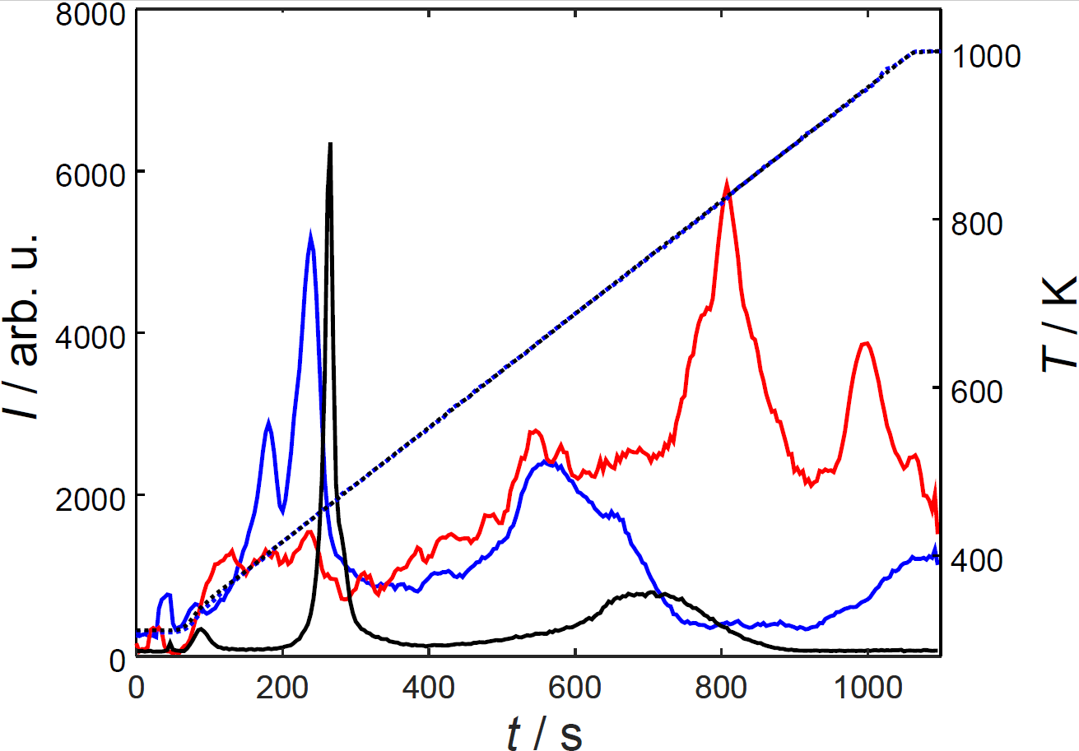
Retention of D and Ar/N pre-implanted Be
Task deliverable (SP 3.1.11, ÖAW, FZJ):
“Compare outgassing of D₂ from D implanted in Be compared to Be + Ar and/or N layer”
m = 4
(only D₂)
m = 4
(D₂ + Ar)
m = 40
(only D₂)
D desorption was compared for D₂ and D₂+Ar implantation at 3 keV, fluences of 1.5 x 10²¹ / m² were applied
Temperature
For the D₂+Ar case, a lower LT peak with two sub-peaks was observed
→ Ar influences D implantation close to the surface, where it is deposited as confirmed by SDTrimSP calculations
Ar mostly desorbs at temperatures over 600 K
P. S. Szabo, C. Cupak, P. Hansen, R. Koslowski, R. Stadlmayr, H. Biber, N. Helfer, N. Aghdassi, C. Linsmeier, F. Aumayr
Notes:
Task: “Compare retention of D in Be to D in Ar and/or N pre-implanted Be.”, Deliverable: “Compare outgassing of D₂ from D implanted in Be compared to Be + Ar and/or N layer”.
D desorption was compared in Be bulk targets for only D₂ and D₂+Ar implantations. Irradiations were performed at 3 keV (leading to 1.5 keV D and 3 keV Ar), the fluence for each species was 1.5 x 10²¹ / m².
TDS measurements were performed with a temperature ramp of 0.7 K/s. For the D₂+Ar case (blue), a significantly different low-temperature (LT) peak behavior for D is observed: The peak is much broader and split into two sub-peaks. Compared to the high-temperature (HT) peak, the peak intentsity is also lower compared to the TDS spectrum of a sample that was only irradiated with D₂ (black). These differences indicate that Ar significantly influences the implantation behavior close to the surface. Shifts in peak position might be caused by different thermocouple mounting.
Ar desorption was also recorded (red), showing only a small LT peak, while most of the Ar is desorbed at temperatures above 600 K.

Slide 12
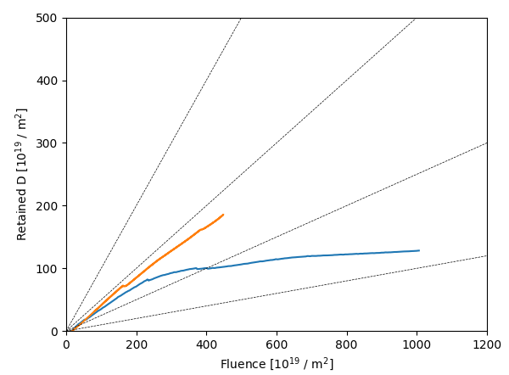
Retention of D and Ar/N pre-implanted Be
D retention in Be films on a QCM was investigated by implanting D₂ and N₂ at 5 keV, TDS was performed to measure desorption from the low-temperature peak
100% retention
50% retention
Implanted N (~4% of D fluence) increases D retention and saturation fluence (see plot)
25% retention
D retention (D+N)
D retention (only D)
LT peak position is not affected by N
10% retention
Less D is desorbed in the LT peak for D+N irradiation (~30% of retained D) compared to only D implantation (~80%)
→ LT peak desorption is affected by N, as observed similarly for D+Ar irradiations (see previous slide)
P. S. Szabo, C. Cupak, P. Hansen, R. Koslowski, R. Stadlmayr, H. Biber, N. Helfer, N. Aghdassi, C. Linsmeier, F. Aumayr
Notes:
D and N implantations were performed on thin Be films on a Quartz Crystal Microbalance (QCM, deposition by C. Lungu). Irradiations were performed with 5 keV D₂ and 5 keV N₂, thus 2.5 keV/D and N. TDS measurements were performed in-situ, due to the temperature stability of the QCM only the Low-Temperature peak of D desorption in Be could be measured.
D retention was calculated from QCM mass change measurements during the irradiation. As the plot shows, concurrent implantation of D and N (orange, D:N ratio 96:4) shows an increase in D retention as well as in the fluence that is needed for saturation.
TDS measurements showed no significant change of the LT peak position.
Temperature-compensated QCM measurements show that only 30% of the retained D were desorbed in the LT peak for the D₂+N₂ case. In contrast, about 80% of retained D were desorbed in the LT peak for only D irradiations (in agreement with Oberkofler, Linsmeier, Journ. Nucl. Mat. 415, 724 (2011)). Similar to the observations for Ar+D irradiations shown on the previous slide, our results indicate an important role of different defect formations close to the surface by heavier ions.
A paper on the temperature-compensation of the QCM by using two different oscillation modes to measure mass changes during TDS measurements has been submitted to Review of Scientific Instruments.

Slide 13
Reports from tasks in SP3
SP3.2:Qualification and modelling of synergistic effects related to hydrogenic fuel retention and He impact. (ITER+DEMO)

Slide 14
Influence of MeV He implantation on W recrystallization (2019)
Study recrystallization and grain growth
No-He w/o annealing
No-He + 5min @ 2000K
By MeV ⁴He/³He ion implantation in poly-crystal. W + post annealing:
Quantitative control of He amount!
<a_{esl}> = (1.17 ± 0.03) µm
<L_{esl}> = (15.1 ± 0.3) µm
→ 10 to 100 appm ⁴He increasing surface coverage with small grains
→ 500 to 5000 appm ⁴He exclusively small grains at surface
→ Multilayer: Diffusion of ⁴He out of implantation region is negligible at 300K as well as at 2000 K
50 appm He + 5min @ 2000K
50 µm
C_{small grain}: 21%
50 µm
Vickers hardness measurements pending (FZJ?)
50 µm
Manuscript finalization delayed because J. Bauer left IPP
J. Bauer / T. Schwarz-Selinger
Notes:
Please help me and add some notes here so I can figure out what to say about your slide / work

Slide 15
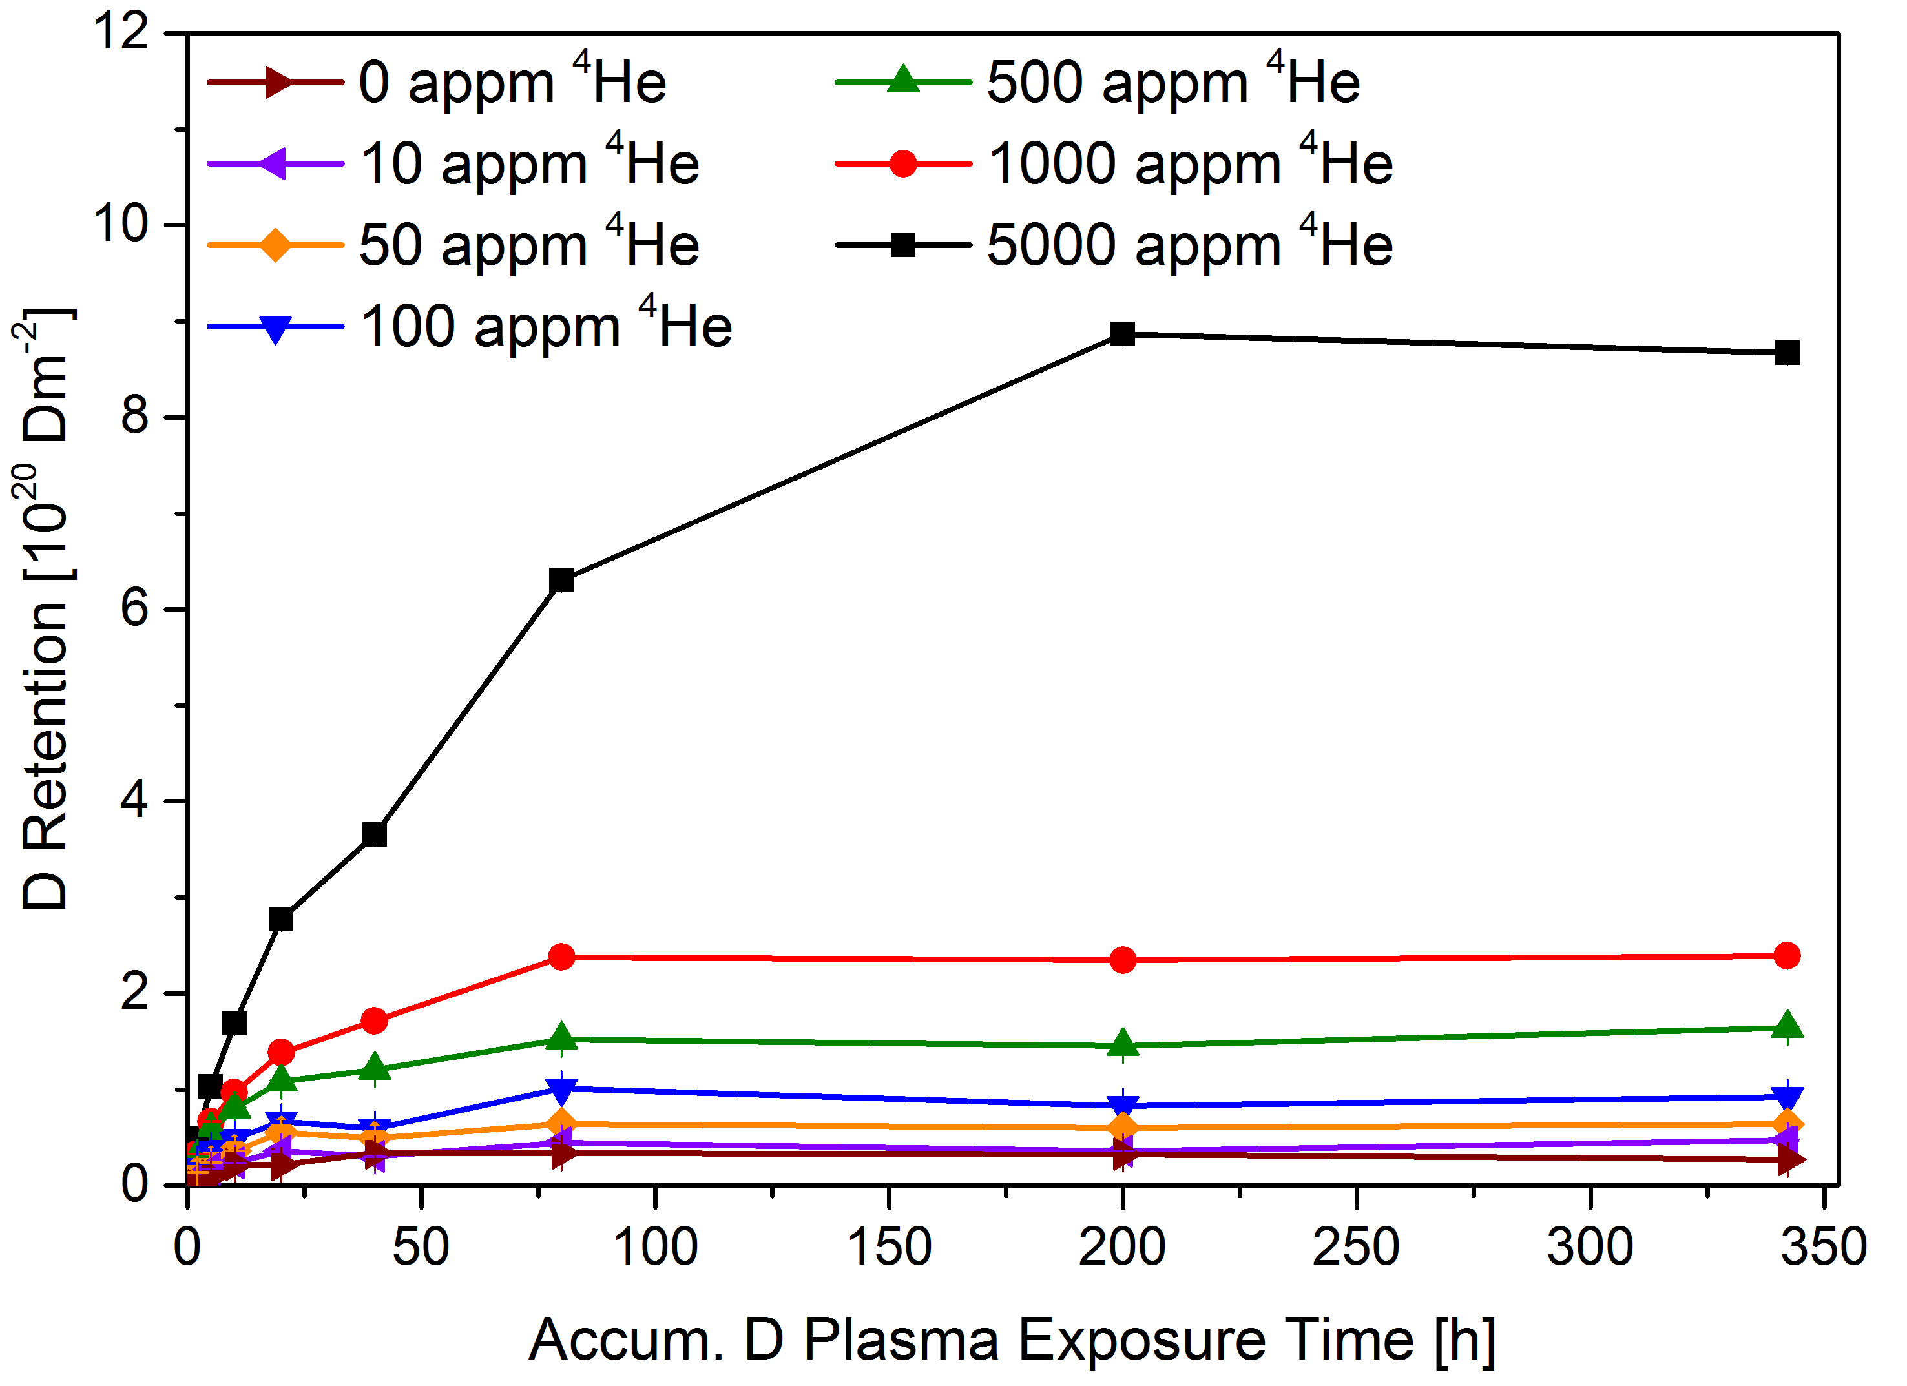
D retention in MeV He implanted and annealed W 2020
Study D uptake as function of D fluence
Study D retention as function of He concentration
Eleven ⁴He ion energies (0.3 to 2.75 MeV/⁴He)
2000 K post annealing
Gentle plasma loading at 370 K to decorate traps
Saturation of D retention is observed in all samples
Final D retention increases with ⁴He concentration
Final D retention does not depend on grain size
The higher the ⁴He conc., the lower the D to ⁴He ratio:
J. Bauer / T. Schwarz-Selinger
Notes:
Please help me and add some notes here so I can figure out what to say about your slide / work

Slide 16
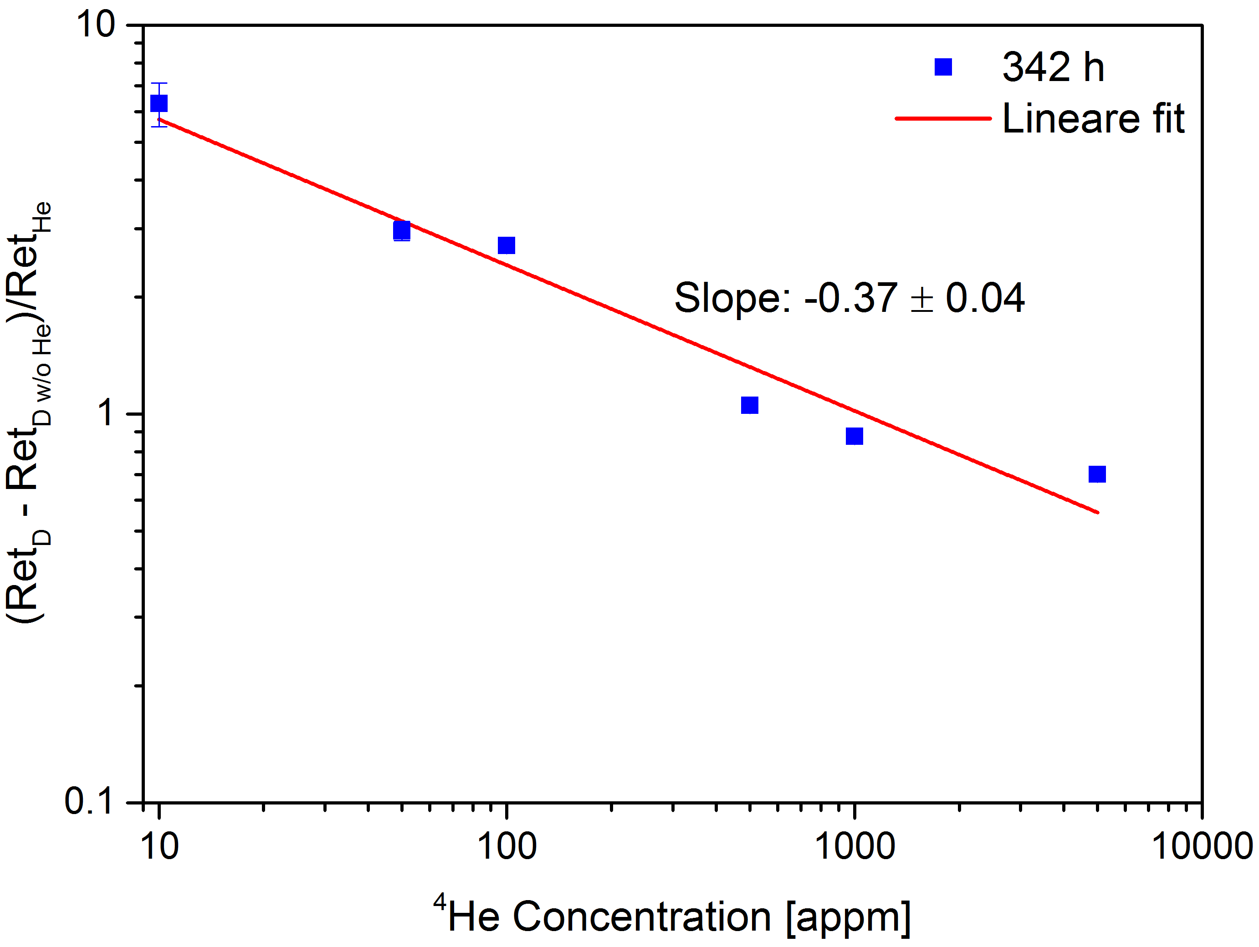
D retention in MeV He implanted and annealed W 2020
Study D uptake as function of D fluence
Study D retention as function of He concentration
Eleven ⁴He ion energies (0.3 to 2.75 MeV/⁴He)
2000 K post annealing
Gentle plasma loading at 370 K to decorate traps
Saturation of D retention is observed in all samples
Final D retention increases with ⁴He concentration
Final D retention does not depend on grain size
The higher the ⁴He conc., the lower the D to ⁴He ratio: see graph
D to ⁴He ratio fits to D trapping at ⁴He bubbles
Future plans:
Repeat with non-annealed He containing samples
He ‘multilayers’ to study D transport
J. Bauer / T. Schwarz-Selinger
Notes:
Please help me and add some notes here so I can figure out what to say about your slide / work

Slide 17
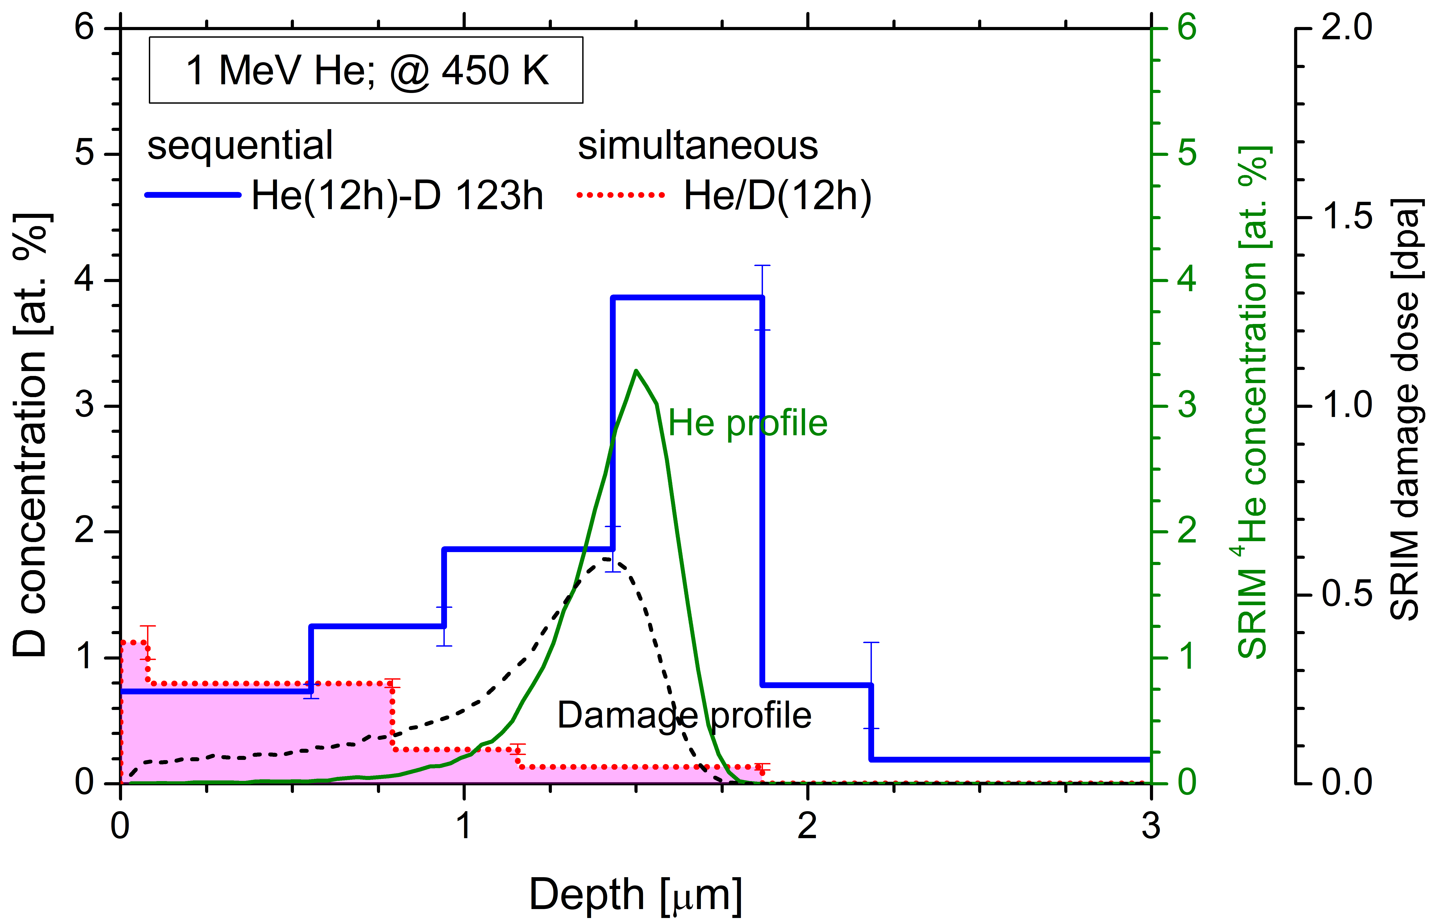
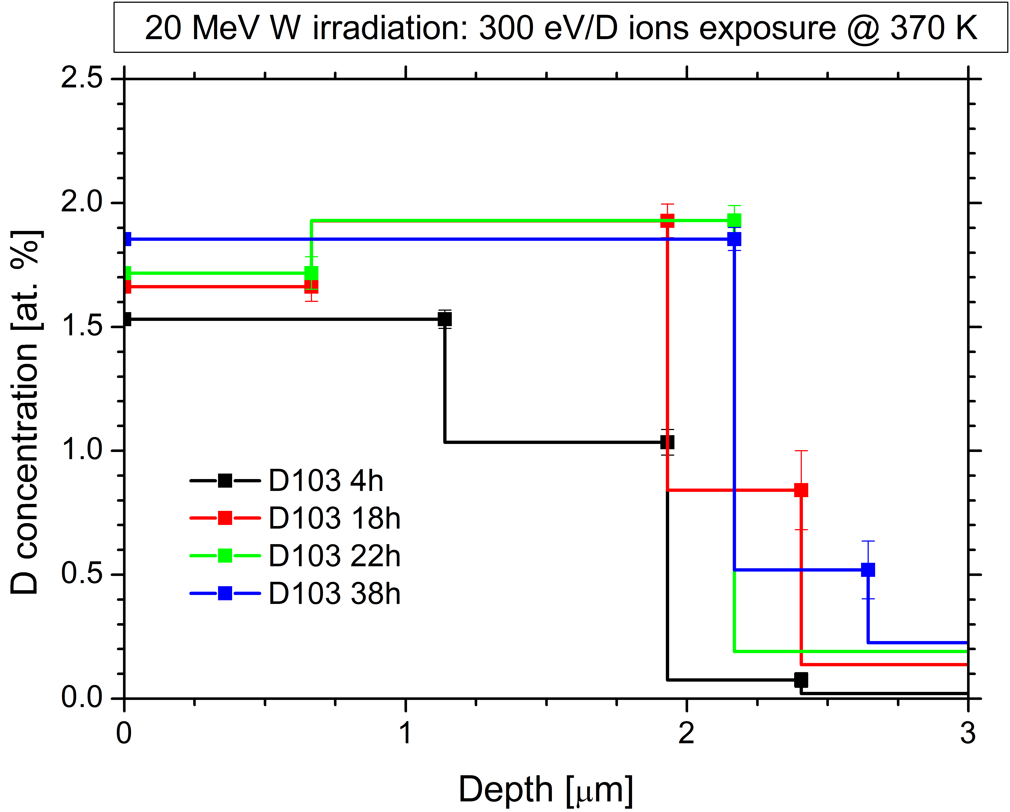
Influence of He on D and retention
Study the influence of simultaneous MeV-He and eV D ions on retention in W
1 MeV He (3 at.%, 0.6 dpa) @ 450 K:
Simultaneous with 300 eV/D D ions irradiation + 300 eV/D D ions loading @ 450K
Simultaneous: D stabilization zone did not reach He peak + something went wrong with additional loading
New experiment performed at lower He energy
Sequential + 300 eV/D D ions loading @ 450 K
D stabilization zone
Higher D concentrations in He peak (4 at.%) for He irradiated compared to:
Self-damaged W at 450 K = 1 at.%, Self-damaged W at 300 K = 1.9 at.% for 370 K D exposure (see lower figure) or for 450 K D exposure = 1.5 at.%
Long exposure times (123h) needed to fill the defects by D indicating that defects with He behave different in filling as compared to self-damaged W (40h – lower figure)
Markelj, Pečovnik, Schwarz-Selinger
Notes:
Please help me and add some notes here so I can figure out what to say about your slide / work
We did simultaneous and sequential exposure of 1 MeV He with 300 eV/D D ions. The He irradiation took place at 450 K and D ion loading also at 450 K. The He irradiation took for 12h in both cases and we implanted about 7e20 He/m2 which is about 3 at.%.
The D stabilization zone is far from maxium He peak, even though we exposed for 12h. For this reason we made another experiment at lower He energy, the lowest achievable in our lab was 700 keV. There was an issue with the additional exposure for the simultaneous case and we don’t know yet what went wrong. Since we observed this we made new experiment with lower He energy of 0.7 MeV – see next slide. We still need to make another set of sequential for 700 keV He.
Long exposure times needed to fill the damaged area. The filling of defects containing He is longer as compared to self damaged W. For standard 20 MeV W irradiated samples we needed 38 h to fill the 2 um. In the He case we needed 120 h both in our set-up.

Slide 18
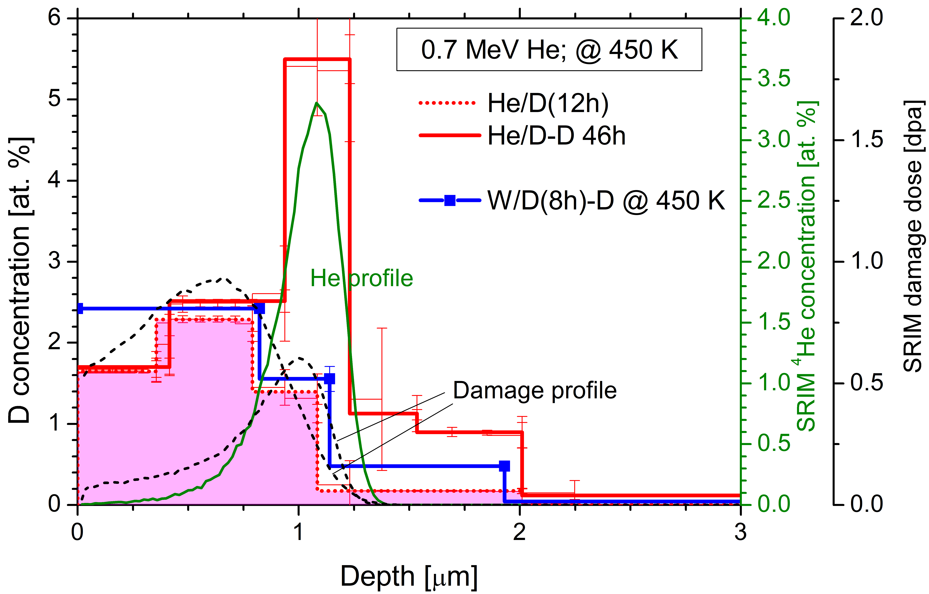
Influence of He on D and retention
Study the influence of simultaneous MeV-He and eV D ions on retention in W
0.7 MeV He (3.3 at.%, 0.6 dpa) @ 450 K:
Simultaneous with 300 eV/D D ions + 300 eV/D D ions loading @ 450 K;
D penetrated partly in the maximum He concentration zone after 12h of irradiation
High D concentrations in He peak = 5.6 at.% - higher as compared to sequential 1 MeV He case (4 at.%)
Higher D conc. than simultaneous 10 MeV W with 300 eV D ions irradiation (0.9 dpa) @ 450 K = 2.5 at.% (on figure W/D(8h)-D)
Similar D concentration down to 0.8 µm as compared to simultaneous W/D(8h)-D
He/D = simultaneous
He(W)/D-D = simultaneous + additional D exposure
To make a clear statement of the effect of simultaneous He/D irradiation, sequential 0.7 MeV He irradiation needs to be done and is planed for this year for comparison
<Markelj, Pečovnik, Schwarz-Selinger>
Notes:
Please help me and add some notes here so I can figure out what to say about your slide / work

Slide 19
Reports from tasks in SP3
SP3.3:Fuel retention and fuel release modelling towards predictions of baking efficiencies in ITER and beyond. (ITER+DEMO)

Slide 20
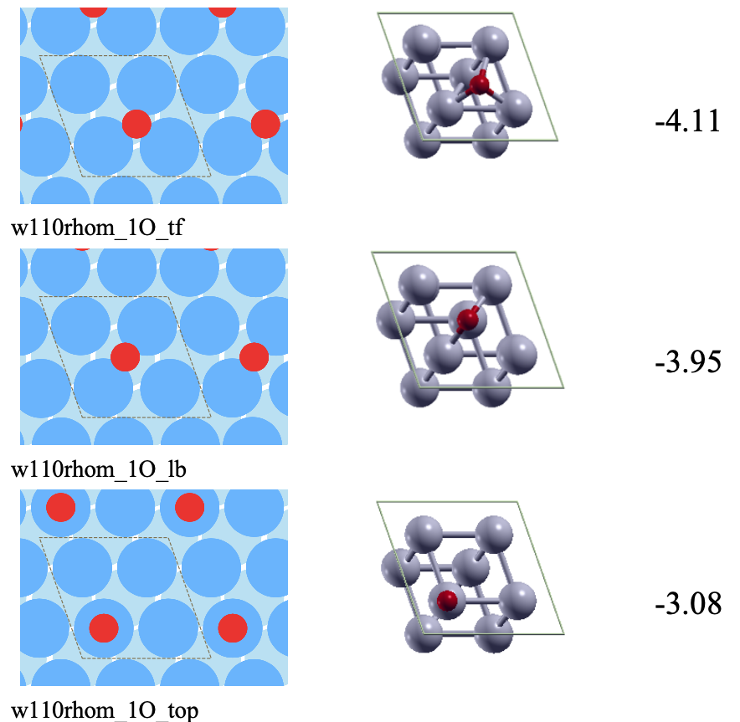
Adsorption sites of Oxygen on Tungsten by DFT 2019
Final goal: Impact of oxygen adsorption on H/D retention and desorption
This year objective: investigating O adsorption on W(110) surface by DFT.
Starting from the bare surface, oxygen coverage was increased up to beyond saturation
At each coverage, many different configurations for oxygen were investigated.
Here we present, at coverage in oxygen 0.25,
Your associations logo
the three most stable configurations.
Adsorption energy is strong: -4.11eV for the most stable TF site.
& CEA
Z. Piazza, M. Ajmalghan, Y. Ferro
Notes:
What we want to do is to understand the impact on H/D absorption and desprtion of the formation of an oxygen layer on top of the tungsten surface.
Before investigating the impact of oxygen on H/D retention, we first need to address oxygen adsorption on the surface, which we did.
We increased the oxygen coverage of the W(110) surface from the bare surface to above saturation.
Here is presented the three most stable configurations for oxygen at coverage 0.25.
The most stable is the Three-Fold adsorption site, followed by the Long-Bridge site and finally the top site.
The difference in adsorption energy between each sites is quite significant, indicating no competition is to be expected and the TF site is occupied.

Slide 21
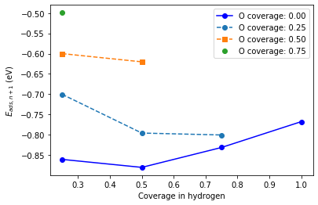
Investigate adsorption of H on oxidized W surfaces by DFT 2020
What did we do and why
Adsorption of H on W(110) with oxygen by DFT
Various coverage in O were considered
from 0 to 1 ML by step of 0.25
Various coverage in H were adsorbed
from 0 to 1 ML by step of 0.25
Main results
OH termination are never observed
Only the Three-Fold sites are occupied by O and H as well.
Since E_{ads} for O is about -4eV, oxygen blocks the TF sites for hydrogen
Oxygen has the effect to diminish the adsorption energy and the strength of H bonding to the W surface
& CEA
Yves Ferro
Notes:
The energetics of H on the WO surface is rather simple.
Despite the many configuration we tested for H, only the three-fold configuration is stable, meaning it is more stable than the in the O2 molecule when in the gas phase.
Top positions exist, but are less stable than O2 - -> no O-H termination of the surface is expected.
Oxygen has the effect of blocking the TF sites for H (E_ads for O in the range of -4 ev, E_ads for H in the range of -0.8eV)
In the present study, the zpe was only corrected for the H2 molecule. The difference in mass between W and O and between O and H does not allow to compute the vibrational frequency of H only or O and H only. Computing the full vibrational frequencies of the system (W,O and H) would be out of our computational capabilities.
Oxygen has the effect to diminish the adsorption energy and the strength of H bonding to the W surface.
At completion of the O layer (1ML), adsorption of H is on top of O, leading to metastable O-H termination.
H can further be adsorbed, reaching 1ML on top of O atoms as shown on the picture. It is however not stable by more the 1.2 eV.
We checked the impact of not considering the vibrational energy on H surface coverage vs T and P on the W/H model. It leads to several hundreds °C deviation.
The thermodynamic model would only be qualitative at best.
What we did instead is to complete the set of data on the WO system by considering O adsorption below the surface.

Slide 22
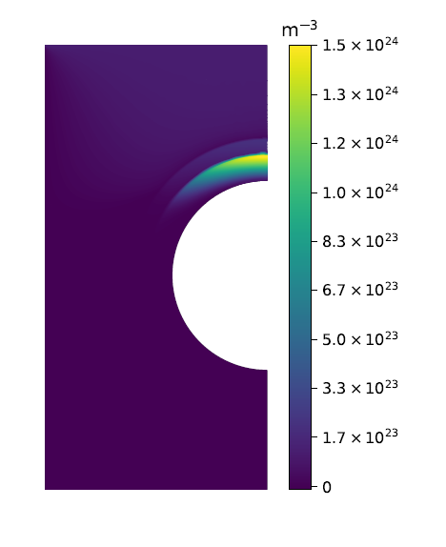
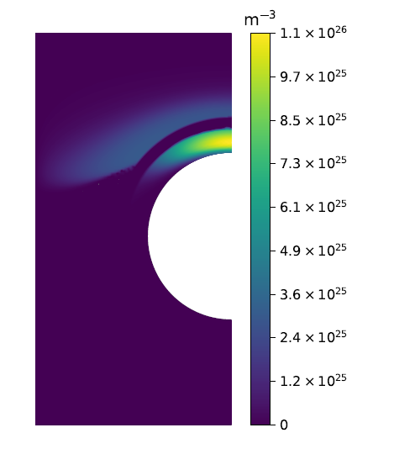
Extension of MRE codes in order to simulate T permeation through 3D configuration including bubble defects and multicomponents material (W, Steel and W-on-Steel) 1/2
We did: Numerical simulation of H transport in multicomponent materials to calculate permeation flux and inventory
H mobile concentration
H retention
With: FESTIM code (finite element
code based on Fenics project)
Hydrogenic inventory in the ITER divertor based on machine learning (2D) Delaporte-Mathurin et al. Scientific Reports (2020) 10:17798
Role of interface condition (c or µ continuity) on permeation flux and inventory (1D and 2D) Delaporte-Mathurin et al. ITPA + submitted to Nucl. Fus.
ITER Divertor Monoblock
Full power scenario t = 2.4 10⁷ s
As perspective: simulate H transport on more complex structures for DEMO (TSVV#7) ; more complex interface condition and add a co-deposit surface model
J. Mougenot, Y. Charles, C. Grisolia, Y. Marandet
Notes:
Please help me and add some notes here so I can figure out what to say about your slide / work

Slide 23
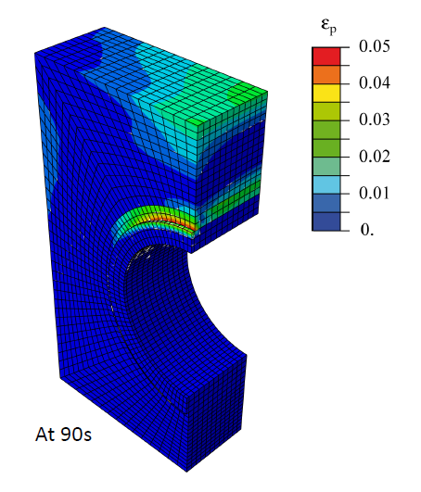
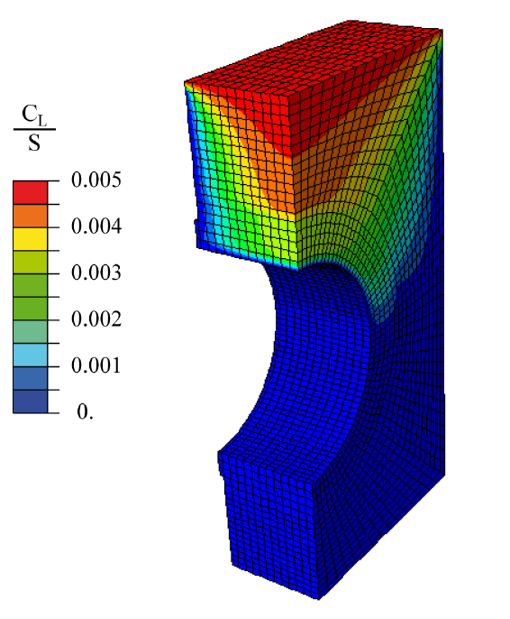
Extension of MRE codes in order to simulate T permeation through 3D configuration including bubble defects and multicomponents material (W, Steel and W-on-Steel) 2/2
We did: Numerical simulation of H transport in multicomponent materials to show impact of mechanical fields
Plastic Strain
With: ABAQUS code (with specific development to treat diffusion/transient trapping/mechanics/thermic)
H diffusion and transient trapping with thermo-mechanical fields for ITER divertor (multicomponent and 3D)
S. Bian et al. SOFT2020
H diffusion (modified by plastic strain) around a bubble
ITER Divertor Monoblock
As perspective: Better coupling between mechanic and diffusion (need data)
J. Mougenot, Y. Charles, C. Grisolia, Y. Marandet
Notes:
Please help me and add some notes here so I can figure out what to say about your slide / work

Slide 24
Reports from tasks in SP3
SP3.4 Quantify the impact of neutron and self-damage on fuel retention in Be and W in combination with seeding species. (ITER+DEMO)

Slide 25
Retention in W-heavy alloys 2019 (“W-balls glued together by Ni/Fe matrix”)
Extension of the investigated D implantation temperature and implantation fluence range
Simulation of neutron damage by irradiation with 20 MeV W⁶⁺
Investigation by NRA and TDS
With increasing implantation temperature and fluence the relative D retention in HPM decreases as compared to tungsten
At 100°C implantation temperature irradiated HPM shows the same retention as irradiated W
D leaves W granules
Fast diffusion in Ni/Fe matrix
Strong loss from surface
No deep diffusion
2020: investigate retention of irradiated HPM at higher implantation temperature
Numerical simulation
H. Maier

Slide 26
Retention in W-heavy alloys 2020
Retention in W-heavy alloys: Influence of radiation damage on retention at different temperatures
D plasma loaded at 100°C
D plasma loaded at 250°C
Irradiation of alloy W-2Ni-1Fe (HPM1850) with 20 MeV W ions; exposure to D plasma (100°C / 250°C loading temperature); NRA depth profiling and thermal desorption
Basic retention behavior after irradiation very close to pure tungsten
Much weaker temperature dependence of relative retention as compared to pure tungsten; different from unirradiated case
Total D release from W reference and from HPM1850 for loading at 100°c and 250°C, respectively
Retention dominate by damage zone
H. Maier
Notes:
In the unirradiated case the relative retention in HPM compared to MF reference tungsten goes down with increasing loading temperature and fluence because both increase the diffusion depth. This is because D goes into the Ni/Fe phase and then leaves the sample. Here everything is controlled by the 2 microns of irradiated layer, not by deeper diffusion. But the relative retention is still going down a little bit compared to pure tungsten.
The paper about the unirradiated case is published in Nuclear Fusion

Slide 27
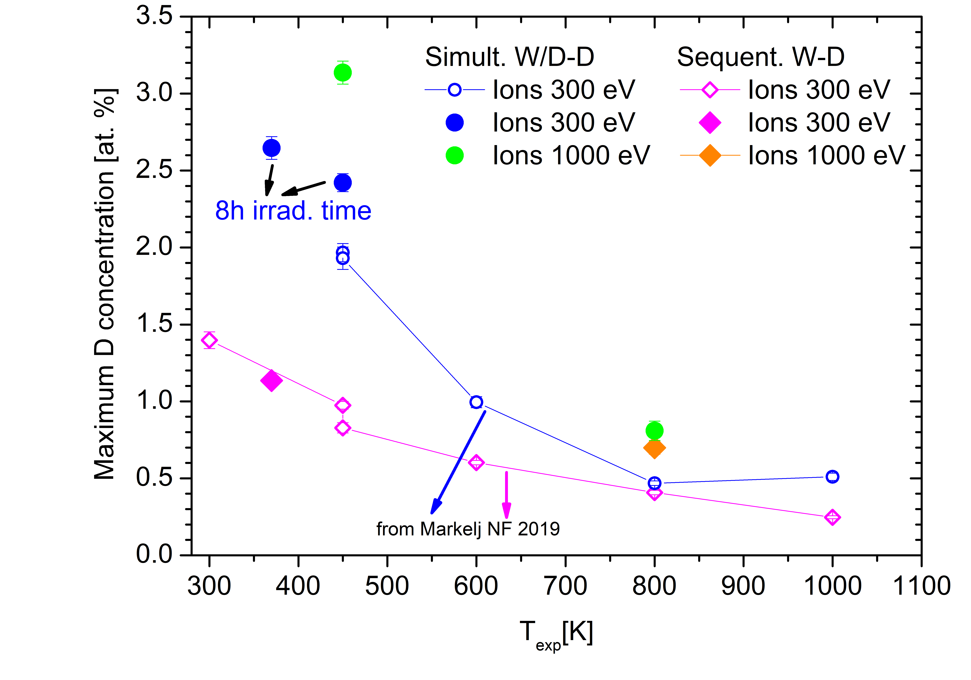
Effect of D presence on displacement damage stabilization
Experiments and modelling of the effect of trapped D on damage stabilisation
D loading @ 450 K
Increase irradiation time and D solute conc. (1 keV/D) for simultaneous 10.8 MeV W ion irradiation and D ion exposure
Increasing the irradiation time from 4h to 8h – stabilizes defects deeper in the damage zone
Higher D conc @ 450 K = 2.4 at. %
New data @ 370 K = 2.7 at. % for simultaneous, sequential as expected
Increasing D solute for 4 times (1 keV/D ion energy and higher D flux):
For 450 K D concentration increases to 3.1 at.%!
For 800 K D concentration increases for both simult. and sequent. – higher filling level?
W-D = sequential 10.8 MeV W - D exposure
W/D = simultaneous 10.8 MeV W/ D ions
W/D-D = simultaneous - additional D exposure
SP3.4 task 2
<Markelj/Pecovnik/Schwarz-Selinger>
Notes:
Please help me and add some notes here so I can figure out what to say about your slide / work

Slide 28
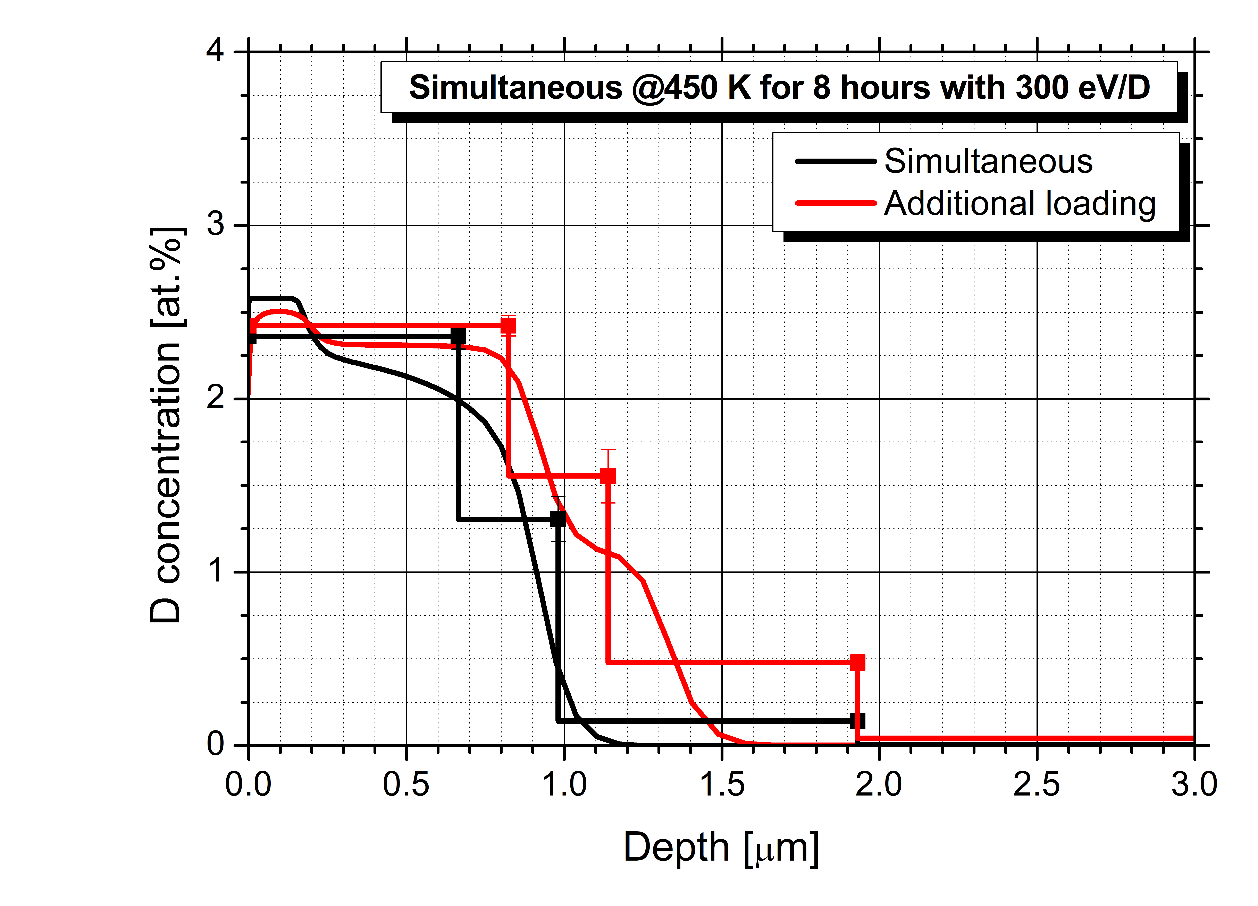
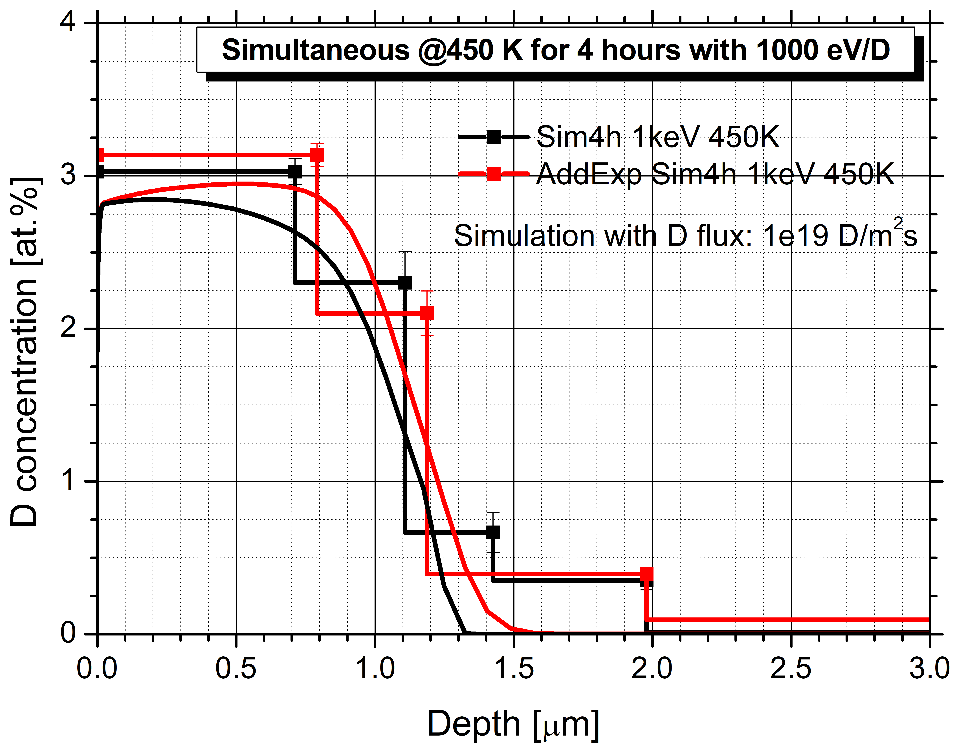
Effect of D presence on displacement damage stabilization
Experiments and modelling of the effect of trapped D on damage stabilisation
Model is capable of describing the complex experimental procedure and the resulting stabilization when 300 eV/D ions are used.
Higher D solute fills more fill-levels of the created defects. This seemingly produces more stabilization. Model cannot replicate this, as stabilization is independent of fill-level occupancy.
Conclusion: higher flux and longer exposures during simultaneous lead to higher D concentration – no indication for saturation.
SP3.4 task 2
<Markelj/Pecovnik/Schwarz-Selinger>
Notes:
Please help me and add some notes here so I can figure out what to say about your slide / work

Slide 29
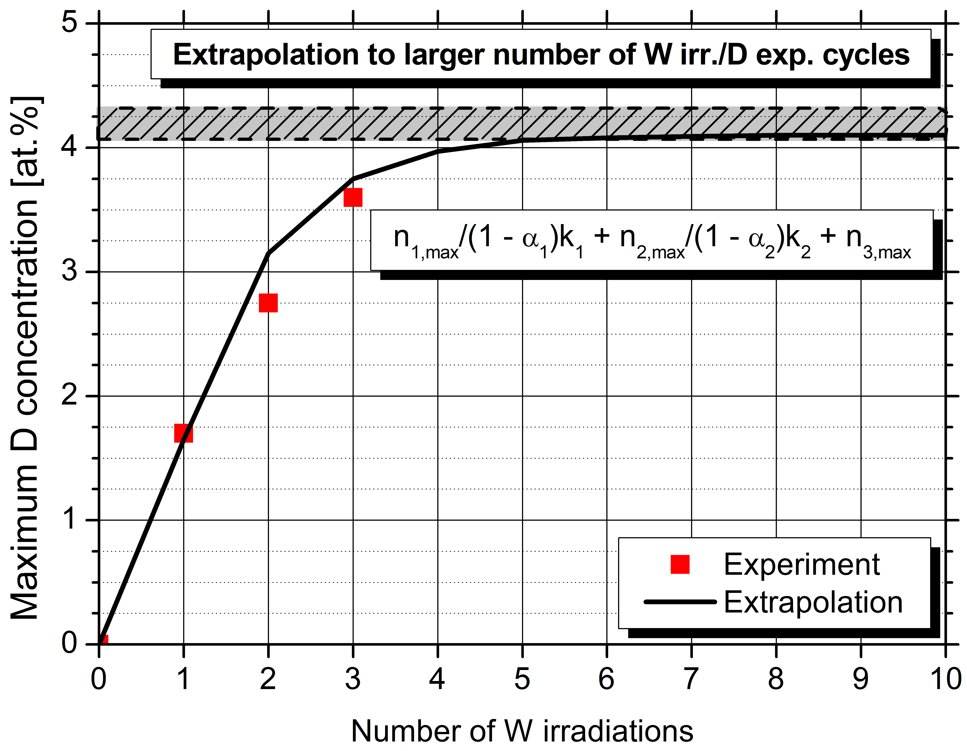
Multiple sequential W damaging and D loading
Experiments and modelling of the effect of trapped D on damage stabilisation
Multiple sequential W damaging and D loading sequences, experiments performed by T. Schwarz-Selinger
Modelling: stabilization model
Third experimental cycle modelled - no fitting parameters - gives good agreement with experiment
$$0=1−{n_{i }}/{\frac{n_{i,Max}}{1−α_{i}\left(1−\frac{n_{i}^{0}}{n_{i }}\right)}}$$
$$\frac{dn_{i}(x, t)}{dt}=\frac{Γ{ η}_{i} Θ(x)}{ρ}\left[1−\frac{n_{i}\left(x, t\right)}{n_{i,max}}\left(1 − α_{i}\frac{n_{i}\left(x, t\right)− n_{i}^{0}(x, t)}{n_{i}\left(x, t\right)}\right)\right]$$
Determined by single damaging
Determined by double damaging
Conclusion: sequential W damaging and D loading sequences show increasing D concentration in each cycle – extrapolation by modelling predicts saturation after five sequences (JNM manuscript Pecovnik et al.)
SP3.4 task 2
<Markelj/Pecovnik/Schwarz-Selinger>
Notes:
Please help me and add some notes here so I can figure out what to say about your slide / work

Slide 30
Summary 1/2
SP3.1: Qualification of the impact of seeding gases (Ar and N) on fuel retention and fuel release in W and Be PFCs and mixed layers
Pure oxide layers reduce bulk uptake
Inlet side surface roughness does not affect gas driven permeation
Surface porosity affects retention in ion beam beam loading experiments
Ar pre-implantation has strong impact on D-TDS spectrum from Be
N+D implantation increases retention in Be
SP3.2:Qualification and modelling of synergistic effects …of He
He in the bulk acts as a strong trap for hydrogen
D/He ration decreases with He concentration
Simultaneous D+He irradiation not yet conclusive

Slide 31
Summary 2/2
SP3.3:Fuel retention and fuel release modelling…
DFT model of W+H+O suggests that surface O reduces H adsorption energy
3D Diffusion trapping modeling capabilities now allow multi material interfaces
SP3.4 Quantify the impact of neutron and self-damage on fuel retention…
Similar to un-damged case, self-damaged heavy alloys retain less as function of fluence
Increasing solute increases damage stabilization at 450K. Cannot be explained by current model
Damage stabilization during multi-step experiment described by model → Allows to estimate maximum retention saturation after 5 steps

Slide 32
Outlook
Permeation through and retention in W, Steel, W on Steel and W on Cu
Influence of
Material interfaces (both graded and layered)
Kinetic barriers at interfaces
Traps at interfaces
Discontinuities in solubility
Surface layers O, C… (which are also material interfaces in a sense...)
Influence on bulk uptake/bulk to surface transition/recombination
Metal to coolant water interface (How does T jump back and forth between metal and coolant water)
Boundary condition as function of Temperature, Water pressure, PH-value...

Slide 33
Outlook
He in Metals (W, Steel, Cu)
I know a lot has been done in FP8 for W
n-damage (W, Steel, Cu)
I know a lot has been done in FP8 for W
Modelling of the above (in close collaboration with experiments for validation)
DFT
Diffusion/trapping
…
Beryllium
Not sure if we have the capability within EUROFUSION to do anything with Be

