Slide 1

SP7: Plasma characterization & Retention
Hennie van der Meiden

Slide 2
OUTLINE
Status & outlook: SP7.4 Plasma Characterization
Status & outlook : SP7.8 Quantification of LIBS
Status & outlook : SP7.10 TOMAS: Toroidal Magnetic devices for characterizing neutrals during Ion Cyclotron wall conditioning

Slide 3
SP7.4: Plasma characterisation
Dedicated measurement of plasma conditions to support plasma-edge codes (SP4 and others)

Slide 4
Tasks to be carried out for SP 7.4
1. Study plasma composition by mass spectrometry and OES (FZJ)
2. VUV measurements (ground state pop. D2) in Magnum (DIFFER, CU)
3. Measurements of ion flux, ne, Te, Vfloat and Vplasma at different radial positions using a multi probe system in Magnum. In addition possible application of flush mounted probes (IAP, DIFFER).
4. Determination of ne, Te, Ti and of near surface plasma during detachment by TS and CTS. (DIFFER).
5. Measure axial plasma potential or pre-sheath profile using LP(DIFFER).
6. Doppler spectroscopy to obtain velocity information (DIFFER)
7. Impurity characterization with filtered 2D camera systems to determine plasma conditions and emission plume from sputtering experiments (FZJ)
8. (TA)LIF experimental set-up and execute measurements to determine lifetime/density of impurity ions (W, Cr etc.) to verify atomic data (FZJ).
9. OES to determine refl. properties of ions on fusion relevant materials: angular and energy distribution, surface roughness polarisation /=> recrystallisation).
10. Determine S/XB for W in GyM (ENEA)
Orange: item/alternative item will be finished in 12/2020
A few examples

Slide 5
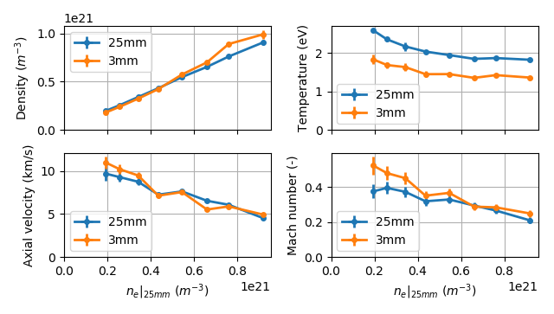
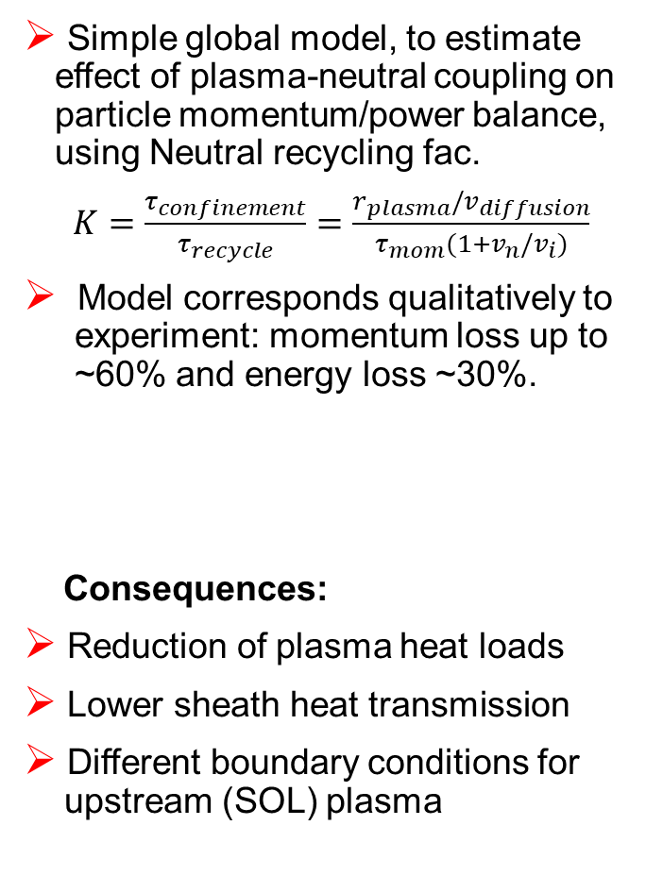




Near-target plasma-neutral coupling DIFFER
At high density $n_{e},$ recombined neutrals can interact with incident plasma in direct vicinity of the target surface, affecting plasma fluxes
TS & CTS measurements were performed on Magnum-PSI ➔ n_{e}, T_{e}, $T_{i}$ and $v_{i}$ at 25 mm down to 3 mm from surface. ➔ direct plasma flux
Simple global model, to estimate effect of plasma-neutral coupling on particle momentum/power balance, using Neutral recycling fac.
$K=\frac{τ_{confinement}}{τ_{recycle}}=\frac{r_{plasma}/v_{diffusion}}{τ_{mom}(1+v_{n}/v_{i})}$
Model corresponds qualitatively to
experiment: momentum loss up to
~60% and energy loss ~30%.
Consequences:
Reduction of plasma heat loads
Lower sheath heat transmission
Different boundary conditions for
upstream (SOL) plasma
$$Cooling$$
$$Stagnation$$
$M<0.5$!
Significant plasma cooling (25%)
Mach numbers < 0.5 indicate
momentum loss, increasing with n_{e}
Jonathan van den Berg et al, to be published

Slide 6
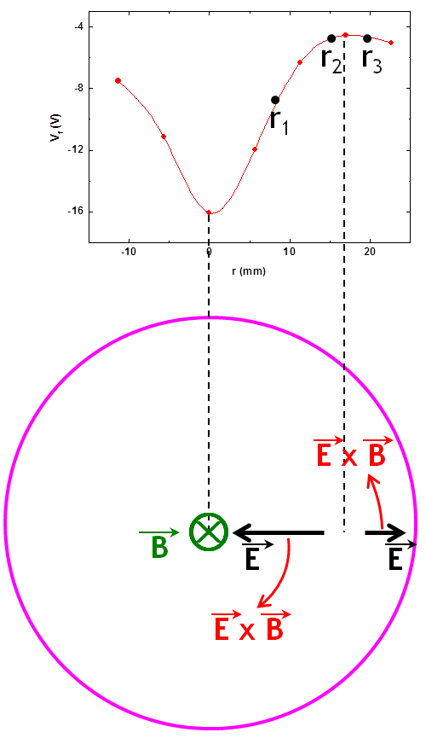
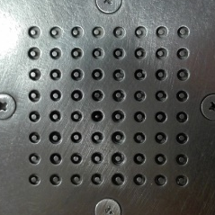
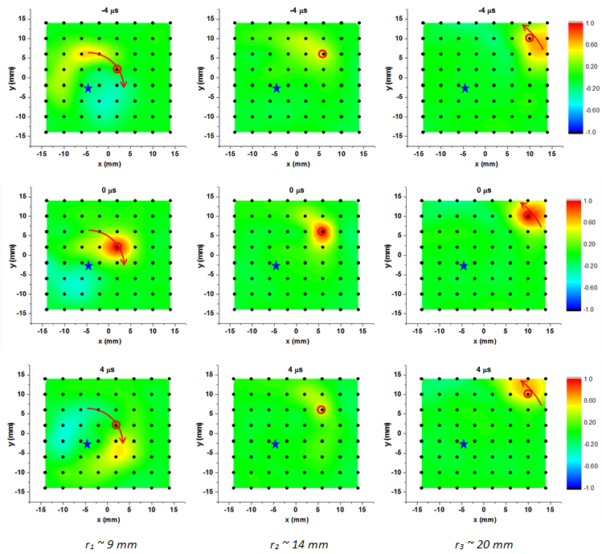
Probe measurements in Magnum IAP-DIFFER
(2019) Cross-correlation analysis estimated for the ion saturation currents gives information about plasma rotation ➔ results in agreement with ExB drift predicted by float. Pot. Meas.
fast slow opposite
ExB drift predicted by floating potential measurements
OES rot. velocity measurements
desirable for comparison ➔ maybe not possible
r = 9 mm r = 14 mm r = 20 mm

Slide 7
Probe measurements in Magnum IAP-DIFFER
Measurements scheduled for December 2020
Goals and deliverables: measurements of the ion flux, floating potential and estimates of electron density, electron temperature and plasma potential using a multi probe system in Magnum-PSI. Now measurements in the plasma at different axial positions close to TS and compare with TS (Te, ne) results.
Measurements will be carried out at normal incidence and at an inclination of 60°
2 publications planned for 2021
C. Costin, Secondary electron emission under magnetic constraint: from Monte Carlo simulations to analytical solution, submitted

Slide 8
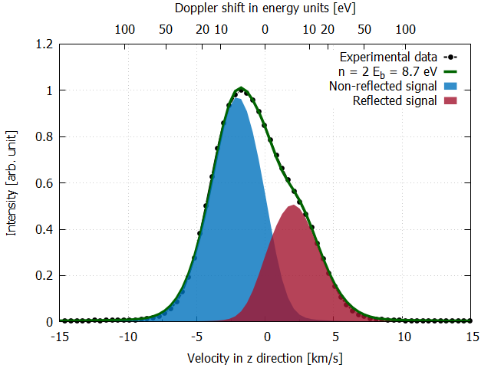
Detection of surface reflection properties of emitted light from ions FZJ
Angular and energy distribution
High res. spectroscopy experiments on sputtered W
Develop Doppler-shifted emission model
Only 1D modelling of angular or energy distribution possible until now
Further development of the model and experiments needed
First results: Thompson energy distribution describes spectrum well
  Publication: S. Ertmer et al. PPCF (submitted 23.07.2020)
Modelled and experimental determined line shape of the emission spectrum of W I.
Notes:
Influence of bulk D plasma (drag)?

Slide 9
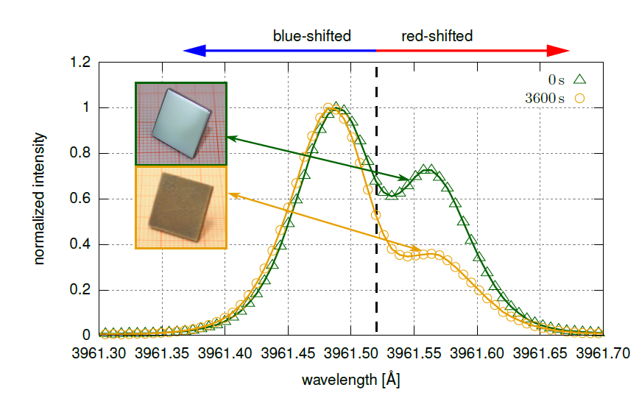
Detection of surface reflection properties of emitted light from ions FZJ
Surface roughness
Experiments on Al
First results:
  Impact of the surface roughness on the line shape
  Published: S. Ertmer et al. Phys. Scr. T171, (2020) 01403
Experiments on W with different roughness still missing
Al I emission spectrum of sputtered atoms of a mirror-like and rough surface after 3600s exposure in PSI-2 observed // surface normal
Polarisation effects also observed

Slide 10
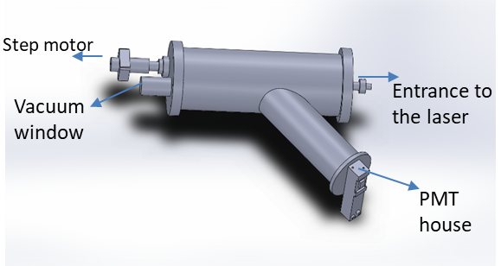
VUV-OES: D2 ground state population in Magnum
CU
Done in 2019
Design/construct VUV spectrometer (CU)
Purchase of the components (CU)
1 - CCD-S3600- D UV enhanced in VUV rango
(Advanced digital high speed CCD line camera,
pixel size (8x200 μm), for VUV range
2 – Reflex objective for VUV range ,
TECHSPEC ReflX objectives, 10x/0.23 NA,
DUV enhanced aluminium
3 – VUV confocal grating 1200 gr/mm f= 20 cm
2020
Assembly of the developed VUV spectrometer
➔ spectrometer tested.
Feasibility study to be finished December 2020
DIFFER will included this in the program and is
aiming for funding to realize active spectroscopy

Slide 11
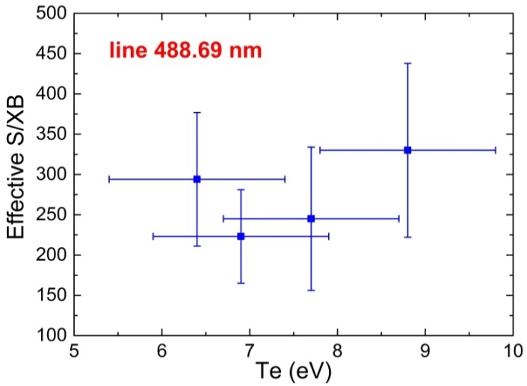
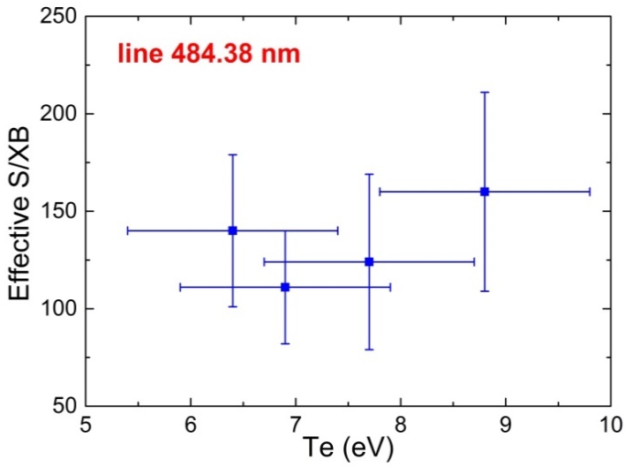
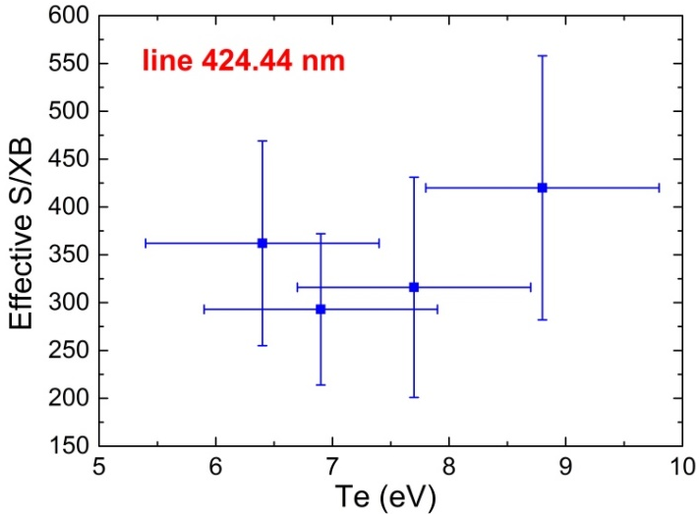
Detection S/XB for W in GyM CNR
S/XB (n_{ions})/photon), enabling to determine W-ion flux from surface (errosion), have been estimated from OES and mass loss measurements
S/XB in GyM operative conditions for more W I lines have been obtained
Re-deposition: expose partially masked W samples to GyM plasma and study the re-deposition by surface analysis (XPS) in order to verify that gross erosion (OES) ≈ net erosion (mass loss) (to be finished in 2020)
Intention to finish the work in 2020:
ERO Modelling SP4.2 to describe the particle loss

Slide 12
Preliminary conclusions SP7.4
CTS/TS measurements show that in near surface plasma of Magnum-PSI the plasma stagnates and the effect becomes stronger at higher n_{e},also plasma cooling was found
Mach number becomes below 0.5, indicating momentum loss
Observations indicate reduction of measured heat loads
Atomic emission from reflected particles can be used for monitoring surface conditions, i.e. reflectivity and roughness and of course W-ion energy distribution
New S/XB results obtained

Slide 13
SP7.8: Quantification of LIBS
Quantified determination of retention and material composition by LIBS
- in-situ LIBS and outgassing (LIBS-LID/NRA)
- CF-LIBS in vacuum and atm. pressure
- Comparison different laser based retention analysis techniques
Joint paper/synopsis LIBS team LIBS for monitoring of tritium and impurities in the first wall of fusion devices accepted for 28th IAEA Fusion Energy Conference (FEC 2020)
Antti Hakola, Eduard Grigore, David Dellasega, Matteo Passoni, Beata Tyburska-Pueschel and RBI thanks for your efforts in production and analysis of the samples!

Slide 14
Tasks to be carried out for SP 7.8
1. Investigate erosion/deposition/fuel retention by (CF)-LIBS and NRA/RBS (DIFFER) or LID-QMS/EDX (FZJ) in between plasma discharges (including outgassing study) and PSI-2 (UT, DIFFER, FZJ, CU, VTT, VR)
2. Comparison ps, ns and dp (CF)-LIBS on ITER coated/doped samples: ablation rate and plasma plume dynamics (ISSP-UL, CU, UT, VTT, FZJ, ENEA, IPPLM)
3. Comparison ps, ns and DP (CF) LIBS on samples from different devices, including tokamaks or W-7X (ISSP-UL, CU, UT, VTT, FZJ, ENEA, IPPLM)
4. (CF)-LIBS on produced reference samples before and after He loading including possible surface modifications (FZJ, ISSP-UL, CU, UT,VTT)*
5. (CF)-ps-LIBS on possible (prompt) deposited W on catcher plate (or segmented sample) during D/Ar exposures in Magnum-PSI (RBS for material roughness) (DIFFER, ISSP-UL) and in PSI-2 for comparison
6. (CF)-LIBS on produced reference samples with Be layers with different type of fuel content (AIP) (VTT (only He), CU, UT)
7. LIAAS for determining surface compositions of W and EuroFer samples, combination of near UV spectroscopy (impurities) and DP lasers (FZJ)
8. Fuel outgassing and in-situ refueling in advanced W PFCs in PSI-2 (FZJ)
9. Finish analysis RH LIBS FTU and recommendations (ENEA,IPPLM)
Orange: will be finished in 2020 or in the first half year of 2021
A few examples

Slide 15
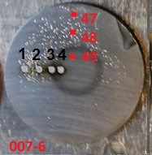
TASKS FOR 2020 UT
Investigate erosion/deposition/fuel retention by (CF-)LIBS& NRA
LIBS
In-situ LIBS measurements after D₂ or D₂-N₂ plasma exposure in DIFFER (Magnum-PSI) using NRA for calibration of D content and outgassing ➔ To be performed December 7-11 2020
Some analysis results
LIBS D/W intensity ratio in W and W-Ta(5%) coatings correlates with NRA
Ta % determined by LIBS is comparable with GDOES
D outgassing in period of 0.5 h to 48 h after exposure in Magnum-PSI was negligibe according to in-situ LIBS&NRA.
CF-LIBS not possible due to the limited spectral range
Ex-situ CF-LIBS measurements in Tartu with similar coatings and comparison with NRA
CF-LIBS overestimates D concentration in W and W-Ta(5%) coatings by an order of magnitude (depends on gas, pressure, delay time, LIBS configuration etc.)
In 2020: dark ring will be investigated in detail in DIFFER
New RBS/NRA can be performed while Magnum mag. is at 1 T
NRA
8 μm W-Ta(5%)
D₂ plasma in Magnum-PSI
Dark ring

Slide 16
TASKS FOR 2020 UT
Perform LIBS on ITER-like coatings: abla. rate&plasma plume dynamics
Ablation rate of coatings manufactured with different methods and different composition varies considerably (100 to 500 nm/shot)
CF-LIBS overestimates D concentration in ITER coated samples
longer delay time increases overestimation (plasma density decreases and deviation from LTE increases)
higher pressure, results in higher n_{e} (closer to LTE) but D concentration is still overestimated
D concentration by CF-LIBS depends on position in plume
CF-LIBS conditions were in his case only partly fulfilled
D/W measurements from LIBS deviate from that found by GDOES ➔ to be investigated further
Conclusion: more in-depth studies with W samples required to find conditions where CF-LIBS applicable
Plasma plume dynamics experiments with Mo samples finished, analysis in progress
Joint publication with UL: atm. pressure LIBS in Ar and N₂ mixtures
For joint work LIBS and analysis on Be coatings, see next slides CU

Slide 17
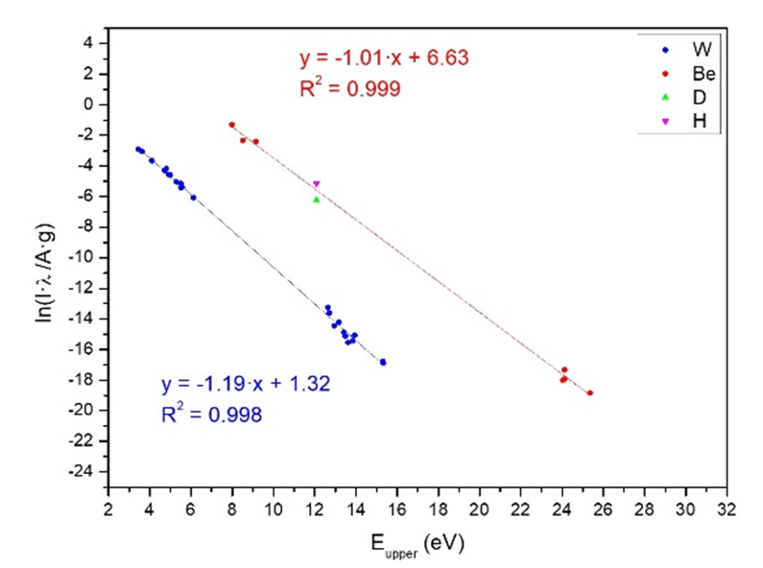
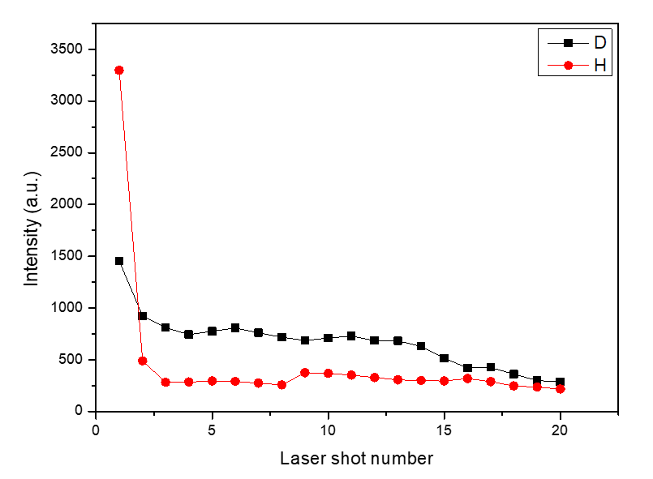
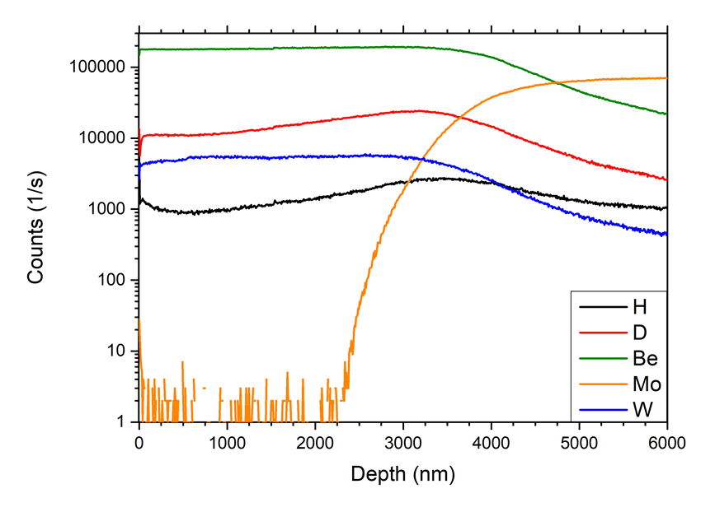
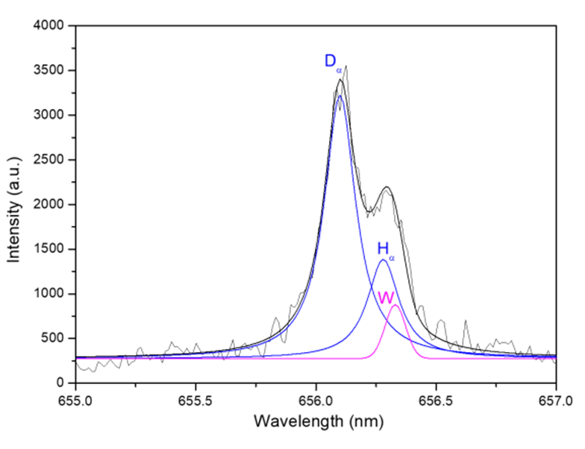
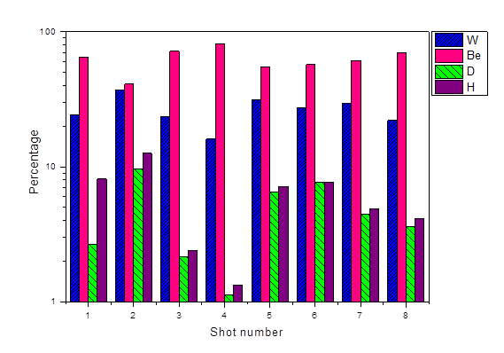
Quantitative fuel retention in BeWD/Mo samples by CF-LIBS CU
Collaboration: CU, VTT, TU, INFLPR, JSI
Ablation rate
275 ± 35 nm/shot
Saha-Boltzmann plot for W, Be, D and H for the first shot of BeWD LIBS analysis.
Dα and Hα intensities according to the laser shot number of the Be33W66D sample
SIMS depth profile of the BeWD/Mo sample for H, D, Be, Mo and W.
Percentage elemental concentration of the BeWD coating (first 8 laser shots into the surface of the sample).
CONCLUSION: Successful CF LIBS quanti. at low pressure, comparison with TDS&SIMS.
Dα, Hα and W spectral lines, spectrally resolved
by Lorentz and Gaussian fittings at 656.1 nm,
656.3 nm and 656.39 nm (4th laser shot).
 | Laser shot number |  |  |  |  |  |  |  | Average
 | 1 | 2 | 3 | 4 | 5 | 6 | 7 | 8
W % | 24.14 | 36.75 | 23.66 | 16.14 | 31.36 | 27.55 | 29.61 | 22.04 | 26.4 ± 6.3
Be % | 65.05 | 40.94 | 71.78 | 81.41 | 54.99 | 57.08 | 61.05 | 70.17 | 62.8 ± 12.3
H % | 8.13 | 12.59 | 2.41 | 1.33 | 7.14 | 7.72 | 4.86 | 4.17 | 6.0 ± 3.6
D % | 2.68 | 9.72 | 2.15 | 1.12 | 6.51 | 7.65 | 4.48 | 3.62 | 4.7 ± 2.9
P. Veis, A. Marin Roldan, V. Dwivedi , J. Karhunen, P. Paris, I. Jõgi, A. Hakola et al., Physica Scripta T171 (2020)
Notes:
Left bottom picture, hydrogen peak from water vapour.

Slide 18
CF-LIBS on Be-coated samples CU
Collaboration: CU, VTT, TU, INFLPR, DIFFER
Sample | Elements | Thickness
1 | BeOCD | 5.7 µm
2 | BeOD | 11.1 µm
3 | BeD | 5.8 µm
4 | BeOCD (100ºC) | 12 µm
(A) LIBS and (B) SIMS depth proﬁles of different elements in the sample 1 for H, D, Be, C, O and W.
(A) Multi elemental Saha-Boltzmann plot for Be I and Ar I-II, (B) Boltzmann plot for Be I, O I, C I and H/D spectral lines using the evaluated Te from the MESB plot for the sample 1 .
V. Dwivedi, A. Marín-Roldán, J. Karhunen, P. Paris, I. Jögi, C. Porosnicu, C.P. Lungu, H. van der Meiden,
A. Hakola and P. Veis, et al., NME from PSI conference (under review)

Slide 19
CF-LIBS on Be-coated samples CU
Collaboration: CU, VTT, TU, INFLPR, DIFFER
Dα and Hα spectral lines, spectrally resolved by Lorentz ﬁttings at 656.1 nm and 656.3 nm, respectively, for the 8th laser shot of the sample 1; (B) Depth profiles of D and H intensities
CONCLUSION: Comparison of at. percen. of Be, O, C, H, D obtained by LIBS, TOF-ERDA&IBA. Very good agreement for D retention.
For C only 1 spectral line for C observed by LIBS – necessitates the use Vacuum UV range for precise CF-LIBS quantification of Carbon containing samples.
Sample | Be% | O% |  |  | C% |  |  | H% | D%
 | LIBS | LIBS | TOF-ERDA | IBA | LIBS | TOF | IBA | LIBS | LIBS | TOF-ERDA | IBA
1 | 52.17 | 7.6 | 4 | 12 | 5.0 | 8 | 11 | 8.4 | 26.9 | 44 | 38
2 | 54.04 | 8.0 | 3.1 | 0.0 | --- | 0.3 | --- | 13.6 | 24.4 | 26 | 24.6
3 | 60.90 | 5.5 | 0.9 | --- | --- | 0.1 | --- | 14.6 | 19.0 | 20 | 19
4 | 55.48 | 4.0 | 2.8 | 7.5 | 1.1 | 6.1 | 5.0 | 8.2 | 27.1 | 23 | 4.5
Variation in the at.% of the elemental composition when changing 0.1 eV the Te, (B) Variation in the at.% of the elemental composition when changing the ne.
V. Dwivedi, A. Marín-Roldán, J. Karhunen, P. Paris, I. Jögi, C. Porosnicu, C.P. Lungu, H. van der Meiden,
A. Hakola and P. Veis, et al., NME from PSI conference (under review)

Slide 20
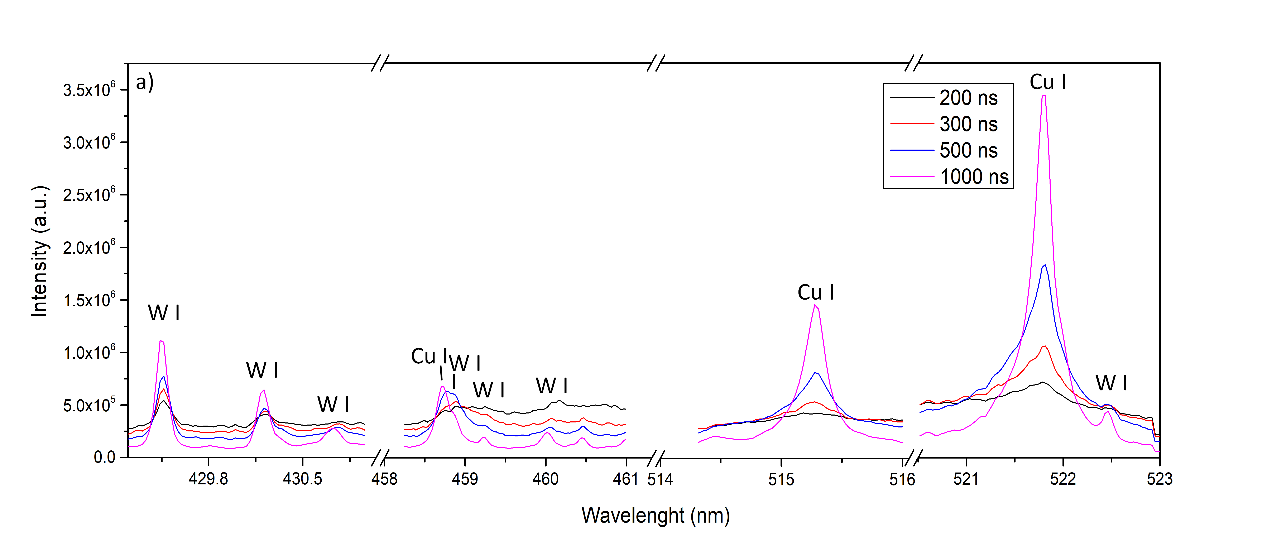
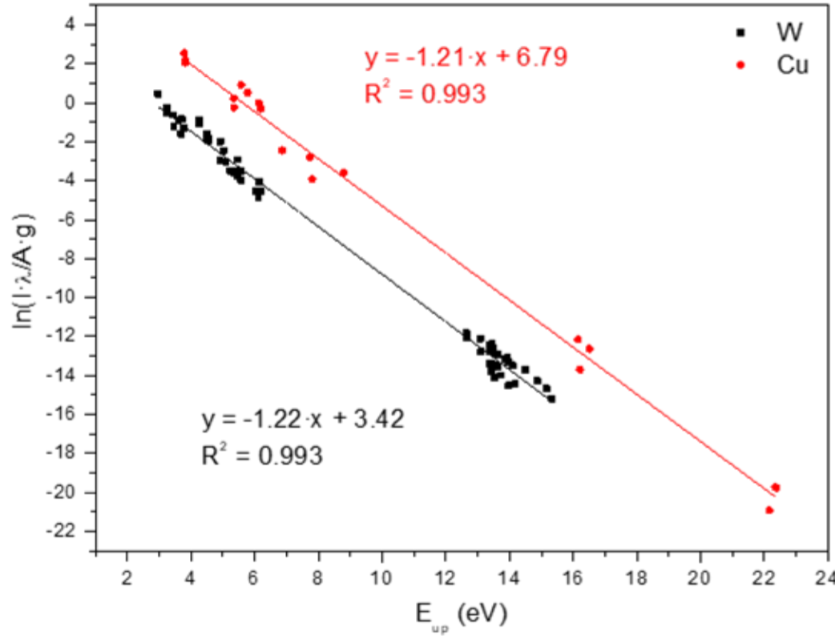
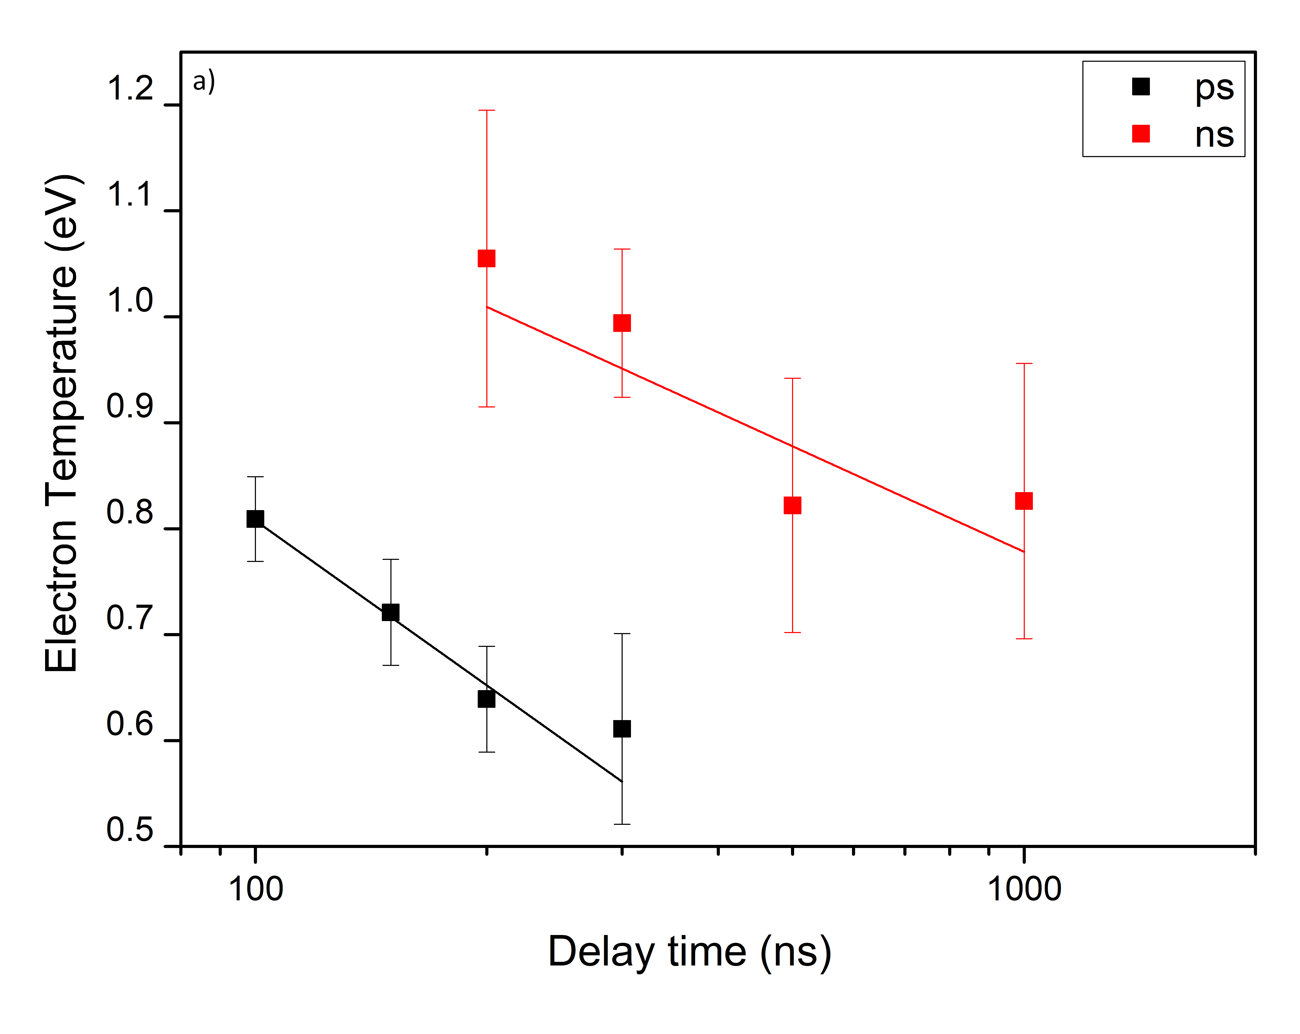
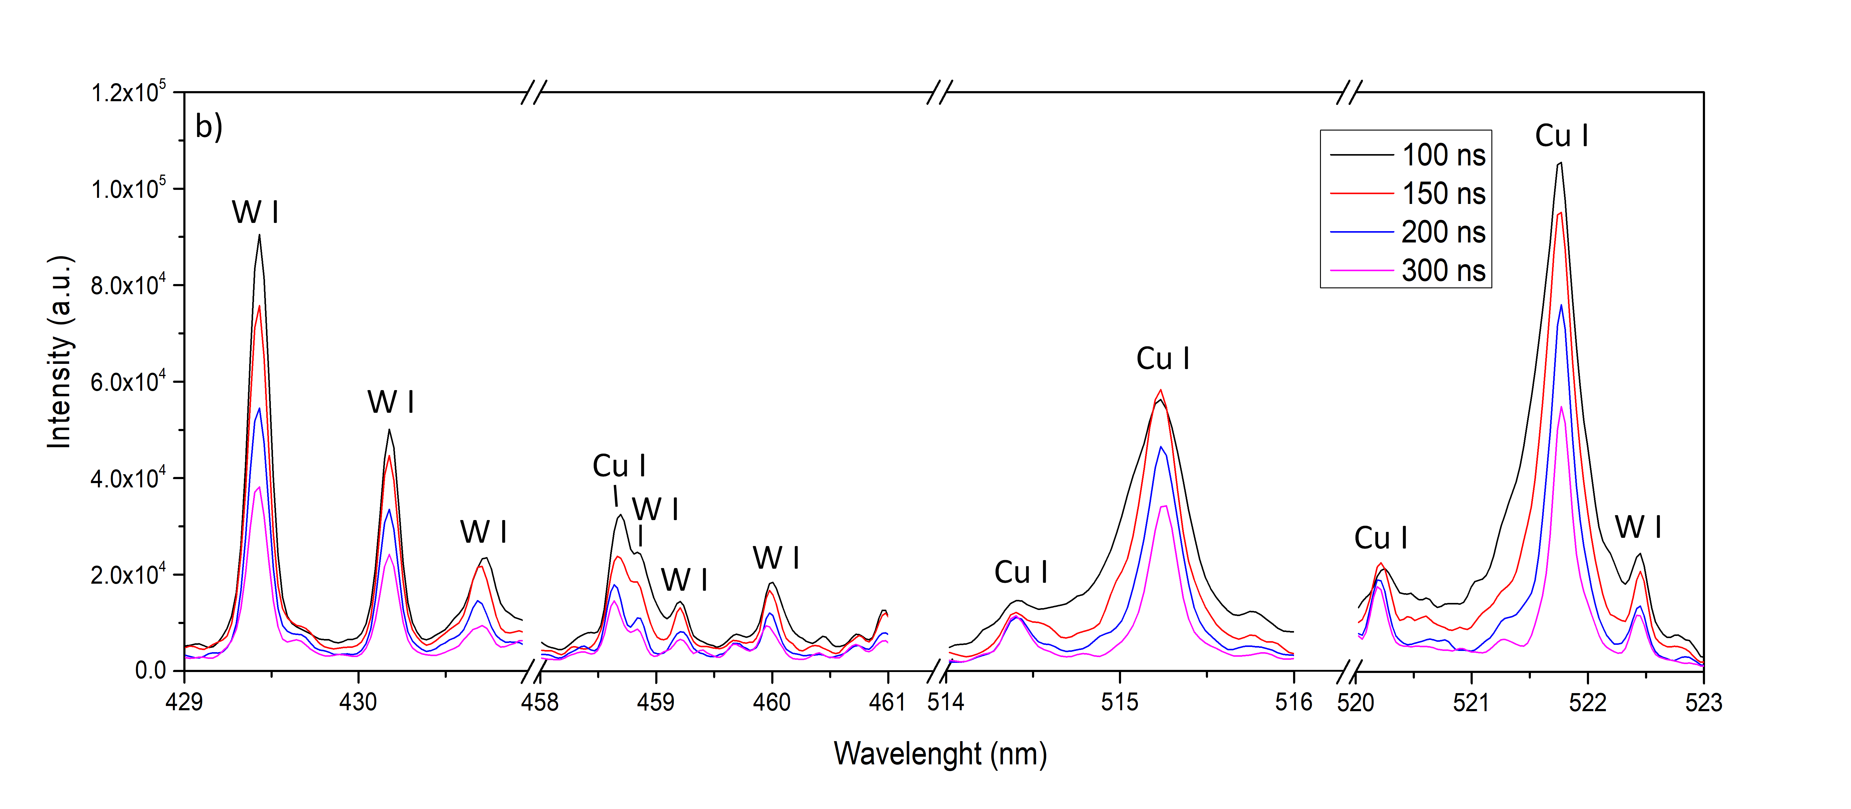
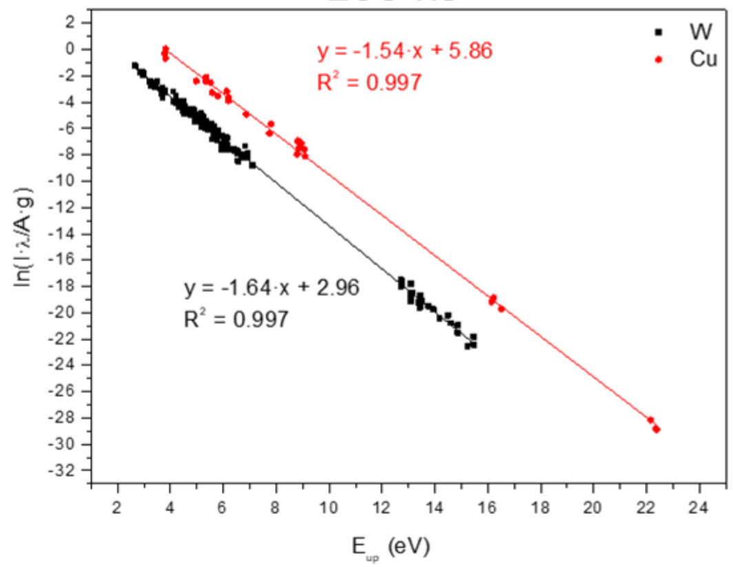
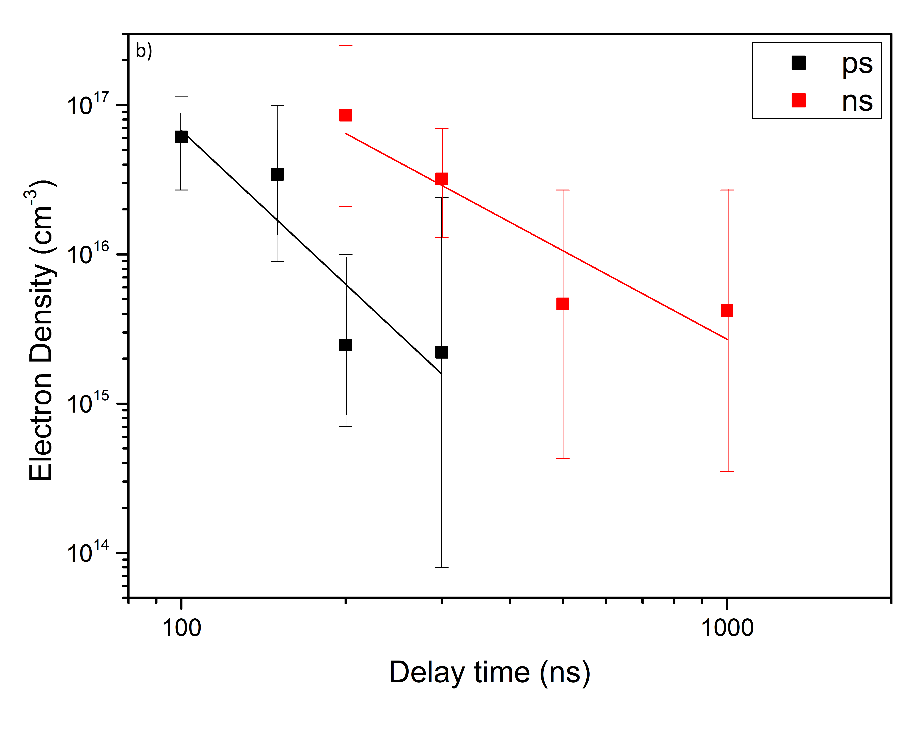
Comparison ps/ns CF-LIBS CU
5 ns
t_{d}=500 ns
30 ps
t_{d}=200 ns
CONCLUSION: In the case of ps LIBS:
No sample overheating, only ablation.
Lower typical n_{e} (less material ablated) and T_{e} lower (higher neutral/ion ration) than in ns LIBS. ➔ Narrower W I-II lines.
More precise CF evaluation of D retention.
Lower abla. Rate => better depth resolution.
A. Marín Roldán, M. Pisarcik, M. Veis, M. Držík, P. Veis, Spectrochimica Acta Part B (under review)
Notes:
-In case of ps, no overheating of the sample, so more precise evaluation of D retention.
-We used 30 ps laser beam which is less in comparison of other groups.
-In ps, Lower electron density, due to lower ablation rate, leads to less stark broadening. In ps, Lower temperature, leads to higher neutral to ionic ratio. ps is more precise and better depth profiling.

Slide 21
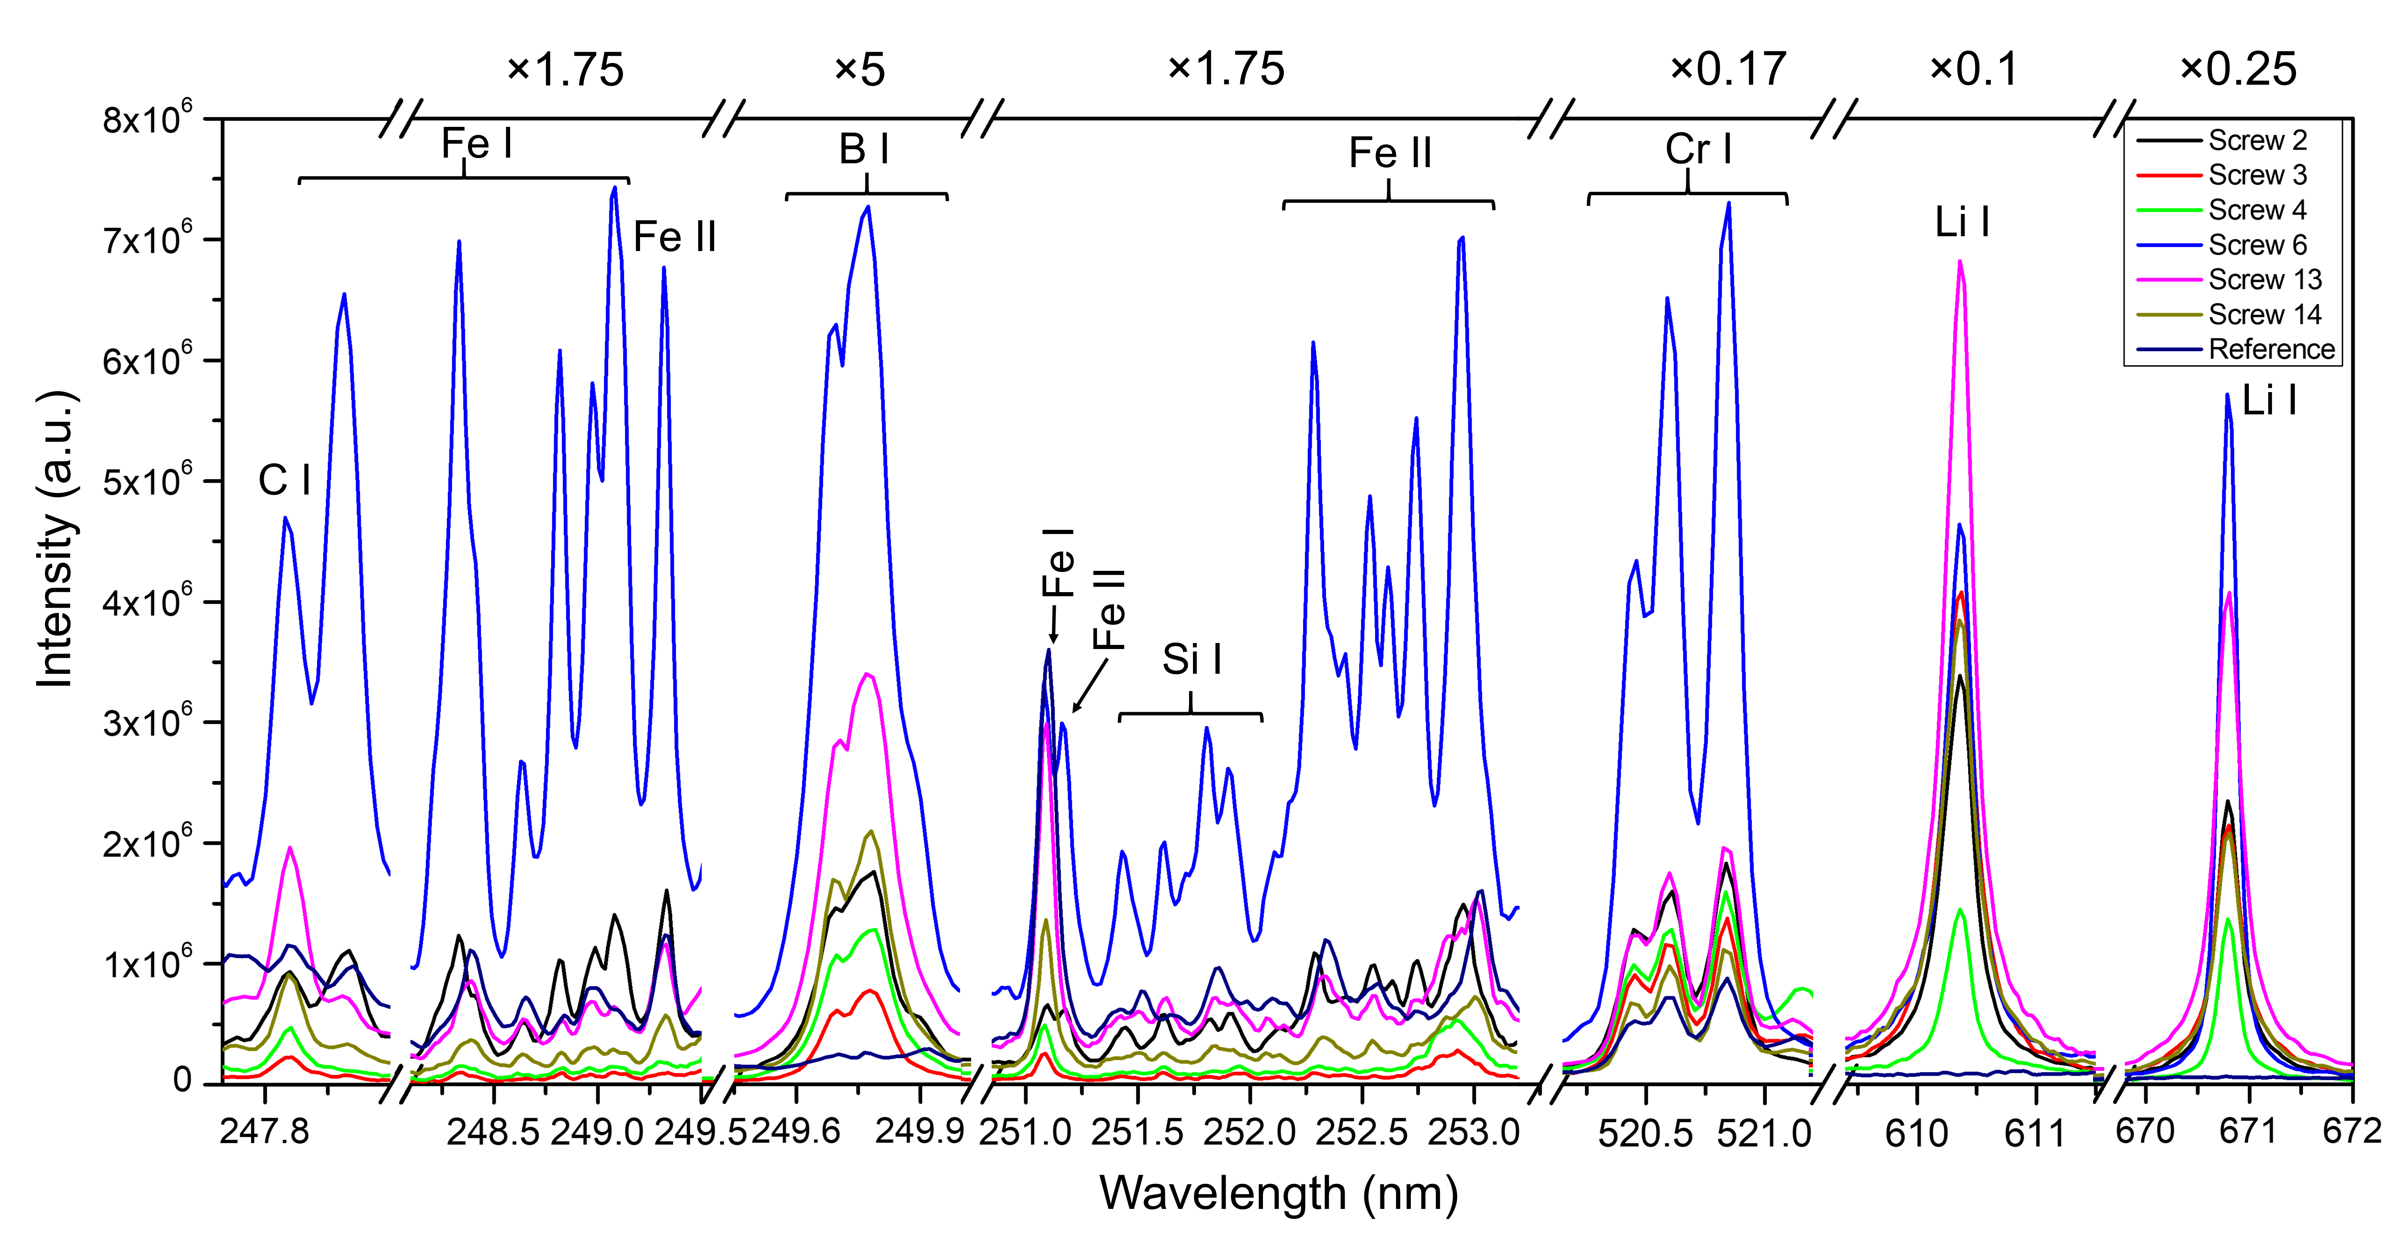
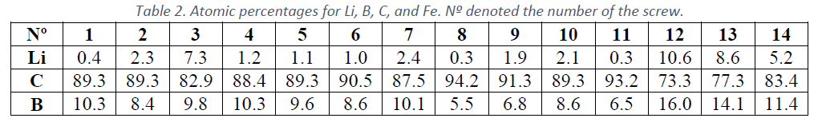
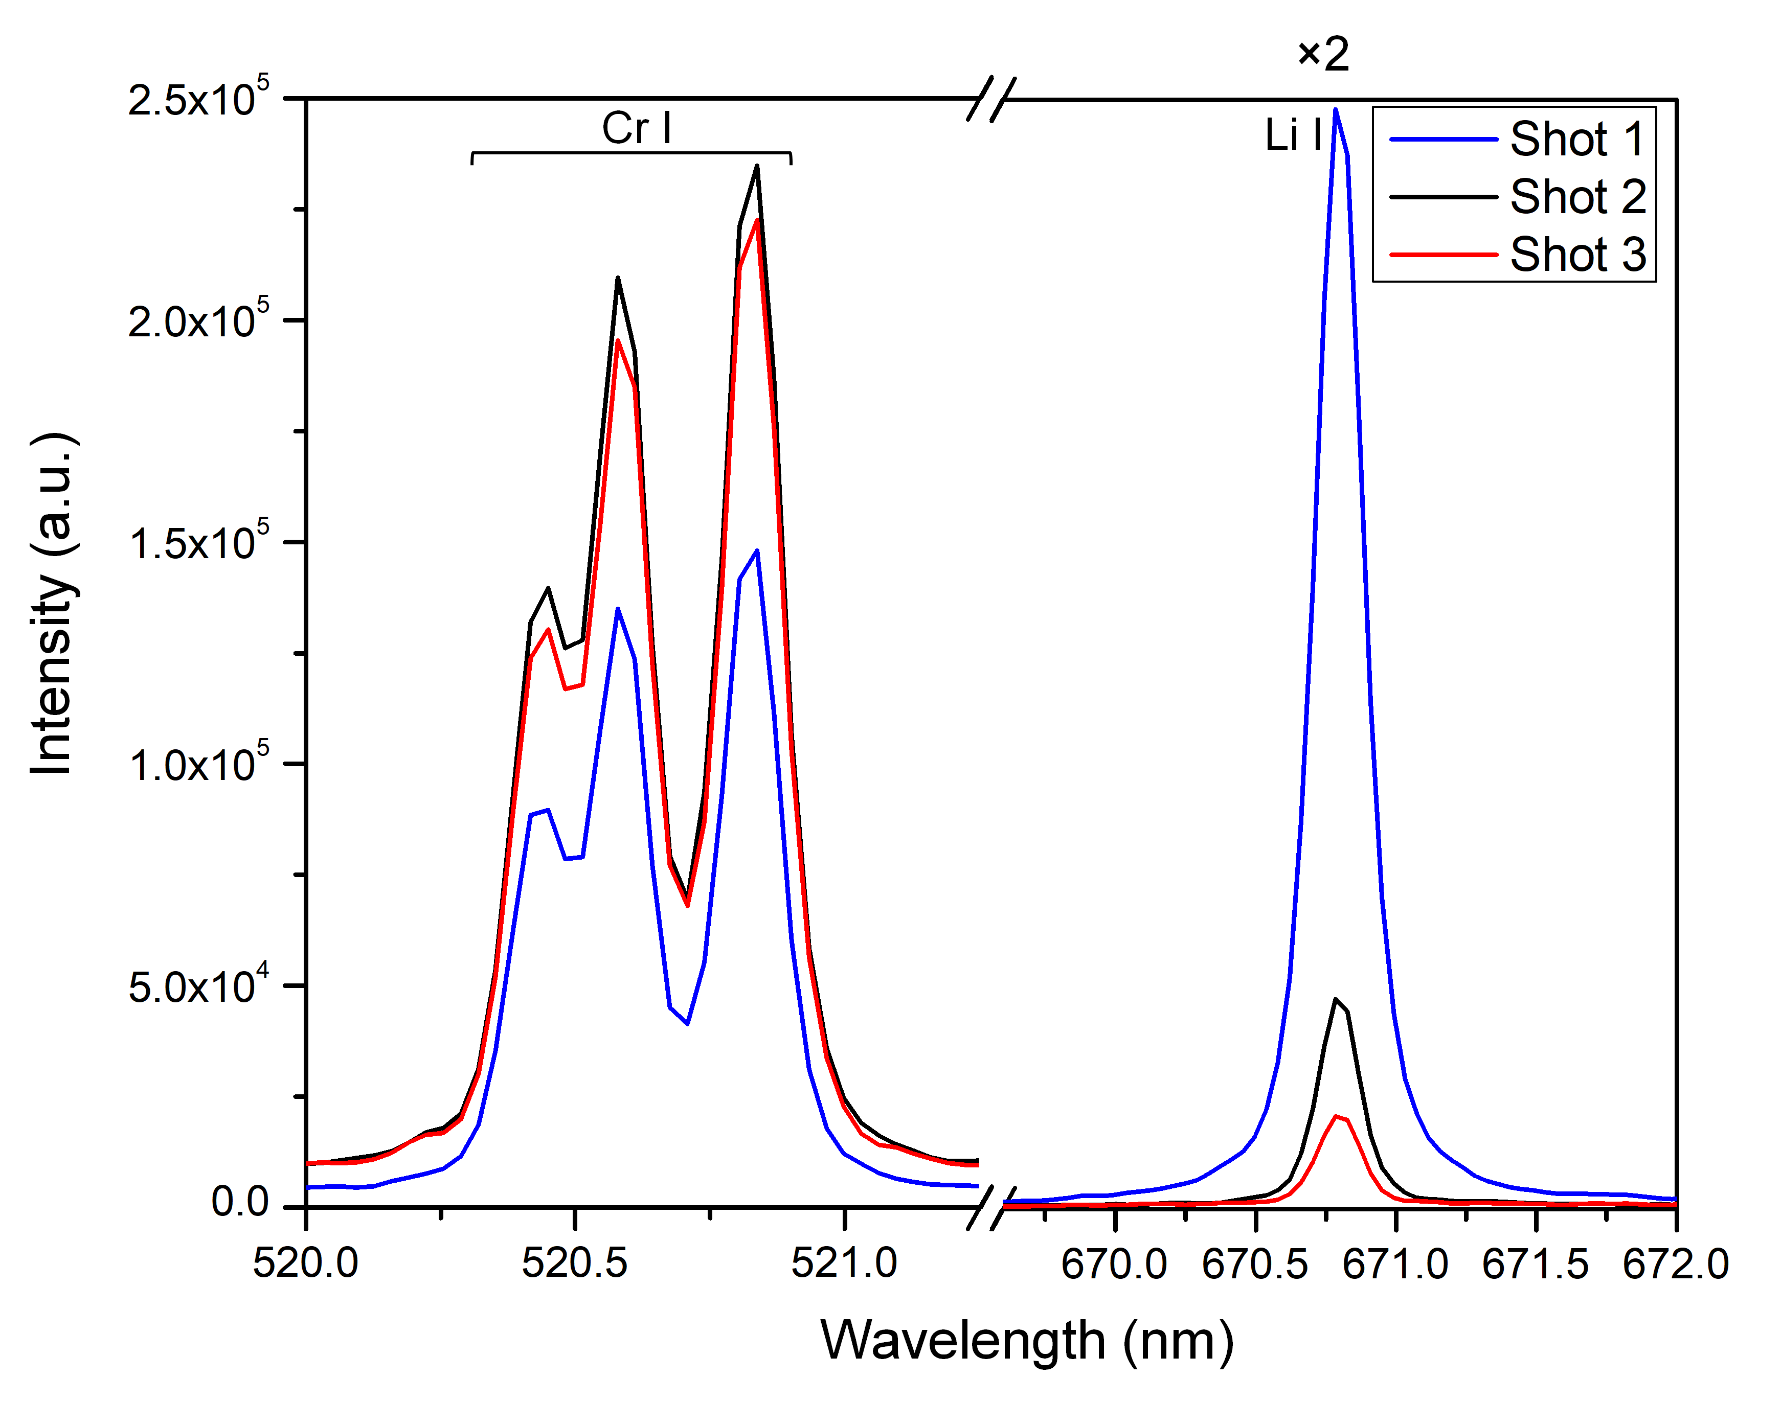
LIBS of COMPASS screws after LM experiments – Li campaign CU
Collaboration: CU, IPP
- Screws number 3, 12, 13, and 14 (closest to the LM divertor) have the highest Li at.% values, while the screws number 8 and 11 (farthest), have the lowest Li at.% values. - C is the main element of the deposited layer (83-94 C at.%). B´s source is from boronization
CONCLUSION: Successful CF LIBS mapping via screws. Similar approach could be used also for other tokamaks.
P. Veis, S. Atikkuke, A. Marin Roldan, V. Dviwedi, R. Dejarnac et al., NME 25 (2020)
Notes:
Use screws, normally for mounting purposed, for measuring local deposition measurements!

Slide 22
Key results 2020 FZJ
Investigate erosion/deposition/fuel retention by (CF)-LIBS and NRA/RBS or LID-QMS/EDX in between plasma discharges (including outgassing study) and PSI-2
The data of the experiments performed in 2018-2019 have been re-evaluated for the publication in Nuclear Fusion
The parameters of W outgassing after plasma exposure (dynamic retention) depends on the plasma flux and/or ion energy.
Due to laser power supply reparation and COVID-19 restrictions there no new measurements in PSI-2 with LIBS were done till now in 2020. The LIBS measurements are planned in November-December 2020.
Fig. 1. Evolution of the D content in W sample at R=2.9 cm measured by LIBS in PSI-2
Fig. 2. Power law coefficient of outgassing at the different locations on the W sample measured by LIBS

Slide 23
Key results 2020 FZJ
Comparison ps, ns and dp (CF)-LIBS on ITER coated/doped samples: ablation rate and plasma plume dynamics
ps-LIBS, performed on W coatings (substrate Mo) D loaded in PSI-2, showed a good sensitivity for the depth profile measurements of hydrogen & deuterium in the W deposit
The light reflected from the metal surface can be important for co-linear observation of LIBS plasma
Due to red Dopler shift the reflected light can be distinguished for hydrogen and deuterium atoms
For ps-LIBS on W coated sample, the reflected light is about of 45% of the total Hα & Dα signals.
Fig. 1. D, W and Mo depth profiles measured by ps-LIBS at 4.6 μmW-coated Mo sample exposed to the D plasma in PSI-2.
Fig. Reflection correction of the Hα line emission for ps-LIBS spectrum.
Valid for all lines?

Slide 24
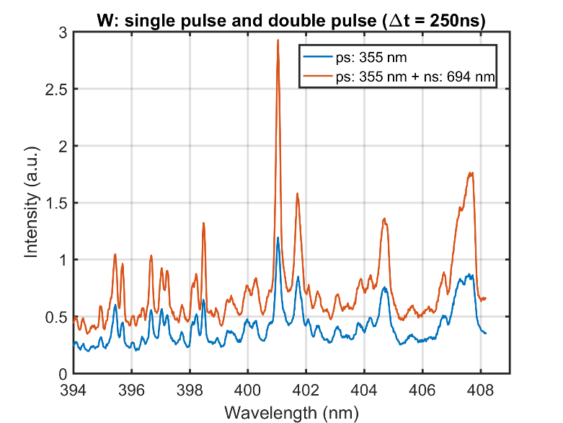
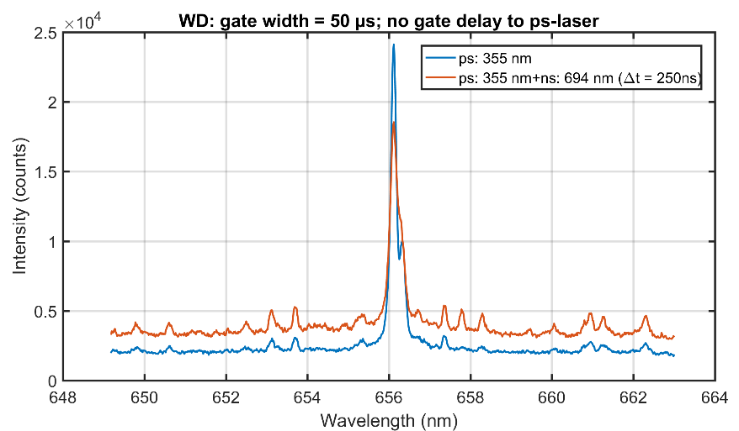
Key results 2020 FZJ
Measurement by transverse DP-LIBS were performed with ps-laser for ablation and ruby laser (1J pulse, 34 ns) for plasma re-heating on W coated samples D-doped
Increase of WI line inensities by a factor of 3-5 was observed at optimum delay time of 250 ns of re-heating ruby laser pulse
No essential change for Hα & Dα line intensities was observed
Fig. 1. W spectra of ps-LIBS and DP-LIBS with optimum delay time for ruby laser.
Fig. 1. Hα & Dα spectra of ps-LIBS and DP-LIBS with optimum delay time for ruby laser.
Analysis comparison ps, ns and DP (CF) LIBS on W-7X samples, was also done

Slide 25
Tasks performed in 2020 with comments VTT
Through the year 2020 VTT has provide support for most tasks in SP7.8:
VTT has analyzed using SIMS all the samples delivered to it before the COVID crisis and later on in 2020
Be LIBS measurements pending for lifting the present strict travel restrictions → re-evaluating the situation in early 2021
Data from 2019 Be samples re-evaluated and paper submitted for PSI 2020 → results reported by CU and UT
SIMS measurements of W-7X samples ongoing → interesting layers!
WEST samples still at CEA

Slide 26
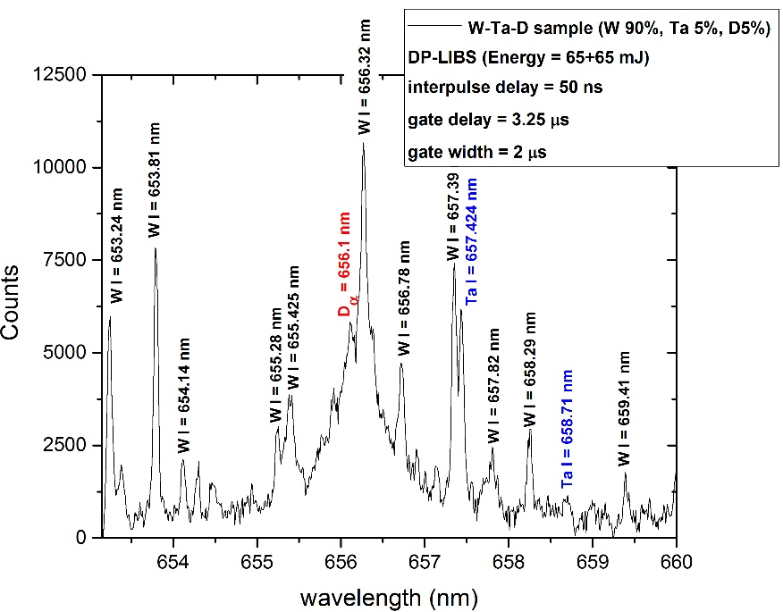
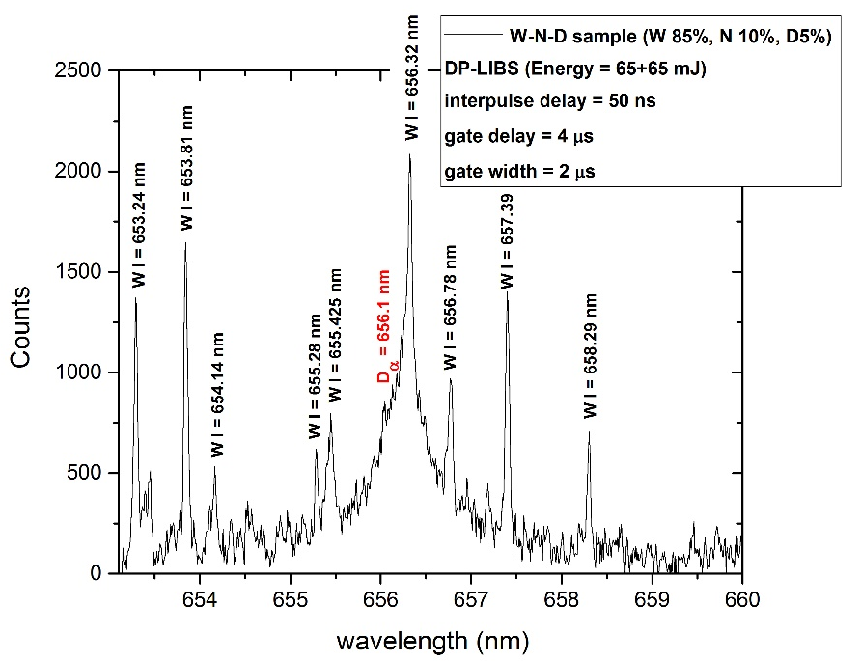
Key results in 2020 (SP5.4) ENEA
Comparison ps, ns and dp (CF)-LIBS on ITER coated/doped samples: ablation rate and plasma plume dynamics
Ns-DP-LIBS was applied to ITER-coated samples:
W/Ta/D (D 5% atomic conc., Ta 5% atomic conc., W 90%) (3 μm layer on Mo.
W/N/D (D 5% atomic, N10%, W 85%), (3 μm layer on Mo.
Measurements have been performed in air with DP-ns-LIBS. Used parameters to resolve D_{α} from H_{α} and W I at 656.32 nm
gate delay 3.5 – 4 ms
gate width 1.5 - 2 ms
interpulse between lasers: 0-50 ns
fluence (l_{exc} = 1064 nm): ≈ 66 J/cm²
➔Ablation rate: 0.5-0.7 mm/shot!

Slide 27
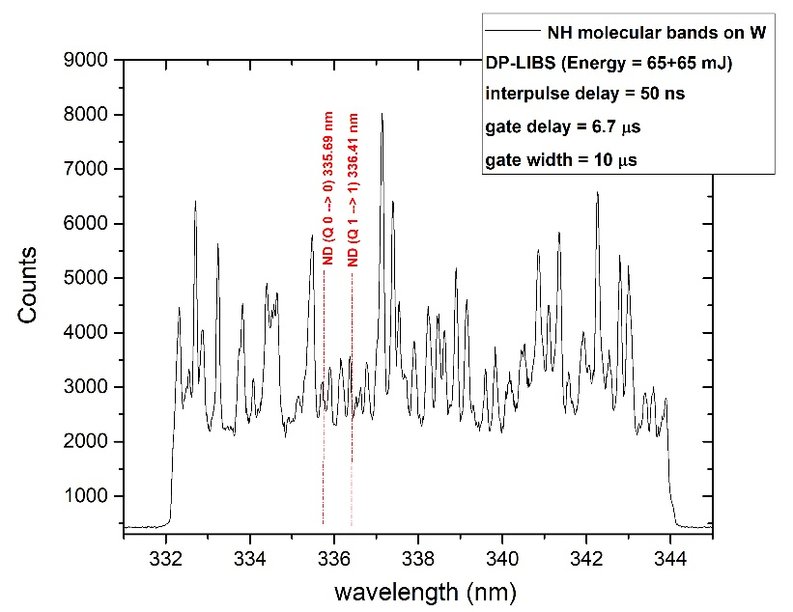
Key results in 2020 (SP5.4) ENEA
Alternative method to detect hydrogen isotopes by LIBS in air without interference between nearby lines: detection of molecular bands NH
0 → 0 and 1→ 1 vibrational bands detected
However, detection of rovib. bands in air on W-based materials appears hardly feasible because of the interference of the many W atomic and ionic lines (in air spark, discernibility better)
NH | Electronic conf. | Vibr. Band (Q x-x) | Wavelength (nm) | Isotopic shift (nm)
 | A³Π_{i}→X³Σ | 0–0 | 336.02 | −0.33
 | A³Π_{i}→X³Σ | 1–1 | 337.13 | −0.72

Slide 28
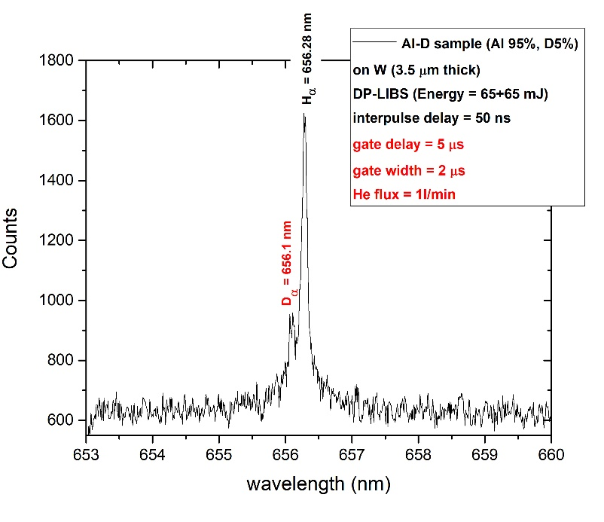
Key results in 2020 (SP5.4) ENEA
DP measurements were performed on 2017-2019 MST2 samples under He (Ar) flux (to be completed when 2020 samples available):
  Al/D (Al 95% atomic conc. D 95%) 3.5 mm thick on W
  W(Ta)/N/D samples (scheduled)
  LIBS was performed by using the gas flux system with different background gases (He, Ar) at flux 1 l/min on the sample.
Results
Clear spectral emission from D/W in H_{a} / D_{a} region (650-660 nm).
In principle the H_{α}/D_{α} lines could be better resolved under He flux; comparable resolution could be obtained under Ar flux but at longer intervals from the laser pulses

Slide 29
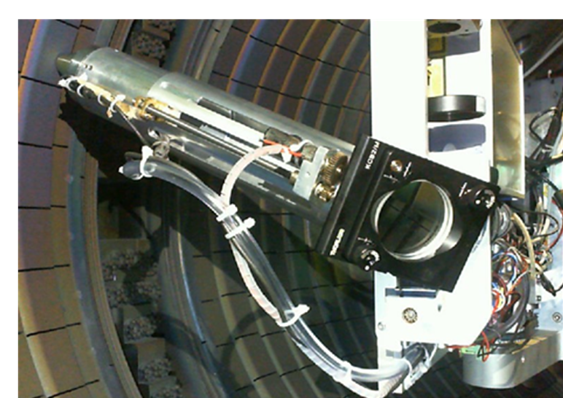
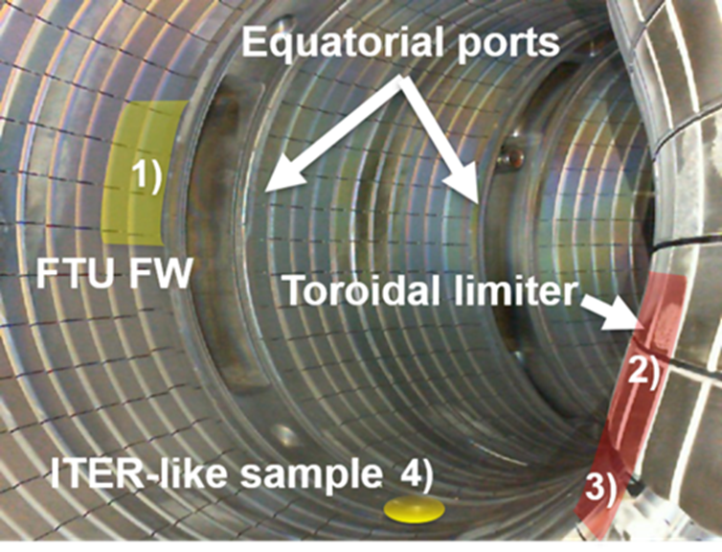
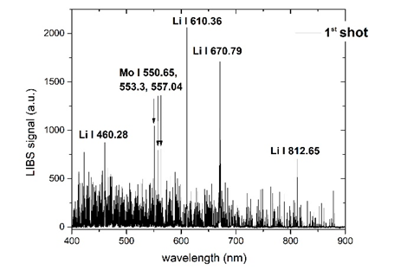
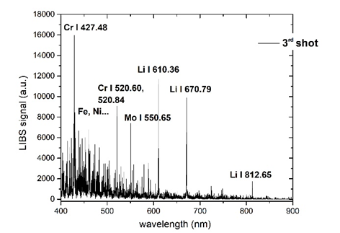
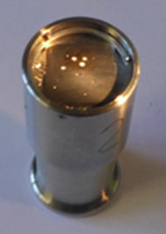
Key results in 2020 (SP7.8) ENEA
Finish analyses of the FTU work carried out by ENEA and associated labs in FTU and give recommendations for future remote handling application of LIBS in tokamaks (ENEA, IPPLM)
The LIBS system measured the FTU First wall elements after the 2019 experimental campaign at the following locations:
FTU stainless steel elements, (areas 1-3) and the TZM poloidal limiter tiles (area 2)
At a small W tile 17.5 x 17.5 mm, coated with 3.5 μm thick Al-D mixed layer (point 4).

Slide 30
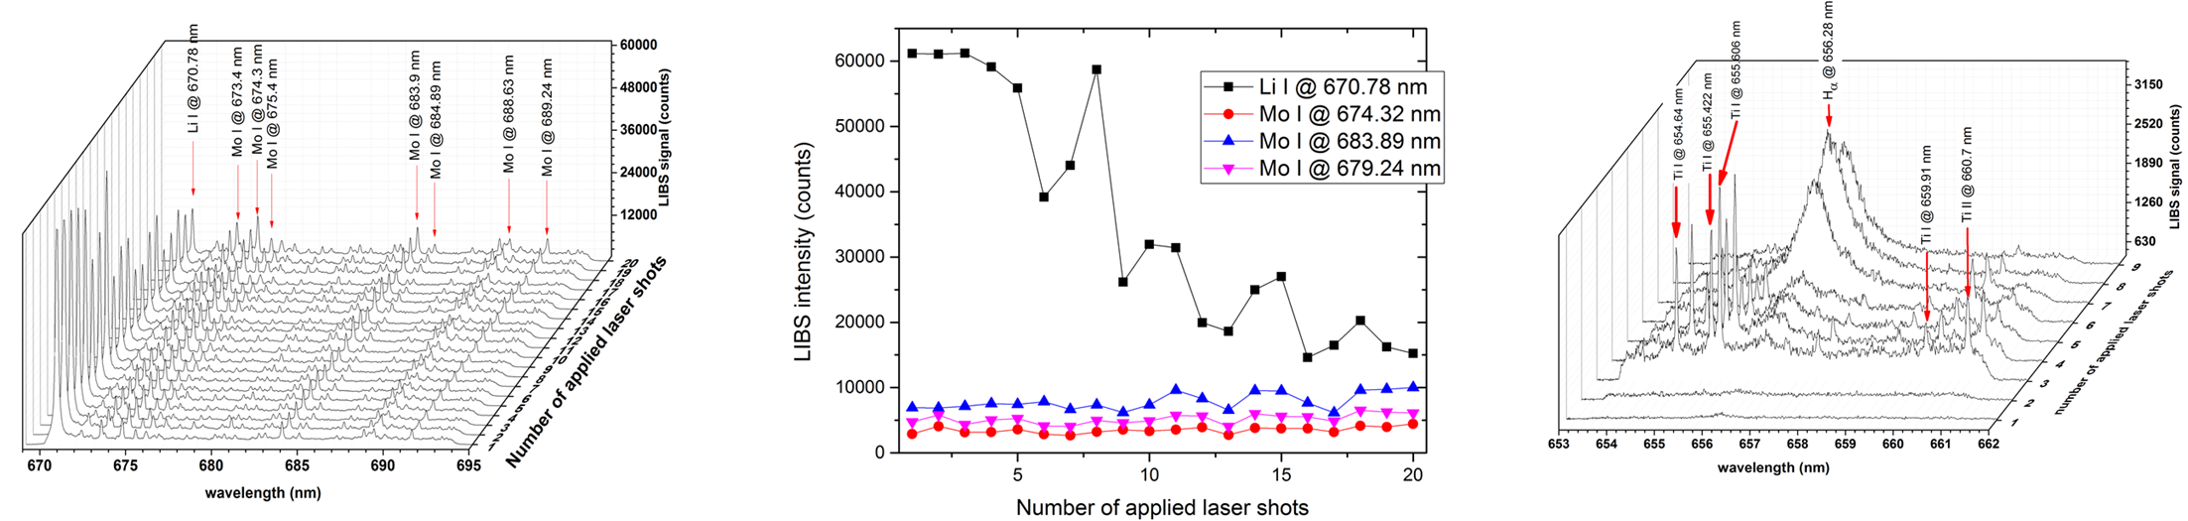
Key results in 2020 (SP7.8) ENEA
Both D and H were observed after few LIBS shots, i.e. NOT in the first 100 nm’s. (Depth profiling analysis on the right) suggesting a deeper contamination.
The results showed a strong superficial Li contamination all over the investigated section.
Therefore, a possible explanation is related to the chemical reactivity of the superficial Li layer towards H (D), producing LiH through the following reaction:
2 Li + H₂ → 2 LiH
and the subsequent reactions with water
(vapour) present in the environment:
LiH + H₂O → LiOH + H₂
LiOH + H₂O → Li⁺ + OH⁻
Report with analysis and recommendations will be finished in 2020

Slide 31
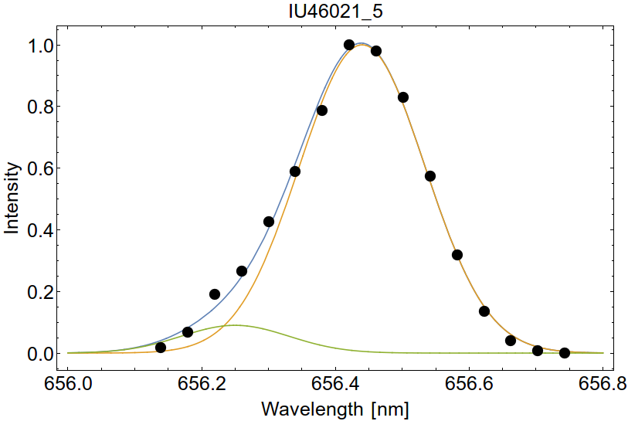
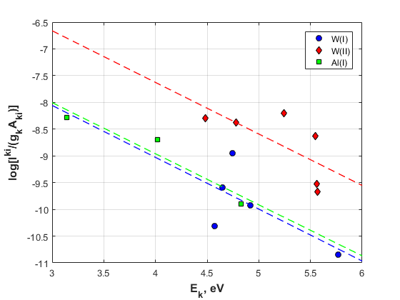
Key results in 2020 LU
ps-LIBS on W/Al/D samples:
Layer thickness 3 µm
D nominal concentration: 5 at.%
150 ps-LIBS (λ = 1064 nm) has been performed, laser fluence 8.8 J/cm^{2,}
gate delay was 200 ns.
Estimated average ablation rate was 120 nm.
Estim. average D concentration 8 at.%
Scatter of points: PLTE not achieved?
LU collaborates also with UT
Dα
Hα
A. Coordinator, B. Scientist | WP PFC & JET2 Annual Meeting | VC | 9-10 Nov 2020 | Page 31
Notes:
31

Slide 32
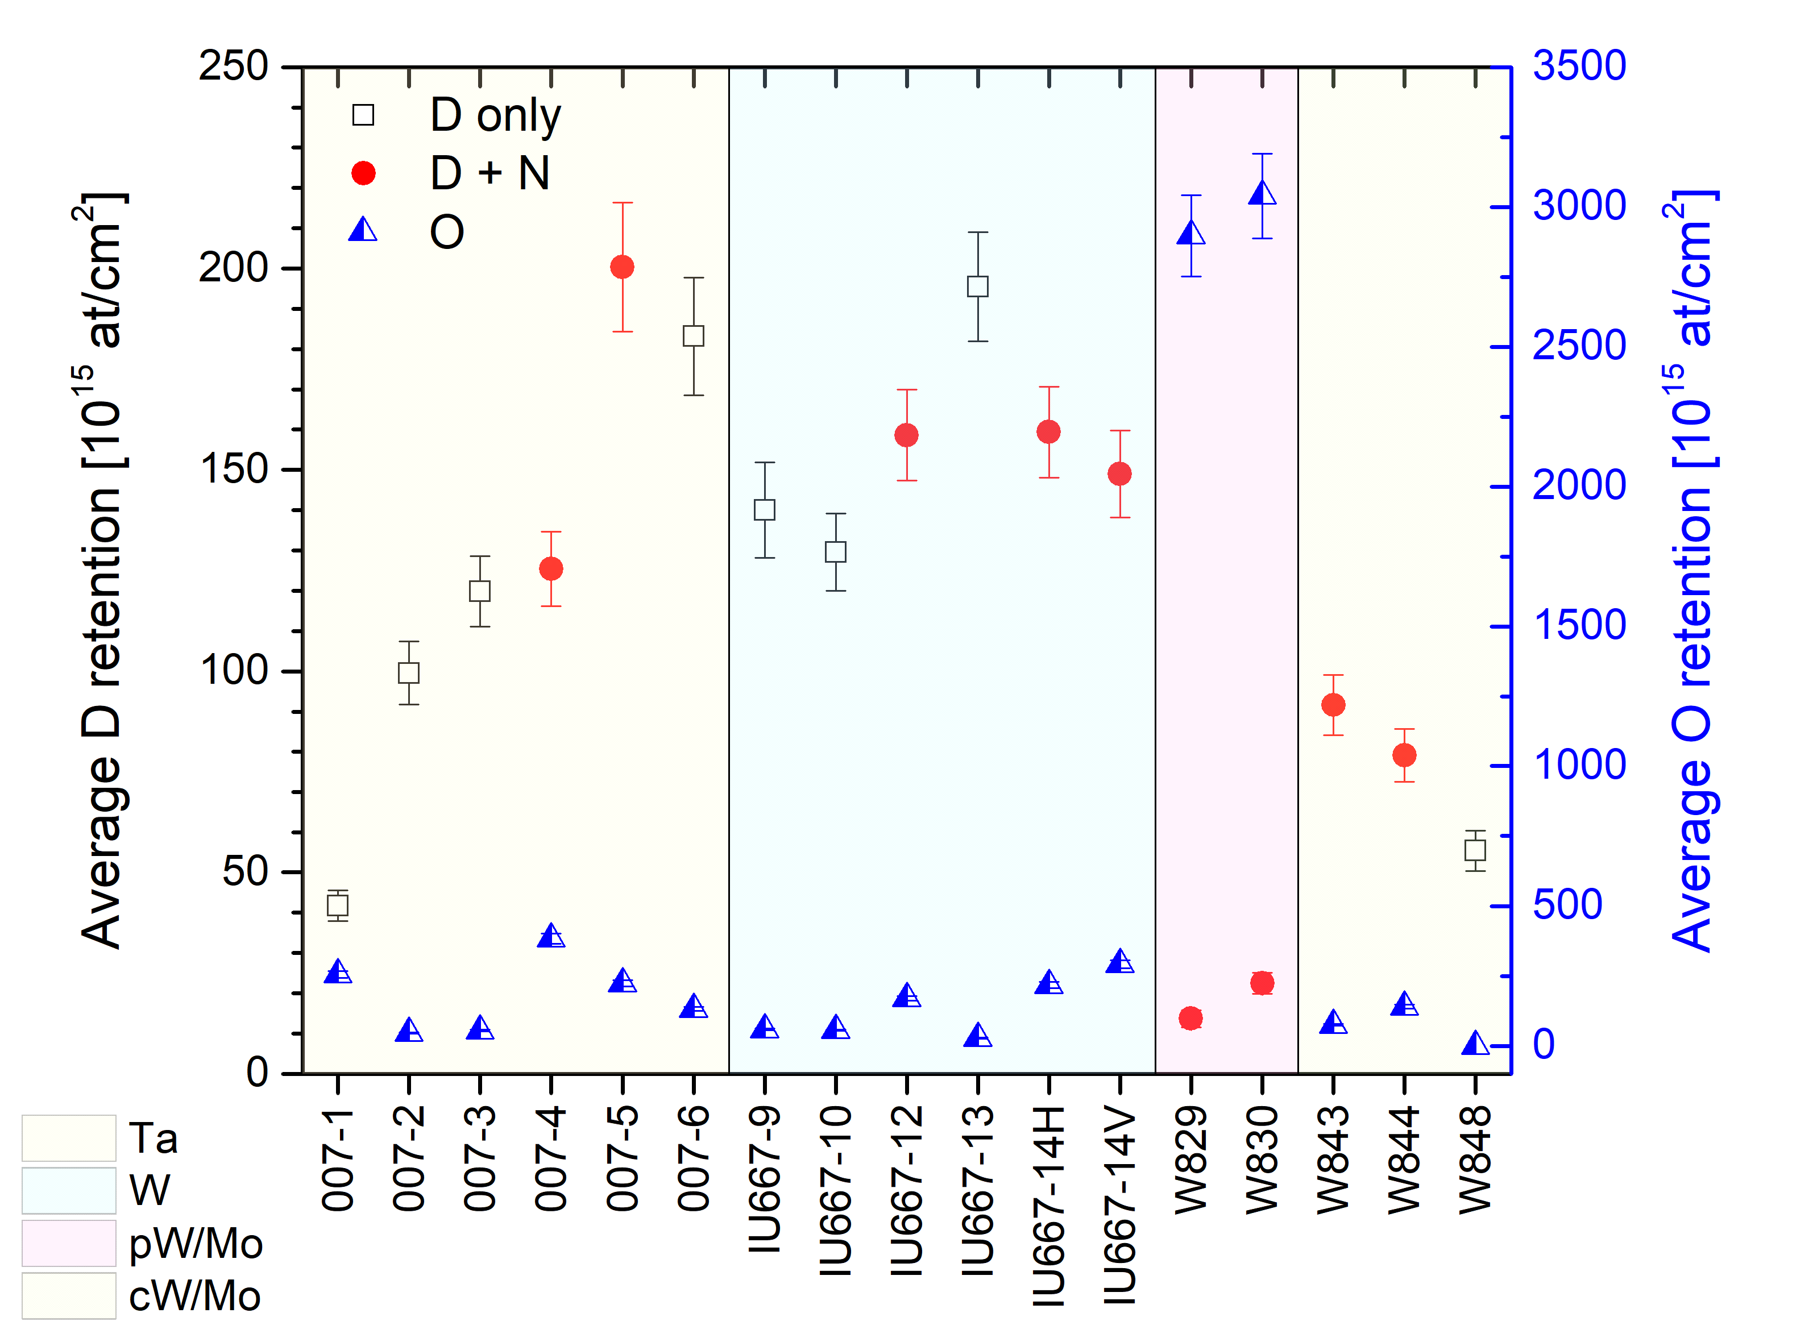
Influence of oxygen: NRA DIFFER
From Beata Tyburska-Pueschel (IBA)
W-Ta
W
P-W
C-W
Average deuterium (squares – exposed only to D plasma, circles – exposed to N-seeded D plasma) and oxygen (triangles) retention in all samples. Average values were taken based on all data point measured per sample.
➔ Low O ➔ high retention, but not whole story: Tsurface and Nmix also important

Slide 33
Preliminary conclusions SP7.8
In general CF-LIBS 25% accuracy can be obtained for D-content measurements at D levels of <5 at.%
For different coatings the ablation rate differs significantly
Ps-LIBS means: less heating of (surrounding) surface, lower ne and lower Te (lowers ionization), both beneficial for line identification
For colinear LIBS systems it is necessary to incorporate surface reflection effects of the emitted light from the atoms/molecules
Higher flux results in slow down of outgassing (implantation energy dependant)
Oxygen plays a big role role in D retention: high O, means low D retention.
Because the multiple tungsten lines interfere, detection of rovib. States of NH/ND remains difficult.
Most tasks will be finished this year
Concerning RH LIBS application in ITER, we still need to know the (infrastructural) boundary conditions for application

Slide 34
SP7.10: Role of energetic neutrals in Ion Cyclotron Wall Conditioning
LPP-ERM/KMS - IEK4 FZJ - VR KTH - NSC KIPT

Slide 35
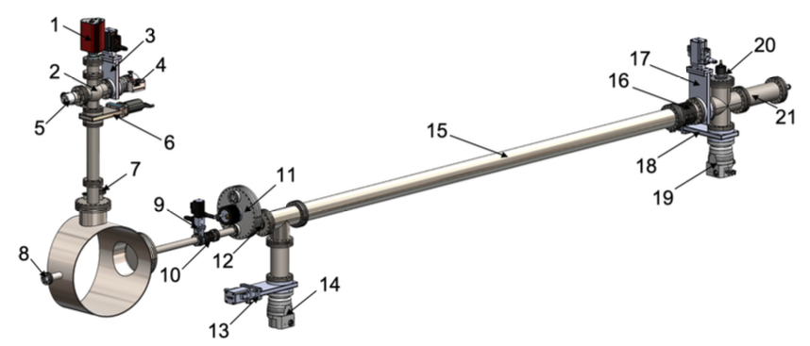
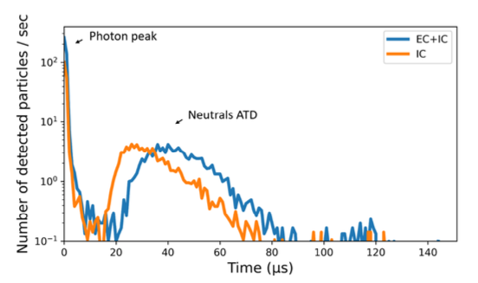
Key results in 2020
Scope
Assessing role of neutrals in surface modification (wall conditioning) by ICWC plasma
Characterizing particle fluxes to PFCs in ICWC
Resolving the energy distribution of the neutrals in the energy range of 10 to 1000 eV
Results overview: experiments
Further integration of the ToF NPA in TOMAS
New detector + laser trigger signal + 2 new pre-pumps + 2 new turbo pumps
Well resolved neutral particle distributions are found in IC heated plasmas in TOMAS
  Most of the neutrals are above 33eV
Instead of characterization spectra: modelling of detection efficiency, i.e. how much neutrals are detected for each neutral arriving at the PFC ?
TOMAS Time-of-Flight NPA
Arrival-time distribution
> 33eV
< 33eV

Slide 36
Conferences & publications SP7 2020
SP 7.8 FZJ
D.Zhao et al., Investigation of laser ablation features of molybdenum bulk for picosecond laser-based techniques in fusion devices, Fusion Engineering and Design 151 (2020) 111379
R.Yi et al., 3-Dimensional analysis of layer structured samples with high depth resolution using picosecond laser-induced breakdown spectroscopy, Applied Surface Science 532 (2020) 147185
S. Mittelmann et al., Laser‑induced ablation of tantalum in a wide range of pulse durations, Applied Physics A 126 (2020) 672
D.Zhao et al., Ex situ analysis of W7-X divertor plasma-facing components by picosecond laser diagnostics, Physica Scripta T171 (2020) 014018
D.Zhao et al., Quantification of erosion pattern using Picosecond-LIBS on a vertical divertor target element exposed in W7-X, Nuclear Fusion, accepted for publication
J. Oelmann et al., Hydrogen content in divertor baffle tiles in Wendelstein 7-X, Nuclear Materials and Energy, submitted
SP 7.8 UT,VTT, DIIFER
I. Jõgi et al. LIBS study of ITER relevant tungsten-oxygen coatings exposed to deuterium plasma in Magnum-PSI, Journal of Nuclear Materials, accepted for publication
SP7.8 CU
A. Marín Roldán, M. Pisarcik, M. Veis, M. Držík, P. Veis, CF analysis of a tungsten-based target for diagnostics of relevant fusion materials comparing ps and ns LIBS, submitted to Spectrochimica Acta Part B: Atomic Spectroscopy.
A. Marín Roldán et al., Laser ablation investigations of metals suitable for plasma-facing components with pico and nanosecond laser pulses (Contribution to SOFT 2020)
SP7.8 CU, VTT, UT, INFLPR, JSI, DIFFER
P Veis, A Marín-Roldán, V Dwivedi, J Karhunen, P Paris, I Jõgi, C Porosnicu, C P Lungu, V Nemanic, A Hakola,Quantification of H/D content in Be/W mixtures coatings by CF-LIBS, Phys. Scr. T171 (2020) 014073.
V. Dwivedi, A. Marín-Roldán, J. Karhunen, P. Paris, I. Jögi, C. Porosnicu, C.P. Lungu, H. van der Meiden, A. Hakola and P. Veis, CF-LIBS quantification and depth profile analysis of Be coating mixed layers, submitted to Nuclear Materials and Energy
SP7.8 CU, DIFFER
J. Miškovičová, M. Anguš, H. van der Meiden, P. Veis, Selection of molybdenum lines by quantitative analysis of molybdenum- zirconium-titanium alloy by CF-LIBS for future fusion applications, Fusion Engineering and Design 153, (9pp) (2020) 111488.
P.Veis et al., CF-LIBS analysis of screws from the COMPASS tokamak vacuum chamber after liquid metal experiments – LiSn campaign (Contribution to SOFT 2020)

Slide 37
Conferences & publications 2020
SP7.8 CU, IPP
P. Veis, S. Atikkuke, R. Dejarnac et al., LIBS analysis of samples from the COMPASS vacuum chamber after liquid metal experiments – Li campaign, Nuclear Materials and Energy 25 (2020) 100809.
SP7.8 CU, India (outside of EUROfusion due to Review character of the paper)
G.S. Maurya, A. Marín-Roldán, P. Veis, A.K. Pathak, P. Sen, A review of the LIBS analysis for the plasma-facing components diagnostics, Journal of Nuclear Materials 541 (2020) 152417.
SP7.8 ENEA, IPPLM
S. Almaviva, L. Caneve, F. Colao, V. Lazic, G. Maddaluno, P. Mosetti, A. Palucci, A. Reale, P. Gasior, W. Gromelski, M. Kubkowska, LIBS measurements inside the FTU vessel mock-up by using a robotic arm, Fusion Eng. Des. 157 (2020)
LIBS measurements inside the FTU vacuum vessel by using a robotic arm
S. Almaviva, L. Caneve, F. Colao, V. Lazic, G. Maddaluno, P. Mosetti, A. Palucci, A. Reale, P. Gasior, W. Gromelski, M. Kubkowska, LIBS measurements inside the FTU vacuum vessel by using a robotic arm, submitted to the Fus. Eng. Des. special issue for the 31st Symposium on Fusion Technology (SOFT2020)
SP 7.4 IAP
C. Costin, Secondary electron emission under magnetic constraint: from Monte Carlo simulations to analytical solution, submitted
SP 7.4 DIFFER
H. J. van der Meiden et al, Incoherent and collective Thomson scattering for the determination of electron and ion properties in low-temperature plasma, JOFE, 10.1007/s10894-020-00262-5 (2020)
SP 7.10 LPP-ERM/KMS - IEK4 FZJ - VR KTH - NSC KIPT
Goriaev, The upgraded TOMAS device: a toroidal plasma facility for wall conditioning, plasma production and plasma – surface interaction studies, RSI 2020, in Review
S. Moon, Characterization of neutral particle fluxes from ICWC and ECWC plasmas in the TOMAS facility, draft

Slide 38
THE END

Slide 39
Backup slides

Slide 40
Te/ne measurements Magnum-PSI: DIFFER
Near surface TS(Te/ne) measurements, as close as 1.9 mm, with 10⁴ stray light suppression of to get inside about ion acceleration in presheath (B=1.2 T)
Close to the wall
The ne drop indicates plasma acceleration
The Te drop observed: electron pressure decay?
Loss of fast electron tail? To be investigated
Jonathan van den Berg et al, JINST (2019), https://iopscience.iop.org/article/10.1088/1748-0221/14/10/C10041

Slide 41
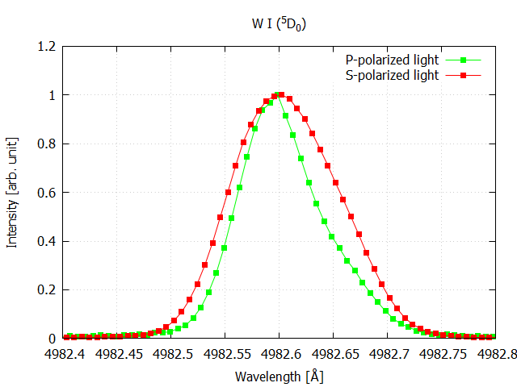
Detection of surface reflection properties of emitted light from ions FZJ
Polarisation and recrystallization
First experiments took place
Polarisation effects are detected in the line shape of sputtered W
Further analyses and experiments needed
WI Spectrum observed at Brewster angle

Slide 42
LIBS GOAL 3 FZJ
Comparison ps, ns and DP (CF) LIBS on samples from different devices, including tokamaks or W-7X
Measurement of the erosion pattern by ps-LIBS on a vertical divertor target of W7-X were performed by ps-LIBS
Depth-profiling of the Mo marker interlayer was used
A simulation model was developed to correct the LIBS data at the erosion zone with the value of 35% due to an imperfect spatial profile of the laser spot
A massive erosion zone extending by about 100 mm in the poloidal direction, where the entire C marker layer deposited above the Mo marker layer was eroded by W7-X plasma in OP1.2A, can be identified
At the peak erosion position, not only 7.6⋅10¹⁹ C atoms/cm² but also 2⋅10¹⁸ Mo atoms/cm² were eroded due to plasma impact
Hα
MoΙ
MoΙ
MoΙ
Fig. 1. (a) Schematic of the TM2v2 target module from IW to PG;(b) heat load at the analysed tile; (d,e,f) depth profile poloidal distributions of H and Mo measured by ps-LIBS for 3 toroidal positions

Slide 43
Develop (TA)LIF for measurement of lifetime/density of impurity ions (W, Cr etc.): verify atomic data FZJ
First test done, using a tuneable diode laser system:
- No detectable signal due to line broadening of the impurities
PLAN: Installation of a Herriot Cell in progress (enhancing interaction path length for increasing signal

Slide 44
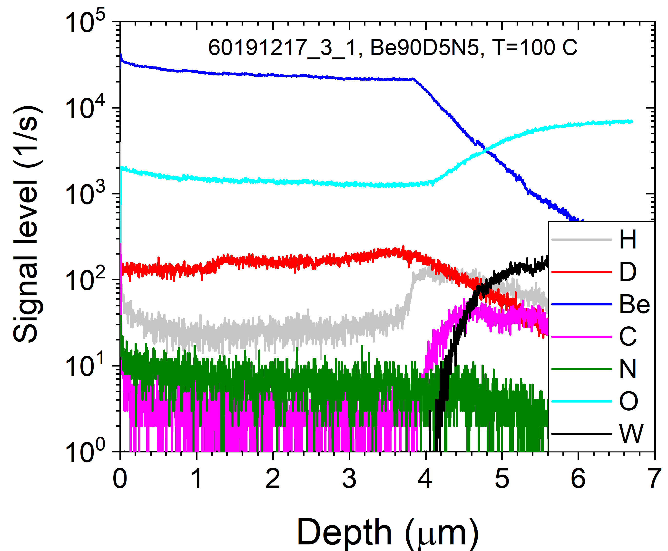
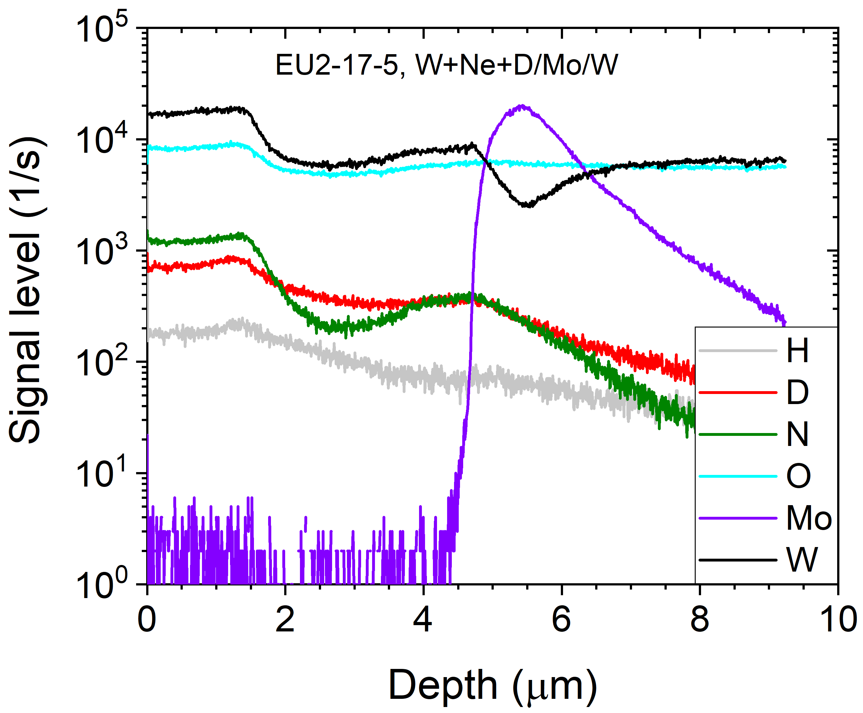
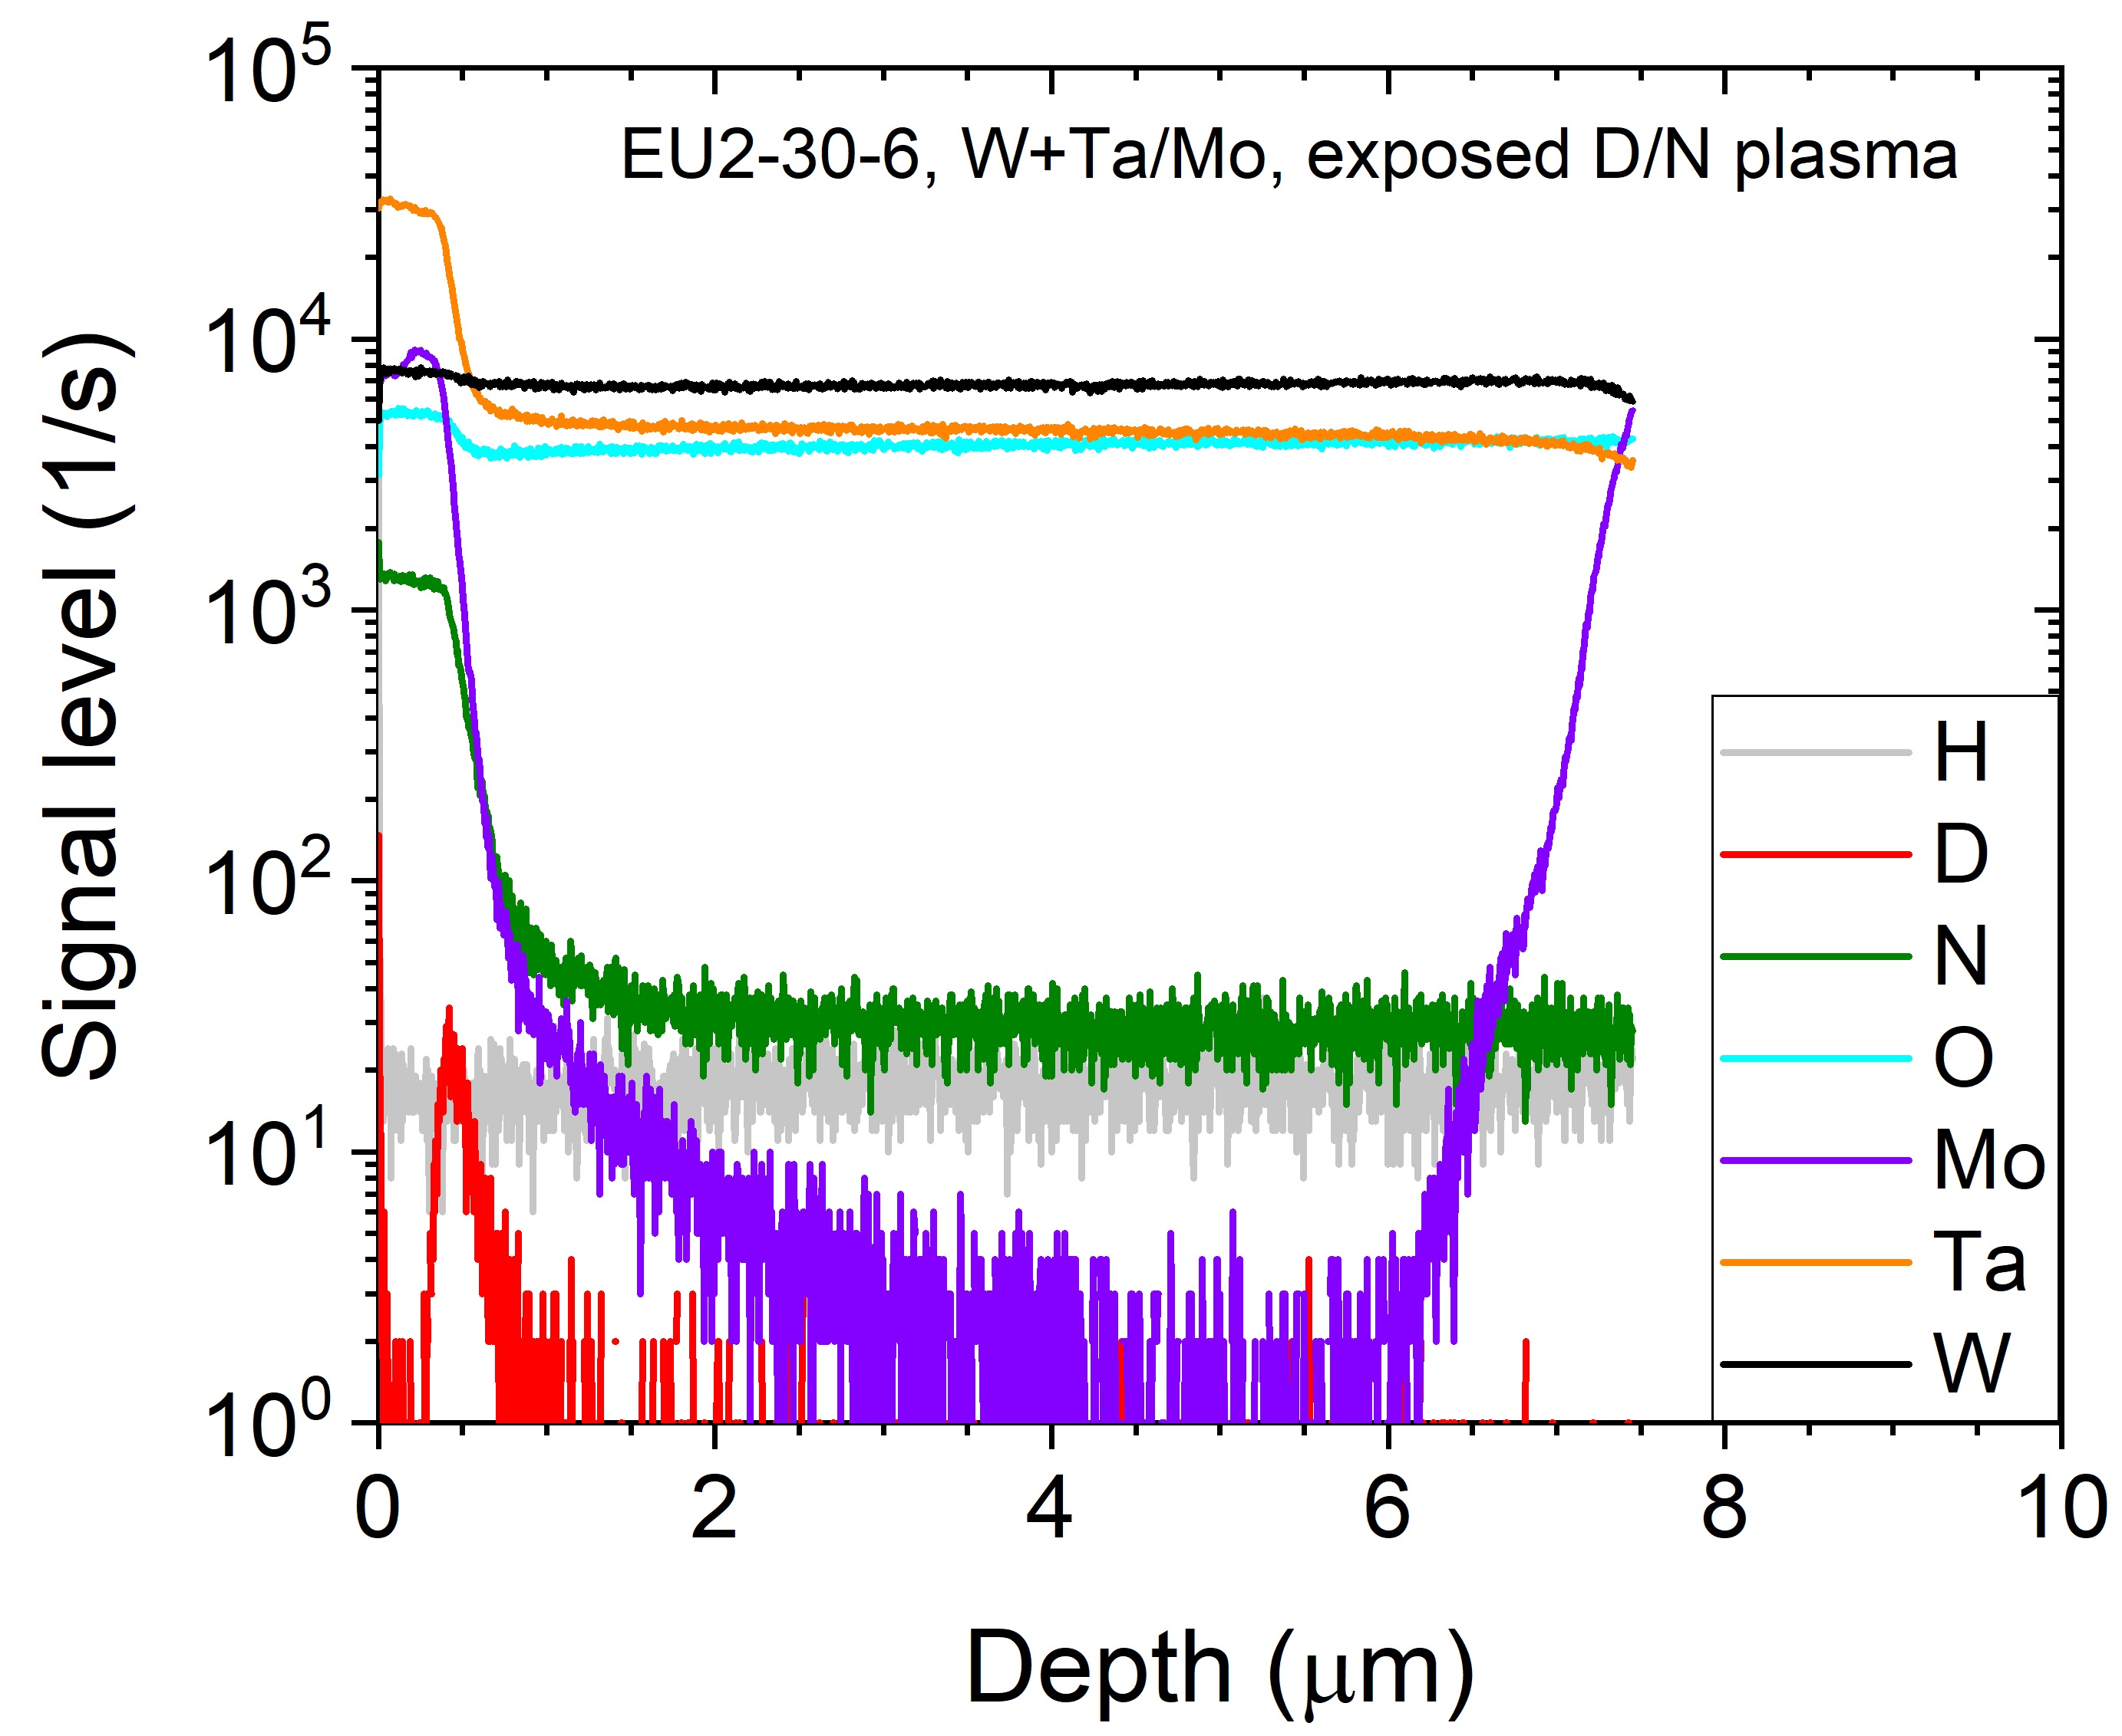
Examples depth profiles (also for SP5.4) VTT
Be-N-D sample, produced at 100°C
W-Ne-D sample on W with a Mo interlayer
W-Ta sample on Mo, exposed to D+N plasma in MAGNUM-PSI

Slide 45
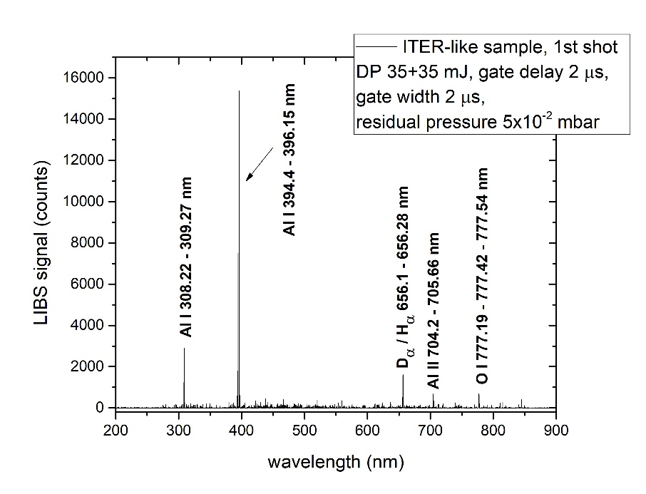
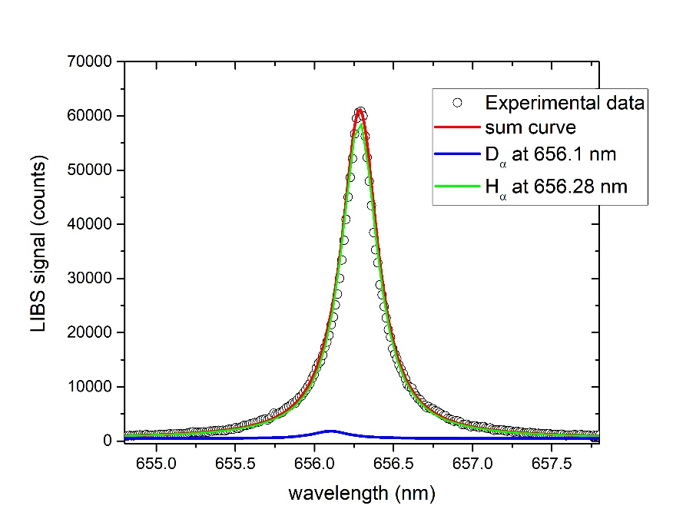
Key results in 2020 (SP7.8) ENEA
CF-LIBS on ITER-like sample (Al-D sample) inside FTU
T_{e} was obtained from the Boltzmann plot of the full range spectrum giving 1 eV.
n_{e} was obtained Stark broadening H_{a} giving 5⋅10¹⁶ cm³.
The intensity ratio D_{a}/H_{a} lines (∝relative concentration) is 2-3%
Applying CF on the H-contaminated superficial layer: Al = 62%, H = 36.5%, D = 1.5% (without H contribution, Al 97.6%, D 2.4%)
Error due to departure from LTE condition and too low pulse energy applied (the D signal is very weak). Trying to increase the LIBS depth resolution → errors in fitting the two contributions of the experimental profiles

Slide 46
Key results in 2020
Results overview: simulations
  Detection efficiency = how much neutrals are detected for each neutral arriving at the PFC ?
    Scattering of neutrals on molecules in the connection between the vessel and the chopper (11) lowers the detection efficiency
    Simulations by SdtrimSP 5.00 show
      Detection efficiency <20% for low energy neutrals typical operation pressure,
      But, no distortion of the energy distribution by scattering, even at higher operation pressure.
  These simulations allow to correct the measured energy distributions and obtain an absolute number of the neutral fluxes in ICWC
TOMAS Time-of-Flight NPA
SdtrimSP 5.00 : detection eff
1e-4mbar
5e-4mbar
eV

Slide 47


Key results in 2020 (I) IPPLM
Topic:
Comparison of ps, ns and dp (CF)-LIBS on ITER coated/doped samples: ablation rate and plasma plume dynamics (ISSP-UL, CU, UT, VTT, FZJ, ENEA, IPPLM)*
Scope:
Characterisation of performance of the
DP LIBS: plasma plume dynamics,
ablation rate and detection capability.
Achievements:
Analysis of tungsten plasma dynamics
in terms of electron temperature and density evolution in a broad range of inter-pulse delays and observation times
Second pulse significantly prolongs the plasma life-time and stabilizes influence on the plasma concentration

