Slide 1

WP Plasma-Wall Interactions and Exhaust in FP9
Sebastijan Brezinsek

Slide 2
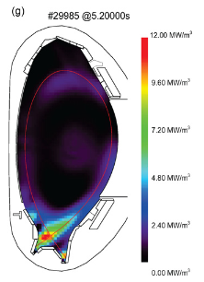
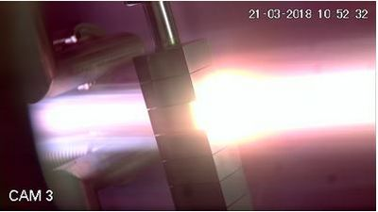
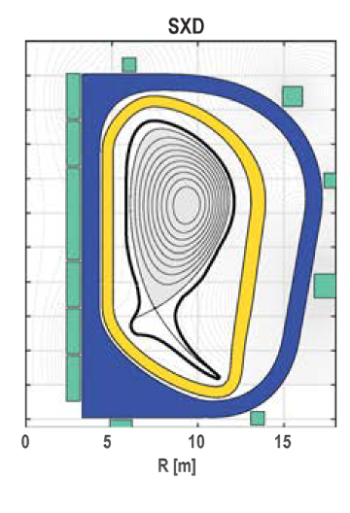
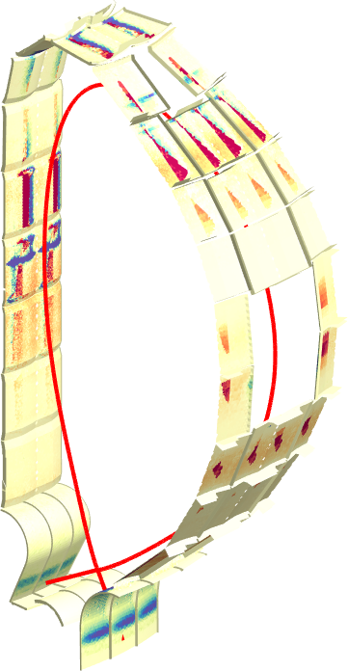
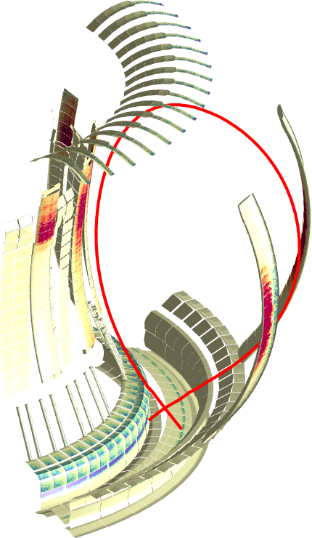
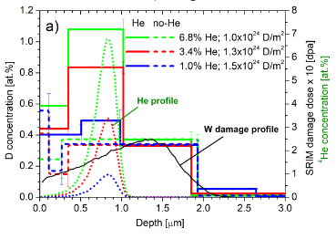
Plasma-Wall Interactions & Exhaust
Focus on ITER and DEMO materials, H, isotopes, He, seeding gases, and impurities.
Goal on steady-state operation.
Radiative divertor
Tungsten +
seed gas (Kr/N₂)
Particle and heat flux
Tungsten + Deuterium
Advanced Divertor Solutions
Tungsten
AUG
DEMO
MAGNUM
[T. Morgan]
JET
ITER
[M. Bernert]
[F. Militello]
WP PWIE covers laboratory experiments, linear plasma devices, and high heat flux facilities and modelling.
[J. Romazanov]
[S. Markelj]
3D erosion & deposition modelling
Beryllium
Fuel (Tritium) retention
Tungsten + Deuterium/Helium
WP PWIE supports experiments at toroidal devices including W7-X.

Slide 3
WP PWIE role in EUROfusion
Works hand in hand with FTD in the area of DEMO PWI, exhaust solutions, and safety
Complements WP DIV studies regarding (plasma) qualification of PFCs for DEMO & JT60-SA, DTT, W7-X
Supports WP PRD in the area of potential liquid metal solutions for DEMO (if funded in FP9)
TSVV
FTD
TSVV
Neutral Gas Dynamics
in the Edge
WP MAT
WP DIV
WP DES
WP SAE
Plasma Exhaust:
Fluid/Gyrofluid Edge Codes
Impurity Sources,
Transport, and Screening
WP PWIE
Plasma Exhaust:
Gyrokinetic/Kinetic Edge Codes
Plasma-Wall Interaction
in DEMO
WP PrIO
WP TE
WP W7X
WP SA
FSD
jointly with WP TE!
Addresses Mission 2 in FSD in laboratory experiments, linear plasma devices, and toroidal devices
Works hand in hand with WP TE (and JET-1) in the areas of PWI and PFC-compatible exhaust solutions
Executes post-mortem analysis of PFCs (JET, WEST, AUG etc.) and associated interpretation
Supervises TSVV modelling tasks in the area of PWI and plasma & particle exhaust

Slide 4
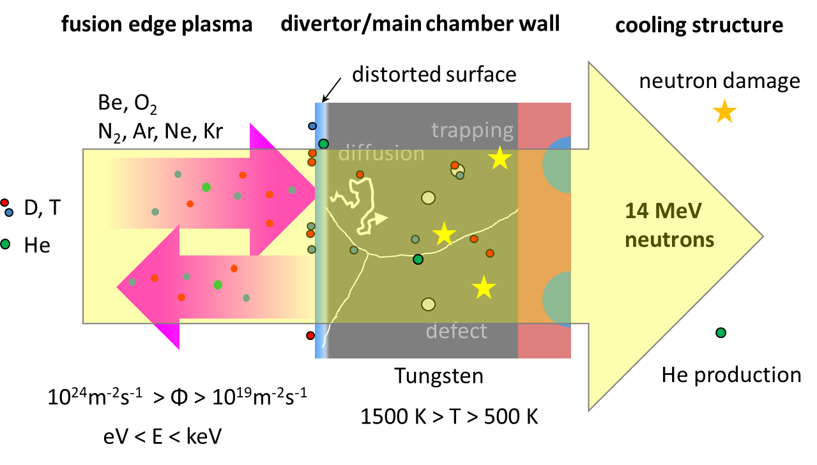
Basic physics studies
Re-crystallisation and morphology changes by plasma & heat load
Properties of re-deposited W and role of impurities
Effective sputtering yields and associated 3D effects
General dust studies and dust release mechanisms
Hydrogen in metals: impact of He and neutron/ion damage
Supersaturation and fuel exchange of hydrogen isotopes on metals
Atomic, molecular & surface processes relevant for/in detachment
Material mixing and segregation modelling
[T. Schwarz-Selinger]
In-situ ion-beam / laser-based analysis techniques in linear devices
In-vacuo material characterization (retention / material composition)
Feeds into predicitions for ITER and DEMO!
Priority list will be regularly adapted in annual work plans …

Slide 5
Contributions to ITER
WP PWIE supports ITER with experimental studies and modelling related to Roadmap Mission 2
Identification of topics according to ITER Research Plan, ITPA DivSOL, and direct interaction with IO
Reference program in FP9 grant, but flexible to adapt urgent high priority items (e.g. limiter start-up )
WP PWIE supports ITER with experimental studies and modelling related to EUROfusion Mission 2
Identification of topics according to ITER Research Plan, ITPA DivSOL, and direct interaction with IO
Reference program in FP9 grant, but flexible to adapt urgent high priority items (e.g. limiter start-up )
Support ITER in lifetime estimations for the W divertor and Be first wall components [budget approach]
  Plasma (He, D) and high heat flux exposure of reference / pre-damaged / recystallised materials
  High fluence experiments (MAGNUM, WEST) / repetitive loads / fatigue of W PFCs
Support ITER in fuel retention estimations and fuel recovery schemes [housekeeping approach]
  Tritium monitor diagnostic: retention location identification and quantification (LID-QMS and LIBS)
  Assessment of ITER tool box: baking, ICWC and ECWC, GDC including laboratory experiments (e.g. TOMAS)
Support ITER in material migration and dust production estimations
  Modelling of global material migration and transport to remote areas and ducts (incl. post-disruption damage)
  Layer stability assessment under consideration of intrinsic and extrinsic impurities
JET-ILW and JULE-PSI will be remaining plasma facilities capable to operate with Be in FP9!

Slide 6
Contributions to DEMO
WP PWIE will work hand in hand with the FTD in the area of PWI and Exhaust
  WP MAT provides plasma-facing materials and WP DIV provides plasma-facing components
  PFCs and PFM qualification under plasma or combined plasma and heat load under WP PWIE
  Joint exploration and assessment of PEX solutions for DEMO with WP DES
Supports DEMO baseline scenario via WP DES: vital input to the conceptual design G2 and G3
  PSI modelling regarding first wall erosion under steady-state conditions and transients
  Re-deposited W layer stability and corresponding dust conversion factors
  Fuel inventory predictions based on implantation and neutron damage in W-based PFCs
Recommends alternative DEMO-compatible plasma exhaust solutions (~before G2)
  Physics basis for alternative power exhaust solutions (highly radiative LSN divertor as reference / WP DES)
  Predictive plasma edge modelling for alternative divertor solutions and their exploitation (PEX)
  Technical realisation within the DEMO boundary conditions (together with WP DES)
The working scheme with FTD is under development: Core Team, DES, PEX Coordination Group (?) etc.

Slide 7
Support for W7-X, JT60-SA, and DTT
W7-X (all-W operation beyond FP9)
Executes a fraction of post-mortem analysis (incl. W) and its interpretation for WP W7X
Supports experimental PWI studies under steady-state conditions in all-C environment
Supports the transformation into an all-W stellarator: predictive modelling and material qualification
JT60-SA (all-W operation likely beyond FP9)
Supports the transformation of an all-C into an all-W device: W divertor components qualification with plasma
JT60-SA plasmas might act as test cases for newly developed TSVV plasma codes
DTT (scientific plasma operation likely beyond FP9)
I-DTT divertor design needs to be agreed between I-DTT consortium and EUROfusion
PFC compatibility with recommendation of WP DTT-ADC and DTT-LMD
Test case for predictive 3D power/particle exhaust and PWI modelling with TSVV-related codes

Slide 8
WP PWIE and former PFC and JET-2 activities
WP PWIE includes previous WP PFC activities
  Plasma and heat loads / transients / high fluence
  PSI physics related to erosion / material migration / PFC analysis
  PSI physics related to fuel retention / fuel removal
  PSI and plasma edge modelling / dust release and modelling
  Laser-PSI qualification / wall conditioning / AM data
WP PWIE includes previous WP JET-2 activities
  Material erosion / deposition / fuel retention quantification
  with full competency in Be and T [and n impact]
6 subprojects
Integration of JET-2 activities into (updated) PFC structure
Subproject coordinators to organise distribution/analysis of JET components / new UKAEA contact person
Preparation of sample analysis plan after DT operation (facilities / timeline / ITER training?)
Close collaboration with WP JET-1 (later WP TE) regarding plasma solutions and T clean-up analysis
The JET analysis activities will depend on JET prolongation and the UKAEA status for the period 2021+.
Proposed UKAEA contact person for WP PWIE: Anna Widdowson.

Slide 9
WP PWIE structure I: PWI and TSVVs activities
J.W. Coenen
J.W. Coenen
A. Hakola
K. Schmid
A. Kirschner
PL
J. Likonen
with WP TE
Inclusion of
TSVVs
in WP
PWIE
P. Tamain /
D. Told
D. Borodin
G. Ciarolo
D. Matveev
Coordination between SPs and TSVVs within WP PWIE
SPs can give input to TSVVs / TSVVs can provide new numerical tools to be used in the SPs
Partial overlap of involved teams is a strength / duplication work must be avoided
Potential overlap with ENR proposals must be avoided

Slide 10
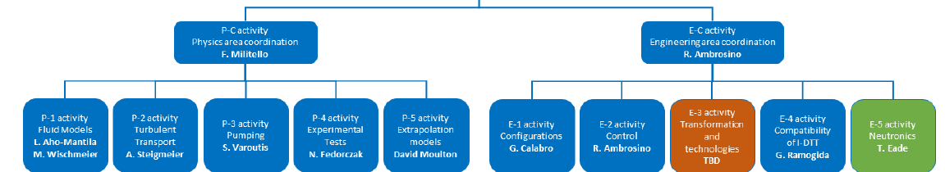
WP PWIE and former ADC-DTT activities
WP ADC-DTT addressed in FP8 the Physics and Technology for DEMO ADC solutions
  Final report with most promising advanced divertor configurations for DEMO foreseen for end of 2020
  Several options and intermediate advanced divertor solutions still under discussion
  Interpretation of experimental results challenging and several physics questions still open
WP PWIE includes partially previous WP ADC-DTT activities
  Principle split of WP ADC-DTT between physics (WP PWIE) and engineering (WP DIV/DES) in FP9
  Continue exploration as full team regarding DEMO simulations / Provide “best ADC solution(s)” until G2
  Prepare for I-DTT regarding boundary modelling and engineering solutions (PEX divertor)
  Physics activities include PEX exploitation predictions and modelling (together with WP TE)
  Simplified structure / interfaces with WP TE and WP DES need to be further elaborated
Deputy Leader
G. Calabro
Univ. Tuscia
L. Aho-Mantila
NN
DPL
NN

Slide 11
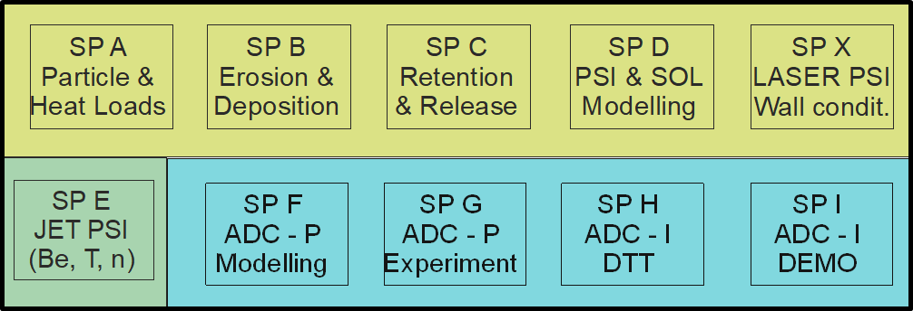
WP Plasma-Wall Interactions & Exhaust
FTD
WP MAT
WP DIV
WP DES
WP SAE
WP PWIE
jointly with WP TE!
WP PrIO
WP TE
WP W7X
WP SA
FSD
Leadership Team:
Project Leader and Deputy
SP Coordinators
TSVV Principle Investigators
Project Officer in FZJ
UKAEA contact person
Looking forward to
your participation
in WP PWIE in FP9!
Strong cooperation between
WP TE and WP PWIE is mandatory to tackle Exhaust issues and exploit PEX projects

Slide 12
Project structure
Subprojects are fixed for the first 5 years
Responsibility: Subproject Leaders (SPLs) and PL
Each subproject consists of about 5 scientific Tasks
  Specific Task Coordinators (STCs) can be appointed by the SPCs and PL and deputy if required to cover a stand-alone subjects (e.g. LIBS development)
  Tasks can be closed and new Tasks defined within the next 5 years
Revision of all present Tasks from PFC and JET-2 is ongoing => focus on ITER/DEMO needs
Closure/pause of specific activities, e.g. ammonia research, advanced steels, LIBS on RH
New tasks and their scope are currently prepared by SPLs and PL
  Definitions in the FP 9 proposal
  Available budget in FP9 is about 1/4 lower than anticipated !
  Prioritisation required
Supportive work for JT60SA, DTT, JET will depend on timing, politics, and on funding situation

Slide 13
Tasks
Each subarea with 4-5 Tasks / defintion ongoing / Call might be required for Coordinators
SP A (Particle &
Heat Loads)
Heat-load HHF
Plasma-load LPD
New materials
Melting
…
SP B (Erosion &
Deposition)
Erosion experiments
Migration exp. (tor.)
PMA coordination
Reference materials
…
SP C (Retention &
Release)
Fuel retention /release
Lab. exp and modelling
He+D+Imp effects
Neutron effects
…
SP D (PSI &
SOL Modelling)
Plasma & PIC model.
PWI (small/large systems)
Dust release/transport
Neutral gas recirculation
…
SP X (mixed)
Laser-based PWI
Wall conditioning
AM data bench.
…
SP E (JET PSI)
JET contact / UKAEA
JET tile analysis
Labs for T, n and Be
LID-QMS / FREDIS
…
Essential:
close contact with TSVVs and WPs via PL and SP coordinators!

Slide 14
Call end of November (?)
Call for participation in WP PWIE along the lines of defined Tasks with dedicated qualifications / facilities. This is INDICATIVE and we will ask for information from the RUs for 5 years.
Definitions of Tasks and Qualifications (e.g. PSI/Edge modeller etc.) is ongoing and needs to be harmonised
The Call might be either in form
  DOCX file to be filled out (see talk of Botond at FP9 info meeting)
  Direct IMS entry with: GENERAL TASK INFO, SELECTION MENUE of QUALIFICATIONS, FACILITIES MENUE
  RU provides INDICATIVE the ppy for the period indicated / ONE SALARY per RU / FREE AREA to indicate WORK
Parallel a PMP / ANNUAL WORK PLAN will be made by SPLs and PL
Selection of MANPOWER and RESSOURCES for the AWP 2021
European Commission asked for annual work plans with SMART deliverables

