Slide 1
New in ETS-6, 11 November 2020
Thomas Jonsson

Slide 2
New in ETS-6
Fixes in interpretative fluxes (thanks to David)
Note: solver4 has give better estimate of the fluxes than solverFEM
numerical derivatives give inaccurate diffusive fluxes
Fixes in interpretative transport coefficients
Replace BGEO and RGEO by B0 and R0
This will speed up or slow down current diffusion by factor R0/RGEO
We have the same problem in ETS-5.

Slide 3
News in ETS-6
Static impurities
No predictive mode, since the atomic process (impurity) actor is not yet available
Static rotation and electrostatic potential, however…
Consistency in various rotation fields is not yet implemented.
Rotation is not included is energy density, energy conservation…
Several global quantities have been added, e.g. integrated current, beta-values
Fill species names

Slide 4
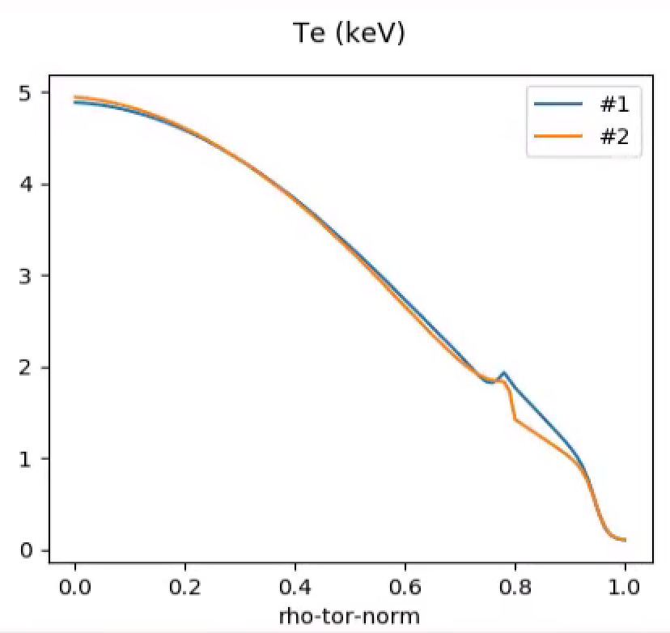
Hyper diffusion
Fix in hyper diffusion – skip last grid point
Add flux from hyper diffusion, see below
But there’s an artifact at the boundary
Different between solver4 and solverFEM
solver4
solverFEM
Flux decay transiently
0.4s
g2tjohns/jet/92436/85063
0.1 s

