Slide 1
SOLPSZ1 integration and testing in ETS6
R. Coelho

Slide 2
Core-edge parameterization
  Detailed in H.D. Pacher et al, J.Nuc. Materials 463 (2015) 591
  Based on numerous edge runs by SOLPS 4.3 for ITER
  DEMO extrapolations possible with major radius strike point R_{outer} scaling corrections
  Core code provides
  Power flux to SOL
  Particle flux to SOL
  Fusion power
  Parametrization provides
  Separatrix DT and He densities
  Separatrix ion and electron temp.
  Separatrix inward neutral DT/He fluxes
  Input parameters
  Detachment level
  Impurity concentration
  Eng. pumping speed

Slide 3
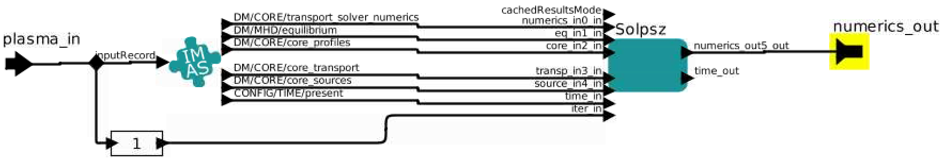
The actor
Rigorous validity check: All IDS data is checked for
  D+ and T+ must be present
  Correct model: “transport solver”
  Predictive Equations only: Ne, Te, Ni, Ti with ion=D, T and He2+
  Fusion sources: global_quantities else provide Palpha as code parameter or set to 0.
  Power to SOL: P_{SOL}>0 and P_{e}*P_{ion}>0 (else stop gracefully)
Flexible inputs:
  Impurity %, Detachment level, pumping speed
  H/L mode scaling to P_{SOL}
  Major radius scaling (e.g. extrapolate for DEMO)

Slide 4
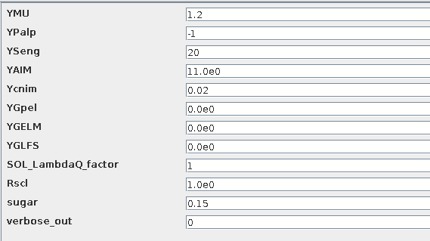
The code parameters
Norm. dettach level
Pumping speed
Impurity %
Scaling for P_{SOL}
Scaling for DEMO
Numerical stability

Slide 5
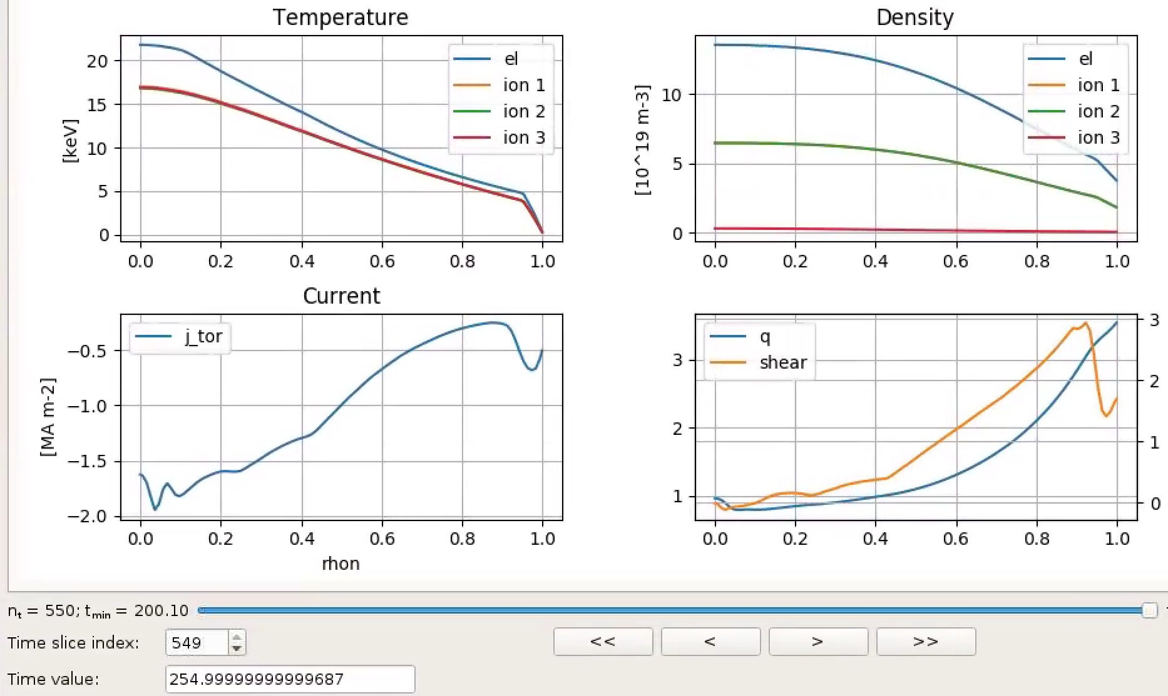
Input scenario
Database entry: g2dpc/iter/134173/17891
Modified by:
  Run HCD sources with period 20s (was 10s)
  Run from t=200s to t=255s → g2rcoelh/iter/134173/17897

Slide 6
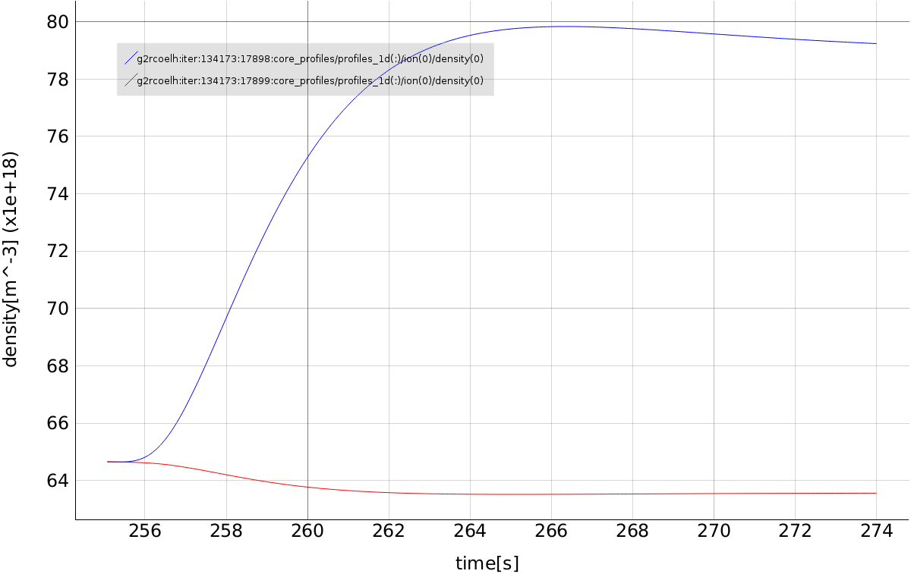
Output on two different scenarios
Database entry: g2rcoelh/iter/134173/17898 and 17899
Code parameters:
  run_out=17898: 0.7% of Neon concentration
  run_out=17899: 2% of Neon concentration
D-ion on axis

Slide 7
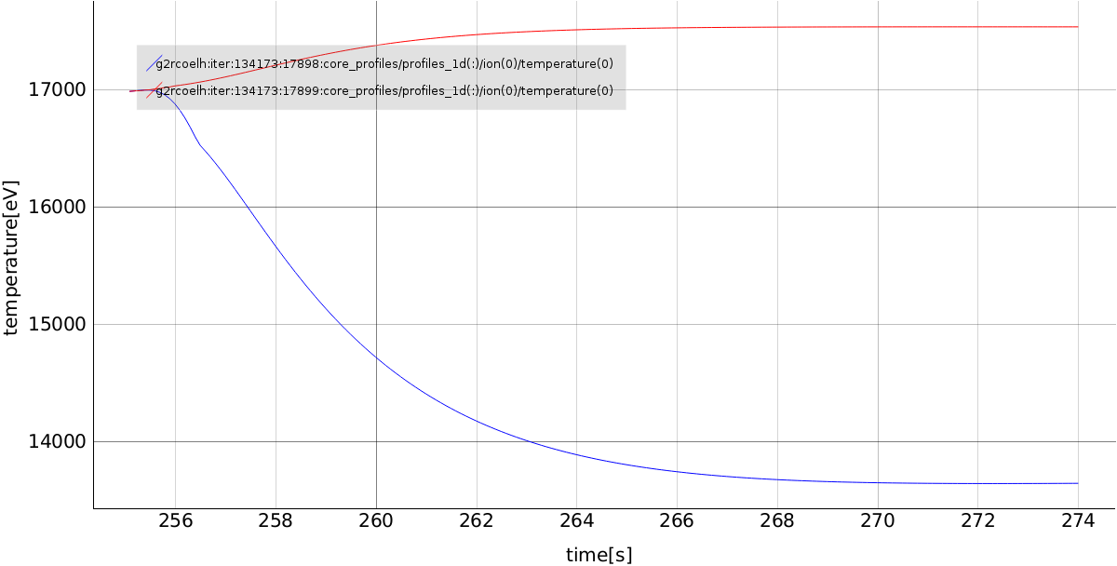
Output on two different scenarios
Database entry: g2rcoelh/iter/134173/17898 and 17899
Code parameters:
  run_out=17898: 0.7% of Neon concentration
  run_out=17899: 2% of Neon concentration
D-ion on axis

Slide 8
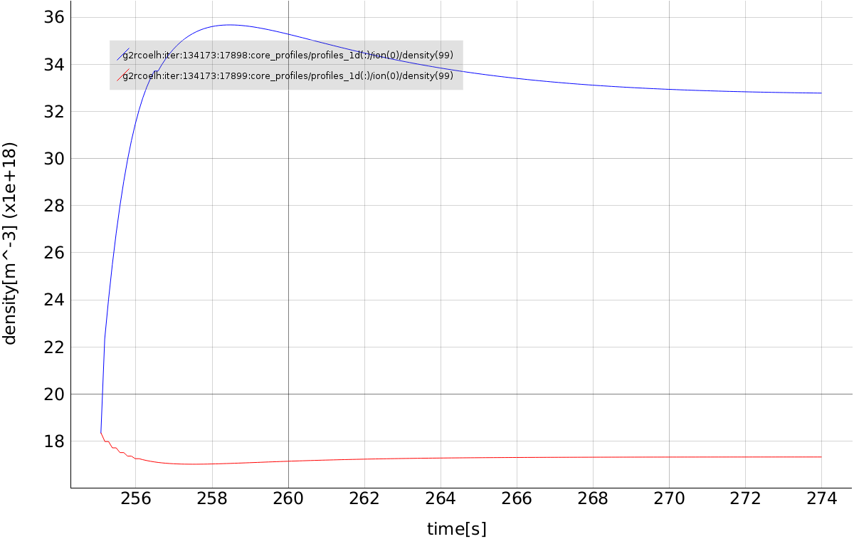
Output on two different scenarios
Database entry: g2rcoelh/iter/134173/17898 and 17899
Code parameters:
  run_out=17898: 0.7% of Neon concentration
  run_out=17899: 2% of Neon concentration
D-ion at the boundary

Slide 9
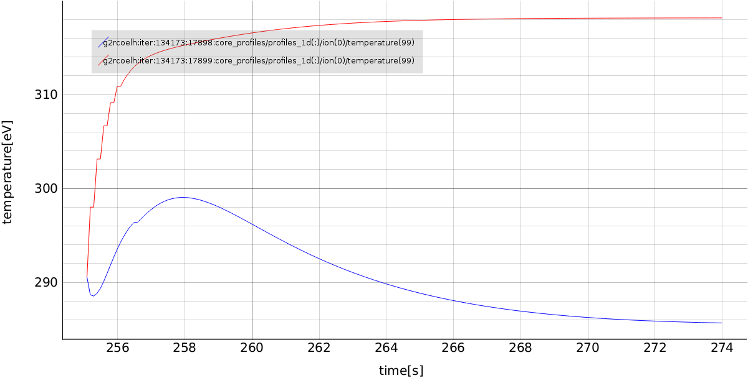
Output on two different scenarios
Database entry: g2rcoelh/iter/134173/17898 and 17899
Code parameters:
  run_out=17898: 0.7% of Neon concentration
  run_out=17899: 2% of Neon concentration
D-ion at the boundary

Slide 10
Preliminary conclusions
Rigorous validity check enforced (i.e. works robustly on ETS)
Results aligned with expectations
But very recently an “ETS feature” is found when writing transport_solver_numerics after convergence loop stages (code%output_flag).

