Slide 1
Information half day January 12, 2021
PMO team
Project Management Office

Slide 2
Agenda
Welcome, introduction
rough planning for the coming few months
The role of the PSO and the PMO (including Q/A)
IMS training
Budget control in FP9
Vinagre 20 min.
Meszaros 40 min.
Genangeli 60 min.
Oron-Carl 60 min.

Slide 3
PMO – who are we?
Programme Manager
Senior Advisor
Secretariat
Legal Advisor
Int. Collaboration Officer
Project Support Office
Communication Office
Training and Education Officer
Project Management Office
Botond Meszaros
Liviu Joita
Carme de Andres
Juergen Gafert
Fusion Science Department
Fusion Technology Department
Administration Department
Notes:
PMO was created to streamline and improve the project management across the consortium.
Goal is to set standards, increase transparency and improve general project management culture.

Slide 4
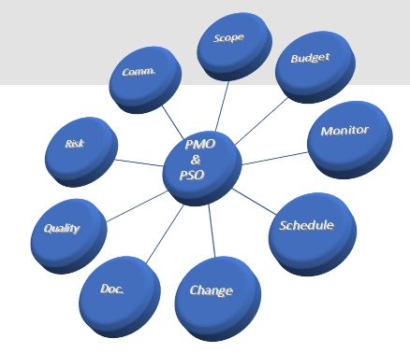
PMO – PSO interface
What was established so far:
Responsibilities defined
Role of PMO and PSO clearly defined and agreed with Administration and Programme Manager
Direct link from PSO to PMO officers
PMO is the main point of contact in EUROfusion PMU
What will be the next steps:
Further templates and guidelines definition
Facilitate reporting/communication effort
Empowerment of PSO
PSO alerts PMO if something is out of target or training is needed
Notes:
Mention that PMO and PSO are partners and need to communicate openly to make sure we move forward.
Message should be we are here to help them if something is not clear, but we need to be informed.

Slide 5
PMO roadmap for 2021
Jan 11th
Today
Apr 30th
PMO@euro-fusion.org
PEPs provided to PBs
FSD WP Wikis updated
End Oct
Annual update/ conversion of existing PEP to PMP Portfolio
TS preparation in IMS
GA
GA
Jan 21st
September
AWP creation and
CWP update
Part 1: PMO handbook
Call selection and resource allocation
Part 2: Final template for WP handbook
Part 3: Final template for PEP
Notes:
Add in Apr30th update of Wikis for the FSD related projects
Mention that we will give the wiki template until the end of January, Feb to work on it, March for interaction and April is ready for PB

Slide 6
Agenda
Welcome, introduction
rough planning for the coming few months
The role of the PSO and the PMO (including Q/A)
IMS training
Budget control in FP9
Vinagre 20 min.
Meszaros 40 min.
Genangeli 60 min.
Oron-Carl 60 min.

