Slide 1
JT-60SA Massive Gas Injection system Installation, commissioning and operation
M. Dibon, G. Matsunaga, S. Nakamura, G. Phillips, C. Sozzi
Acknowledgement: G. Giruzzi, M. Hanada

Slide 2
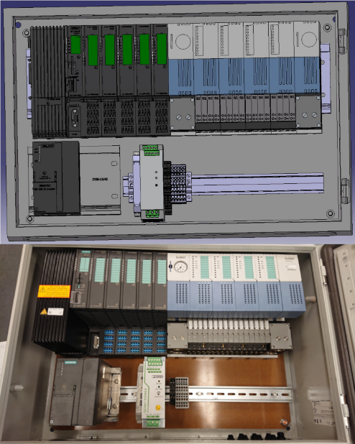
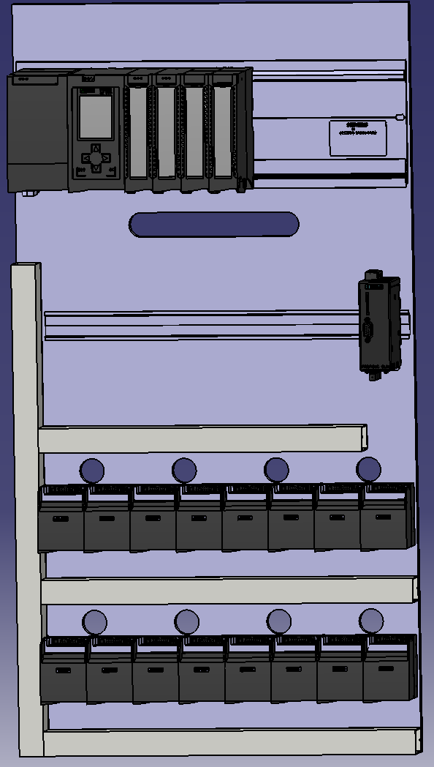
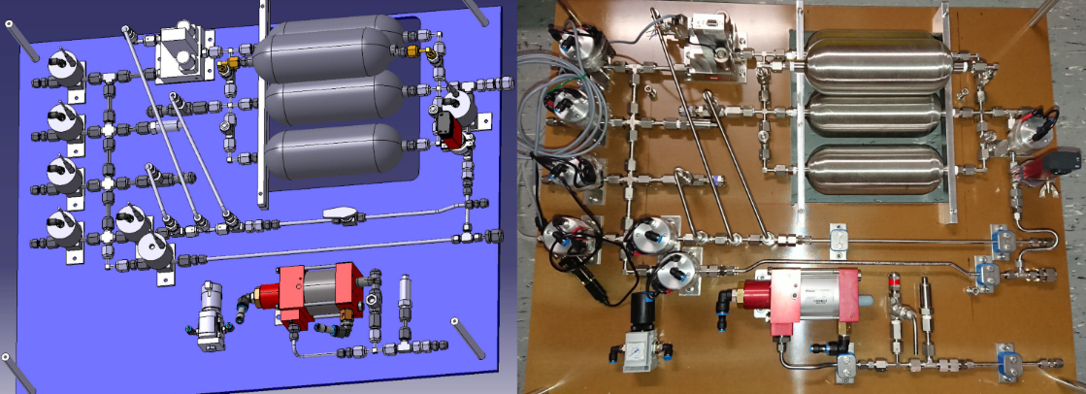
Installation
Installation in 2023
MGI valves + cables in vacuum vessel
Vacuum feed throughs in torus hall
Gas prep system in pumping room
PLC in Electronics room
HMI in Control room
On-site presence is necessary to supervise and inspect

Slide 3
Commissioning, training and operation
On-site presence during commissioning and training
Adjustment of system parameters during commissioning
Quick trouble shooting
Training directly after commissioning
Optional training videos to recap
Operation manual will be delivered with the system
Operation of the MGI system by QST personnel
No remote operation foreseen

Slide 4
Maintenance and software
Maintenance done mainly by QST personnel
Maintenance manual will be delivered
No remote maintenance foreseen, on-site assistance
Control software, programming environment and HMI design software all on control computer
No additional software delivered with the system
Software documentation delivered with the system

Slide 5
Documentation
Documentation package includes:
Design basis document
Manufacturing drawings
Certificates
Test reports
Manuals for components (gauges, EPC, PLC etc.)
Installation manual (what goes where and how)
Software documentation (printout of code with comments)
Operation manual (where to click in HMI)
Maintenance manual (When to look at what and how to repair)

