Slide 1
Poznan Supercomputing and Networking Center
Overview of the achievements of the EUROfusion AAI project activities 2020/2021
Presenter: Marcin Płóciennik PSNC

Slide 2
Outline
Overview of the achievements of the EUROfusion AAI project activities and possible future steps
EUROfusion AAI project ideas and overview
Glossary and basic concepts
Current situation
Proposed architecture
Investigation of existing solutions
Implementation
Benefits
Summary, Next steps, Discussion points
© Poznan Supercomputing and Networking Center

Slide 3
EUROfusion AAI project ideas and overview
EUROfusion AAI project: outcome of the EUROfusion IT Group investigation/activities
GOAL: Implementing a federated authentication and authorization infrastructure for EUROfusion
Activities:
Collect requirements
Propose architecture
Setup EUROfusion AAI Proxy
Setup IdPs
Pilot with selected EUROfusion services
Involved institutions:
PSNC
UKAEA
CEA
EUROfusion-Garching
GEANT
Requirements
Architecture
Investigation of technical solutions
Evaluation of technologies
Implementation
IdP's
AAI Proxy
Services Integration
© Poznan Supercomputing and Networking Center

Slide 4
Poznan Supercomputing and Networking Center
Basic concepts and glossary

Slide 5
Glossary
Authentication: the act of confirming identity.
Authorization: specifying access rights to resources.
Authentication and Authorization Infrastructure (AAI) : an infrastructure that supports Authentication and Authorisation. A minimal AAI consists of IdP and SP.
Identity Provider (IdP): the component that issues assertion about the end user, typically containing user’s identity and attributes.
Service Provider (SP): the component that evaluates the assertion issued by IdP in order to grant access to resources.
Federation: A federation is a collection of organizations that agree to interoperate under a certain rule set. Federations will usually define trusted roots, authorities and attributes, along with distribution of metadata representing this information. In general each organization participating in a federation operates one IdP for their users and any number of SPs.
© Poznan Supercomputing and Networking Center

Slide 6
eduGAIN
eduGAIN (http://edugain.org) is a “federation of federations”
it joints national AAI federations, simplifying access to content, services and resources for the global research and education community.
over 2,800 identity providers
eduGAIN helps nearly 27,000,000 students
© Poznan Supercomputing and Networking Center

Slide 7
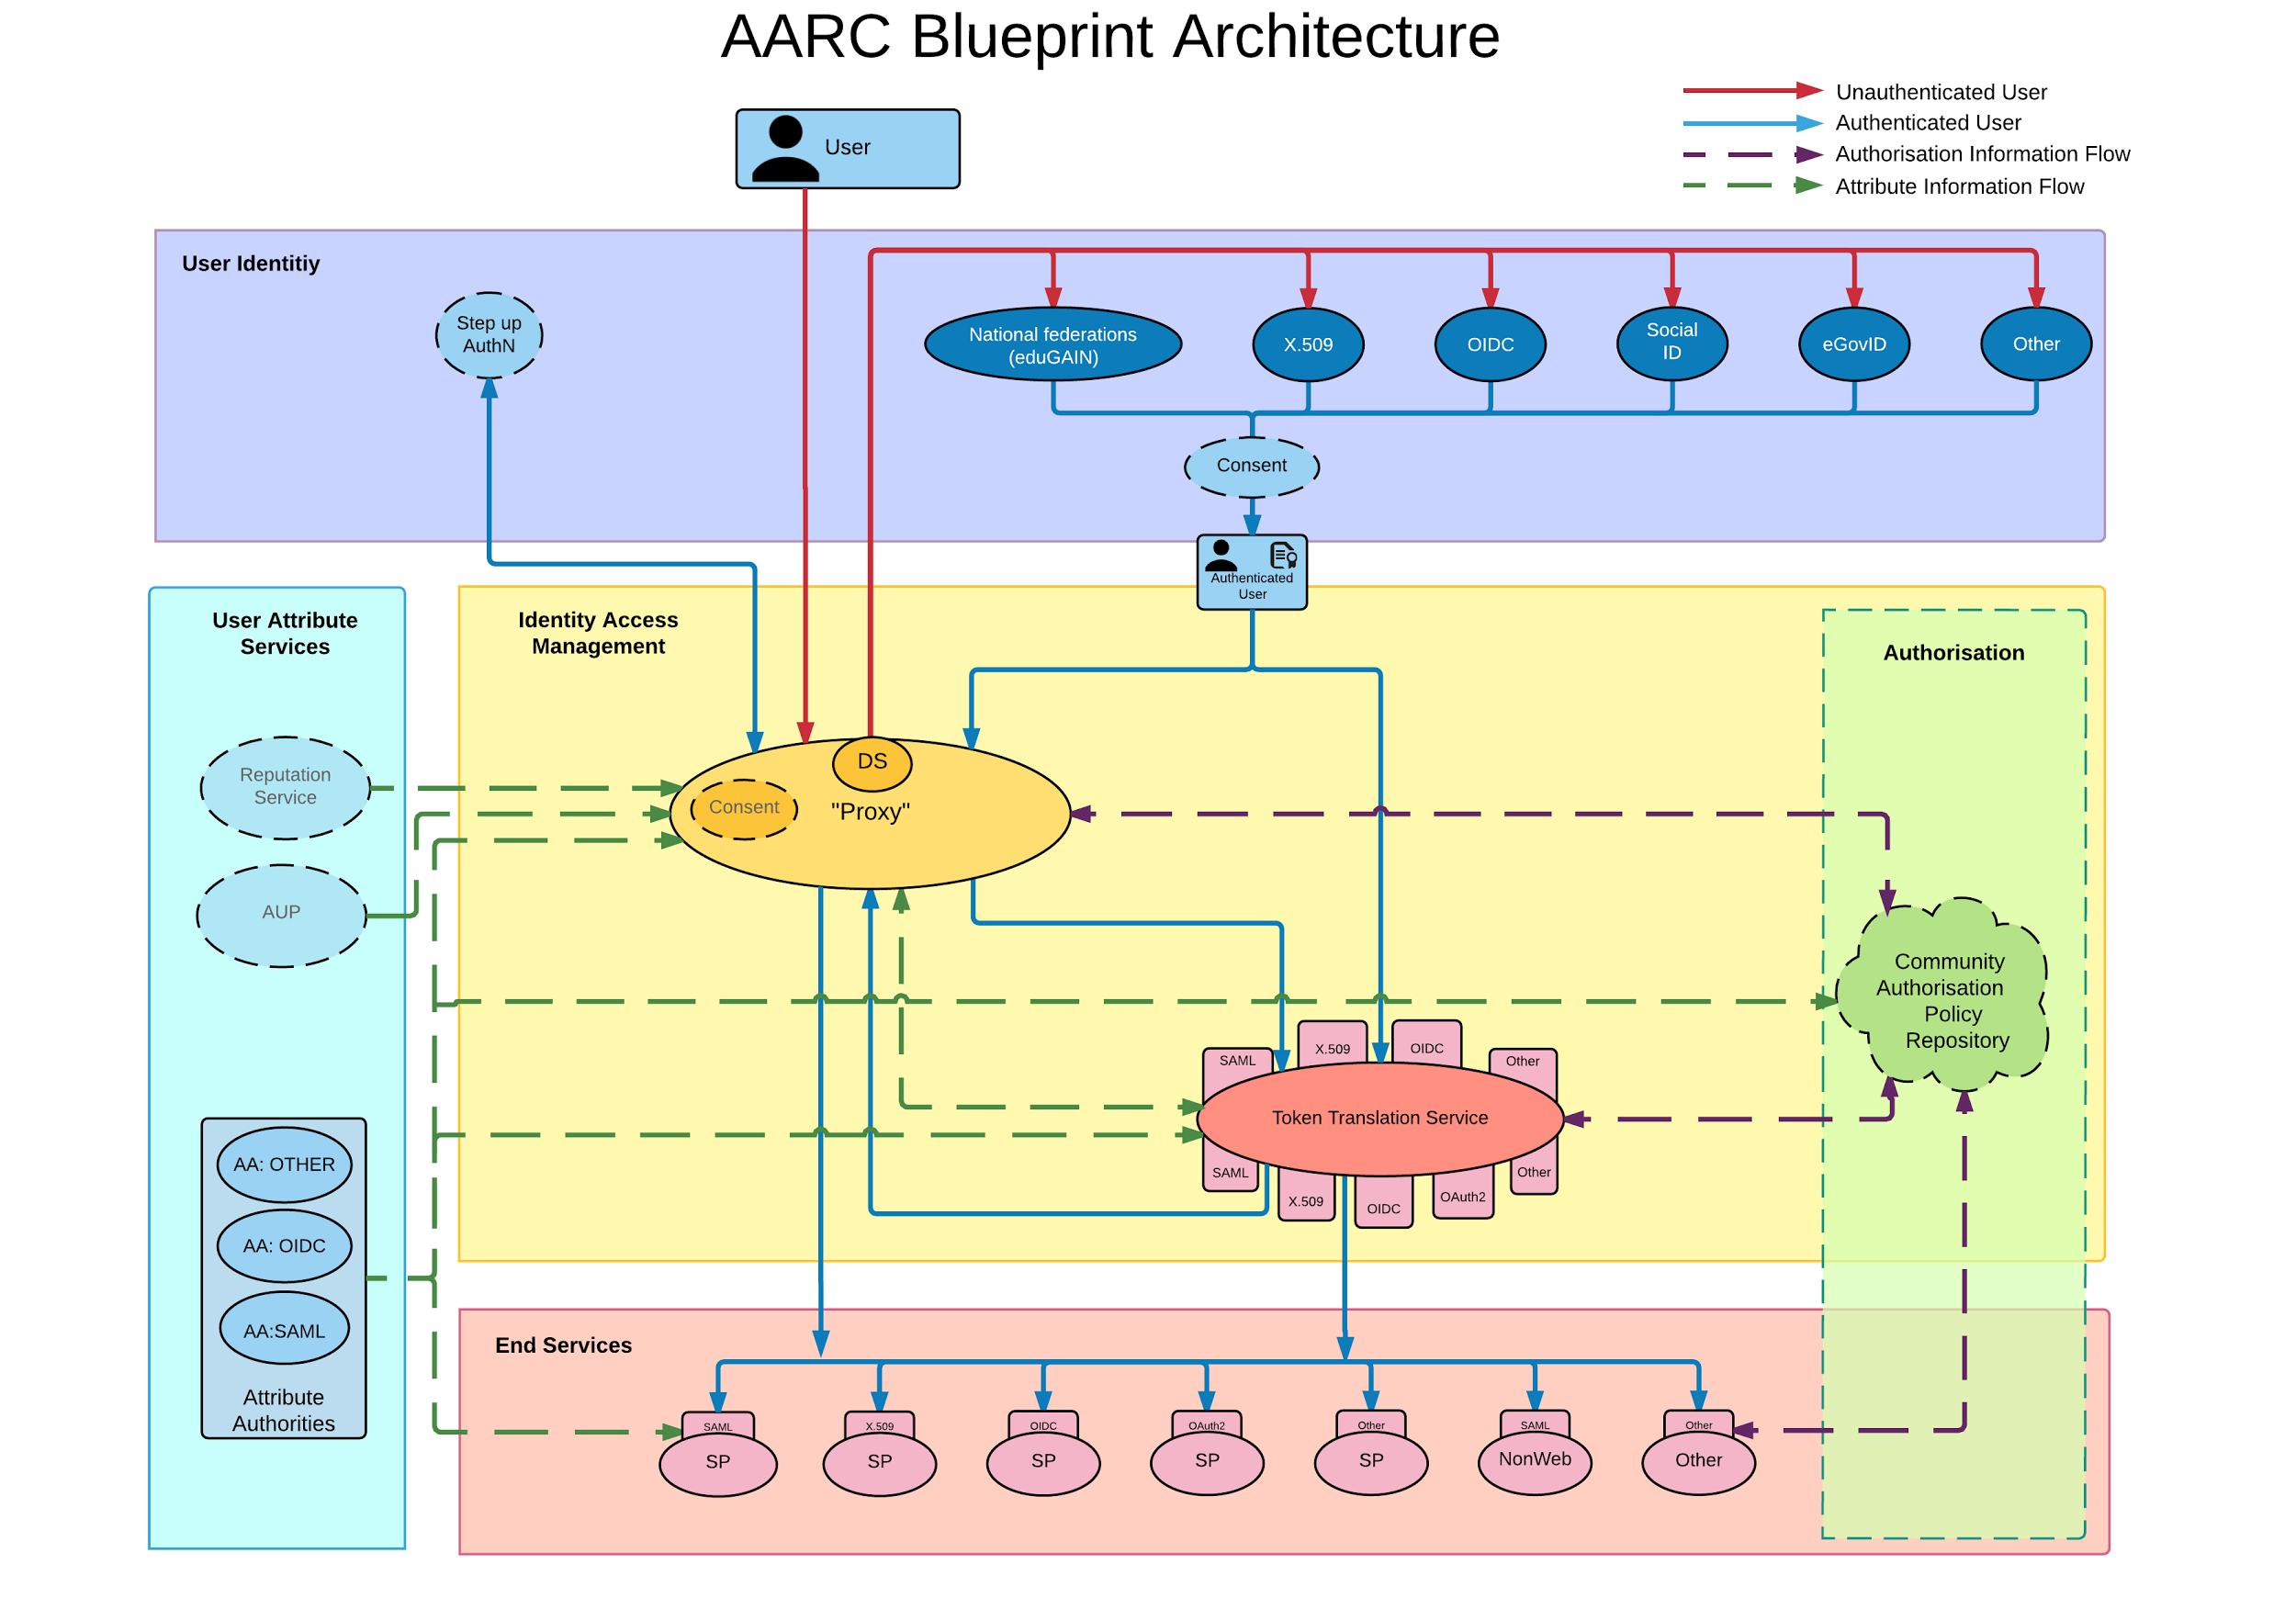
AARC Blueprint Architecture
AARC - Authorization and Authentication for Research and Collaboration- an EC funded project
AARC has designed a Blueprint Architecture [BPA] to provide set of interoperable architectural building blocks for software architects and technical decision makers, who are designing and implementing access management solutions for international research collaborations.
© Poznan Supercomputing and Networking Center

Slide 8
Poznan Supercomputing and Networking Center
Current situation

Slide 9
Current situation
REGISTRATION
SITE A
Each site implements their identity management (IdM) for the services they provide to the community.
The result is that a user who wants to access a service (Service A) offered by Site A, will have to register at the IdM of Site A, get an account that can be used just for the service or services provided by Site A.
If the user wants to access a service from Site B, the user has to repeat the same process, resulting in having another account in Site B.
LOGIN
ADFS
LDAP
DB
SERVICE A1
ACCOUNTS
ACCOUNTS
ADFS
LDAP
DB
SERVICE B
SITE B
REGISTRATION
LOGIN
© Poznan Supercomputing and Networking Center

Slide 10
Requirements
Support multiple AAI technologies (SAML, X.509, OAuth2….)
There is no single technology appropriate for all types of services.
Make use of existing federations, in particular eduGAIN for SAML and IGTF for X.509.
Access management on EUROfusion level- to facilitate authorization management, e.g. via groups
Decrease administrative work on resources by defining access to local resources per group instead per single user
Facile integration of users / organizations that are not members of the chosen AAI infrastructure (eduGAIN)
© Poznan Supercomputing and Networking Center

Slide 11
Poznan Supercomputing and Networking Center
Proposed architecture

Slide 12
Proposed architecture
Home IdP C
IdP A (e.g. based on users.euro-fusion.org)
SAML/OIDC
Users can still follow the rules of getting EF account
IdP B (e.g. EF Garching)
Accounts from different IdPs can be merged even with different e-mail addresses
EUROfusion AAI Proxy
SAML/OIDC
Service A
Service B
Service C
SITE A
SITE B
SITE C
© Poznan Supercomputing and Networking Center

Slide 13
How it works
For a service, all it has to do is send the user to the EUROfusion AAI proxy, in order to authenticate.
The EUROfusion proxy will present the request to the user in order to select his/her preferred identity provider, to send him/her there in order to authenticate.
When the user successfully authenticates, the user is sent back to the EUROfusion proxy with a number of attributes (e.g. first name, last name, email).
The proxy looks up the user in the Membership Management service and adds extra attributes relevant to EUROfusion (e.g. the community user identifier, the groups and roles the user belongs to, other authorization information that might be relevant to the service the user is trying to access).
This information is returned to the service as SAML attributes or OIDC claims.
© Poznan Supercomputing and Networking Center

Slide 14
Poznan Supercomputing and Networking Center
Investigation of existing solutions

Slide 15
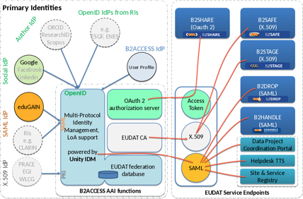
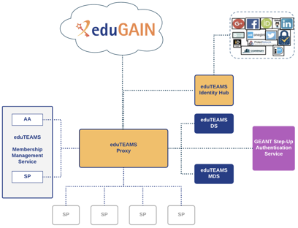
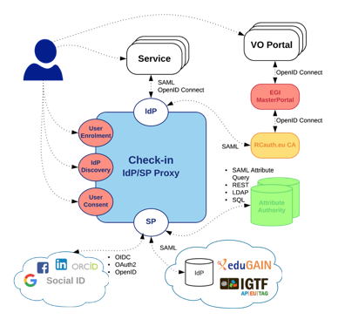
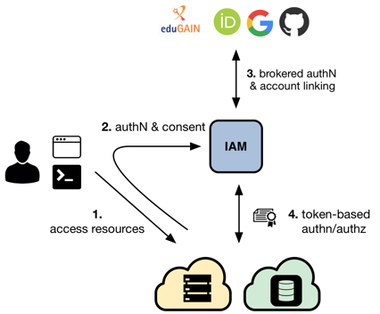
Investigation and initial pilots of different solutions for EUROfusion AAI Proxy (EOSC-hub Fusion CC)
© Poznan Supercomputing and Networking Center

Slide 16
Tests performed
Test of the selected software solutions ( to host AAI Proxy at PSNC)
INDIGO IAM – installation/tests
Unity – installation/tests
As a result of testing phase, the drawbacks and consultation with EF IT Group, proposed investigation and contact with the AAI Proxy service providers
Discussions/analysis/meetings
EGI Check-in - GRNET
eduTeams - GÉANT
© Poznan Supercomputing and Networking Center

Slide 17
Selected solution for EUROfusion AAI Proxy - eduTeams
eduTEAMS decouple the Identity Management from the service and the respective hosting sites.
Using one of the supported protocols for enabling federated authentication (e.g. SAML, OIDC, OAuth2),
Many of the scientists come from universities and research institutes that are part of their national identity federation; through that, in eduGAIN, users are able to authenticate using their institutional accounts to gain access to the services.
GÉANT host EUROfusion, dedicated AAI Service powered by the eduTEAMS technology
Signed collaboration for the pilot with GÉANT
© Poznan Supercomputing and Networking Center

Slide 18
Selected solution for EUROfusion AAI Proxy - eduTeams
For Community Managers
A central point for the community to manage its user membership, to connect Identity Providers and Service Providers and to define and apply access and sharing policies
Secure access and sharing of common resources and services
Secure user authentication and identification
Group and role management
VO management
For Users
Sign in to services with existing identities via eduTEAMS
First class support of eduGAIN Identity Providers
Support for the Research and Scholarship entity category, Code of Conduct and Sirtfi to support scalable authorisation
Support for a wide range of external Identity Providers, such as ORCID and Google
Support for web and non-web based services - access to HTTP APIs
Account linking
© Poznan Supercomputing and Networking Center

Slide 19
Poznan Supercomputing and Networking Center
GÉANT

Slide 20
Membership Association
Mission: To provide an open, innovative and trusted information infrastructure for the European knowledge economy and to the benefit of society worldwide
In Europe: 40 NRENs, 10.000 institutions and 50 million academic users

Slide 21
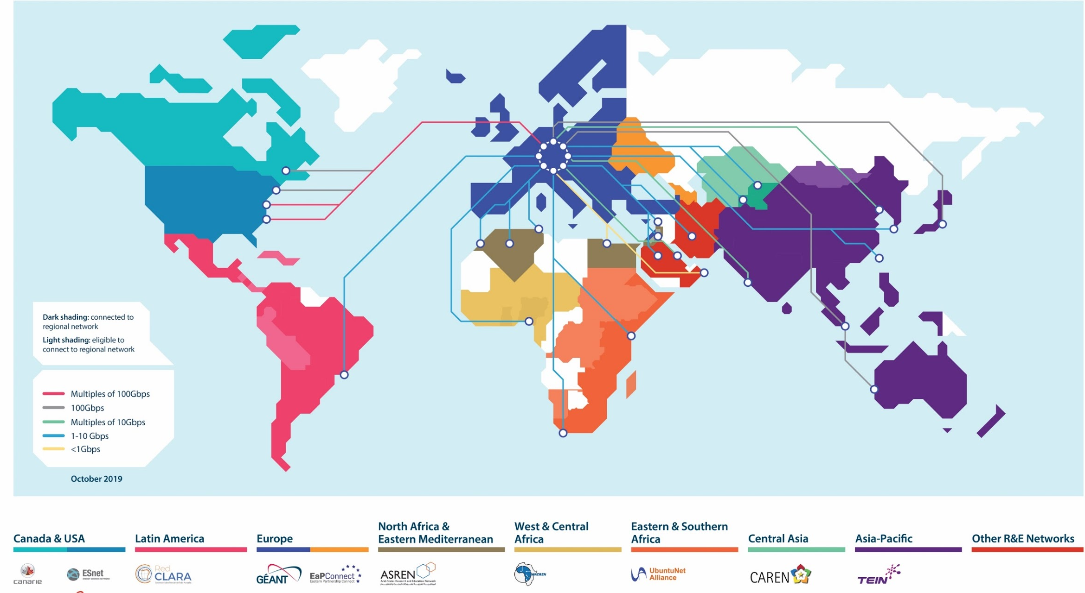
Network

Slide 22
Trust, Identity & Security
Supporting users and enabling secure access to services
eduroam - secure global roaming access service 250+ million authentications per month in 106 territories
eduGAIN - interconnects identity federations around the world, simplifying access to content, services and resources ~ 3500 identity providers accessing services
InAcademia - Lightweight student validation service
eduTEAMS - Making managing virtual teams easy
Trusted Certificate Service – delivering cost-effective digital certificates. In partnership with Sectigo

Slide 23
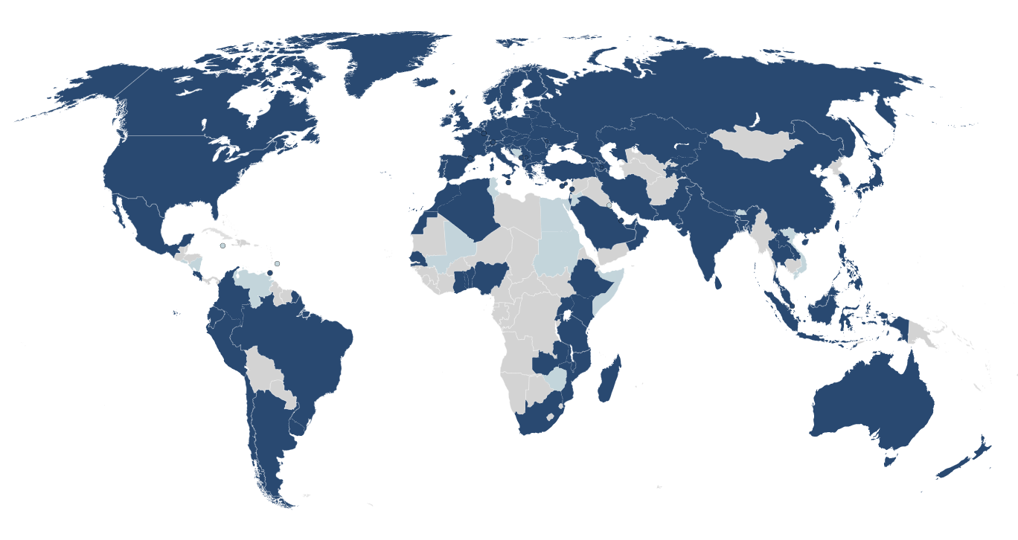
Service uptake – National Roaming Operators (NROs)
106
Countries
12 new NROs
6000+
Institutions
11% growth
26,000+
Service Locations
Internet Hall
of Fame 2019
Klaas Wierenga
>1 billion international authN in 2019
21% growth
CONNECT article
Notes:
Licia
First time that we mentioned INTERNATIONAL billion authN

Slide 24
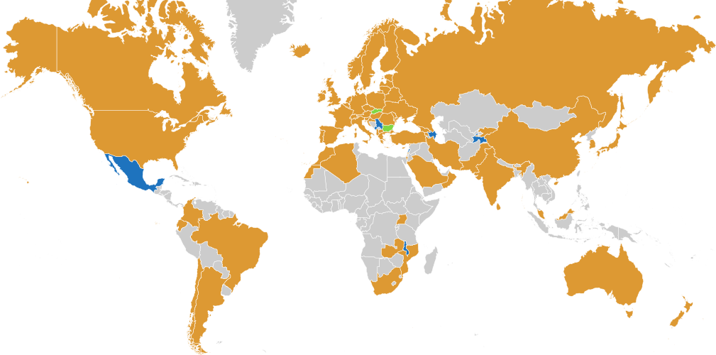
Service uptake – Identity Federations
68 Identity Federations
9 new members
3658 Identity Providers
23% growth
2944 Service Providers
27% growth
Notes:
Marina
Going back to the eduGAIN, service uptake continues to grow
with 9 new identity federations that have joined eduGAIN, we also tracked significant growth in number of idps and sps

Slide 25
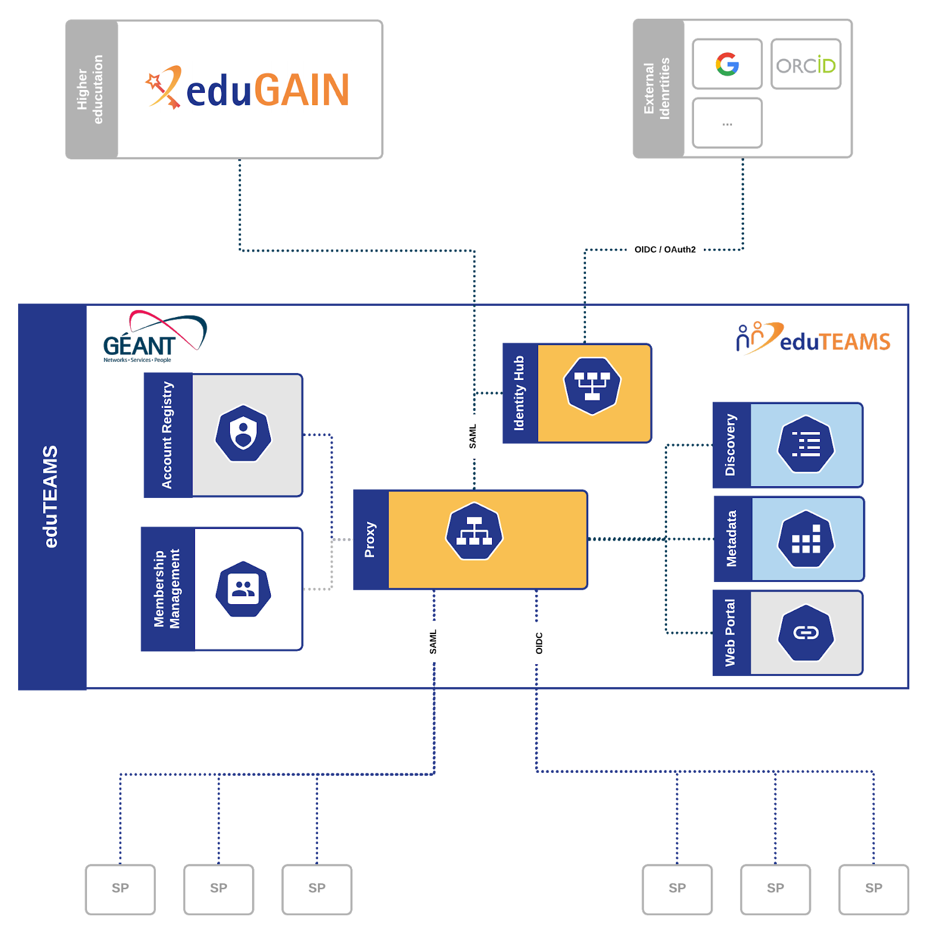
Managing virtual teams made easy
Users sign in to services with their community identity via eduTEAMS
Users register once and access any service (available to the their community)
Reduces complexity for Service Providers by providing one integration point for all services
Integration with GÉANT, EOSC and other communities and/or eduGAIN services
Notes:
Licia

Slide 26
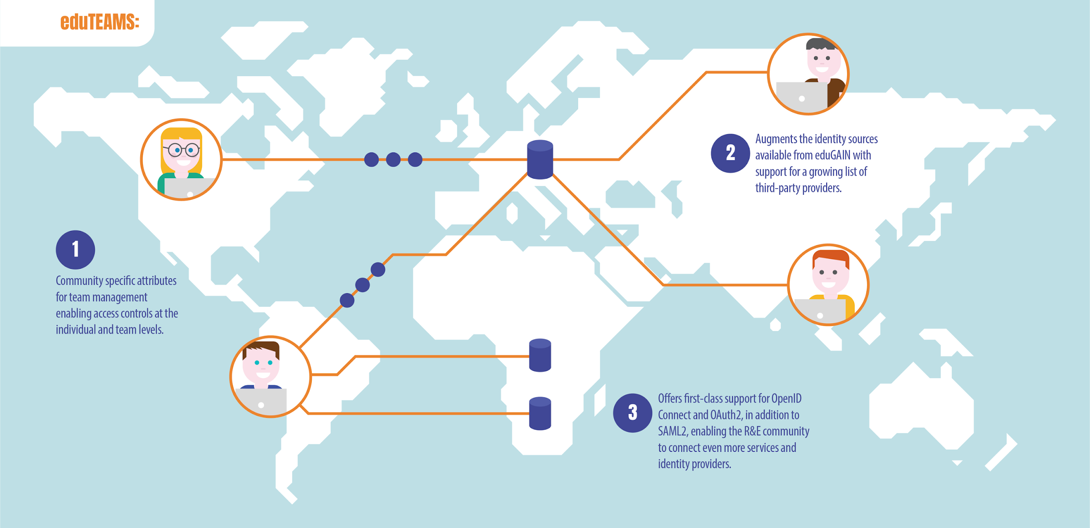
Managing virtual teams made easy
Notes:
Licia

Slide 27
Deployments and Achievements
eduTEAMS Service | Production
FENIX (European HPC) | Production
PaNOSC (UmbrellaID) | Production
RedIRIS | NextGEOSS | Production
VESPA (EuroPlanet) | Production
LAGO | Production
EOSC Life | Transition to Production
SURF Research Access Management | Transition to Production
GN4-3 | Implementation
EUROfusion | Implementation
OCRE | Implementation
ARCHIVER | Implementation
LUMI (European HPC) | Design
PRACE (European HPC) | Design
eduTEAMS one of the components of EOSC AAI
eduTEAMS technology underpins AAI for the Erasmus Programme for Student mobility
Notes:
Licia
Add KPIs from TA: · eduTEAMs: Web UI availability - Target: 99%
· eduTEAMs: number of communities using the service – Target: 10 (not in Y1!!!)

Slide 28
Investigation of selected solutions for IdPs
Shibboleth Identity Provider
Keycloak Identity Provider
Key Features
Out-of-the-box support for LDAP, Kerberos, JAAS, X.509, SPNEGO, Duo Security
Out-of-the-box support for reading user data from arbitrarily-structured LDAP directories
Fine-grained control over the data to release to a relying party system.
Works with any compliant SAML 1.1 and 2.0 Service Provider implementation.
Key Features
Single-Sign On Login once to multiple applications
Standard Protocols: OpenID Connect, OAuth 2.0 and SAML 2.0
LDAP and Active Directory: Connect to existing user directories
Social Login Easily enable social login
Identity Brokering: OpenID Connect or SAML 2.0 IdPs Password Policies: Customize password policies
© Poznan Supercomputing and Networking Center

Slide 29
Poznan Supercomputing and Networking Center
Implementation

Slide 30
Setting up new IdPs
UKAEA
First attempt with Shibboleth IdP
IdP was setup, but there were issues in integration with LDAP schema
Quite some time spend in debugging of the issues (without access to site;) )
Second attempt
KeyCloak was setup and configured (based on PSNC example)
Integration with EUROfusion AAI done and tested
PSNC
KeyCloak IdP was setup and containerised version prepared
Integration with EUROfusion AAI done and tested
CEA
Central CEA IdP was setup and added to eduGain federation
Integration with EUROfusion AAI done and tested
EF Garching
KeyCloak IdP was setup but only with test account
Integration with EUROfusion AAI done and tested
Import/integration with AD/LDAP tested (but not exposed) -> waiting decision
© Poznan Supercomputing and Networking Center

Slide 31
Setting up of EUROfusion AAI Proxy
eduTeams AAI Proxy, based on Perun, have been installed and configured as a service dedicated for EUROfusion
During the pilot the service have been updated to the latest version of software
Acceptance environment have been set-up
Demonstration for administrators have been provide by Geant
Several IdPs have been integrated in the Acceptance environment
Services have been integrated in the Acceptance environment
© Poznan Supercomputing and Networking Center

Slide 32
Integration of the services
Initially selected services:
Any service at UKAEA currently using users.euro-fusion.org🡪 selected Room Booking service
Service have been integrated and configured accordingly --> Demo by Matt
Using OIDC
IDM/IMS at EF/Garching -> will require change, was not possible due to subcontracting
Test service similar to WEST portal -> it is ongoing activity (dependent on central CEA policies/security team)
Using SAML
Other proposed services
Services at EF Gateway: developed in EF WPISA CPT (Catalogue QT) + Fair4Fusion Dashboard
Service have been integrated and configured accordingly -> Demo by Michal
Using OIDC
© Poznan Supercomputing and Networking Center

Slide 33
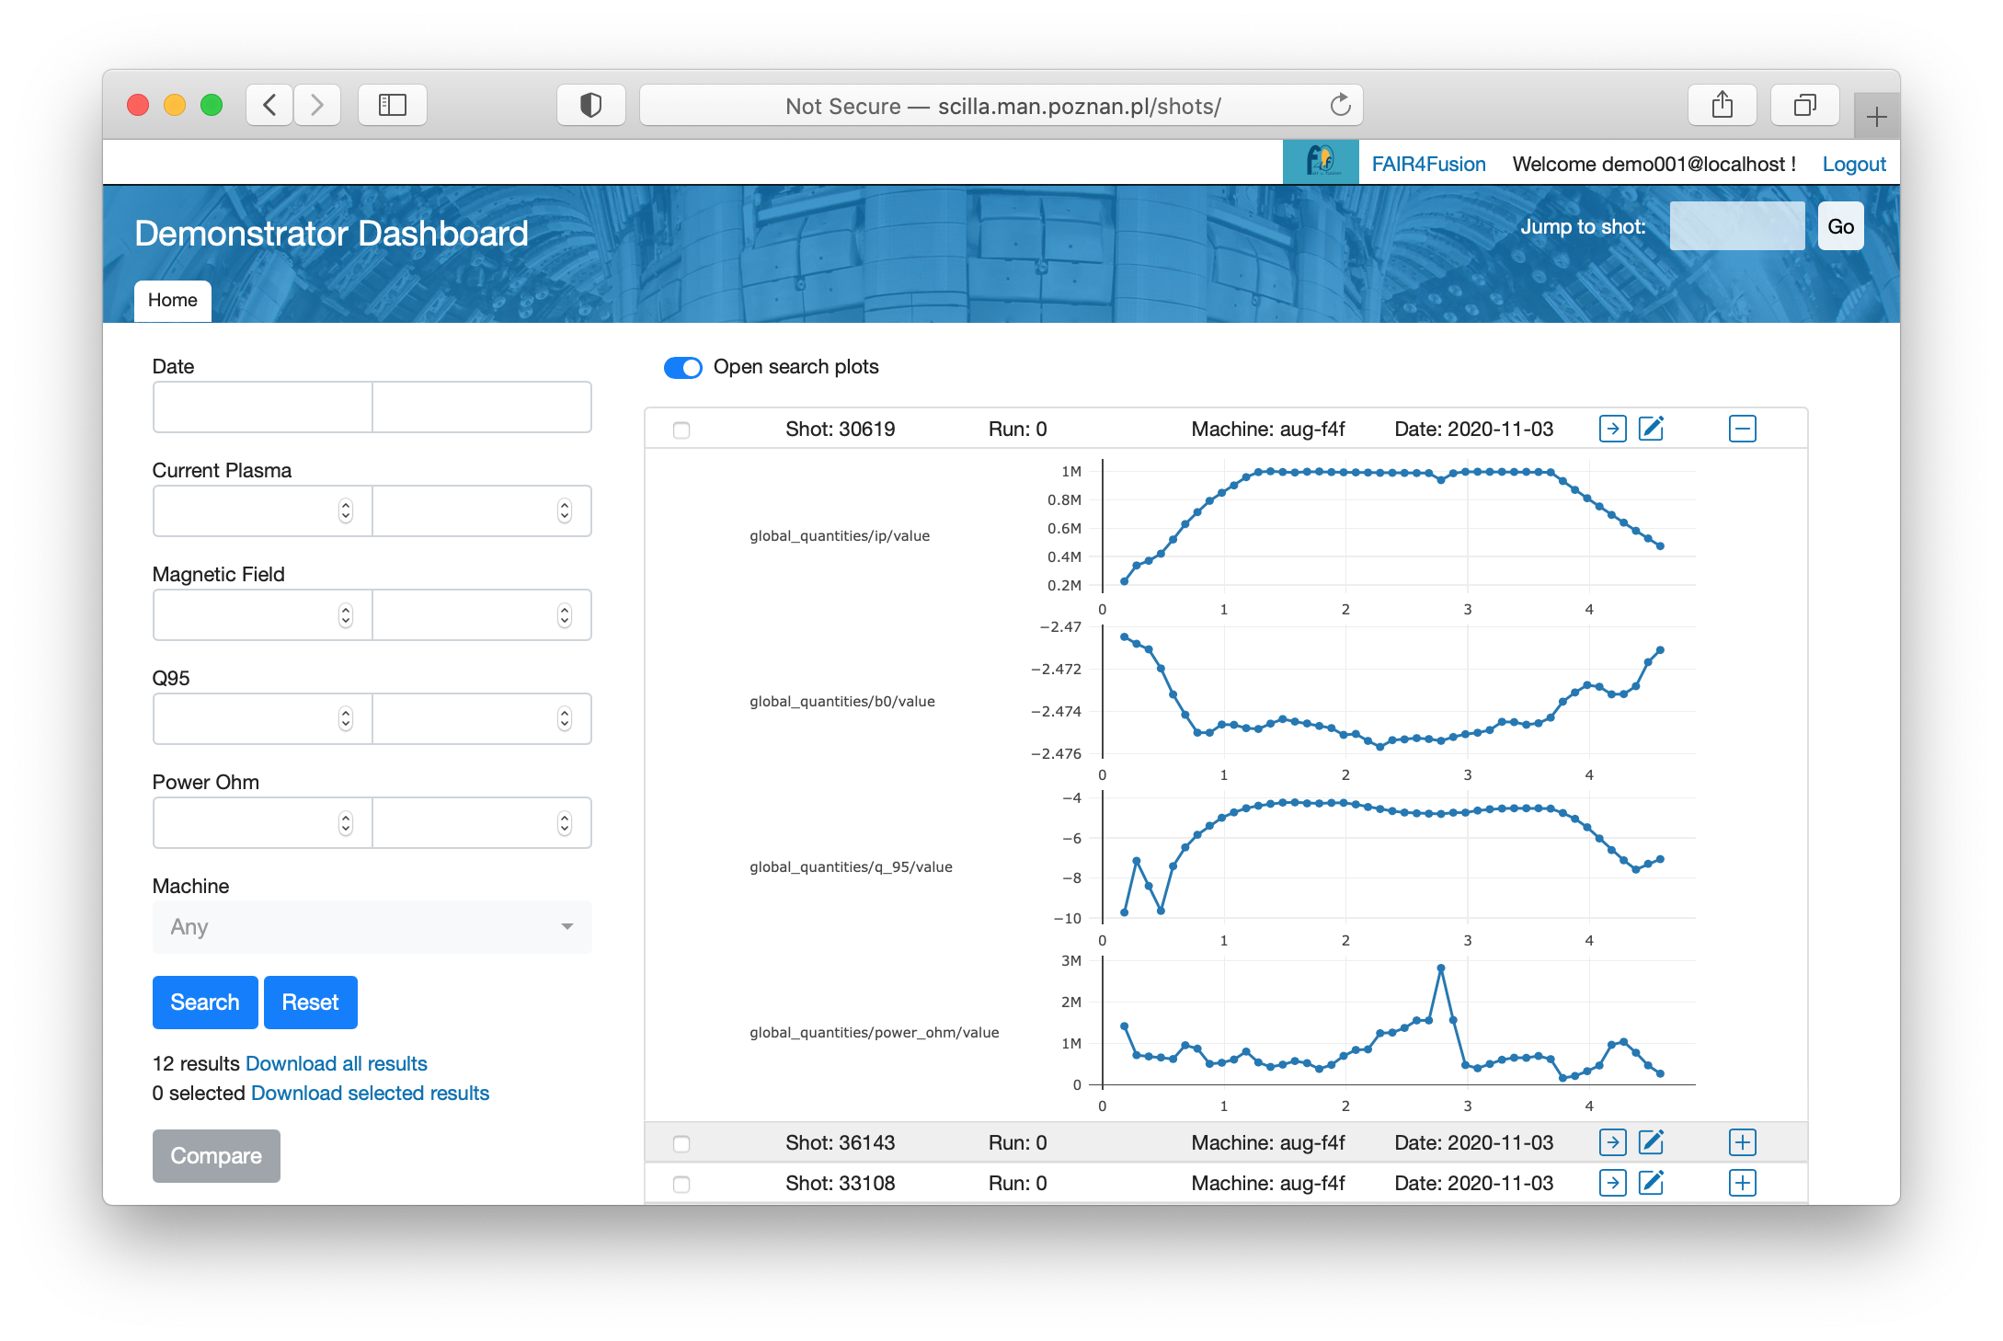
Demonstrator – Fair4Fusion Dashboard and EF Catalogue QT
Catalogue QT(IMAS Summary IDS database) and Fair4Fusion Dashboard Demonstrator (based on JET Dashboard concept)
IMAS based format, search based on metadata: Summary IDS
UDA and MDSPlus reader to ingest data
Comparing/filtering selected data from MAST/JET/AUG/WEST
Installed on Gateway - integrated with EUROfusion AAI Proxy
© Poznan Supercomputing and Networking Center

Slide 34
Poznan Supercomputing and Networking Center
Benefits

Slide 35
Benefits – general overview
Improve security by fine grained authorisation shared between all interested parties:
Home institutions or EUROfusion(for EF IdPs) - responsible for adding and removing users
EUROfusion -responsible for group or virtual organisation management
Service providers - responsible for granting access to services
Reduce, simplify and improve management issues
People’s identity and attributes (e.g. affiliation) easily verified through a federated AAI
Provide access to pan-European e-Infrastructures and compatibility to the main middleware solutions in use (e.g. EOSC)
Reduce the burden of multiple users’ accounts, issued by individual labs.
Less accounts people have to keep track of
Ideally single sign on
Improves the security
© Poznan Supercomputing and Networking Center

Slide 36
Benefits
A user can authenticate at one identity provider and access all the services that are available to the EUROfusion community.
All services in EUROfusion receive the same consistent information about the user, including the community user identifier, which is the same for all services.
Users can share data and resources across services as they are uniquely and consistently identified.
Access policies, users and groups can be managed from a central location, the EUROfusion AAI with the ability to delegate to part of the management to authorized users.
© Poznan Supercomputing and Networking Center

Slide 37
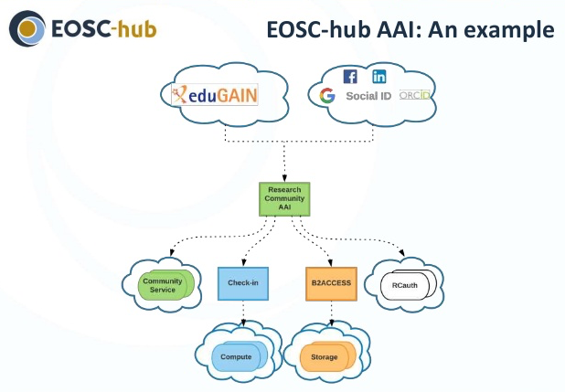
Benefits – easy integration with EOSC infrastructure
Each AAIs can act as service gateway
Researchers sign with their community identity via their community AAI
Community specific services are connected to a single Research Community AAI
E-Infra services are connected to single e-Infra AAI service gateways e.g. B2Access, EGI Check-in, Indigo IAM
© Poznan Supercomputing and Networking Center

Slide 38
Poznan Supercomputing and Networking Center
Summary,
Next steps
Discussion points

Slide 39
Summary
All planned activities have been performed
Adjustments based on investigation during the project
Instead of “software” - “service” due to possible cost of maintenance
Choice of services to be integrated
More IdP’s integrated
Major achievements
Acceptance environment
IdPs installed and tested
EUROfusion AAI Proxy setup, configured and operational
Selected services integrated
Provided examples and guidelines for IdP installation, service integration
© Poznan Supercomputing and Networking Center

Slide 40
Next steps and discussion points
Transition from acceptance environment to production
IdPs: Policies needs to be in place
Green light for the IdP@ Garching
EUROfusion AAI – right policies and technical controls in place so that the EUROfusion AAI service will be operated in compliance with the GDPR
To be decided:
The first point is to identify which legal entity will be the Data Controller for the service(The Data Controller is the entity “owning” the service)
The DPO of that legal entity needs to be directly involved and drive this process
What we absolutely need is the Privacy Policy and the Acceptable Use Policy
Useful examples/templates/guidelines:
AARC Policy Development Kit https://aarc-community.org/policies/policy-development-kit/
GEANT templates:
Data Inventory https://wiki.geant.org/pages/viewpage.action?pageId=131634682
Data Mapping https://wiki.geant.org/pages/viewpage.action?pageId=131634706
Data Protection Impact Assessment: https://wiki.geant.org/pages/viewpage.action?pageId=131634708
Integrated services needs to accept this policies
© Poznan Supercomputing and Networking Center

Slide 41
Next steps
Integration of the services:
Access to central services (e.g. other services using users.euro-fusion.org currently like wiki pages, etc, IMS, Indico, …)
Access to ACH’s services (Data services, HPC, IM Infrastructure)
Necessary component for making the data FAIR: as step for accessing experimental and modelling data (also as important element for provenance/ open data etc)
Strong interest from CEA to continue the integration for the WEST
Further scenarios related to more fine grained authorisation
Future support - for the discussion
Currently support for services/community AAI as small part of the PSNC CSI ACH proposal(?)
© Poznan Supercomputing and Networking Center

Slide 42
Involved people - acknowledgments
PSNC: Marcin Płóciennik, Paweł Spychała, Tomasz Kuczyński, Michał Owsiak, Konrad Leszczyński
UKAEA: Matt Gallagher, Grist David, Liviu Joita,
CEA: Thierry Hutter
EUROfusion Garching: Rudolf Bauer, Stefan Beck
GEANT: Christos Kanellopoulos, Simone Visconti, Mario Reale, Chris Atherton
© Poznan Supercomputing and Networking Center

Slide 43
Questions?
marcinp@man.poznan.pl
This work has been carried out within the framework of the EUROfusion Consortium and has received funding from the Euratom research and training programme 2014-2018 under grant agreement No 633053.The scientific work is published for the realization of the international project co-financed by Polish Ministry of Science and Higher Education in 2019 and 2020 and in 2021 from financial resources of the program entitled "PMW"; Agreement No. 5040/H2020/Euratom/2019/2 and 5142/H2020-Euratom/2020/2”.

Slide 44
Researchers sign in using their institutional (eduGAIN), social or community-managed IdP via their Research Community AAI
Community-specific services are connected to a single Community AAI
Generic services can be connected to more than one Community AAI proxies through eduGAIN
e-Infra services are connected to a single e-infra SP proxy service gateway
EUROfusion Identity
EUROfusion Services
Notes:
Licia
Add KPIs from TA: · eduTEAMs: Web UI availability - Target: 99%
· eduTEAMs: number of communities using the service – Target: 10 (not in Y1!!!)

Slide 45
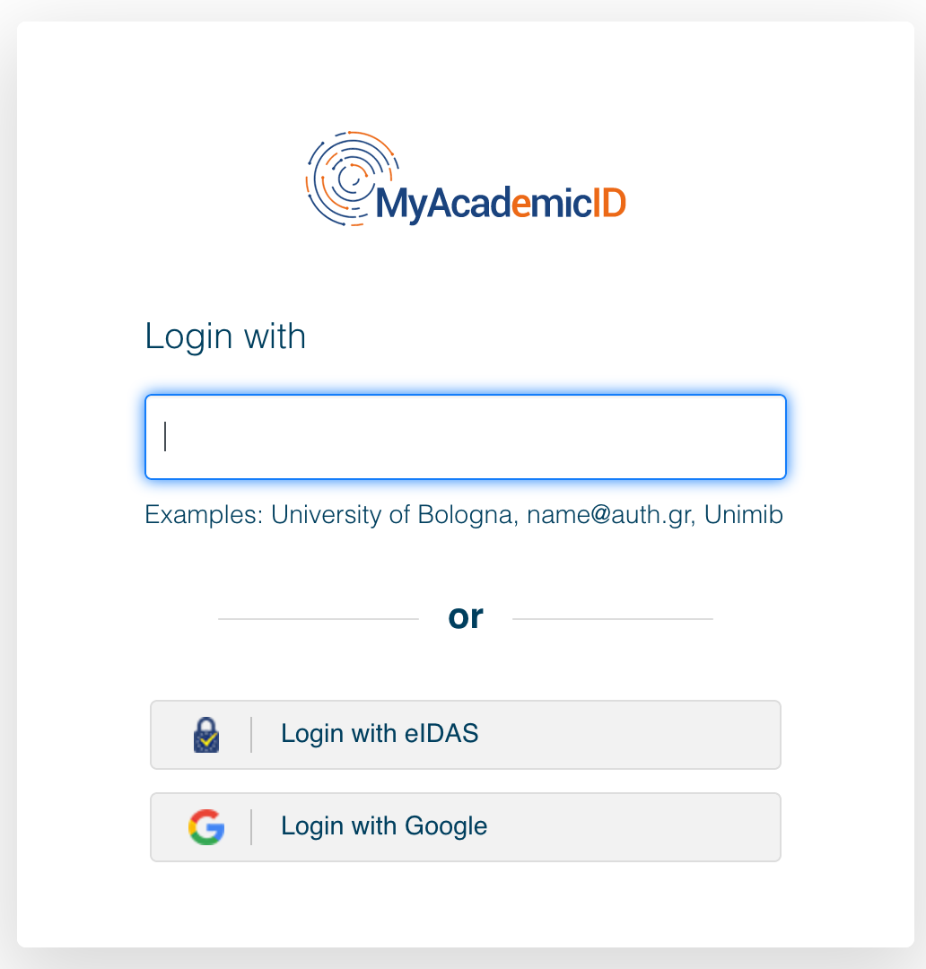
User Login with multiple Identity Providers
EUROfusion Identity
EUROfusion Services
Notes:
Licia
Add KPIs from TA: · eduTEAMs: Web UI availability - Target: 99%
· eduTEAMs: number of communities using the service – Target: 10 (not in Y1!!!)

Slide 46
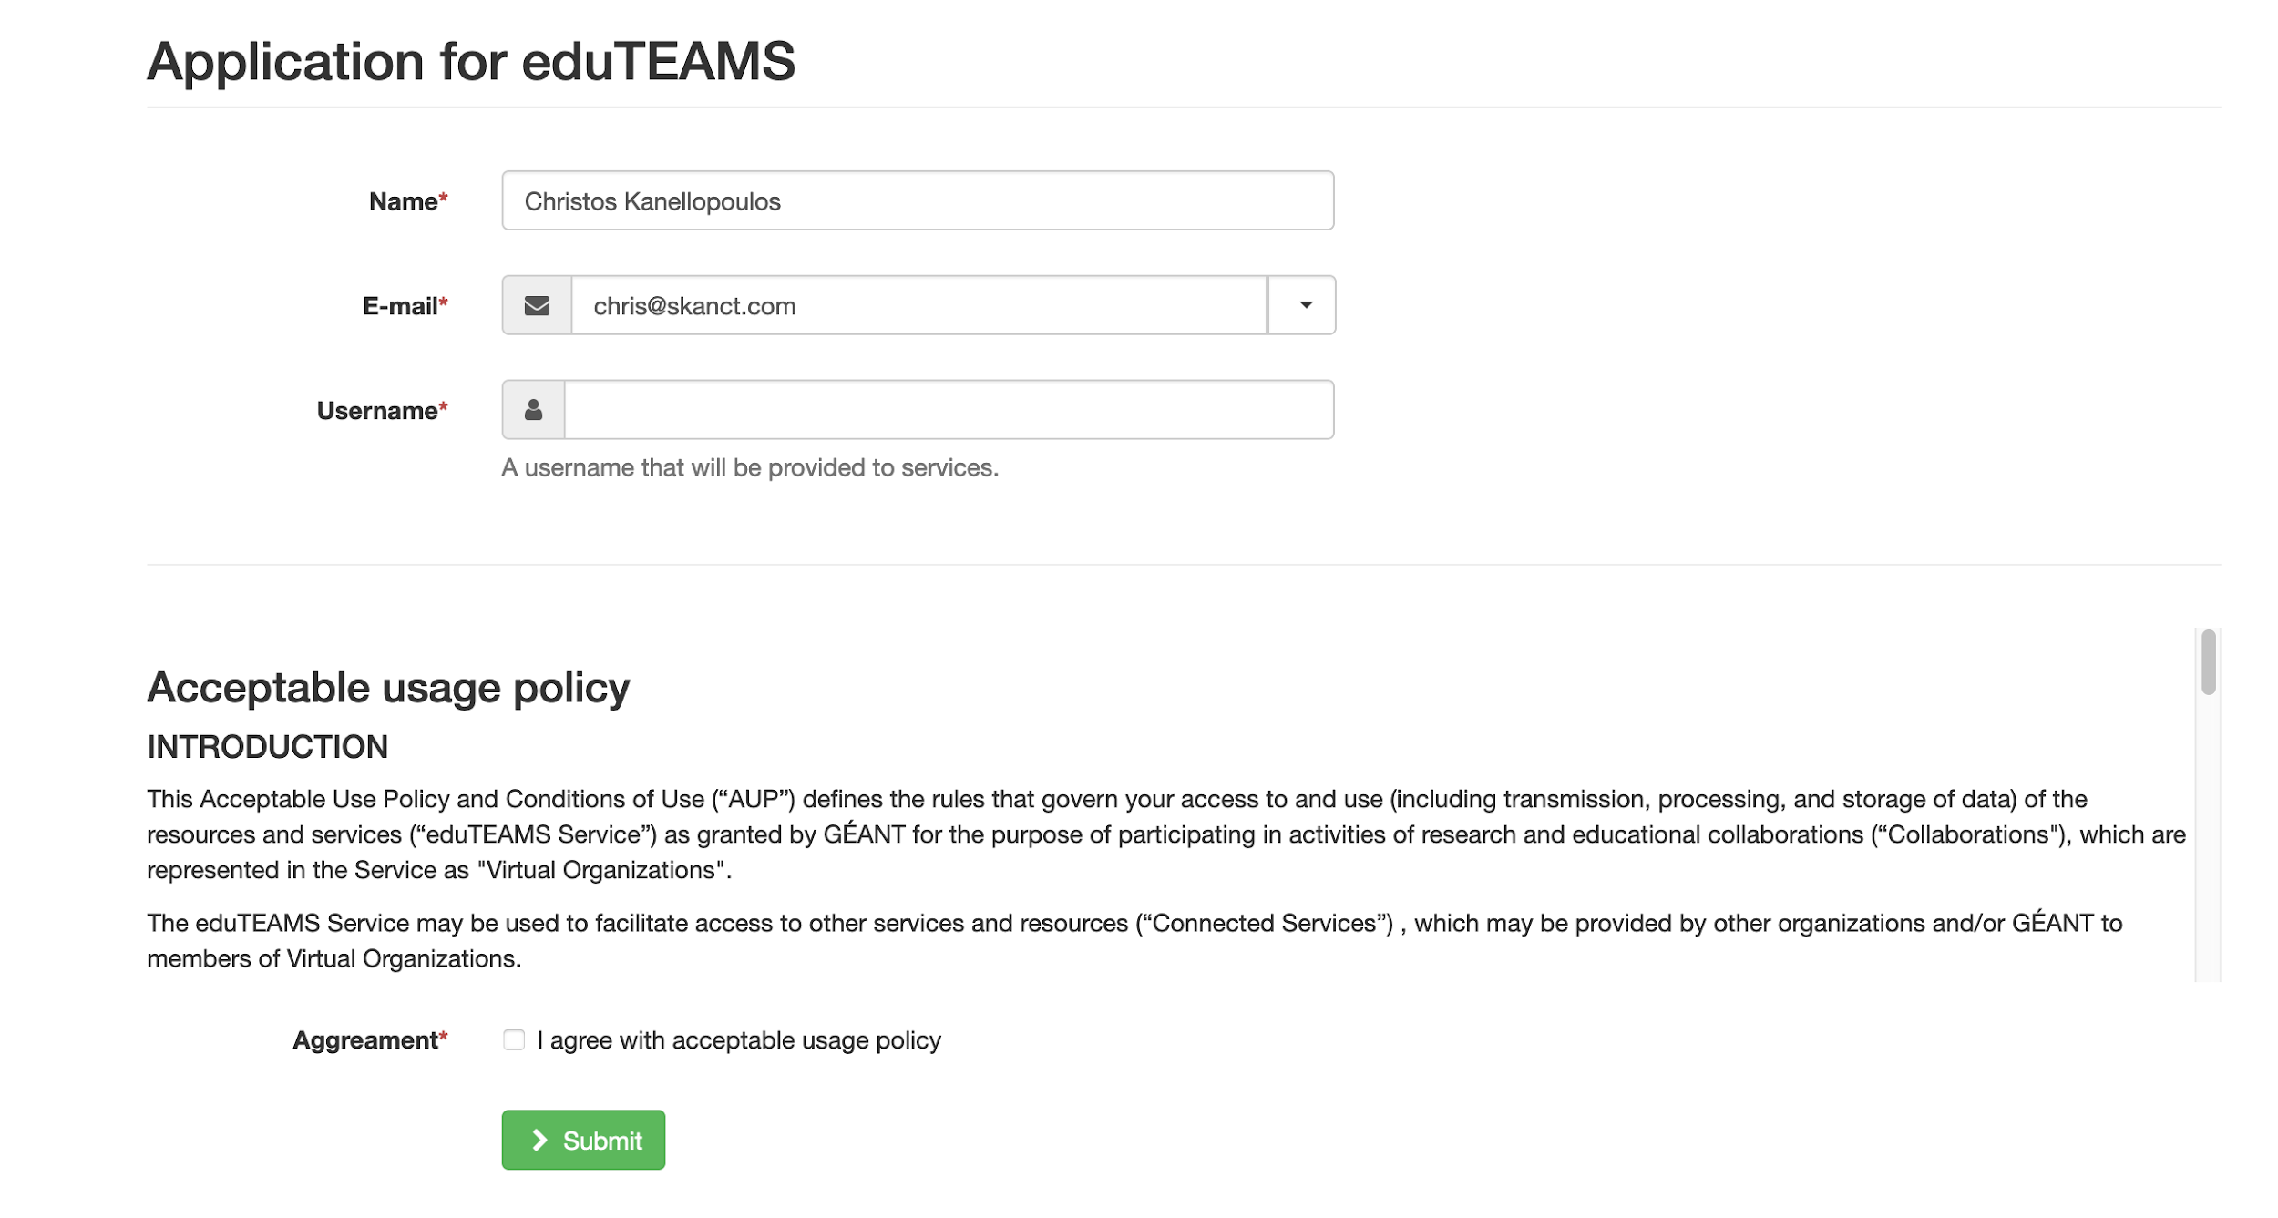
User Registration
EUROfusion Identity
EUROfusion Services
Notes:
Licia
Add KPIs from TA: · eduTEAMs: Web UI availability - Target: 99%
· eduTEAMs: number of communities using the service – Target: 10 (not in Y1!!!)

Slide 47
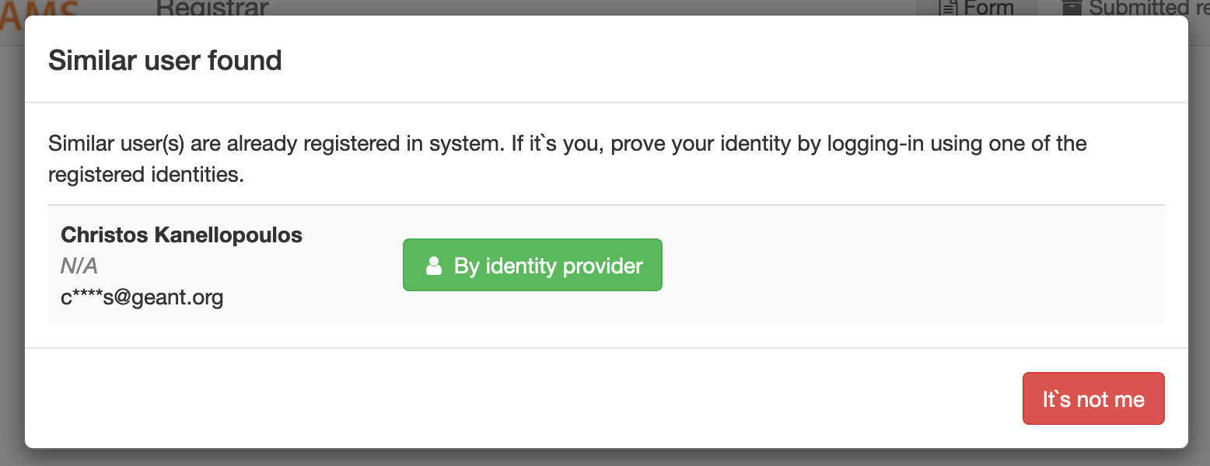
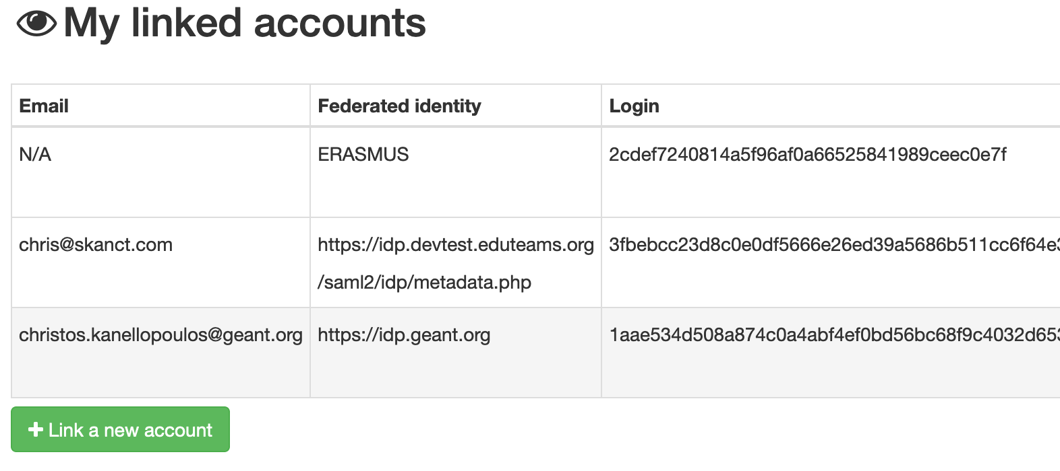
Identity Linking
EUROfusion Identity
EUROfusion Services
Notes:
Licia
Add KPIs from TA: · eduTEAMs: Web UI availability - Target: 99%
· eduTEAMs: number of communities using the service – Target: 10 (not in Y1!!!)

Slide 48
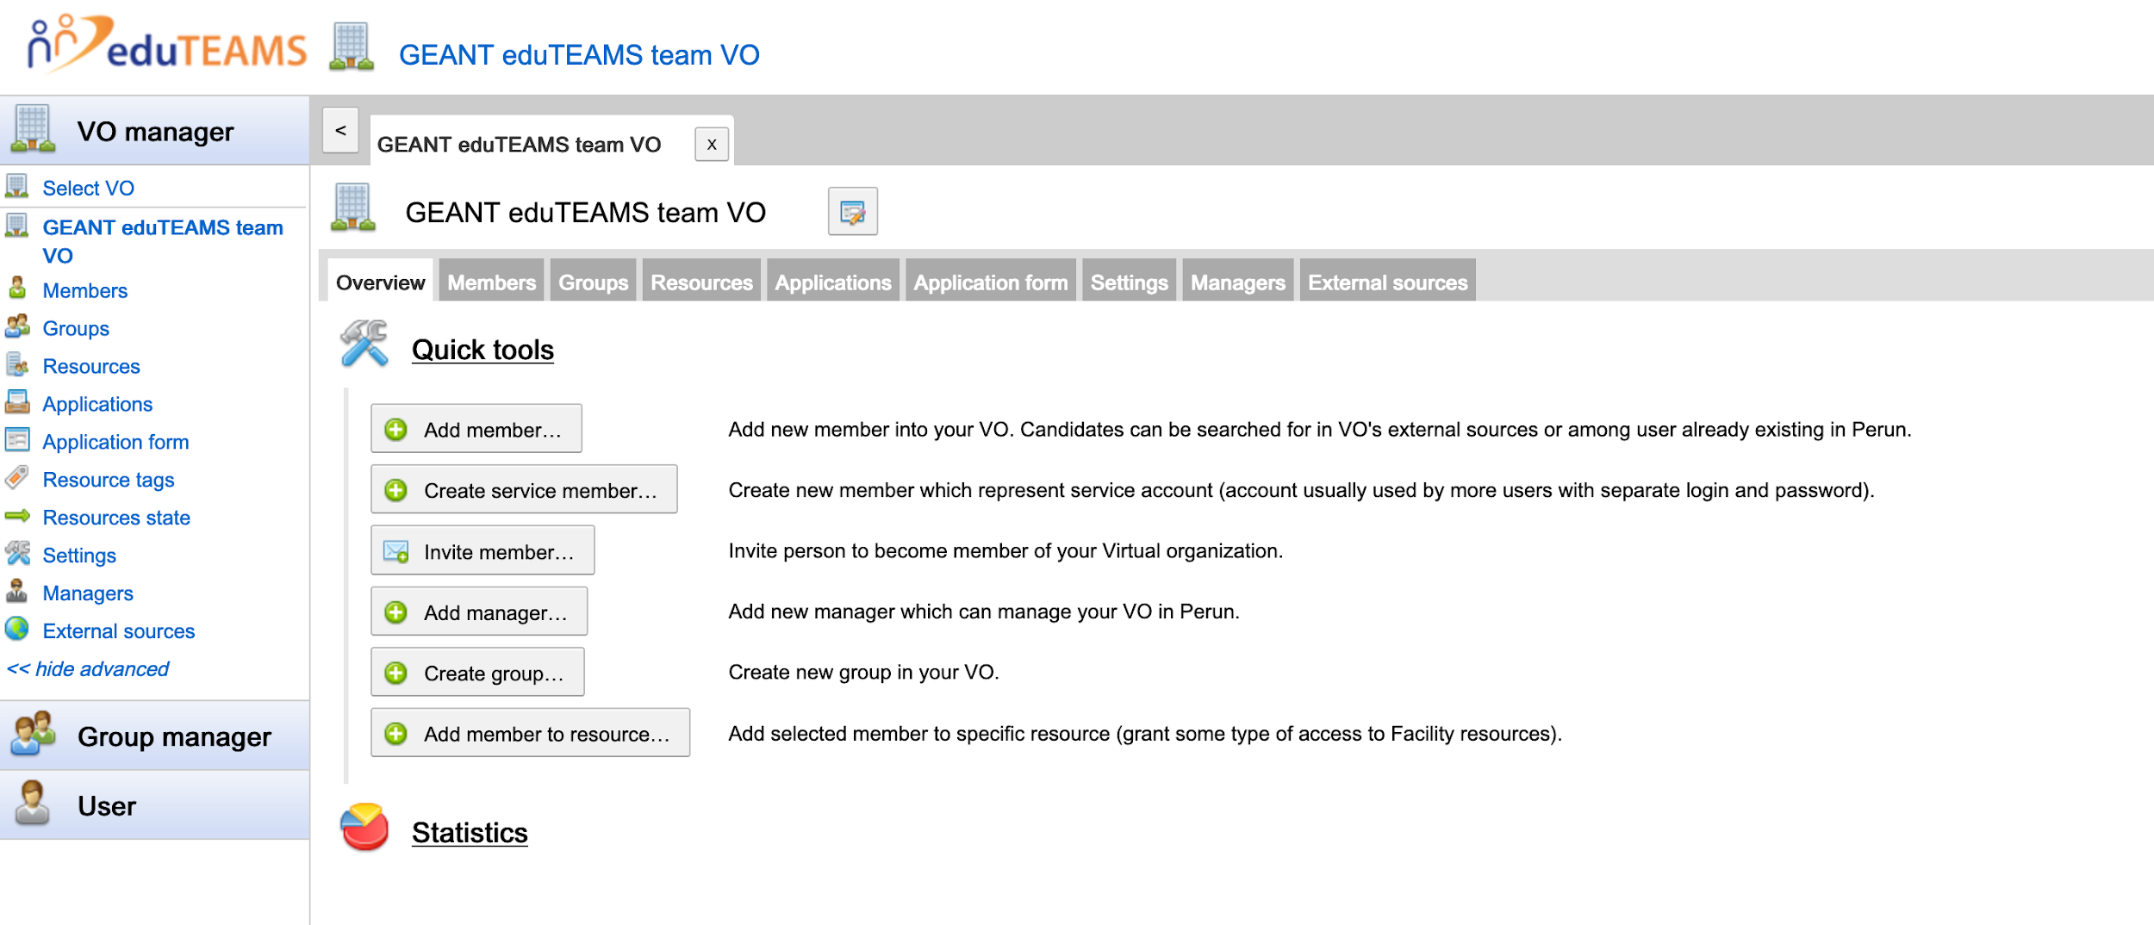
EUROfusion Identity Management
EUROfusion Identity
EUROfusion Services
Notes:
Licia
Add KPIs from TA: · eduTEAMs: Web UI availability - Target: 99%
· eduTEAMs: number of communities using the service – Target: 10 (not in Y1!!!)

Slide 49
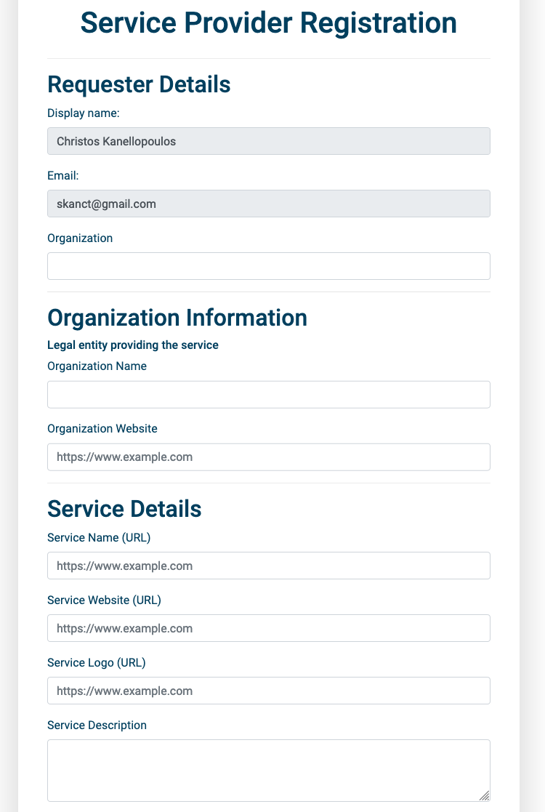
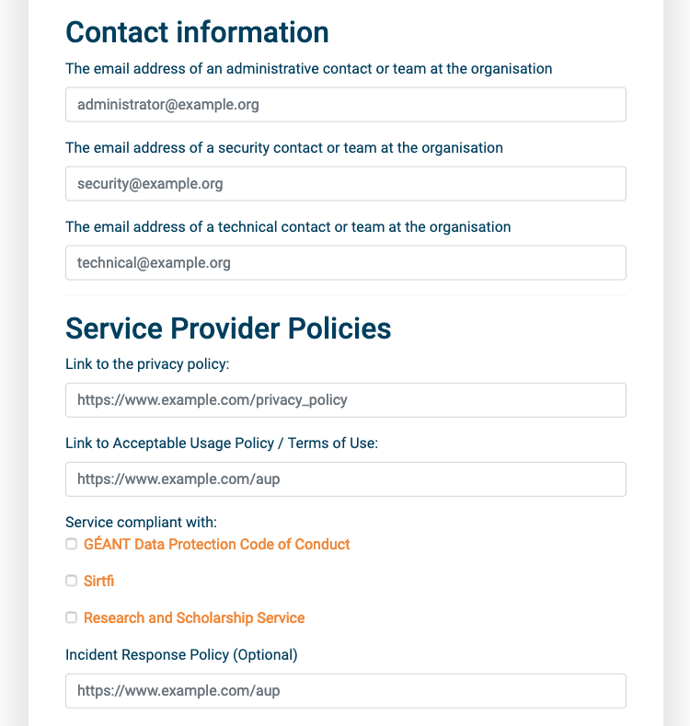
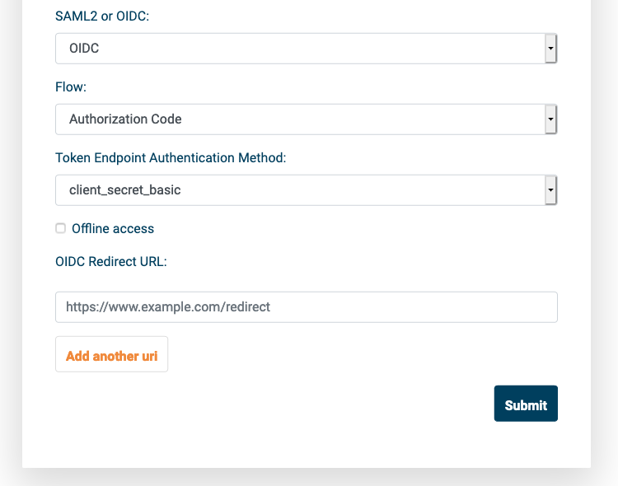
Connecting Service
EUROfusion Identity
EUROfusion Services
Notes:
Licia
Add KPIs from TA: · eduTEAMs: Web UI availability - Target: 99%
· eduTEAMs: number of communities using the service – Target: 10 (not in Y1!!!)

Slide 50
Thank you
christos.kanellopoulos@geant.org
© GÉANT Association
As part of the GÉANT 2020 Framework Partnership Agreement (FPA), the project receives funding from the European Union's Horizon 2020 research and innovation programme under Grant Agreement No. 856726 (GN4-3).

