Slide 1
Fair4Fusion – Blueprint EUROfusion IT Group meeting 18.03.21
Authors : Marcin Plociennik (PSNC) Shaun de Witt (UKAEA) Frederic Imbeaux (CEA) David Coster (IPP) Par Strand (Chalmers)
This slide set is released under CC-BY-SA-4.0

Slide 2
Fusion vs other Big Science
Where are my data?
Which flight do I need
to get access
experimental data?

Slide 3
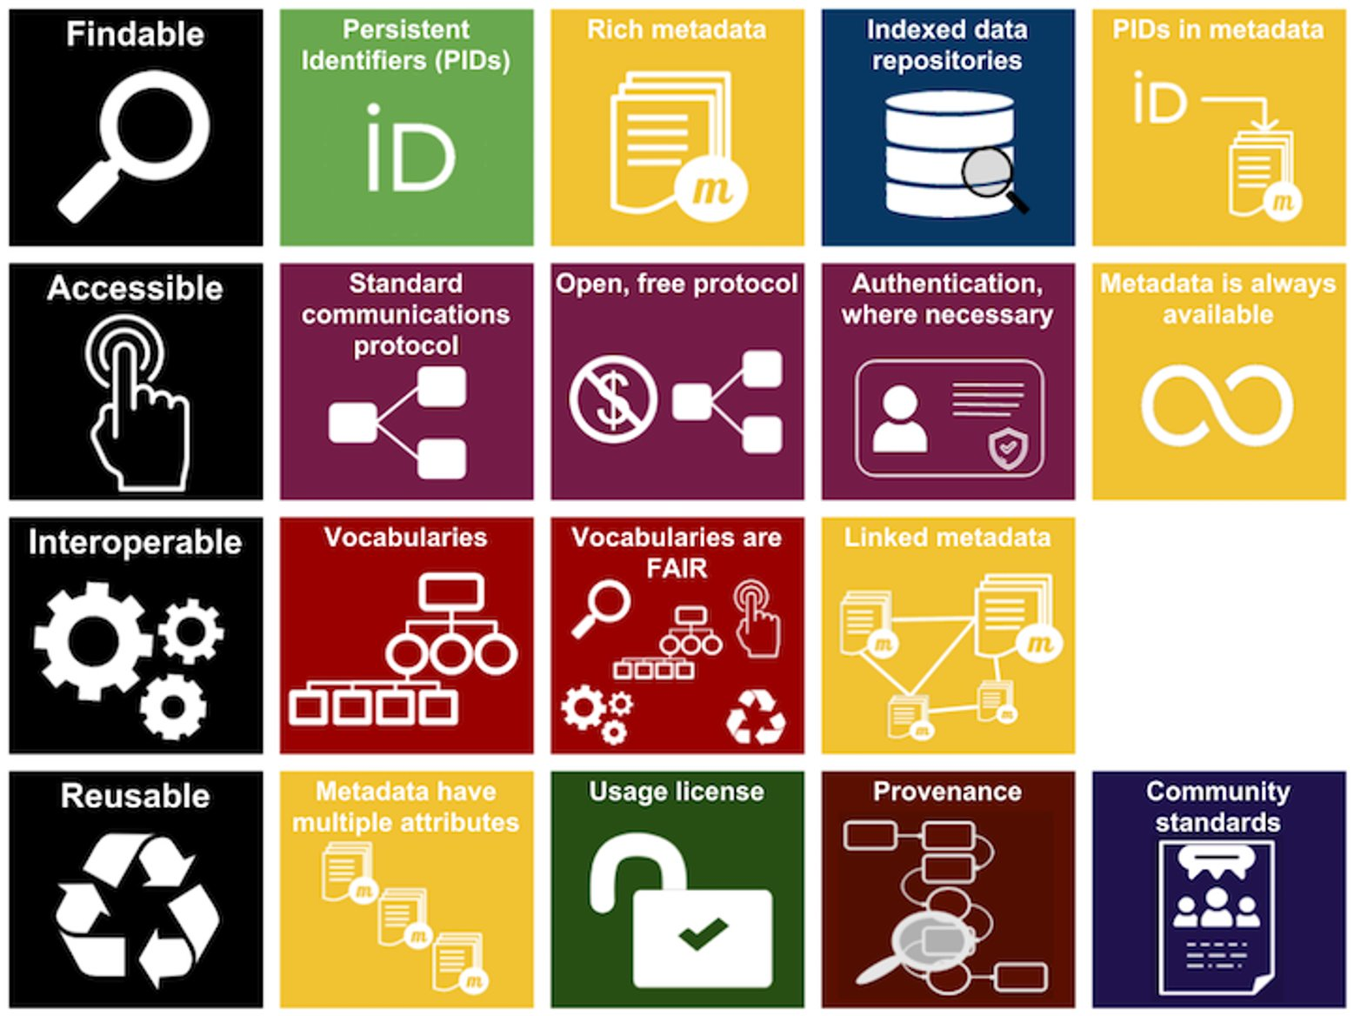
Where does Fusion sit in FAIR?

Slide 4
Fair for Fusion – Open Access for fusion data in Europe
Project duration: 24 months
(2019-2021)
Total budget: € 1 987 960
In Fair4Fusion we work on: Comprehensive assessments of FAIR data requirements and open data issues in fusion programme Recommendations on the best technical approaches for providing access to data Development of support platforms and tools required to implement an open data policy adapted to the needs of the fusion research programme. Pooling the talent and knowledge from big science programmes and organisations With the objectives of: Further developing tools and platforms needed for an open data approach. Raising the profile and awareness of FAIR and open data within the fusion programme. Laying the foundations for implementing an open data policy adapted to the needs of the present and especially the future fusion energy research programme, particularly in the run up to the operation of ITER from the middle of the next decade.
Consortium: 7 partners
Project website: https://fair4fusion.eu/

Slide 5
Fair4Fusion ambition
F4F
The Magnifying glass, Tap, Gears set, Recycle sign, Storage, Infinity, Discussion, Shield, and Man User icons made by Freepik from www.flaticon.com are licensed by CC 3.0 BY. All other icons made by ARDC. Entire FAIR resources graphic is licensed under a Creative Commons Attribution 4.0 International License
we have addressed issues of community standards and metadata always available and linked metadata in year 1

Slide 6
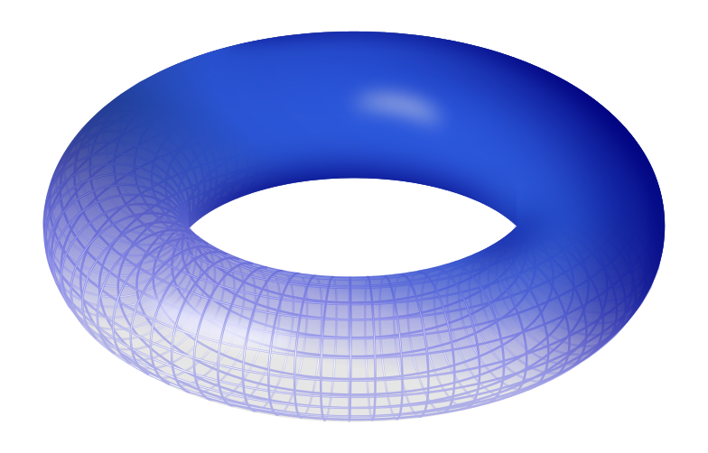
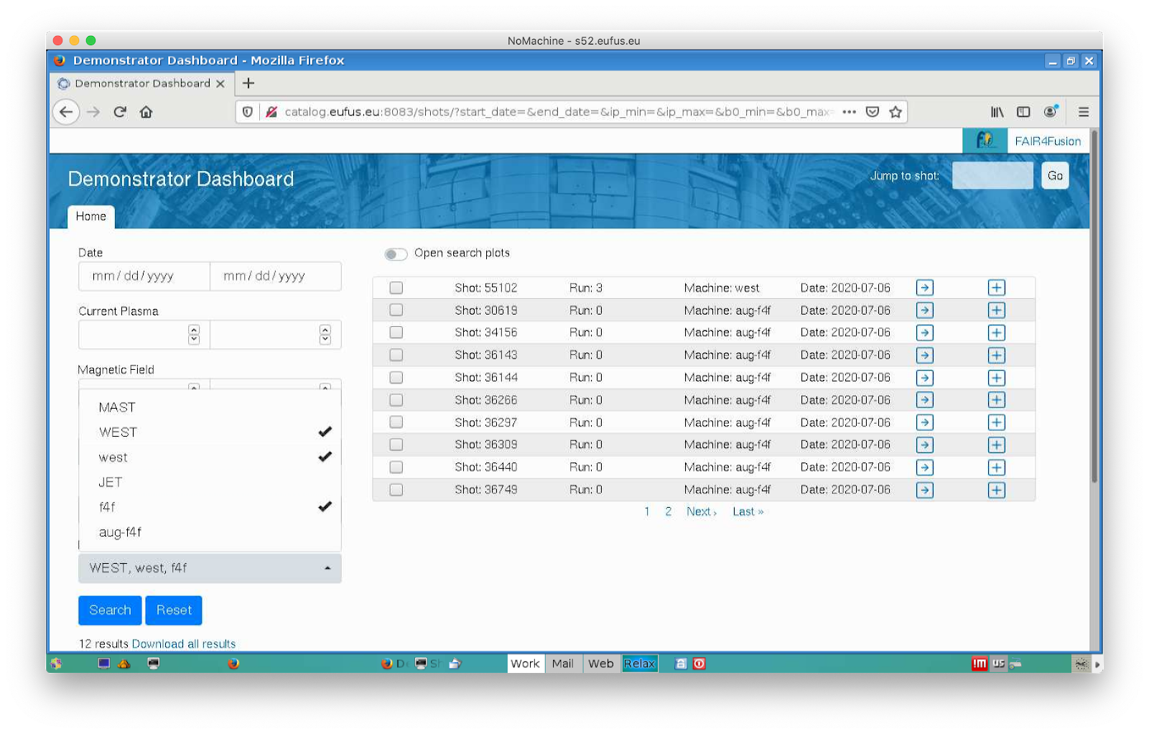
Goals outputs: Fair for fusion innovation
F4F
Torus Image © Leonid_2. licensed under the Creative Commons Attribution-Share Alike 3.0 Unported license

Slide 7
Expected outputs: Fair for fusion innovation
Develop Tools and Platform needed for an open data approach
Evolving existing data towards FAIR data compliance
Tools and platform to demonstrate the benefits of FAIR
Increase Trust in data by including relevant provenance information - a well-defined metadata schema
Allow for easy cross site data identification and access, with a flexible approach to data delivery.
Raise the profile and awareness of FAIR data within the fusion program
Lay the foundations for implementing an open data policy particularly in the run up to ITER
Ensure policies meet both FAIR requirements and data is ‘as open as possible, as closed as necessary’
Ensure the architecture meets user requirements in terms of scalability, flexibility and ease of use.

Slide 8
Project approach
Requirements, Policies and Data Landscape
Blueprint Architecture
Demonstrators
FAIR Components
Components development
Technology Evaluator

Slide 9
Data Identification and Policy Landscape
Existing experiments have some internal degree of FAIRness
But not across the EU fusion community
Need a way to make scientific analysis (i.e. metadata and data) interoperable across multiple fusion experiments.
Benefits not only for manual database queries
but would also enable the use of new methods of research with Data Mining and Machine Learning techniques at an unprecedented scale
The IMAS Data Dictionary is recommended for achieving interoperability within the community.

Slide 10
Use Case Definitions
Developed with fusion researchers and members of FAIR groups
76 user stories identified so far
Covers
Security
Data Access
GDPR
Searching & Querying
Experimental Impact
Visualisation
Who
Fusion scientists / data scientists / members of the public
What
scalar data / 1-d data / 2-d data / structured data
Limitations
usually from the data providers (GDPR, no impact on operations, cost)

Slide 11
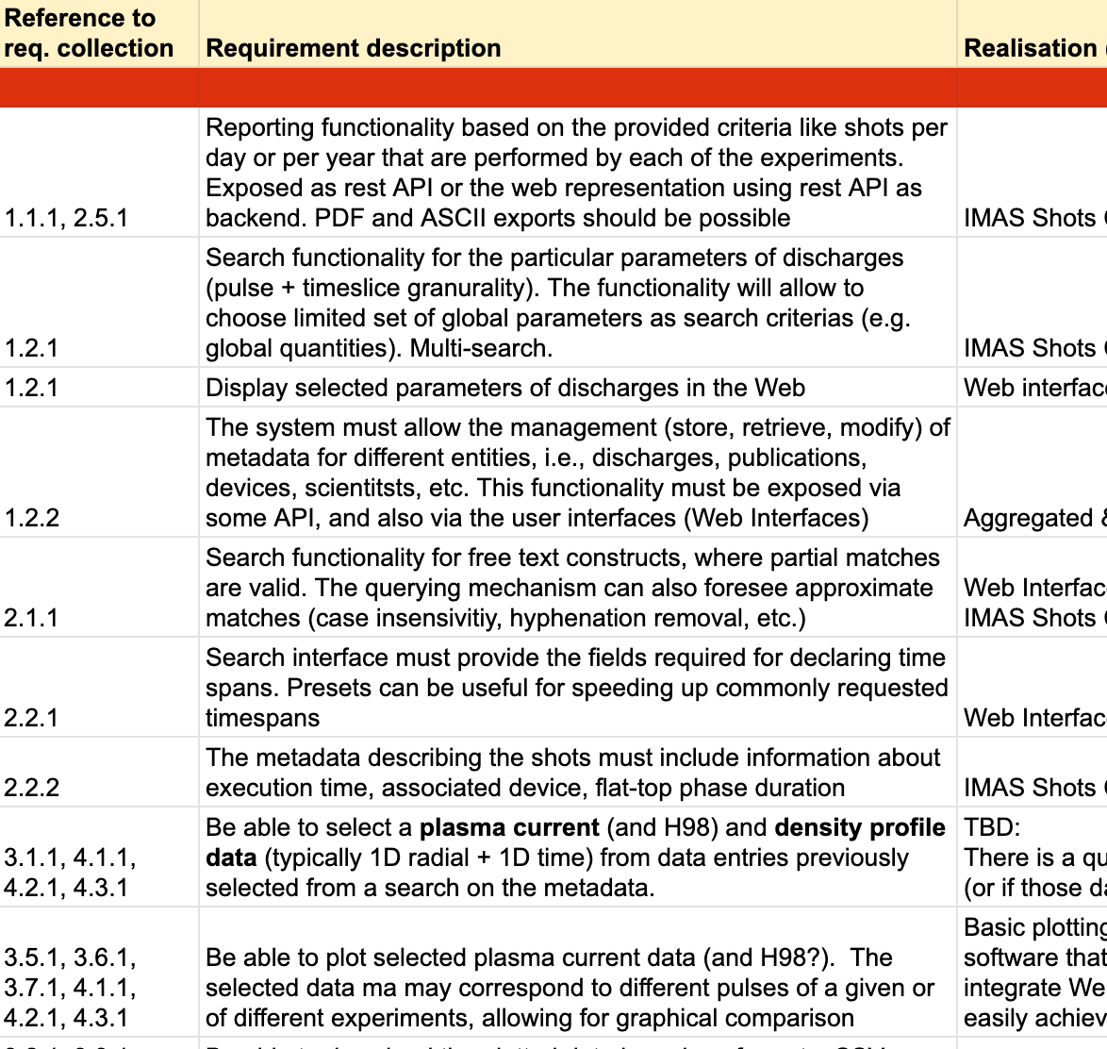
Requirements Specification
Converting the use cases and user stories into a list of the technical requirements specification
99 requirements
Requirements used for prototype planning and blueprint architecture
Definition of the functionalities in the blueprint
44 functionalities grouped into 11 categories

Slide 12
Functionalities list - categories
F1 Search
F2 Visualisation and accessing outputs
F3 Report generation (output metadata resulting from the Search)
F4 User Annotation Curation Management
F5 F4F Metadata Management
F6 Subscriptions and notifications
F7 Versioning and provenance
F8 Authentication
F9 Authorization/Access restrictions
F10 Accounting
F11 Licensing

Slide 13
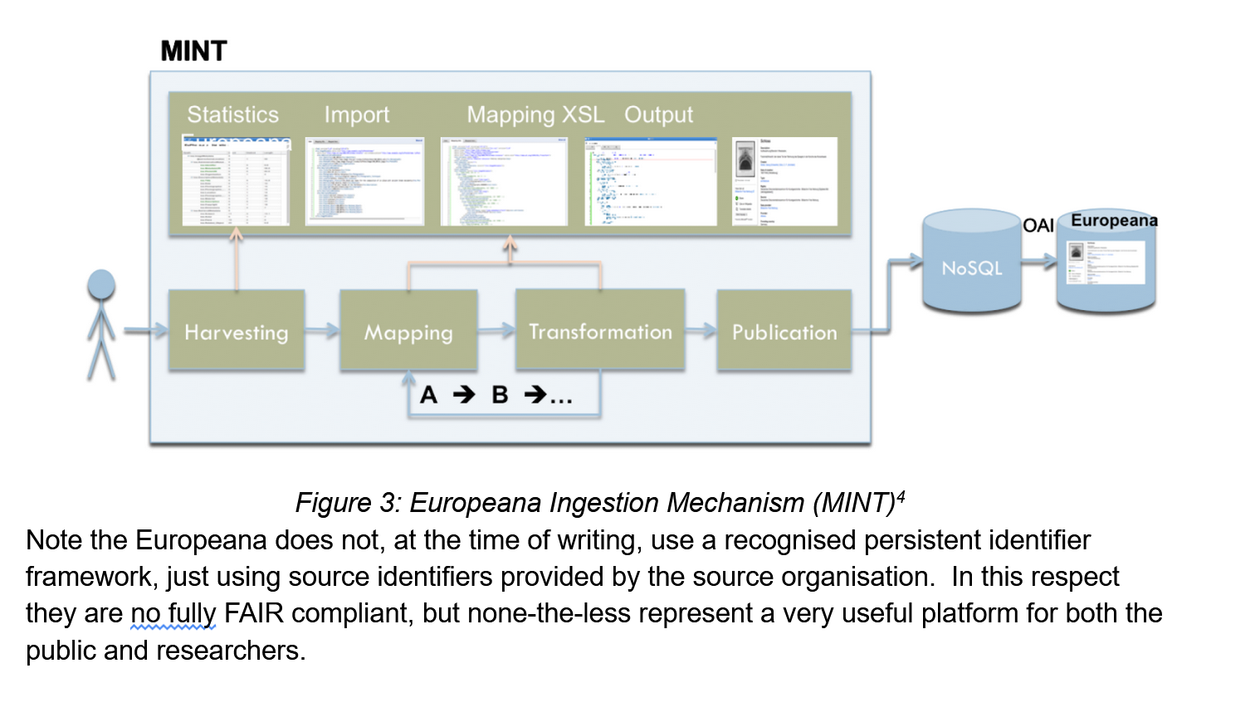
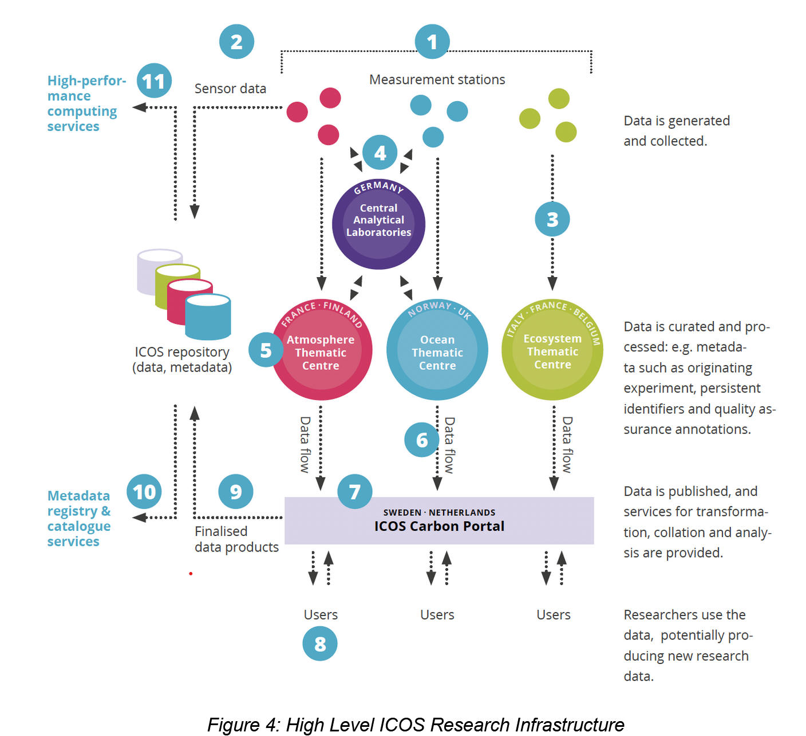
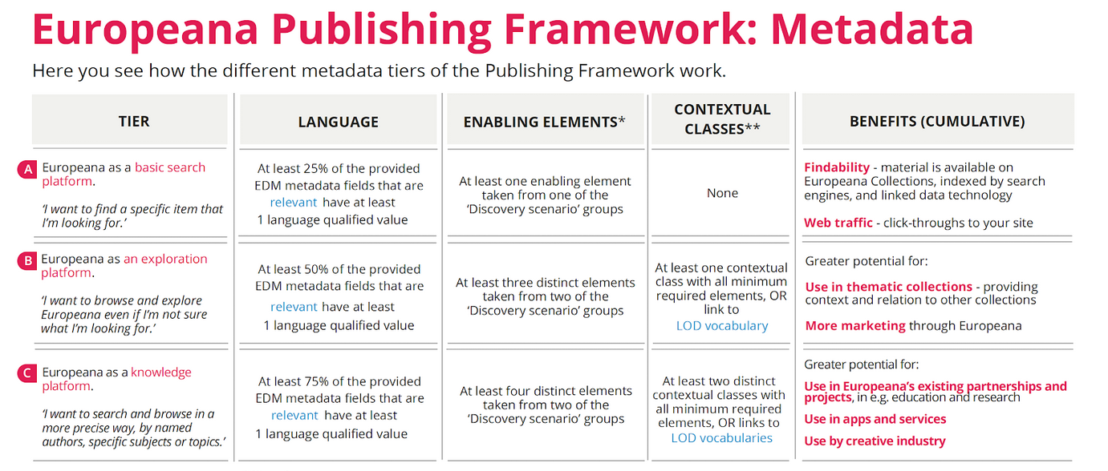
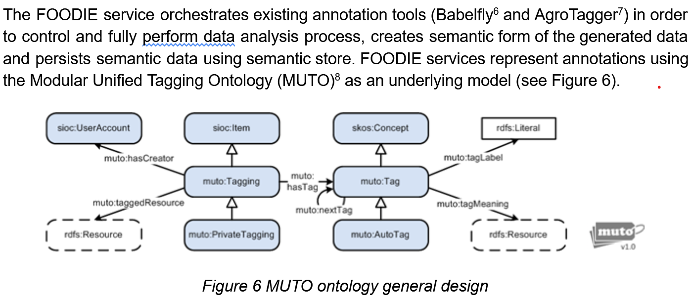
Investigation of other platforms
An investigation of other FAIR platforms and their architectures to look for reuse opportunities.
CLARIN
EUROPEANA
ICOS
FOODIE
ROHUB
EVER-EST
EOSC Eocystem Projects

Slide 14
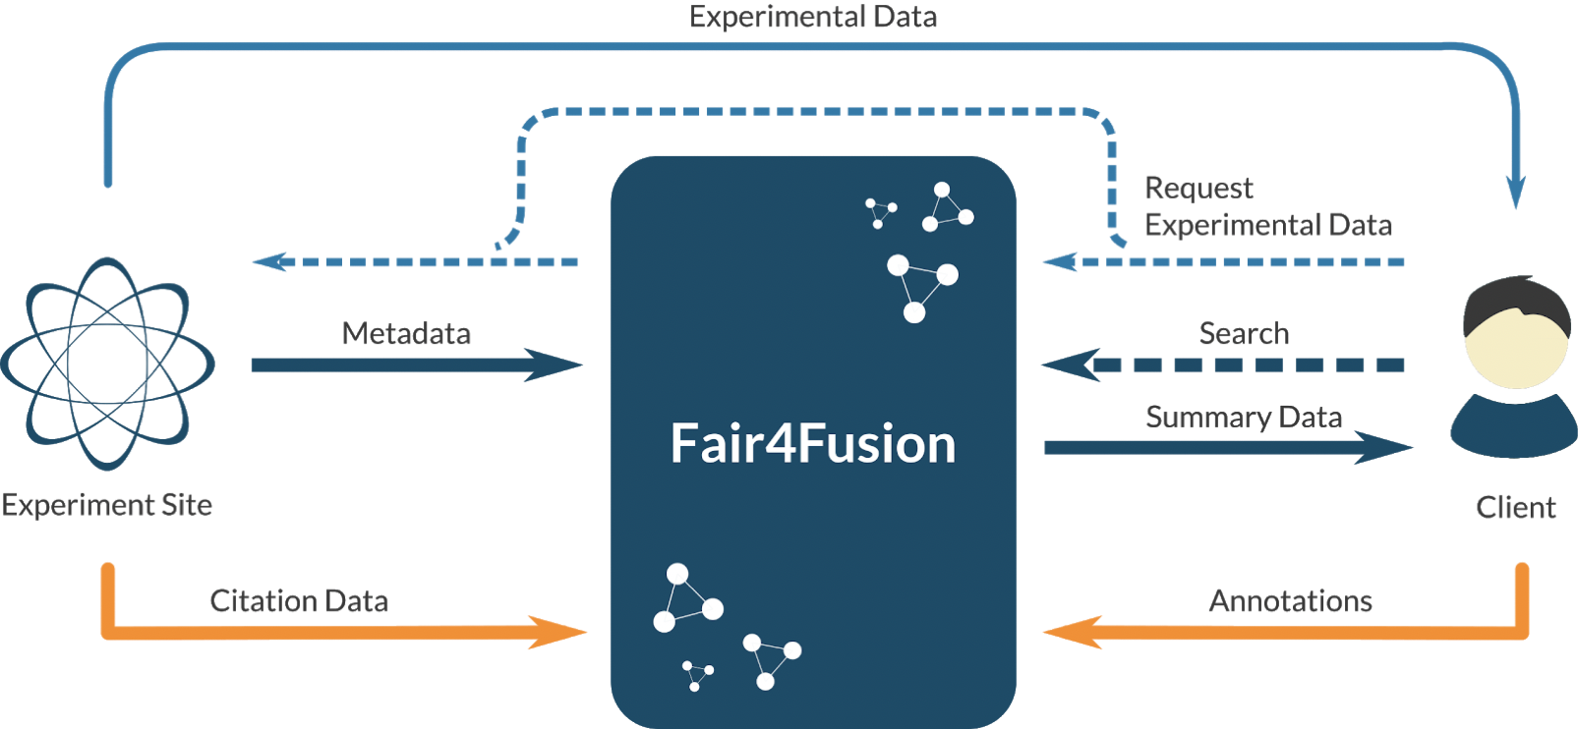
Architectural Blueprint for Fusion Open Data Framework
The architecture of the pilot implementation
Long term Blueprint architecture for Fusion Open Data Framework
Blueprint content (current status):
Fusion background, experiments
Current state of the art – policies and data access, fairness
User stories , requirements, list of functionalities
Architecture
Baseline architecture
Components
Relationship, standards, protocols
Initial technological options
Initial recommendations
Draft available for comments
(version 1.3)

Slide 15
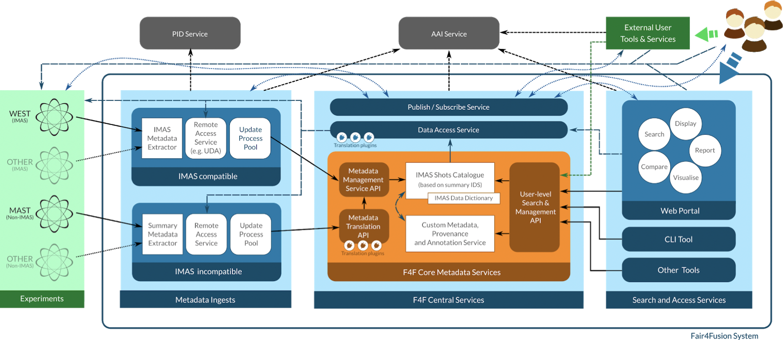
Draft Blueprint Architecture

Slide 16
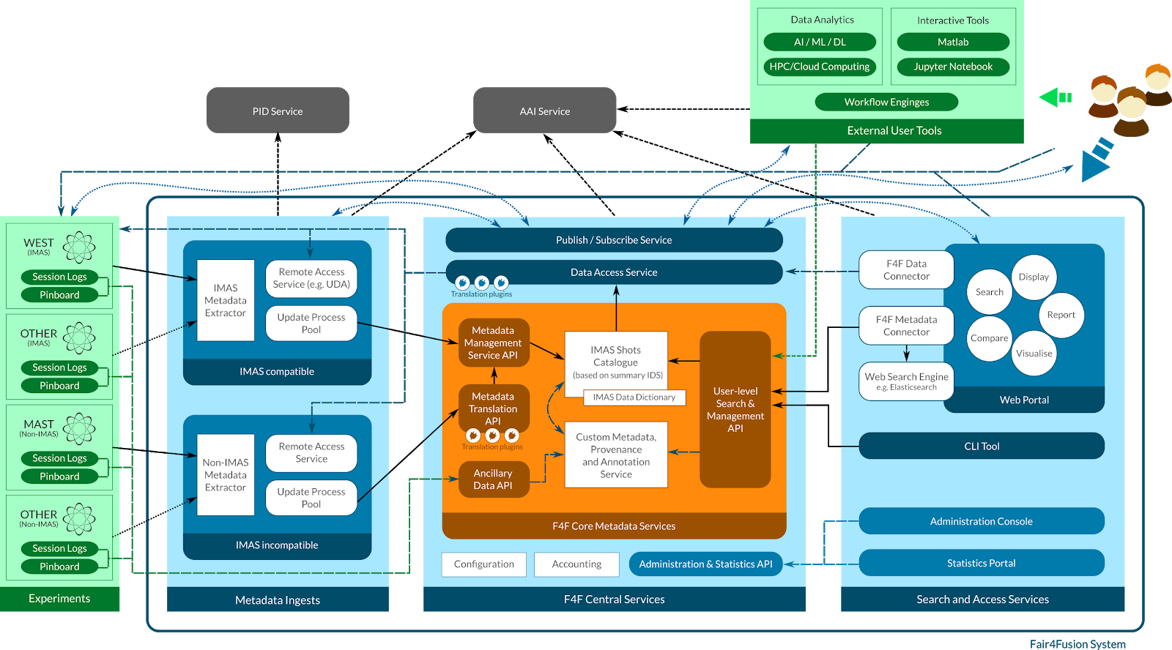
More detailed diagram

Slide 17
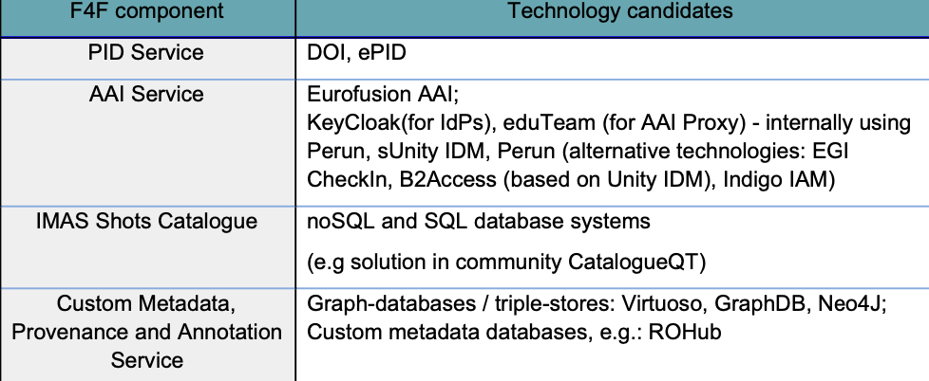
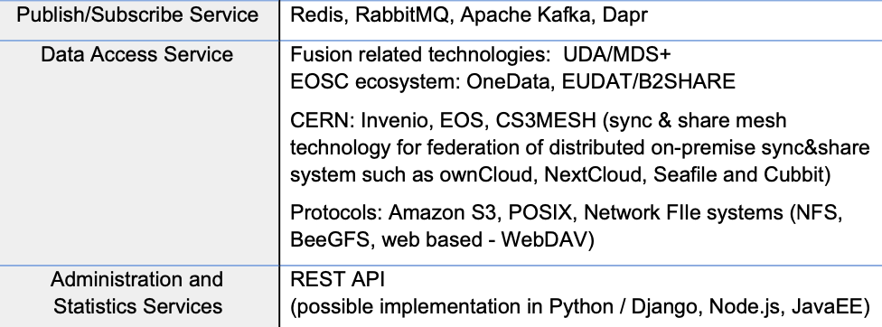
Technology Survey and Evaluation
Conducting a technology survey of existing technologies and open data platforms and their designs to assess their suitability for use in the fusion community
Iterative process
Initial feedback for the demonstrators
Evaluation of the selected solution against the user requirements and the FAIR principles
Result:
Report describes the details of the technology survey,
Initial technology table have been included into the Architecture Blueprint

Slide 18
Metadata Standards and Ontology Mapping
Agreed to use Summary IDS as basis for physics metadata schema
IDS structures already based on extensive discussions with the community
Augmented with elements from Dublin Core to support FAIR
Gathered list of existing fusion glossaries
Which sort of highlights the issue with developing a Ontology
Investigating use of OAI-PMH for harvesting
…but looks like a ‘push’ model from experimental sites is more suitable

Slide 19
Data Interoperability 4 FAIR and Open Data
Investigated different PID solutions and obtained relevant costings
Demonstrated interoperability of DataCite and Handle systems
Proposed recommendations on granularity at which they could and should be applied
Shot/Pass level strongly recommended for interoperability
Other levels at site discretion
Investigating long term funding sources

Slide 20
Standardised Models of Provenance
Proposed modelling provenance in W3C PROV
Started mapping existing MAST provenance data to PROV
Highlight gaps
Identify areas for improvement
Gathering information of provenance information at other sites
Develop tools to allow easy mapping between existing practices and PROV
Create a template in machine readable format which sites can fill in existing PROV information and integrate into processing chains

Slide 21
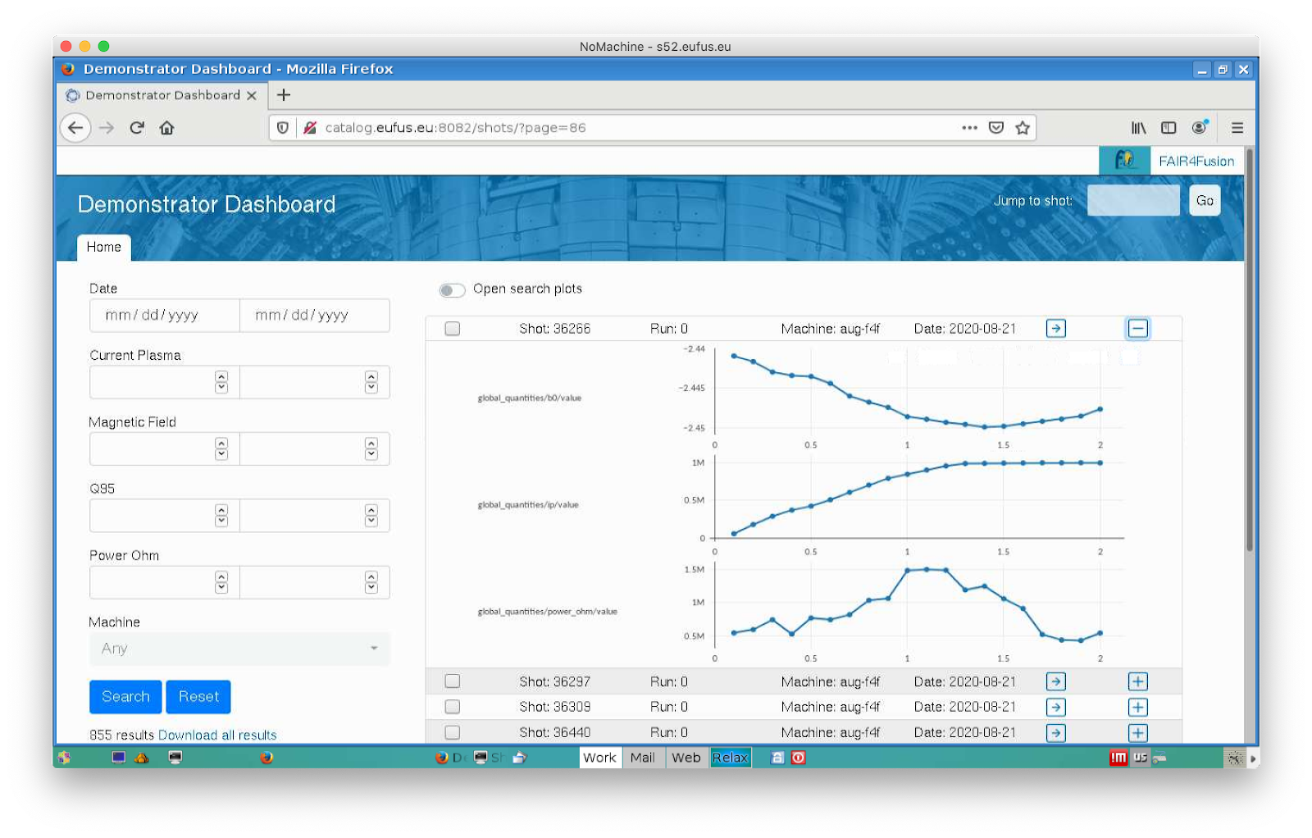
Fair4Fusion Demonstrators
Two different demonstrators to prioritise different technologies and approaches
Demonstrator #1
Data and metadata ingestion from various sites
Based on re-use of existing components
Use of IMAS and EUROfusion Gateway
Using Federated AAI
Demonstrator #2
Alternative metadata representations
Alternative visualisation frameworks
Search technologies

Slide 22
Fair4Fusion Initial recommendations
Policy | Establish a central metadata catalogue, accessible and searchable (through a Web Portal), gathering data from multiple experiments. Make the actual data also publicly accessible, after an embargo period. Use IMAS Data Dictionary to publish metadata and data in an interoperable way, thus progressively develop mappings of data of EU experiments to IMAS.
Architectural fundamentals | The system should integrate metadata coming from many sources, which may be natively using different formats, and present it in an unified format to the users. In order to enable easy usage of the system, the integration of metadata and its provisioning should be managed centrally, with help of specialised services accessible with well-defined remote interfaces.
Metadata handling | The metadata structures should be based on existing standards, in particular on IMAS Data Dictionary and its internal data structures like Summary IDS and "dataset_fair" IDS. If some metadata is not supported by IDSes, as a first step it should be analysed if the IDSes could be extended to support this metadata.
Integration of metadata from experimental sites | Experiments internally use different formats for their metadata. Assuming IMAS as the underlying format for metadata within the F4F environment, there is a need to provide a set of translation services to enable translation of custom formats to IMAS. The push and pull styles of data retrievement can be considered. In any case, if it is not denied by certain policies or/and technical restrictions on sites, it is recommended to base the integration on the REST protocol.
Physical data access | Access to physical data not stored within the F4F system itself should be possible for F4F clients: based on search results it should be possible to retrieve experimental data. EuroFusion encourages the sharing data generated by EuroFusion funded projects through the IMAS/IDS infrastructure.

Slide 23
Fair4Fusion Initial recommendations
Client components integration | The central services of the system should be accessible for both the client tools being the integral part of the F4F system as well as for possible external clients. In order to provide an easy and standardised way of client access, it is recommended to provide a well-defined REST API as the main entry-point to the system.
Core services | The role of core services is to store aggregated metadata coming from different experiments as well as other kinds of data and metadata essential for the system that is provided by users or inferred from existing data. The data structures employed by the core services should be based on IMAS and possibly other widely-accepted standards (e.g. W3C PROV for provenance). Whenever possible and justified the usage of existing services, such as CatalogueQT, is recommended. Note that this service has been already extended as part of the Demonstrator work carried out during the F4F activity (WP5). The central services should be provided with High Availability principles (e.g. using Kubernetes cluster)
Supplementary services | In order to support generic functionality an integration of few additional services should be considered. An example could be a PubSub service to enable asynchronous communication within the system or proxy service enabling access to experimental data. Additional services may be also needed to enable remote configuration and accounting. It is recommended to use existing software to provide these services.
User-level components | The main entry point to the system needs to be a Web Portal offering an extensive set of features for searching, filtering, displaying, comparison and management of metadata. It should also enable access to experimental data. It is recommended to implement the portal in a modern way, i.e. divide it into frontend (responsible for the presentation and user interactions) and backend (aimed to provide a flexible way of integration with services). In addition to Web Portal, there should be a command-line client interface provided for all use cases that need some sort of automation (possibly based on REST API).
AAI | In order to ensure good-level of security and enable easy integration of components, the system should use federated AAI. AAI should be implemented in accordance with the AARC blueprint architecture. Once EUROfusion AAI Proxy is made operational its usage is recommended.
Persistent Identifiers (PIDs) | All data exposed by the system, including metadata and experimental data that can be referenced, should be marked with Persistent Identifiers (eg. DOI or ePIC) so that they can be uniquely recognized.
Licenses | Issue to be addressed : compatibility of clearance procedures with public data licenses

Slide 24
Questions?
For more please follow us on social media and check the web site for project updates
https://www.fair4fusion.eu
@fair4fusion
https://www.facebook.com/Fair4fusion
https://www.linkedin.com/company/fair4fusion

