Slide 1
WPRIO Proposal:
Synthetic diagnostic for IR data analysis in ITER
RO: M-H Aumeunier
2021, March 18th

Slide 2
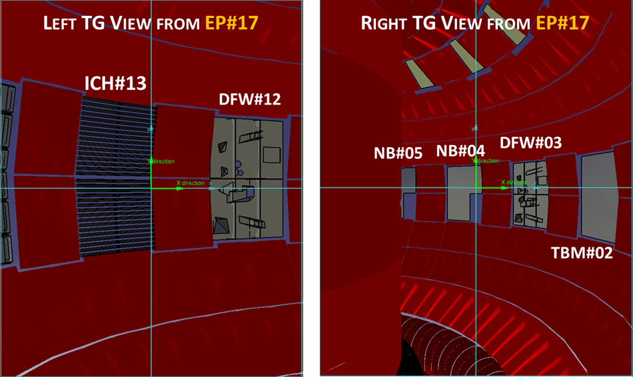
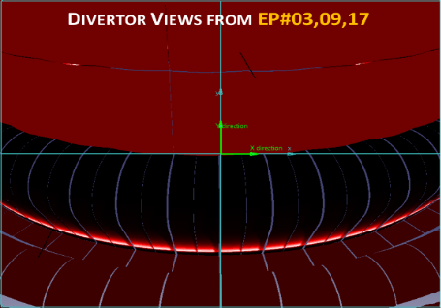

IR measurements for power load control in ITER metallic environment (from IR imaging systems)
IR thermography is a key diagnostic in fusion devices
1/ Machine Protection / Wall Monitoring System (avoid PFC damaging, crack, water leak) ➔ needs simple and robust method for real time monitoring (feedback control to Plasma Control System)
2/ Wall-Plasma Interaction studies (study PCF ageing, understand edge plasma, optimize plasma scenario) ➔ needs fine knowledge of physical phenomenon & higher accuracy measurement (10% for T>400°C & 20% for colder T°)
A wide camera network: 21 IR cameras in ITER [3-5µm] to monitor the surface T° of > 80% of the in-vessel components with wide T° range = [200-3600°C]
➔ Automatized and robust system needed for monitoring Plasma Facing Components and assisting protection officers

Slide 3
IR measurement is not straightforward
IR measurement is not free of errors :
Environment : parasitic light coming from the observed scene itself - radiative environment,, variable emission, multiple reflections
Instrument : optical transfer function, straylight, calibration
Development of an integrated approach aiming to get more reliable optical measurement based on:
Better characterization of optical instrument performances (spatial resolution, measurement accuracy)
Better characterization of environment (optical and thermal-radiative properties of in-vessel materials) (experimentally and numerically)
Synthetic diagnostic able to predict accurately and correct if possible measurement
Our objective: demonstration of reflection-robust IR temperature measurements of PFCs basing on numerical approach (synthetic diagnostic) for real-time application and offline analysis

Slide 4
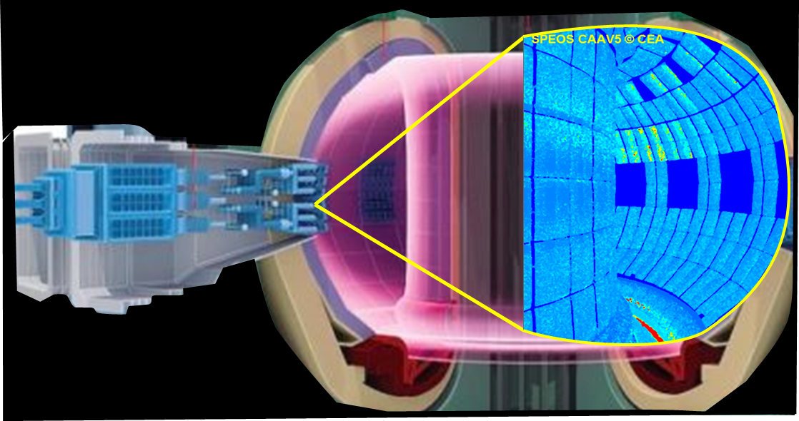
A “digital twin” approach for predicting and improving IR measurement
A synthetic diagnostic: an end-to-end simulation aiming to model all physical phenomenon involved in the IR measurement chain: from source to optical response of instrument
1
IR Source Modeling
Modeling of plasma heat loads deposited on PFCs (main IR source)
Modeling of resulting 3D temperature field
Synthetic IR images
2
Materials Thermal-radiative Modeling
Emissivity model
Reflectivity Model
3
ITER Wide Angle Viewing Sytem
Optics Modeling
Camera model
Optical Transfer Function
Light propagation in 3D model based on Monte Carlo Ray Tracing (MCRT) code
(ANSYS-SPEOS CAAV5 here) getting all radiations of thermal scene

Slide 5
Work proposal for WP PRIO
Such an integrated approach is developed since several years through several collaborations (AUG, W7X, Basel Univ., etc.) in order to deal with IR measurement in radiative and metallic environment
Thanks to WPRio, we aim to incorporate future developments in line of ITER objectives within a collaborative vision following to 4 axes
Task 1: Development of ray tracing codes
Task 2: Characterization of optical properties of materials
Task 3: IR experiments in tokamaks
Task 4: Development of inverse methods for filtering reflections

Slide 6
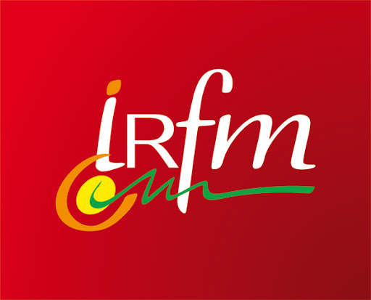
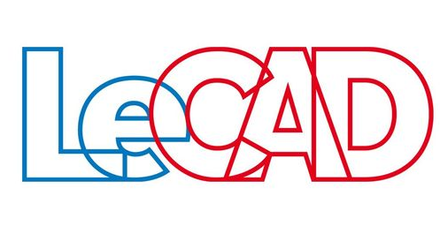
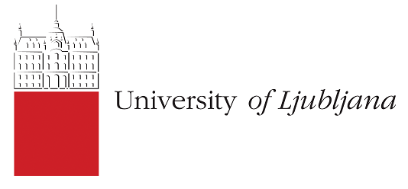
Task 1: Development of ray tracing codes
Objective: anticipate IR measurement through synthetic diagnostic modelling all physical phenomenon involved in the measurement chain
Sub-tasks:
Modeling thermal scene for a given plasma scenario using field line ray tracing code and thermal computations for converting deposited heat flux to surface temperature
Developing Monte Carlo Ray Tracing code able to propagate the rays within 3D complex
Activities under progress:
Benchmarking of Infrared Synthetic Diagnostic codes (CEA, University of Ljubljana):
magnetic field line tracing SMARDDA versus PFCFLUX code
photonics code Raysect with ANSYS-SPEOS code (considered as reference code for IR)
To be implemented in integrated platform (as SMITER)
Participating members : CEA (MH. Aumeunier), University of Ljubljana (L. Kos), NFRI (Korea)

Slide 7
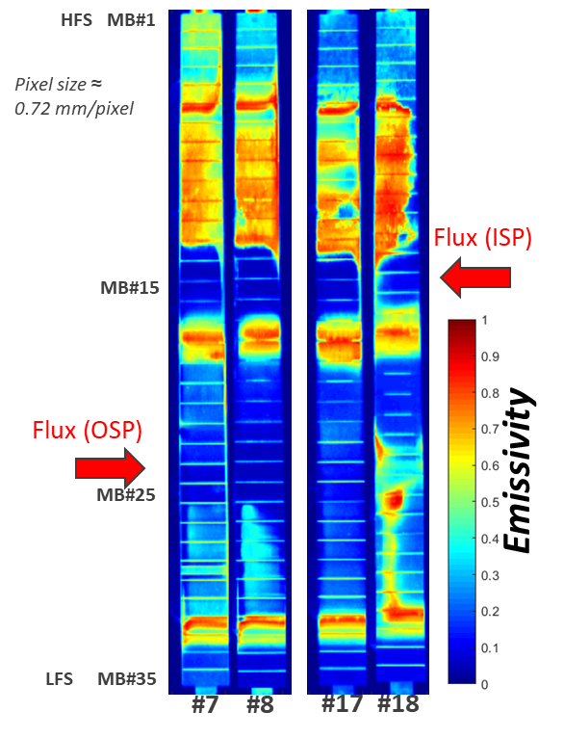
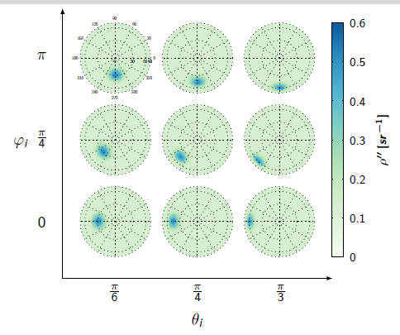
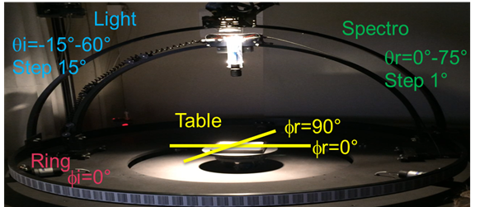


Task 2: Characterization of optical properties of materials
Objective: characterize experimentally and numerically the complete optical behavior of metallic components: directional emissivity and bidirectional reflectivity as a function of wavelength, temperature, incident and observation angle, and this for various surface roughness
Involved activities:
Measuring spectral angular distribution of BRDF (reflectance) of W samples at ambiant T°
Fitting complete BRDF models
Post mortem analysis of WEST ITER-like PFU
Participating members : Basel university (L. Marot), CEA (MH. Aumeunier), IUSTI (J.Gaspar)
Emissivity measurement of 4 ITER-like PFU
BRDF models
Measure
Courtesy M. Le Bohec
Courtesy J. Gaspar
7

Slide 8
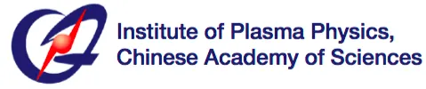
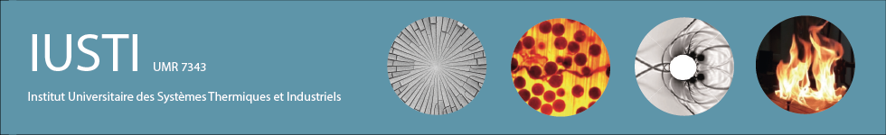

Task 3: IR experiments in tokamaks
Objective: benchmarking IR modeling reflections with existing devices for getting reliable reflection model for ITER
Deployment of IR synthetic diagnostics on WEST, ASDEX-U, W7-X and EAST on wide angle view (FW) and high resolution view (divertor)
WPRio Activities : benefit the feedback on existing devices for
Improving ITER first wall protection : predicting reflections patterns on ITER cameras with reliable synthetic diagnostic
Monitoring beveled PFCs : understand and anticipate the materials optical properties effects from edge loadings on divertor monoblocks
Participating members : CEA (MH. Aumeunier), IPP-Garching (A.Herrmann), IPP-Greifswald (M.Jakubowski), ASIPP (M.Le Bohec, B.Zhang, China)

Slide 9
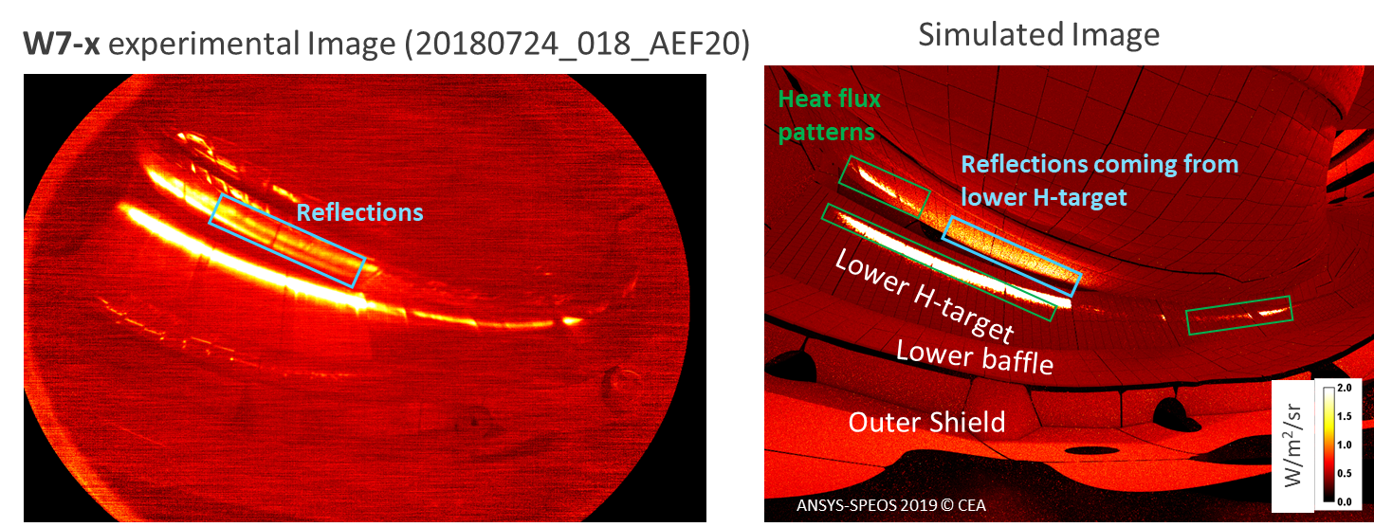
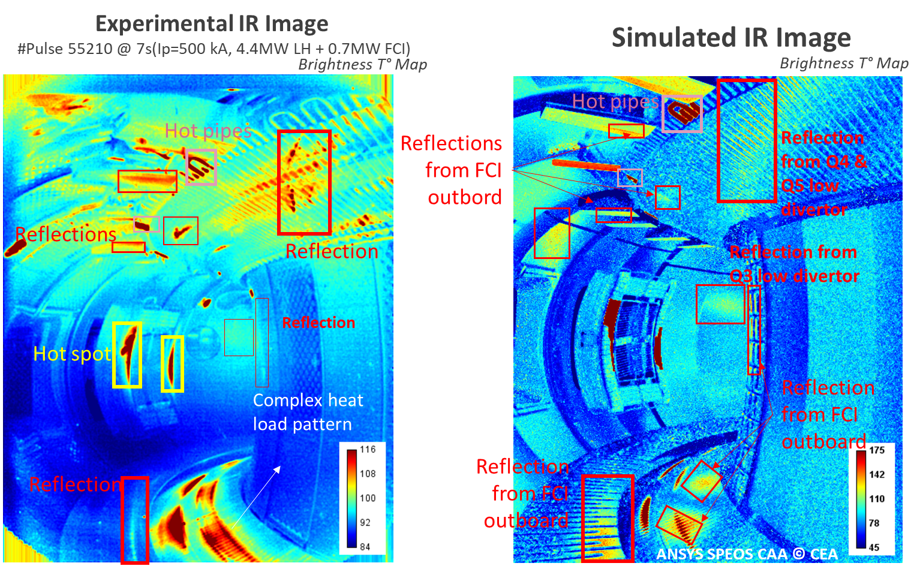
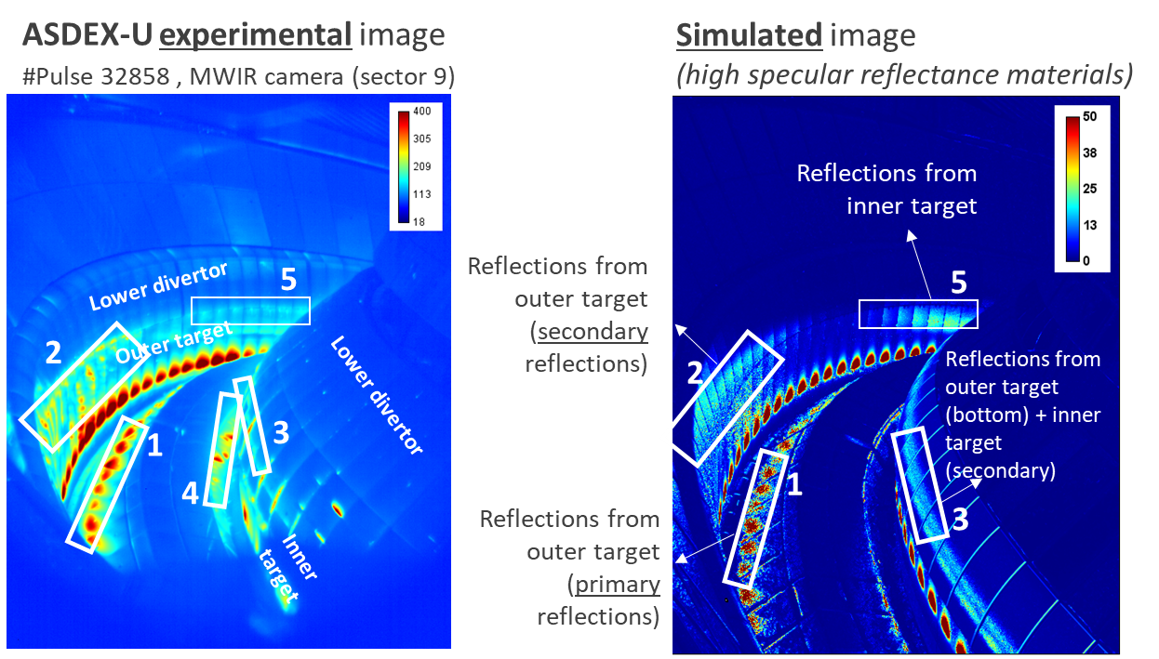
Applications to current devices
Discriminating thermal events from reflections features in experimental image from simulation…
WEST wide angle TG view
Carbon machine !
Reflections patterns are quite reproduced and the original/source flux is found (even outside fov) with simulation
Metallic machine
MH. Aumeunier et al., Nuclear Materials and Energy 26 (2021) 100879
Metallic machine

Slide 10

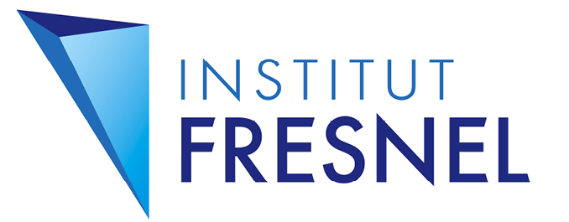
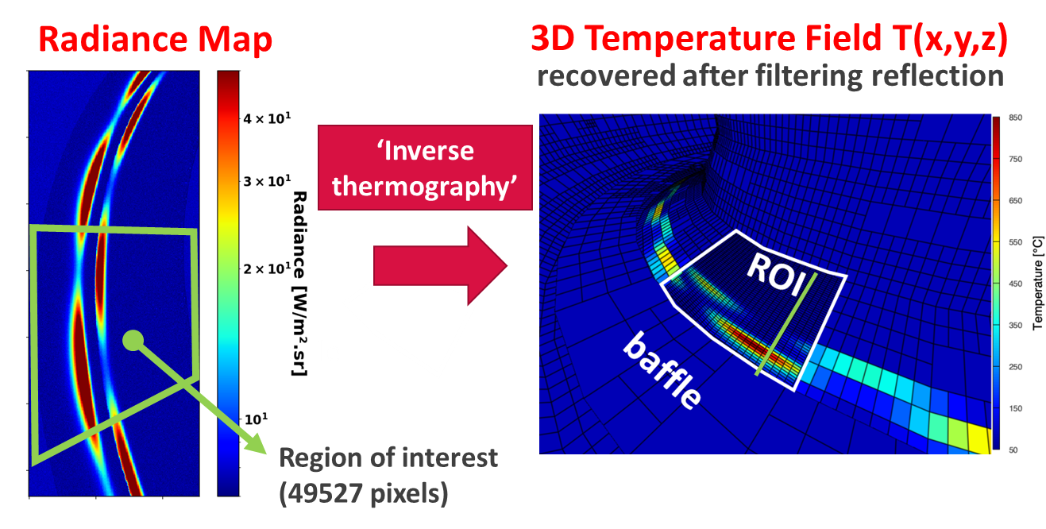
Task 4: Development of inverse methods for filtering reflections
Objective: Developing inverse methods to find the true temperature or emissivity of monitored surfaces from IR measurements
R&D activities :
Development of reduced model of radiative transport operator
Development of new techniques based on machine learning techniques using synthetic data base
Participating members : CEA/IRFM (MH. Aumeunier), CEA/LIST (R.Miorelli), IUSTI, Aix-Marseille (F.Rigollet), Fresnel Institute, Aix-Marseille University (M.Adel), ASIPP (M.Le Bohec, China)

Slide 11
Work proposal for 2021 & outlooks
Task 1: Development of ray tracing codes
Task 2: Characterization of optical properties of materials
Task 3: IR experiments in tokamaks
Task 4: Development of inverse methods for filtering reflections
2021 : Benchmarking codes Ray-Sect vs ANSYS-SPEOS: application to ITER antenna heat flux
2022-25: efforts to model secondary heat sources in ITER (alpha losses, ECRH straylight, NB shine-through) , SOLPS modeling of radiation pattern (not initiated)
2021 : investigation of detailed numerical models of BRDF (reflectance) and emissivity for implementing in IR synthetic diagnostics
2022-25: post mortem analysis of WEST W samples & fitted model versus wavelength, temperature and roughness
2021 : Study of loading edges of WEST ITER-like PFU (impact of shaping and/or optical properties of edges of PFU) by comparing photonic models and experimental results
2022-25: Benchmarking of enhanced IR reflections models with tokamaks experiments + application on ITER geometry
2021 ++: development of reduced photonic model + investigations of machine learning techniques
2022-25: using tokamaks experiments as demonstrator of developed tool with the aim of implementing it to ITER

