Slide 1
Wall thermal events & hot spot monitoring system
March 30th, 2021
Raphael Mitteau

Slide 2
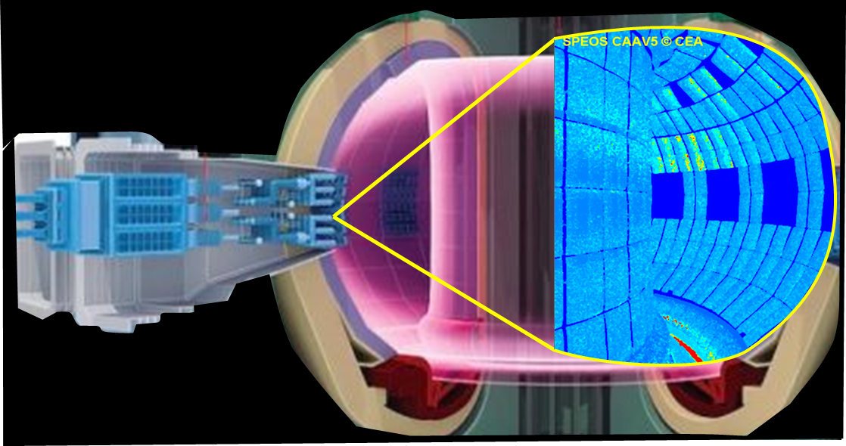
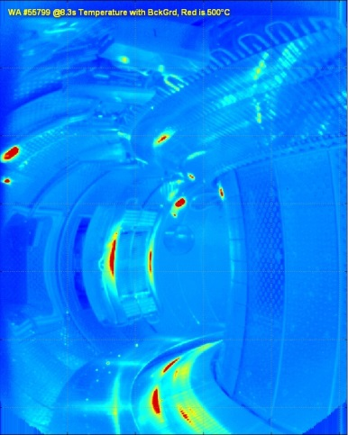
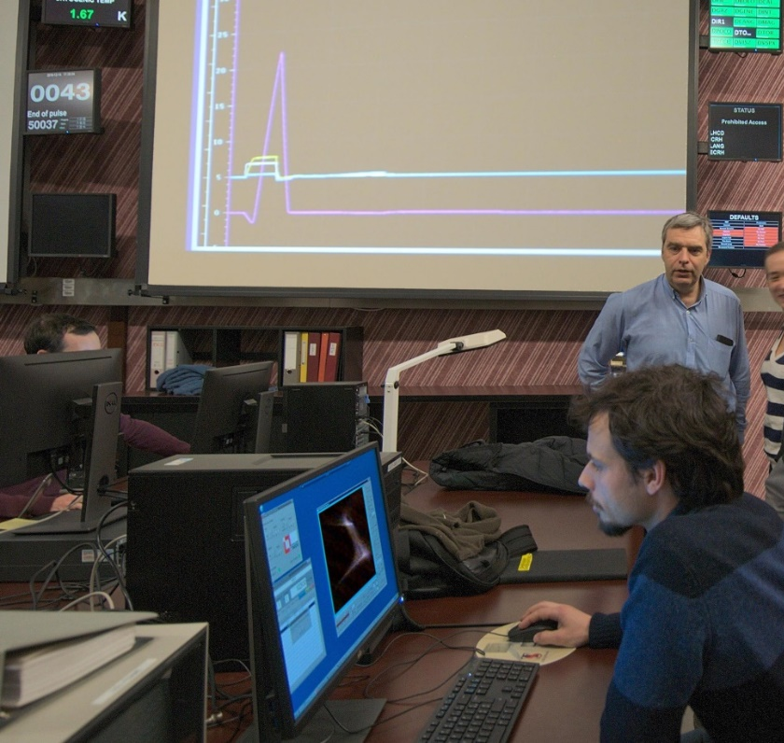
Context : Machine Protection & Infrared wall monitoring
Manual processing of wall & divertor thermal events – assisted with basic image analysis tools
ITER wide angle viewing system
(Courtesy MH Aumeunier)
Experimental IR image of WEST during thermal plateau
Thermal events on the Wall during plasma operation – normal and off-normal events
Strike lines, heat & particles losses the wall (eg. ECH stray losses), poorly cooled components (diags), photonic reflections
Detection & expertise of wall thermal events to be done shot by shot, toward real time
Imaging techniques, detection, segmentation, automated data pipelines, adding metadata and descriptors.
Prevent wall incidents & damage, avoid aggravation + automatic data processing
Human expertise, capitalisation to expert system & automated image analysis, check to allowables (op. envelope)

Slide 3
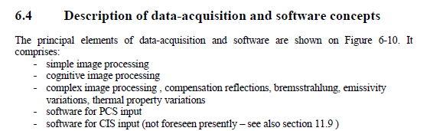
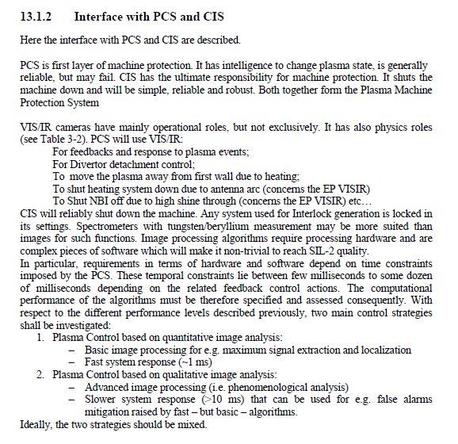
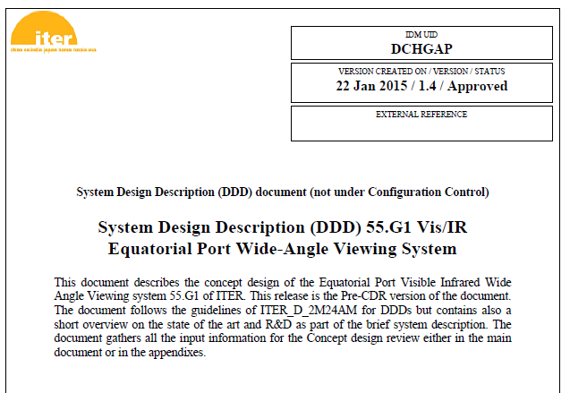
ITER (WAVS) needs image processing & cognitive vision
System Design Description (DDD) 55.G1 Vis/IR Equatorial Port Wide-Angle Viewing System (ITER_D_DCHGAP v1.4)
Page 78
→ cognitive image processing
Page 114
→ image processing
Based on phenomeno-logical analysis

Slide 4
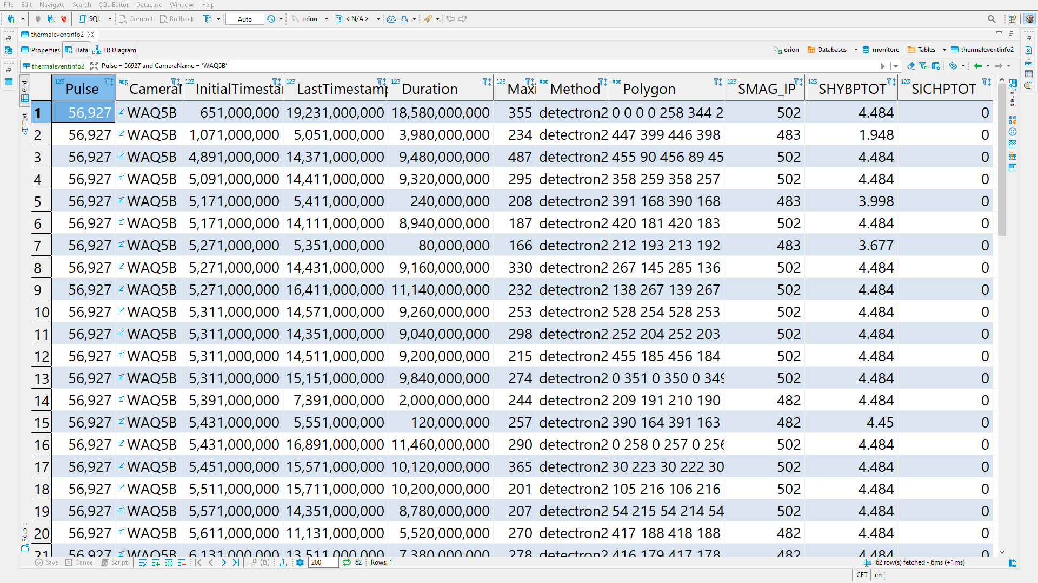
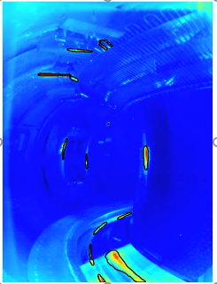
Proposed activities PrIO (2021)
Set up automatized data pipeline, for 'machine processing' of divertor & wall thermal events
Use of WEST wide angle tangential viewing system as a proxy to ITER WAVS
Thermal event detection, image segmentation, features enrichment, analyse & expertise
Detection using artificial intelligence techniques, machine learning, deep learning
Mask-RCNN
Max-TREE
WEST-56927
Automatic detection of thermal events using 'trained' algorithm
Following detection, events are stored in a SQL database, along with relevant metadata, available to analyst's

Slide 5
Competences, Collaboration & Interfaces
WEST IR imaging group (> 50% R. Mitteau, V. Moncada, E. Grelier /Post-Doc/, Collaborators <10%)
Collaborations : EU IR imaging group
Imaging group W7X / IPP-Greifswald (Aleix SPUIG-SITGES, Marcin JAKUBOWSKI)
UPC
CEA technological research LIST/Saclay
Others (EU teams welcome … )
Interfaces (existing / possible / future)
DIFI project (Diagnostic Infrastructure Activities For ITER) – ROs : IO = Simrock / Udintsev – CEA - D. Mazon Data acquisition, storage, IR movie display
ITER Framework Contract for “Final Design of the ITER Plasma Control System for PFPO-1” Reference: IO/20/OT/70000648/JLE CEA participation to task 6.5 : Plasma control system – Wall heat load control

