Slide 1
Strategy for developing a new synchrotron radiation synthetic diagnostics for the JOREK code
C.Sommariva, M. Hoppe, S. Silburn, E. Nardon and J.P. Graves

Slide 2
Outline of the presentation
Introduction
3D synchrotron radiation synthetic diagnostic strategy: synchrotron radiation model
3D synchrotron radiation synthetic diagnostic strategy: numerical scheme
Conclusions

Slide 3
INTRODUCTION

Slide 4
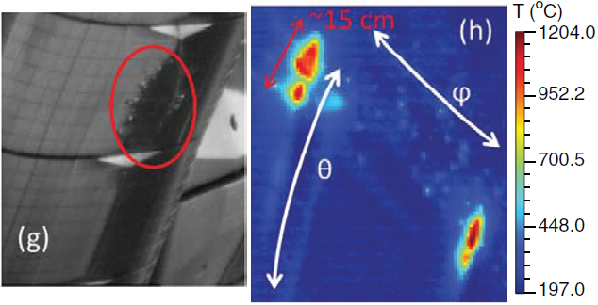
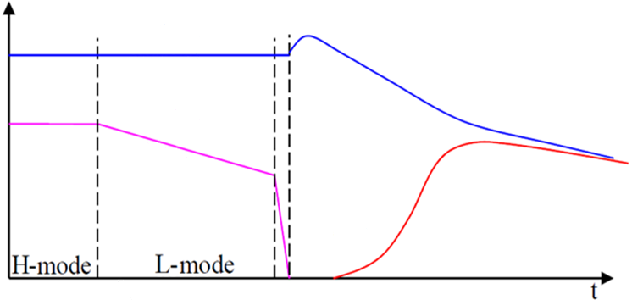
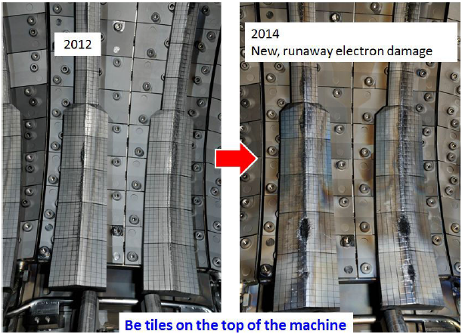
Disruptions & Runaway electrons
1) disrupting plasma
2) triggering
MMI
5) Current Quench (CQ):
-Loss of plasma current (I_{p})
→ Toroidal E-field: $E∝L\frac{dI_{p}}{dt}$
I_{p}
3) Plasma cooling:
-MHD instabilities
T
4) Thermal Quench (TQ)
-Loss of confinement
6) Runaway Electron beam:
-MeV energy electron beam
-NOT ALWAYS PRESENT
I_{RE}
RE strikes on JET tiles [1-2]

Slide 5
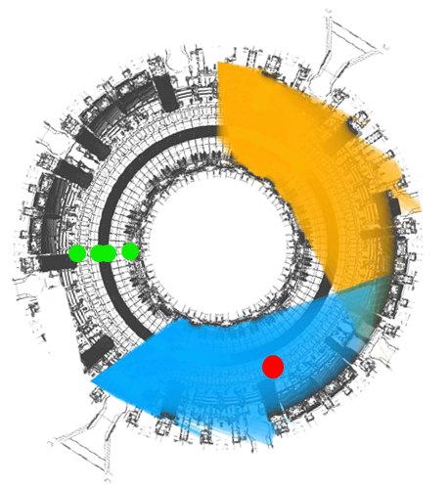
Introduction
Highly directional synchrotron radiation emitted by RE beams can be observed in both visible and IR spectra
In JET two cameras are capable of observing the synchrotron light emitted by RE beams [3]:
KLDT-E5WE: fast camera on the visible spectrum (monochromatic)
KLDT-E5WC: wide angle camera on the IR spectrum (λ=3-3.5μm)
KLDT
Vertical
polarimetry
I_{p}
RE
m=6 islands
m=5 islands
During the JET RE experiments, videos from KLDTs cameras showed multiple features appearing in the beam radiation patterns:
similar features are simulated using JOREK-RE fluid [5] and the experimental image might be reproduced using the JOREK-particles module
KL8
SPI
JET SPI,
Fast Visible Cameras,
Vertical polarimetry [3-4]
m=4 islands
partial collapse

Slide 6
3D SYNCHROTRON RADIATION SYNTHETIC DIAGNOSTIC STRATEGY: SYNCHROTRON RADIATION MODEL

Slide 7
Detected power from plasma EM-radiation
The radiated power detected by a point on the sensor for unit of wavelength $λ$, unit of view angle $dΩ_{n}$ and of surface $dA$ is described by [6]:
$$\frac{d^{3}P}{dλdAdΩ_{n}}\left(x_{0},n,λ,t\right)=\int{δ\left(\frac{r}{r}−n\right)\frac{n⋅\hat{n}}{r_{p}^{2}}P_{R}\left(x,p,x_{0},λ,t\right)f\left(x,p,t−\frac{c}{r}\right)dxdp}$$
Where:
$n$ is and arbitrary direction of the pixel view angle
$x_{0}$ position on the sensor
$\hat{n}$ orientation of the sensor at the position $x_{0}$
$r=x−x_{0}$ distance between a point in space and the pixel position
$P_{R}$ spectral and full angular distribution of the synchrotron power of an electron emitted towards a pixel
$f$ is the electron distribution function
$c$ is the speed of light.

Slide 8
Synchrotron power emitted by test electrons (1)
A test electron distribution can be written as:
$$f\left(x,p,t−\frac{c}{r}\right)=\sum_{i}{δ\left[x−x_{i}\left(t−\frac{c}{r}\right)\right]⋅δ\left[p−p_{i}\left(t−\frac{c}{r}\right)\right]}$$
Substituting it in the detected power equation and performing the integration in $x,p$:
$$\frac{d^{3}P}{dλdAdΩ_{n}}=\sum_{i}{δ\left(\frac{r_{i}}{r_{i}}−n\right)\frac{n⋅\hat{n}}{r_{i}^{2}}P_{R}\left(x_{i},p_{i},x_{0},λ\right)}$$
Having defined: $x_{i}=x_{i}(t−c/r_{i})$, $p_{i}=p_{i}(t−c/r_{i})$ and $r_{i}=x_{i}−x_{0}$
Calling $Ω_{n}$ the view range of the sensor at the position $x_{0}$ and integrating over $dΩ_{n}$:
$$\frac{d^{2}P}{dλdA}=\left\{\begin{matrix}\sum_{i}{\frac{r_{i}⋅\hat{n}}{\left|r_{i}^{3}\right|}P_{R}\left(x_{i},p_{i},x_{0},λ\right)}, if r_{i}∈Ω_{n} \\ 0 otherwise\end{matrix}\right.$$

Slide 9
Synchrotron power emitted by test electrons (2)
The synchrotron power received by a detector due to a test electron population is obtained integrating over $dλ$ and $dΩ_{i}=\frac{r_{i}⋅\hat{n}}{\left|r_{i}^{3}\right|}dA$:
$$P=\sum_{i}{\int_{λ_{1}}^{λ_{2}}{\int_{Ω_{i}}{P_{R}\left(r_{i},λ,γ,θ_{p}\right)}dΩdλ}}$$
Where:
$Ω_{i}$ is the solid angle within which the synchrotron emission is received
$γ,θ_{p}$ are respectively an electron relativistic factor and its pitch angle
The synchrotron radiation wetted region, required for integrating over $Ω_{i}$, is found to be conical with an apex angle of $θ_{c}\sim γ^{−1}$ [6-8]:
Assumption: all synchrotron radiation emitted by a test electron is strictly contained in a cone with an apex angle of $θ_{c}=γ^{−1}$

Slide 10
Full spectral and angular power distribution
The full spectral and angular power distribution of the synchrotron radiation corrected for the finite speed of light is [7-10]:
$$P_{R}\left(λ,ψ,χ\right)=\frac{ce^{2}}{\sqrt{3}ε_{0}κλ^{4}γ^{2}}{\left(1−\frac{\sqrt{γ^{2}−1}}{γ}\cos{θ_{p}}\cos{θ}\right)\left(1+γ^{2}ψ^{2}\right)}^{2}\left\{\frac{γ^{2}ψ^{2}}{1+γ^{2}ψ^{2}}K_{\frac{1}{3}}\left(ψ\right)\cos\left[\frac{3}{2}ξ\left(z+\frac{z^{3}}{3}\right)\right]−\frac{1}{2}K_{\frac{1}{3}}\left(ξ\right)\left(1+z^{2}\right)\cos\left[\frac{3}{2}ξ\left(z+\frac{z^{3}}{3}\right)\right]+K_{\frac{2}{3}}\left(ξ\right)z\sin\left[\frac{3}{2}ξ\left(z+\frac{z^{3}}{3}\right)\right]\right\}$$
With: $ξ=\frac{2π}{3λκ{\left(γ^{2}+ψ^{2}\right)}^{\frac{3}{2}}}$ , $z=\frac{γχ}{\sqrt{1+γ^{2}ψ^{2}}}$, $κ$: local curvature of the particle orbit
Ultra-relativistic electrons: $\frac{v}{c}\sim 1$
Small orbital angles (spherical angles centered on the emission cone):$\frac{ψ}{2π}≪1$, $\frac{χ}{2π}≪1$
The plasma is optically thin (no-interactions between radiation and plasma)

Slide 11
3D SYNCHROTRON RADIATION SYNTHETIC DIAGNOSTIC STRATEGY: NUMERICAL SCHEME

Slide 12
JET Camera characteristics and modeling
The characteristics of the JET KLDT-E5WE and KLDT-E5WC cameras are [11]:
Pinhole cameras with an entrance aperture diameter of 3mm
Different pinholes for the top and the bottom of an image:
Upper image pupil at: -0.324m
Bottom image pupil at: -0.236m
upper plane
pixel
$$Ω_{n,1}$$
$$Ω_{n,2}$$
JET KLDT-E5WE/C cameras can be modeled as two point-like observers having visual ranges of $Ω_{n,1}$ and of $Ω_{n,2}$ looking through different detection planes
Each plane is discretised in $N=N_{x}∙N_{y}$ equally spaced pixels
lower plane

Slide 13
Angular integration of the radiated power
The full synchrotron power distribution has to be integrated over the solid angle $dΩ$:
Write the $dΩ$ integral in terms of area integrals
$$\int_{Ω_{i}}{P_{R}(λ,Ω(ψ,χ))}dΩ=\int_{A_{p}}{P_{R}\frac{r_{i}⋅\hat{n}}{\left|r_{i}^{3}\right|}}dA$$
Discretise the surface integral over a pixel with a 2D numerical integration scheme
For each j_{th} - node:
Compute the node position in terms of orbital coordinates $\left(ψ_{i,j},χ_{i,j}\right)$
Compute the contribution $P_{R}(λ,ψ_{i,j},χ_{i,j})\frac{r_{i,j}⋅{\hat{n}}_{j}}{\left|r_{i,j}^{3}\right|}$
$$\frac{r_{i,j}∙{\hat{n}}_{j} }{r_{i,j}}$$
Integration node
$$e^{−}$$
LoS
light path
pixel
Compute the surface integral over the pixel area $P(λ)≅\sum_{j}{w_{j}}P_{R}\left(λ,ψ_{i,j},χ_{i,j}\right)\frac{r_{i,j}⋅{\hat{n}}_{j}}{\left|r_{i,j}^{3}\right|}ΔA_{p}$

Slide 14
Spectral integration
Cameras are sensitive within specific wavelength ranges:
JET KLDT-E5WC: 3 < λ < 3.5μm
JET KLDT-E5WE: ~400 < λ < ~ 700nm
Issue: the modified Bessel functions $K_{1/3}$ and $K_{2/3}$ are not necessarily supported by mathematical libraries (e.g. CUDA [12]):
Numerical implementations exist but with which performance [13]?
The synchrotron power distribution has to be integrated w.r.t the wavelength $λ$ for all camera sensitivity intervals.
Possible solutions:
Precompute the values of $K_{1/3}$ and $K_{2/3}$ off-line, store them in a look-up table and interpolate the desired values
Precompute the values of $K_{1/3}$ and $K_{2/3}$ off-line and train an interpolator using machine learning technique
Standard numerical methods can be used for integrating in $dλ$ after knowing $K_{1,2/3}$
Spectral integration of the radiated power distribution [11]:
$$P_{Ω}∝\int_{λ_{1}}^{λ_{2}}{\frac{A}{λ^{4}}\left[AK_{\frac{1}{3}}\left(\frac{D}{λ}\right)+BK_{\frac{2}{3}}\left(\frac{D}{λ}\right)\right]dλ}$$
$$K_{\frac{1}{3}}\left(ξ\right)=√3\int_{0}^{∞}{\cos{[\frac{3}{2}ξ\left(\frac{t^{3}}{3}+t\right)]}dt}$$
$$K_{\frac{2}{3}}\left(ξ\right)=√3\int_{−∞}^{∞}{t⋅sin{[\frac{3}{2}ξ\left(\frac{t^{3}}{3}+t\right)]}dt}$$

Slide 15
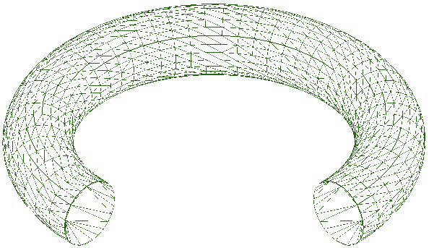
Select active electrons for reducing algorithm cost
For a simulation of 10⁶ particles with a camera defined by 1024 pixels 1.024·10⁹ 3D integrations are required: expensive!
Tokamak boundary
Select only active particles:
For each pixel and for each electron:
$$e^{−}$$
$$e^{−}$$
visible paths
Compute the electron - pixel node radiation paths
For each radiation path:
blocked paths
Check if contained in the pupil visual range
Check if contained in the electron emission cone
pixel
Check if the path does not intersect the tokamak boundary
pixel
pupil
Accept path if {A,B,C} are verified

Slide 16
Algorithm overview and parallelisation
The overall algorithm can be split in two different kernels:
find active radiation paths for each pixel:
Compute the radiation paths of e⁻
Check if radiation paths are active
If a e⁻ has at least one active radiation path, store it as active particle
Compute the radiated power of the j_{th}-e⁻ on the i_{th}-pixel:
Integrate the radiated power over all $λ$-intervals for each integration node
Integrate the power of each $λ$-interval over the pixel surface
Possible time integration over multiple time-slices during a shutter opening period
The parallelisation of the algorithm on a hybrid MPI-GPU architecture is almost perfect:
Pixels are completely independent
e⁻ contributions are almost independent
a reduction per pixel is required
Proposed strategy:
Split the detector in multiple subdomain
Allocate each subdomain-pupil group to a different MPI communicator
Subdivide the particle group in multiple MPI tasks within each MPI communicator
A task particle list is divided within all GPUs composing a node:
Reduction operations in communicator
Time integration based on asynchronous GPU kernels (if implemented)

Slide 17
CONCLUSIONS

Slide 18
Conclusions
The power received by a pixel can be modeled as the sum over all particles of the area-spectral integrals of an e⁻ full spectral and angular synchrotron power distribution
code speed-up may be achieved using simplified models
Spectral integration requires a fast method for evaluating $K_{1/3}$ and $K_{2/3}$ functions
Solid angle integrals can be performed computing the synchrotron radiation power deposited on the surface of a pixel
Reduction of the computational complexity can be achieved selecting only “active” light paths for each pixel:
Active paths: paths contained in both the pupil view range and synchrotron emission cone without intersecting the tokamak boundary
A hybrid MPI-GPU strategy can be used for parallelizing the synthetic diagnostic in both pixel-pupil domain and particle list
Possible use of asynchronous kernels for time integration (if implemented

Slide 19
References
[1] C. Reux et al., Nucl. Fusion, vol.55, p.093913, 2015
[2] A. Fil, PhD thesis, IRFM, 2015
[3] S. Silburn, JET refresher course, CCFE, UK, 2018
[4] https://users.euro-fusion.org/openwiki/index.php/KL8
[5] V. Bandaru et al., Plasma Phys. Control. Fusion, 2020 (accepted), 10.1088/1361-6587/abdbcf
[6] M. Hoppe et al., Nucl. Fusion, vol. 58, p. 026032, 2018
[7] J. Schwinger, Phys. Rev., vol. 75, p. 1912, 1949
[8] G. R. Blumenthal et al., Rev. Mod. Phys., vol. 42, p. 237, 1970
[9] L. Carbajal et al, Plasma Phys. Control. Fusion, vol. 59, p. 124001, 2017
[10] V. L. Ginzburg et al., Sov. Phys. Usp., vol. 11, p. 34, 1968
[11] S. Silbrun, private communication, 2021
[12] M. Abramowitz, I. A. Stegun, Handbook Mathematical Functions, 1964
[13] CUDA Math API, CUDA Toolkit v11.2.1 Documentation, 2021
[14] Y.C. Keluskar et al., ITM Web Conf., vol. 32, p. 03052, 2020

Slide 20
BACKUP SLIDES

Slide 21
The modified Bessel and the Airy functions
Airy’ functions [1]:
$$A_{i}(z)=\frac{1}{π}\int_{0}^{∞}{\cos\left(\frac{t^{3}}{3}+zt\right)dt}=\frac{1}{2π}\int_{−∞}^{∞}{\cos\left(\frac{t^{3}}{3}+zt\right)dt}$$
$$\frac{dA_{i}}{dz}=−\frac{1}{π}\int_{0}^{∞}{t⋅sin\left(\frac{t^{3}}{3}+zt\right)dt}=−\frac{1}{2π}\int_{−∞}^{∞}{t⋅sin\left(\frac{t^{3}}{3}+zt\right)dt}$$
Relation between the Airy and the modified Bessel functions [1]:
$$K_{\frac{1}{3}}(ξ)=π\frac{√3 }{√z}A_{i}(z)=\frac{√3 }{2√z}\int_{−∞}^{∞}{\cos\left(\frac{t^{3}}{3}+zt\right)dt=}\frac{√3 }{2}\int_{−∞}^{∞}{\cos{[\frac{3}{2}ξ\left(\frac{t^{3}}{3}+t\right)]}dt}$$
$$K_{\frac{1}{3}}\left(ξ\right)=−π\frac{\sqrt{3}}{z}\frac{dA_{i}}{dz}=\frac{\sqrt{3}}{2z}\int_{−∞}^{∞}{t⋅sin\left(\frac{t^{3}}{3}+zt\right)dt}=\frac{√3}{2}\int_{−∞}^{∞}{t⋅sin{[\frac{3}{2}ξ\left(\frac{t^{3}}{3}+t\right)]}dt}$$
$$z={\left(\frac{3}{2}ξ\right)}^{\frac{2}{3}}$$
[1] M. Abramowitz, I. A. Stegun, Handbook Mathematical Functions, 1964

Slide 22
The useful integrals
$$\int_{−∞}^{∞}{\sin\left(\frac{t^{3}}{3}+zt\right)dt}=\int_{0}^{∞}{\sin\left(\frac{t^{3}}{3}+zt\right)dt−}\int_{0}^{∞}{\sin\left(\frac{x^{3}}{3}+xt\right)dt}=0, x=−t$$
$$\int_{−∞}^{∞}{t⋅cos\left(\frac{t^{3}}{3}+zt\right)dt}=\int_{0}^{∞}{t⋅\cos\left(\frac{t^{3}}{3}+zt\right)dt−}\int_{0}^{∞}{x⋅\cos\left(\frac{x^{3}}{3}+xt\right)dt}=0, x=−t$$
$$\int_{−∞}^{∞}{t^{2}⋅cos\left(\frac{t^{3}}{3}+zt\right)dt}=\int_{−∞}^{∞}{\left(1+t^{2}−1\right)⋅cos\left(\frac{t^{3}}{3}+zt\right)dt}=\int_{−∞}^{∞}{\left(1+t^{2}\right)⋅cos\left(\frac{t^{3}}{3}+zt\right)dt−\int_{−∞}^{∞}{⋅cos\left(\frac{t^{3}}{3}+zt\right)dt}}=$$
$$\int_{−∞}^{∞}{\cos\left(\frac{3}{2}ξp\right)dp}−\frac{2}{\sqrt{3}}K_{\frac{1}{3}}\left(ξ\right)=−\frac{2}{\sqrt{3}}K_{\frac{1}{3}}\left(ξ\right)$$
Where: $p=t+\frac{t^{3}}{3} →dp=\left(1+t^{2}\right)dt$

Slide 23
The useful integrals
Integrals:
$$\int_{−∞}^{∞}{\left\{\frac{1}{γ^{2}}+\frac{1+γ^{2}ψ^{2}}{2γ^{2}}\left(x^{2}+y^{2}+2xy\right) \right\}⋅\left\{A\cos{[\frac{3}{2}ξ\left(\frac{t^{3}}{3}+t\right)]}−B\sin{[\frac{3}{2}ξ\left(\frac{t^{3}}{3}+t\right)]}\right\}dt}=\frac{1}{γ^{2}}\left(1+\frac{1+γ^{2}ψ^{2}}{2}(x^{2}−1)\right)\frac{2}{\sqrt{3}}AK_{\frac{1}{3}}\left(ξ\right)−\frac{1+γ^{2}ψ^{2}}{γ^{2}}x\frac{2}{\sqrt{3}}BK_{\frac{2}{3}}\left(ξ\right)=\frac{1}{γ^{2}}\left(1+\frac{1+γ^{2}ψ^{2}}{2}\left(x^{2}+1−2\right)\right)\frac{2}{\sqrt{3}}AK_{\frac{1}{3}}\left(ξ\right)−\frac{1+γ^{2}ψ^{2}}{γ^{2}}x\frac{2}{\sqrt{3}}BK_{\frac{2}{3}}\left(ξ\right)=\frac{1}{γ^{2}}\left(1+\frac{1+γ^{2}ψ^{2}}{2}\left(x^{2}+1−2\right)\right)\frac{2}{\sqrt{3}}AK_{\frac{1}{3}}\left(ξ\right)−\frac{1+γ^{2}ψ^{2}}{γ^{2}}x\frac{2}{\sqrt{3}}BK_{\frac{2}{3}}\left(ξ\right)=\frac{1}{γ^{2}}\left({−γ}^{2}ψ^{2}+\frac{1+γ^{2}ψ^{2}}{2}\left(x^{2}+1\right)\right)\frac{2}{\sqrt{3}}AK_{\frac{1}{3}}\left(ξ\right)−\frac{1+γ^{2}ψ^{2}}{γ^{2}}x\frac{2}{\sqrt{3}}BK_{\frac{2}{3}}\left(ξ\right)=\frac{2\left(1+γ^{2}ψ^{2}\right)}{γ^{2}\sqrt{3}}[\left(\frac{{−γ}^{2}ψ^{2}}{1+γ^{2}ψ^{2}}+\frac{1}{2}\left(x^{2}+1\right)\right)AK_{\frac{1}{3}}\left(ξ\right)−xBK_{\frac{2}{3}}\left(ξ\right)]$$

Slide 24
Relations
Frequency and wavelength in vacuum: $ω=\frac{2πc}{λ}$ with $c$ the speed of light
Jacobian of the wavelength: $\left|\frac{dω}{dλ}\right|=\frac{2πc}{λ^{2}}$
Instantaneous radius of curvature: $R=\frac{1}{κ}$ with $κ$: curvature
Instantaneous angular velocity ultra-relativistic limit: $ω_{0}=\frac{c}{R}$
Solid angle: expressed as units of area over the unit of sphere surrounding the apex
an object which blocks all rays from an apex has a number of steradians equal to the total surface of the unit sphere: $4π$
Normalisation used in [1] for the electric field of a charge: $e^{2}→\frac{e^{2}}{4πε_{0}}$
All this trickeries are required for obtaining Eq. 4 of [2] from Eq. II.31 of [1]

Slide 25
Relations
Solid angle differential: $dΩ=r⋅n\frac{dA}{r^{3}}$ with $dA$ the surface element, $r$ relative position between particle and detector and n the detector orientation dA detector surface area

Slide 26
Corrections due to doppler effect
Correction to the angular velocity due to Doppler effect:
$ω_{D}=\frac{ω}{1−β\cos{θ_{p}}\cos{μ}}$
with $θ_{p}$: pitch angle and $μ$: angle between the direction of the magnetic field and the line-of-sight

Slide 27
The modified Bessel and the Airy functions
Integrating over all possible view direction $n$:
$$\frac{d^{2}P}{dλdA}=\iint{δ\left(\frac{r}{r}−n\right)\frac{n⋅\hat{n}}{r_{p}^{2}}P_{R}\left(x,p,x_{0},λ,t\right)f\left(x,p,t−\frac{c}{r}\right)dxdpdΩ_{n}}=\int{\frac{r⋅\hat{n}}{r^{2}}P_{R}\left(x,p,x_{0},t\right)f\left(x,p,t−\frac{c}{r}\right)dxdp}$$
The distribution function of test particles can be written as:
$$f=\sum_{i}{δ\left(x−x_{i}(t−\frac{c}{r})\right)\left(p−p_{i}(t−\frac{c}{r})\right)}$$
Hence:
$$\frac{d^{2}P}{dλdA}=\sum_{i}{\int{\frac{r⋅\hat{n}}{r^{2}}P_{R}\left(x,p,x_{0},λ,t\right)δ\left(x−x_{i}(t−\frac{c}{r})\right)\left(p−p_{i}(t−\frac{c}{r})\right)dxdp}}=\sum_{i}{\frac{r_{i}⋅\hat{n}}{r_{i}^{2}}P_{R}\left(x_{i},p_{i},x_{0},λ\right)}$$

Slide 28
The modified Bessel and the Airy functions
Integrating over the pixel surface and noting that $dΩ_{i}=\frac{r_{i}⋅\hat{n}}{r_{i}^{2}}dA$:
$$\frac{dP}{dλ}(λ,t)=\sum_{i}{\int{P_{R}\left(x_{i},p_{i},x_{0},λ\right)dΩ_{i}}}$$
Or in terms of the spherical coordinates $ψ_{i},ξ_{i}$ and of the particle relativistic factor $γ_{i}$ and pitch angle $θ_{i}$:
$$\frac{dP}{dλ}(λ,t)=\sum_{i}{\int{P_{R}\left(ψ_{i},ξ_{i},γ_{i},θ_{i},λ\right)\sin\left(ψ_{i}\right)dψ_{i}dξ_{i}}}$$

