Slide 1
Development of GEM detector as a compact neutron spectrometer for fusion plasmas NS-GEM
EUROfusion Enabling Research
Reference No. CfP-FSD-AWP21-ENR-04-IPPLM-01
Responsible Officer: Denis Kalupin
Principal investigator: Marek Scholz
Project implementation time: 1.07.2021 – 30.06.2024

Slide 2
Outline
Introduction
Some notes on neutron spectrometry for fusion
GEM detector
NS-GEM project
breakdown structure
PMs breakdown
Work Plan
Summary
deliverables
comunications
publications
missions

Slide 3
Introduction
Neutrons are the most accessible particles of all the fusion products
and they provide direct information on the fusion power
Role of neutrons in fusion
Neutrons emitted from a deuterium/tritium thermonuclear plasma are the main signature of the nuclear fusion and plasma parameters
Total nuclear reactivity of the plasma is measured in order to determined plasma parameters and the fusion power
Neutron diagnostic system for fusion
Time resolved neutron yield monitor
Activation system
Neutron profile camera
Neutron spectrometers
provides ion temperature
information on the neutron fractions from thermal and non-thermal fusion reactions (fuel ratio).
Notes:
After a short introduction,
I shall first describe the most important processes generating radiation in hot plasmas,
a particular focus will be on bremsstrahlung
Then I proceed with some discussion on detectors,
and analysis methods including some illustrations by results from the Wendelstein 7-AS stellarator
Finally I will give a brief description of X-ray diagnostics systems proposed for W7-X
I should mention here, that I will not address X-ray spectrometers in my talk, this has been covered by Dr. Biel.

Slide 4
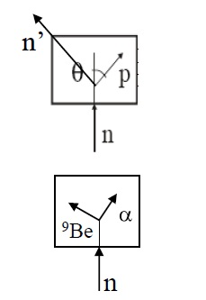
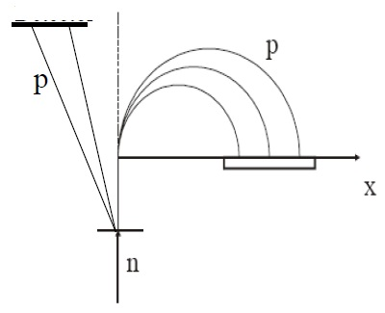
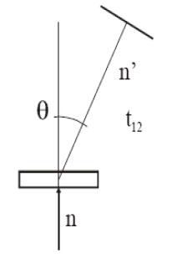
Introduction
Neutron spectrometeric techniques
In-beam
ToF
TPR
MPR
PMT, size
vacuum
vacuum, magnet, size, weight
PMT, stability
Det.
Det. 2
Det.:
NE213, stilbene
scatterer
Det.:
CVD, ND
Det.
scatterer
(thick)
Det. 1
converter
(thin)
about 8%.
3.4 to 4.2 %
about 8%.
4.5 to 7.4 % FWHM.
(+) pro:
high efficiency suited for 2.45 MeV
(-) con:
random coincidences exposed scatterer
(+) pro: sensitivity (background rejection)
(-) con: low efficiency, complexity
(+) pro:
conceptually simple
(-) con:
exposed to full n flux, function mixed

Slide 5
Introduction
The goal of the project is:
Development of a new concept of an innovative compact neutron spectrometer based on a gas electron multiplier detector (NS-GEM) for use in the ITER HRNS system, construction of a demonstrator and testing it on 14 and 2.5 MeV neutron sources.
The main drive for development of this compact NS-GEM is the need of an in-beam compact system with high energy resolution, low sensitivity to $γ$-rays and high-count rate, with operation capabilities in different conditions related to neutron ﬂux environment.
The result of the implementation of this project and the achievement of the above-mentioned goal should be:
Determination of the spectrometer measurement capabilities;
Development of the technical documentation of this spectrometer;
Construction of a NS-GEM demonstrator.

Slide 6
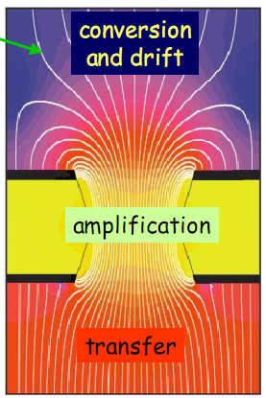
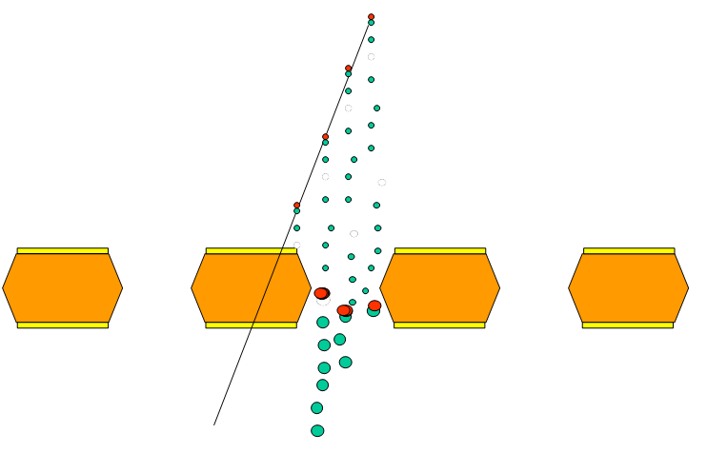
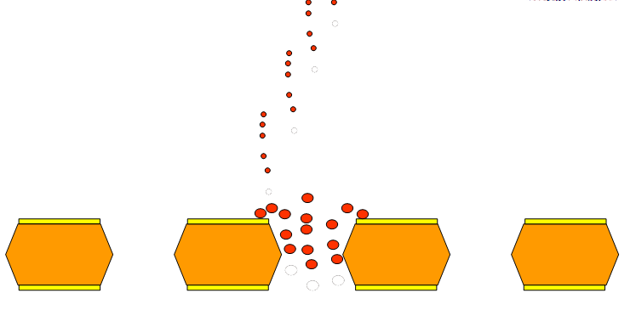
GEM principles
time 6 ns
Electron cluster
E field lines
ion cluster
time 1 μs
Ion clusters are trappede by Cu foil
The holes are completely ions free after 1 μs
HIGH RATE CAPABILITY

Slide 7
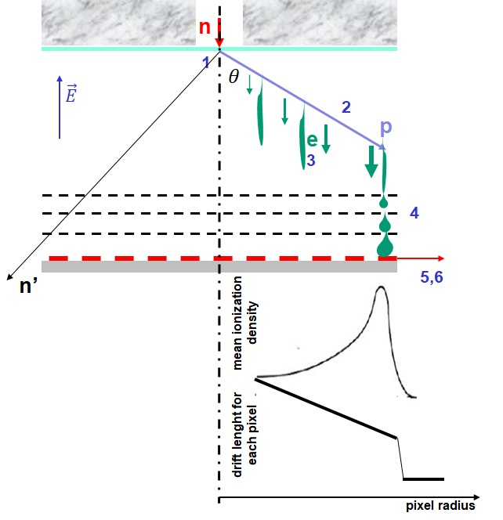
Basic Idea
$$E_{n}=\frac{E_{p}}{\cos^{2}θ}$$
Basic idea of the GEM detector as a neutron spectrometer.
the convertor for converting neutron to proton,
the proton recoil trace,
electron cloud transport in the drift regions,
electron avalanches through GEM holes,
collection of the electron cloud on the anode pixel and
GEM signal post-processing to calculate charge, time and position to reconstruct trace of the proton recoil.
n - the collimated neutron beam, p – recoil proton; n’ – scattered neutron

Slide 8
Short Remarks
Performance indicators in the design of the spectrometer:
SENSITIVITY – the ability to measure weak components in the neutron emision;
RATE CAPABILITY – the number of useful counts in the spectrum (it determines the achievable time resolution;
ENERGY BITE – the energy range covered by the instrument;
ENERGY RESOLUTION
STABILITY – operational and calibration
FLEXIBILITY - inherent capability to measure neutrons in a large range of energies and wide range of neutron emission intensities (dynamic range)
INTERFACING ISSUES – installation requirements

Slide 9
NS-GEM Project
EUROfusion Enabling Research
Reference No. CfP-FSD-AWP21-ENR-04-IPPLM-01
Responsible Officer: Denis Kalupin
Principal investigator: Marek Scholz
Project implementation time: 1.07.2021 – 30.06.2024

Slide 10
Breakdown structure
 | 2021 | 2022 | 2023 | 2024
Theory and modelling: NS-GEM synthetic diagnostic | Assumptions and design requirements for ITER neutron spectrometers | Performance analysis of NS-GEM. First evaluation | Performance analysis. Assessment of SN-GEM measurement capabilities | Summary of SN-GEM measurement capabilities.
NS-GEM Demonstrator | Design of NS-GEM demonstrator | Construction of NS-GEM demonstrator | Construction of NS-GEM demonstrator. Upgrade | Analysis of the possibility of designing the system in accordance with the requirements of HRNS-ITER
 | Initial stage of modeling MCNP NS-GEM | NS-GEM test Serie 1 | NS-GEM test Serie 2
 |  | Benchmark 1 o the MCNP modelling of NS-GEM | Benchmark 2 o the MCNP modelling of NS-GEM
Neutron generator NG-14 MeV | Design of the measuring set-up | Construction of the measuring set-up | Experimental Serie 2 | Summary of the possibilities of using the NG-14 MeV for ITER neutron diagnostic tests
 | MCNP modelling of the radiation field in the NG-14 MEV hall and at the measuring set-up | Performance test of the 14 MeV neutron source
 |  | Experimental Serie 1
Deliverables | Annual report 1 | Annual report 2 | Annual report 3 | Final report

Slide 11
Role in the Project
Team |  |  | Role in the project
IFJ | Marek | Scholz | Principal investigator
IFJ | Jakub | Bielecki | NS-GEM synthetic diagnostic, performance analysis
IFJ | Krzysztof | Drozdowicz | Project expert – neutronic
IFJ | Axel | Jardin | NS-GEM synthetic diagnostic, performance analysis
IFJ | Wojciech | Królas | IFJ Lab responsible
IFJ | Arek | Kurowski | NG-14 MeV Lab responsible
IFJ | Urszula | Wiącek | MCNP numerical calculations
IFJ | Anna | Wójcik-Gargula | Numerical activation calculations
IFJ | Urszula | Woźnicka | Coordination of the project
IFJ |  | Technician | NG-14 MeV service
IFJ |  | N.N. | Young researcher, PhD student (spec. plasma diagnostic)
AGH | Władysław | Dąbrowski | NS-GEM demonstrator design and tests
AGH |  | N.N. | NS-GEM demonstrator design and tests
CEA | Didier | Mazon | Project expert, consultations of the NS-GEM design and synthetic diagnostic

Slide 12
PMs Breakdown
Team |  |  | PM [ppm] | Goods & services [EURO] | Missions [EURO]
IFJ | Marek | Scholz | 109 | 24 000 | To CEA: 12 000
IFJ | Jakub | Bielecki
IFJ | Krzysztof | Drozdowicz
IFJ | Axel | Jardin
IFJ | Wojciech | Królas
IFJ | Arek | Kurowski
IFJ | Urszula | Wiącek
IFJ | Anna | Wójcik-Gargula
IFJ | Urszula | Woźnicka
IFJ |  | Technician
IFJ |  | N.N.
AGH | Władysław | Dąbrowski | 43 | 24 000
AGH | N.N.
CEA | Didier | Mazon | 9 |  | From CEA: 12 000
Total: |  |  | 161 | 48 000 | 24 000

Slide 13
PMs Breakdown 1st approximation
Team |  | 2021 (July-Dec.) | 2022 | 2023 | 2024 (Jan.-Jun.)
 |  | [pm] | [pm] | [pm] | [pm]
IFJ | Marek Scholz | 3 | 4 | 4 | 4
IFJ | Jakub Bielecki | 2 | 2 | 2 | 2
IFJ | Krzysztof Drozdowicz | 2 | 4 | 4 | 2
IFJ | Axel Jardin | 2 | 3 | 3 | 3
IFJ | Wojciech Królas | 0 | 2 | 2 | 0
IFJ | Arek Kurowski | 2 | 3 | 3 | 2
IFJ | Urszula Wiącek | 2 | 3 | 3 | 2
IFJ | Anna Wójcik-Gargula | 2 | 2 | 2 | 2
IFJ | Urszula Woźnicka | 3 | 3 | 3 | 3
IFJ | Technician | 0 | 2 | 2 | 0
IFJ | N.N. | 0 | 5 | 5 | 5
AGH | Władysław Dąbrowski
AGH | N.N.
CEA | Didier Mazon | 2 | 3 | 2 | 2

Slide 14
Work Program 2021
 | Title | Description | Exp. date
W1 | Kick-off Meeting | Work program approval (IFJ PAN, AGH, CEA, PMU) Responsible: M. Scholz (IFJ PAN) | First week of April, 2021
W2 | NS-GEM synthetic diagnostic. Phase 1 | Development of preliminary assumptions for the performance analysis and response functions of the NS-GEM. Technical Note T1 Responsible: J. Bielecki, A. Jardin (IFJ PAN), D. Mazon (CEA) | 10.2021
W3 | Design of NS-GEM | Design of NS-GEM laboratory demonstrator Technical Note T2 Responsible: W. Dąbrowski (AGH) | 10.2021
W4 | Model of the test stand at the NG-14 MeV | Preliminary design of the experimental set-up at the neutron generator NG-14 MeV. MCNP modelling of the experimental set-up at the neutron generator hall Technical Note T3 Responsible: K. Drozdowicz, A. Kurowski, U. Wiącek (IFJ PAN) | 10.2021
W5 | Design review meeting | Presentations of the W2-W4 realization Review of Notes T1-T3. Reviewer: D. Mazon (CEA) Validation of Notes T1-T3: M. Scholz Responsible: U. Woźnicka (IFJ PAN). | 11.2021
W6 | Annual Report no. 1 | Deliverable D1: Design assumptions of the SN-GEM demonstrator and measuring set-up at NG-14 MeV. Collective preparation of Technical Notes T1-T3. Editors: M. Scholz, U. Woźnicka | 11.2021

Slide 15
Work Program 2022
 | Title | Description | Exp. date
W7 | NS-GEM demonstrator | Construction and test of a laboratory demonstrator of the NS-GEM Technical Note T4 Responsible: W. Dąbrowski (AGH) | 10.2022
W8 | NS-GEM numerical modelling. Phase 1 | 1. MCNP modelling of particles transport in simplified variants of NS-GEM 2.Numerical modelling of activation of NS-GEM structure elements in the radiation fields Technical Note T5 Responsible: K. Drozdowicz, U. Wiącek, A. Wójcik-Gargula (IFJ PAN) | 10.2022
W9 | Experimental set-up at the NG-14 MeV | Performance tests and description of radiation fields in the neutron generator hall Technical Note T6 Responsible: K. Drozdowicz, A. Kurowski, U. Wiącek, Technician (IFJ PAN) | 10.2022
W10 | Design review meeting | Presentations of the W7-W9 realization Review of Notes T4-T6. Reviewer: D. Mazon (CEA) Validation of Notes T4-T6: M. Scholz Responsible: U. Woźnicka (IFJ PAN). | 11.2022

Slide 16
Work Program 2023
 | Title | Description | Exp. date
W11 | Annual Report no. 2 | Deliverable D2: Design of the SN-GEM demonstrator and experimental set-up at NG-14 MeV. Collective preparation of Technical Notes T4-T6. Editors: M. Scholz, U. Woźnicka | 02.2023
W12 | Experimental set-up at NG-14 MeV | Construction of a dedicated experimental set-up at the IFJ PAN neutron generator. Technical Note T7 Responsible: K. Drozdowicz, A. Kurowski, Technician (IFJ PAN) | 03.2023
W13 | Tests of SN-GEM on neutron sources | Neutron test measurements Responsible: W. Dąbrowski (AGH), A. Kurowski (IFJ PAN) | 09.2023
W14 | Assessment of SN-GEM measurement capabilities, Part 1 | Analysis of the test results of the SN-GEM demonstrator Technical Note T8 Responsible: W. Dąbrowski (AGH) | 10.2023
W15 | Design review meeting | Presentations of W12-W14 realization Review of Notes T7, T8. Reviewer: D. Mazon (CEA) Validation of Notes T7, T8: M. Scholz Responsible: U. Woźnicka (IFJ PAN). | 11.2023

Slide 17
Work Program 2024
 | Title | Description | Exp. date
W16 | Annual Report no. 3 | Deliverable D3: Test results of the SN-GEM demonstrator at the NG-14 MeV. Collective preparation of technical Notes T7-T8. Editors: M. Scholz, U. Woźnicka | 02.2024
W17 | Numerical modelling. Phase 2 | 1.Benchmark of MCNP modelling with experimental results of the NS-GEM. 2.Numerical modelling of activation of NS-GEM structure elements in the ITER neutron field Technical Note 9 Responsible: K. Drozdowicz, U. Wiącek, A. Wójcik-Gargula (IFJ PAN) | 05.2024
W18 | Assessment of SN-GEM measurement capabilities, Part 2 | Assessment of the possibility of using SN-GEM as an element of HRNS for ITER. Technical Note 10 Responsible: W. Dąbrowski (AGH), A. Jardin (IFJ PAN), D. Mazon (CEA) | 05.2024
W19 | NS-GEM synthetic diagnostic. Phase 2 | Simulation of the NS-GEM responses for various ITER scenarios Technical Note 11 Responsible: J. Bielecki, A. Jardin (IFJ PAN) | 05.2024
W20 | Final design review meeting | Presentation of the final design and test results of the NS-GEM demonstrator Review of Technical Notes T9-T11. Reviewer: D. Mazon (CEA) Validation of Technical Notes T9-T11: M. Scholz Responsible: U. Woźnicka (IFJ PAN). | 06.2024
W21 | Final Report | Deliverable D4: Development of GEM detector as a compact neutron spectrometer for fusion plasmas NS-GEM Editor: M.Scholz and the project team | 06.2024

Slide 18
Deliverables
Year | Title | Description
2021 | D1: Annual Report 1 | Design assumptions of the SN-GEM demonstrator and measuring set-up at NG-14 MeV.
2022 | D2: Annual Report 2 | Design of the SN-GEM demonstrator and experimental set-up at NG-14 MeV.
2023 | D3: Annual Report 3 | Test results of the SN-GEM demonstrator at the NG-14 MeV.
2024 | D4: Final Report | Development of GEM detector as a compact neutron spectrometer for fusion plasmas NS-GEM.
Reporting
All ENR project PIs must submit the annual reports on achievement of project deliverables (template and submission instructions will be provided by the PMU).
The reports should be as brief and clear as possible, referring to publications and other information for details. However there should be enough information to support statements that deliverables have been achieved.

Slide 19
Communications
IMS – information (financial) management
The contractual information for all ENR projects will maintained in https://IMS.euro-fusion.org.
PIs will get access to their project area (implemented under the WP EnR) and must maintain Task and Deliverable description. PMU (in consultation with PIs) will maintain the financial planning of the project in IMS.
IMS must be also used to manage all the missions by the project participants.
IDM – document management
The contractual documents (e.g. Task Agreement) and reporting is to be done through https://IDM.euro-fusion.org.
PIs will get access to the stored documents and the possibility to upload reports.
All systems are linked to the EUROfusion Active Directory (AD) and share user credentials, but the access must be authorized separately.

Slide 20
Communications
WIKI pages – project working area
All ENR projects will maintain a Wiki page accessible to all EUROfusion members (same as e.g., WPs or TF Wikis) which documents the team, deliverables, scope, meetings, results, links with various WPs, use of experimental data, reports, publications.
https://wiki.euro-fusion.org/wiki/WPENR_wikipages:_Enabling_Research_Work_Package
INDICO – meetings & presentations
All ENR projects will receive a dedicated space at https://indico.euro-fusion.org/category/212/.These must be used to organise meetings and store meeting materials. Principal Investigators are given the management right to the INDICO category (folder) dedicated to their project. Please note that, any materials uploaded to the EUROfusion INDICO system will remain there for the entire Horizon Europe framework (at least).

Slide 21
Publications
All publications and presentations to international conferences must be submitted for approval at the EUROfusion pin board: https://users.euro-fusion.org/webapps/pinboard/EFDA-JET/.
The approval of publications must be done by the Principal Investigator.
All publications should have the EUROfusion disclaimer in the acknowledgement and the final author manuscript version of the paper (before it is typeset by the publisher) needs to be provided for the EUROfusion repository.

Slide 22
Missions
Missions of ENR project team members within the project will be supported through the dedicated ENR mission budget (must be allocated to the project in IMS).
IMS mission application is required – approval by the PI
Mission rules in FP9 have changed:
- no Unit Costs, all missions will be
done on actual costs;
tickets are eligible;
support level 70% (indirect costs are eligible)

