Slide 1
The Large Helical Device a strategic International Collaboration for WPW7X
J. A. Alonso, A. Dinklage and I. Calvo with input from the LHD team

Slide 2
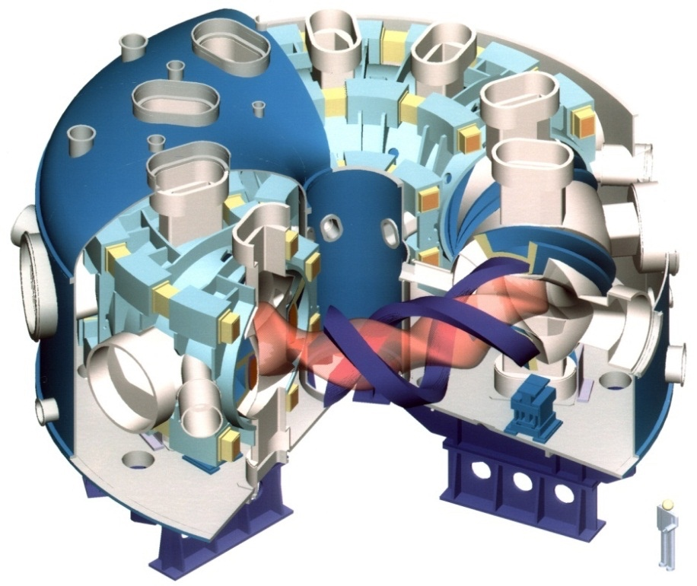
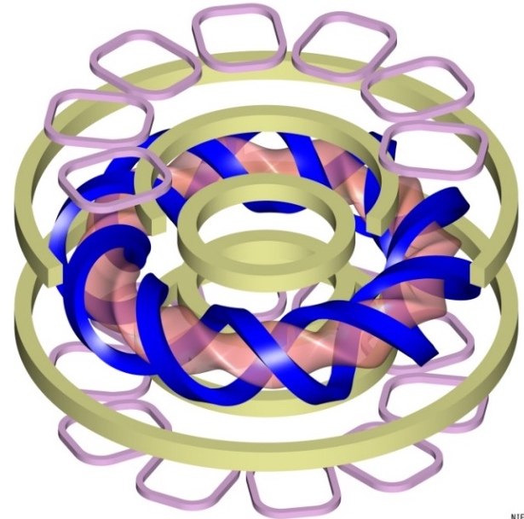
The Large Helical Device
Specifications
Mode numbers: l/m = 2/10
All superconducting system
helical/poloidal coils and bus lines
Major radius: 3.42 ~ 4.1 m
Minor radius: ~0.6 m
Volume(plasma): 30 m³
Toroidal B field strength: < 3 T
10-pair RMP coils (normal conducting)
Slide courtesy of N. Tamura

Slide 3
Outline
4-slide summary of the 2020 LHD campaign
Timeline and prospects for the next campaigns
Strong points of the Large Helical Device
Some topics of special relevance for WPW7X and Roadmap M8

Slide 4
Summary of the 22nd LHD campaign
October 2020 – February 2021
Campaign-defining aspects
  Main gas
  Available fueling-heating and other relevant operation capabilities
Several important LHD mission achievements (see next)

Slide 5
10 keV central ion temperature
Achievements of the 22nd LHD campaign
T_{i} =10keV with T_{e} = 8.1keV
T_{i} = T_{e} = 8.7keV
With about 30 MW NBI + 2 MW ECRH
Wall conditioning (He ECDC), C pellet injection, and small amounts of ECRH necessary.

Slide 6
10 keV central ion temperature
Achievements of the 22nd LHD campaign
EC Discharge Cleaning with Helium was instrumental (1MW/40s, 32 shots).
CX losses from edge neutrals thought to be responsible for lower NBI deposition.

Slide 7
Record neutron rate and W_{dia}
Achievements of the 22nd LHD campaign
2.1MJ
4.1x10¹⁵ n/s

Slide 8
Others
Achievements of the 22nd LHD campaign
T_{e}=10keV with n_{e}=2x10¹⁹m⁻³
Quasi SS e-ITB sustained with detachment (RMPs and Ne puff)

Slide 9
Outline
4-slide summary of the 2020 LHD campaign
Timeline and prospects for the next campaigns
Strong points of the Large Helical Device
Some topics of special relevance for WPW7X and Roadmap M8

Slide 10
Slide courtesy of
T. Morisaki, K. Ida

Slide 11
23rd LHD Experimental campaign
Oct. 14, 2021 – Feb. 17, 2022 (61 days of XP)
Call for proposals from mid June to early July (more foreign-friendly system will be launched) –for information on who to contact see next slide.
LHD FY2021 Research Forum (July) –provides researchers the first-hand opportunity to present ideas for experiments to be conducted on LHD.
5th LHD Workshop will be held between mid-Feb and mid-Mar 2022.

Slide 12
Topical group structure, leaders and advisers
 | Topical Group | Keywords | Leader | Domestic Adviser
 |  |  | Deputy
1 | Multi-ion plasma | He removal Multi-ion transport in terms of core-edge(wall) coupling | Naoki TAMURA (tamura.naoki@nifs.ac.jp) Masahiro KOBAYASHI (kobayashi.masahiro@nifs.ac.jp) | Kazuaki HANADA (Kyushu U.)
 |  |  | Gen MOTOJIMA Yutaka FUJIWARA | [TBD]
2 | Turbulence | Interactions of turbulence in phase-space (e.g. coupling between high-k and low-k) real-space (e.g. turbulence spreading) | Tokihiko TOKUZAWA (tokuzawa.tokihiko@nifs.ac.jp) | Shigeru INAGAKI (Kyushu U.)
 |  |  | Tatsuya KOBAYASHI Toru TSUJIMURA Motoki NAKATA | [TBD]
3 | Spectroscopy | Non-Maxwellian distribution / Anisotropy Collisional-radiative properties of molecules through high-Z ions | Motoshi GOTO (goto.motoshi@nifs.ac.jp) | Ryouhei KANO (National Astronomical Observatory of Japan)
 |  |  | Mikiro YOSHINUMA Tetsutaro OISHI Tomoko KAWATE | [TBD]
4 | Instability | Wave-Particle Interactions (e.g. Landau damping, TAE, ...) Abrupt events/Transitions | Yasuhiro SUZUKI (suzuki.yasuhiro@nifs.ac.jp) Kenichi NAGAOKA (nagaoka.kenichi@nifs.ac.jp) | Yuto KATOH (Tohoku U.)
 |  |  | Yuki TAKEMURA Shuji KAMIO | [TBD]
*International Advisers will be also added

Slide 13
Outline
4-slide summary of the 2020 LHD campaign
Timeline and prospects for the next campaigns
Strong points of the Large Helical Device
Some topics of special relevance for WPW7X and Roadmap M8

Slide 14
Strong points of LHD (I)
Adapted from M. Osakabe’s presentation at the LHD Workshop
Good platform for transport studies
  Several advanced plasma diagnostics
    High spatial/temporal resolution of TS T_{e} and n_{e} measurements, and CXRS T_{i}, V_{tor} and n_{C}.
    Hydrogen isotope fraction (H/D) profile measurements.
    HIBP for core electrostatic potential measurements.
    Several turbulence diagnostics (PCI, DBS, ECE, etc.).
  Pellet injectors (fueling and TESPEL impurity tracers)
  Multiple heating methods (p-NBI, n-NBI, ECRH, ICRH).

Slide 15
Heating systems for next campaign
3 Negative-NBIs (tangential inj., NBI#1 - #3)
  E = 180 – 190 keV
  H 16 MW, D 8 MW
  Optimization of beam optics will be performed for achieving a full power
2 Positive-NBIs (radial inj., NBI#4, #5)
  E = 40 – 80 keV
  H 12 MW, D 18 MW
    Option: He 8 MW (as last year’s result with 3IS, available only with NBI#5)
Electron Cyclotron Heating (ECH)
56 GHz x 1 (for low B_{t}), 77 GHz x 2, 154 GHz x 2,
116/154 GHz x 1(to be fixed)
  Total ~5.1 MW
Ion Cyclotron Heating (ICH) (38.47MHz)
  Total ~5 MW
  HAS(3.5U/L): 1 MW x 2, FAIT(4.5U/L): 1 MW x 3
Slide courtesy of N. Tamura

Slide 16
Strong points of LHD (II)
Good platform for Fast Ion studies
  Only device with multiple high-energy n-NBIs (16MW, 180kV).
    Combined NBI+ICRH (5MW installed) leads to EP tails
    Can lead to a significant fast ion population.
  Several FI diagnostics
    Neutron monitors, FIDA, FILD and NPA.

Slide 17
Strong points of LHD (III)
Good bench for steady-state control and PMI studies
  The device has run discharges >2500s long.
  Real-time TS and feed back control system for ECH plasmas are now prepared.
  Material probes are installed.
Good platform for high-β studies
  Dedicated 56GHz gyrotron for start-up at 1T + lots of NBI power
  High-beta database being constructed (for reactor extrapolation).
  High-beta transport degradation observed. Difficulty to access low-ν and high-β simultaneously

Slide 18
Outline
4-slide summary of the 2020 LHD campaign
Timeline and prospects for the next campaigns
Strong points of the Large Helical Device
Some topics of special relevance for WPW7X and Roadmap M8

Slide 19
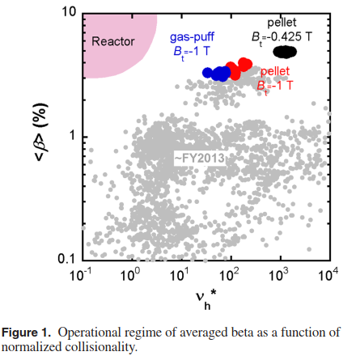
Some scientific focal points for WPW7X (I)
and Roadmap Mission 8: Stellarator
High-β studies
  low-field plasma production (ICRH start-up + X3 heating) and
  physics of transport at high beta.
Fueling (incl. pellet) and particle transport (incl. H/D/He differential transport).

Slide 20
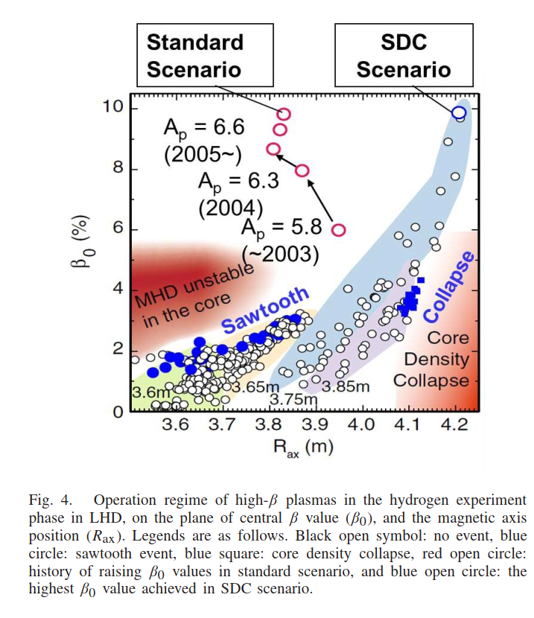
Some scientific focal points for WPW7X (II)
and Roadmap Mission 8: Stellarator
Operational boundaries (“Sudo” density limit, radiative, MHD)
  Also the absences of limits otherwise expected on theoretical grounds! –LHD has operated above the linear ideal MHD limit.

Slide 21
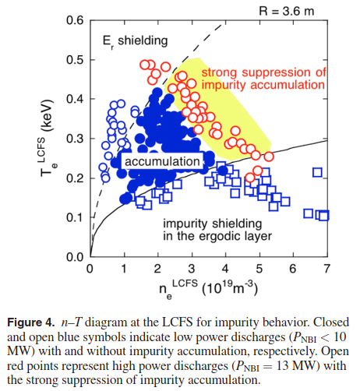
Some scientific focal points for WPW7X (III)
and Roadmap Mission 8: Stellarator
Understand and control of the impurity content
  SOL impurity screening and core accumulation
3D code validation
  Multi-species GK turbulence codes (GKV, stella, GENE…)
  Edge/SOL (EMC3/EIRENE)
  Fast Ion Transport (ASCOT, …)

Slide 22
Take-home messages
LHD is large superconducting helical device of a volume similar to W7-X –has so far “set the standard” as a stellartor.
  Has put together a large body of knowledge on stellarator physics and significantly contributed to stellarator International Databases.
Has impressive operational and diagnostic capabilities that allow to explore scientific and technical aspects that W7-X will only be capable of addressing in several years.
Most likely, we only have the 2021 and 2022 campaigns left before its permanent shutdown.
  This requires to identify and address strategic for EUROfusion.

Slide 23
Back-up slides

Slide 24
Access to high beta low collisionality regimes at reduced field.
Description | According to the energy confinement scalings, it should be possible to achieve FFHR2m2 beta/nu values in LHD at 1T with P=22MW and ne=5e19. The experiment should target those values and examine confinement degradation and or MHD activity that prevents from achieving the expected values.
Relevance for M8 | One the of milestones of M8 in FP9 is the high-beta, low-collisionality W7-X operation. With the foreseeable increase of heating power this appears mots likely at reduced field (1.7T). LHD has operated at 1T with ~4% beta but only high-nu. The identification of obstacles to achieve high-beta/low-nu and whether or not they are Heliotron-specific is important.
Ref. | https://doi.org/10.1088/1741-4326/aa65aa

Slide 25
Start-up and plasma sustainment at reduced field
Description | Produce and characterise a plasma with ICRH, aiming at values that could provide a adequate plasma for subsequent NBI and/or ECRH X3 plasma sustainment.
Relevance for M8 | See previous slide.
Ref.

Slide 26
Characterisation and physics description of operational limits
Description | Identify the causes of the several operational boundaries in LHD (radiation, currents/MHD, heating...) and its implication for the W7-X. (Also the absences of limits otherwise expected on theoretical grounds!).
Relevance for M8 | In today's devices, the most limiting operational boundary is the density or "Sudo" limit, which is related to the radiative power balance with low-Z (C, O) impurities with peripheral radiation. This limit is however or lesser importance in a burning plasmas with strong self-heating and different wall elements. A more profound physics understanding is required for extrapolation. The relevance of MHD boundaries (saw-teeth, core density collapse) for W7-X needs to be elucidated.
Ref. | https://doi.org/10.1109/TPS.2017.2784380

Slide 27
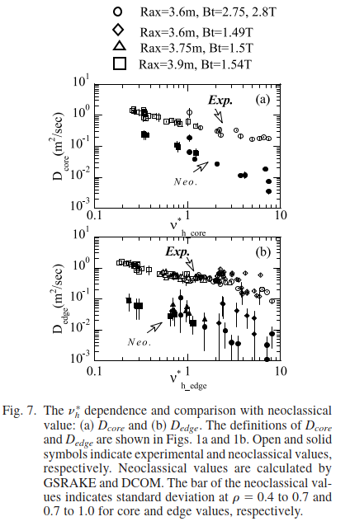
Pellet Fuelling and Particle transport in high-n, high-T regimes
Description | Characterise and model (NC + turbulent) the pellet fueling and particle transport in LHD.
Relevance for M8 | Considerable uncertainty exist about the extrapolation of density profiles to reactor scenarios. It is generally considered necessary to have central pellet fuelling, but the particle deposition and transport are not well understood. The LHD offers the diagnostic and modelling capabilities to characterise particle transport.
Ref. | https://doi.org/10.13182/FST10-A10795

Slide 28
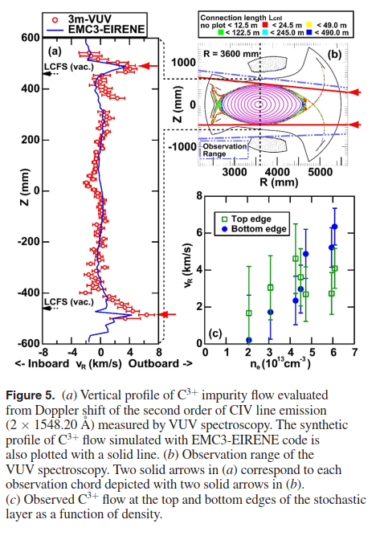
EMC3/ERIENE modeling of LHD edge-SOL-divertor and detachment.
Description | Validate the EMC3/EIRENE code in LHD with dedicated PWI studies. Study the importance of drifts, particularly in detached conditions with an without seeding. The validation of the div-sol model is required for the posterior validation of erosion-depositinon-migration tools like EROV2.
Relevance for M8 | The SOL regions of LHD and W7-X are quite different as are their divertors. The differences are such that they preclude any direct comparison without a sofiticated edge/sol modeling. The differences, on the other hand, offer good conditions for the validation of the Eruopean code EMC3/EIRENE. Detachment access conditions, physics (e.g. volumetric recombination not observed in W7-X, required diffusivity coefficients) should be a primary focus of the validation.
Ref. | http://dx.doi.org/10.1088/0029-5515/55/10/104021

Slide 29
Characterisation and modeling of the operation conditions of benign impurity transport and source control (screening).
Description | Diagnose the relevant edge and core plasma parameters in regimes of edge screening and high NBI power to pursue validation of the edge (EMC3) and core (NC+Turbulent) impurity dynamics and transport. Investigate the importance of asymmetries in the impurity transport for its potential instrumentalisation.
Relevance for M8 | Impurity accumulation is often regarded as the Achilles heel of stellarators. LHD has meticulously explored the parameter space and the accumulation properties on the plasmas (see reference). Regions of core and edge screening have been identified. Recently, the combination of NBI torque and Ti gradients has been claimed to strongly suppress accumulation. The understanding of the strategies to avoid accumulation and their extrapolation to reactor conditions should be pursued.
Ref. | https://doi.org/10.1088/1741-4326/aa6187

Slide 30
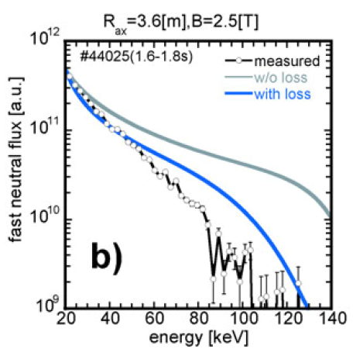
ASCOT validation against LHD ICHR and NBI generated fast ions.
Description | Application of similar diagnostic and simualtion tools in LHD and W7-X aimed at the validation of ASCOT.
Relevance for M8 | LHD has illustrated a general agreement between experiments and expectations of the effect of the magnetic configuration on fast particle confinement. Detailed analysis of the FI loss pattern, Alfvén wave interactions are scarce. Is LHD fast ion confinement regareded sufficient in FFHR2m2 high and low density scenarios?
Ref. | https://doi.org/10.13182/FST10-A10800

