Slide 1
IMS training April 16th, 2021
Project Management Office

Slide 2
PMO output per knowledge area/topic
Work Package management knowledge areas
Scope
Budget
Monitor
Schedule
Change
Documents
Quality
Risk
Comms.
• PMP template
• Process for creation, update, review and approval of PMP
• Guidelines documenting scope management (CWP, AWP)
• Guidelines documenting budgeting of deliverables⁽¹⁾
• List of high budgetary impact items⁽²⁾
• Status of Program progress
• Status of alignment of PMPs with GA deliverables
• Critical issues table
• List of KPIs ⁽¹⁾
• Integrated schedule at program level (updating/maintenance/reporting)
• Scheme for project schedule follow-up
• Guidelines for schedule definition
• PCR template
• Process for change mgmt.
• PCR register
• Templates for documents (except AWP, CWP and all contractual documents)
• PM related standard IDM structure
• Process for review and approval
• Quality check of GA deliverables (S.M.A.R.T.)
• Quality check of project deliverables (IDM review process) jointly with PSOs
• Process for review and approval
• PM Quality methods and tools
• Risk register template
• Guidelines for risk management
• Program risk register
• PM related training courses
• PM related coaching (tools, procedures, guidelines)
• Regular meetings with PL/TFLs & PSOs (including PIO)
Output
IT/software tools definition, upgrades, maintenance and support
⁽¹⁾ Consultation with Admin + HoD + PL/TFLs
⁽²⁾ Combined effort of PMO and Admin
Notes:
Output is not a single time work. There are ongoing activities/improvements/processes etc..
Yearly reporting – PMO will support on defining guidelines or improvements if requested
(2) – goal is to have a close monitoring of these items to anticipate issues – regular report (every quarter?) continuous reporting with checkpoints during the year created by PMO in collaboration with ADMIN for HoDs

Slide 3
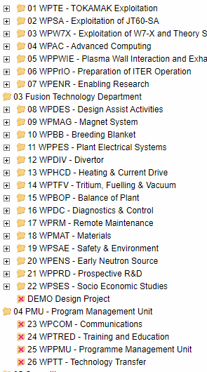
PMO single point of contact
PMO
Beneficiaries
Single point
of contact
WP monitoring
Contact: Carme
FSD WPs
Botond
Change &Risk mng
Contact: Carme
FTD DEMO WPs (DES, MAG, …SAE) WPSES + WPPRD
PIO
Single point
of contact
Carme
Integrated Schedule
Contact: Botond
WPENS
Communication & Training
Contact: Botond
PMU WPs + TBM
Single point
of contact
Juergen
Process, tools & templates dev
Contact: Juergen
IT tools and service
Single point
of contact
Liviu
Quality
Contact: Juergen
The Single Point of Contact is the person whom the WPs interacts for issues (questions) related to the scope of responsibilities of the PMO
After evaluation of workload/processes developed some roles shall be adjusted

Slide 4
PMP/PEP & other Documents – Dependence & Sequence
CWP (2021-25)
including all Work Packages (WP)
limited level of detail for each WP
PMP/PEP
central and single point of reference (i.e. one single repository of WP information); specific for WP
under responsibility of respective PL/TFL
to be approved by respective "Board"
covers 5 years (consistent with CWP)
Including WBS & Planning (for 5 years)
→ Deliverables (defined in line with WBS)
→ more details for each upcoming year
Use of existing
sections from
approved PMP
(annual update)
AWP (2022, …):
→ Information from PH (Updates)
→ Information from PEP for 2022, …
2022, …
IMS (2022, …): Definition of
Task Specifications for 2022
Deliverables for 2022, … (Level-3)
New Templates will allow easy extraction of dedicated sections for use in other documents (e.g. AWP)

Slide 5
IPS – Integrated Programme Schedule (1)
AIMS
Identification and tracking of
grant level and critical activities, deliverables, milestones and decision points that have a significant impact on the overall delivery of the programme
dependencies required for achieving critical milestones and taking key decisions
Integration and regular update of information on
time schedule from the Work Packages
critical activities, deliverables, milestones and decision points
Basis for
reporting and monitoring approach (e.g. identification of significant deviations from the agreed baseline)
notifying the Department Heads and the Programme Manager about deviations
(Change and version control applied)

Slide 6
IPS – Integrated Programme Schedule (2)
Hierarchical approach
Top layer - Grant Agreement level schedule
Grant deliverables and milestones;
other important milestones from the Roadmap and the CWP regarded as highly important
Middle layer - Schedule for critical items identified for closer monitoring
Following the criteria defined by the EUROfusion management, a number of items from the WPs are monitored closely due to their importance.
e.g. Pilot plants, Items with high budgetary impact or high scope impact, etc.
Lowest layer – Work Package schedule:
The detailed schedule of the WPs (very different level of maturity and details)

Slide 7
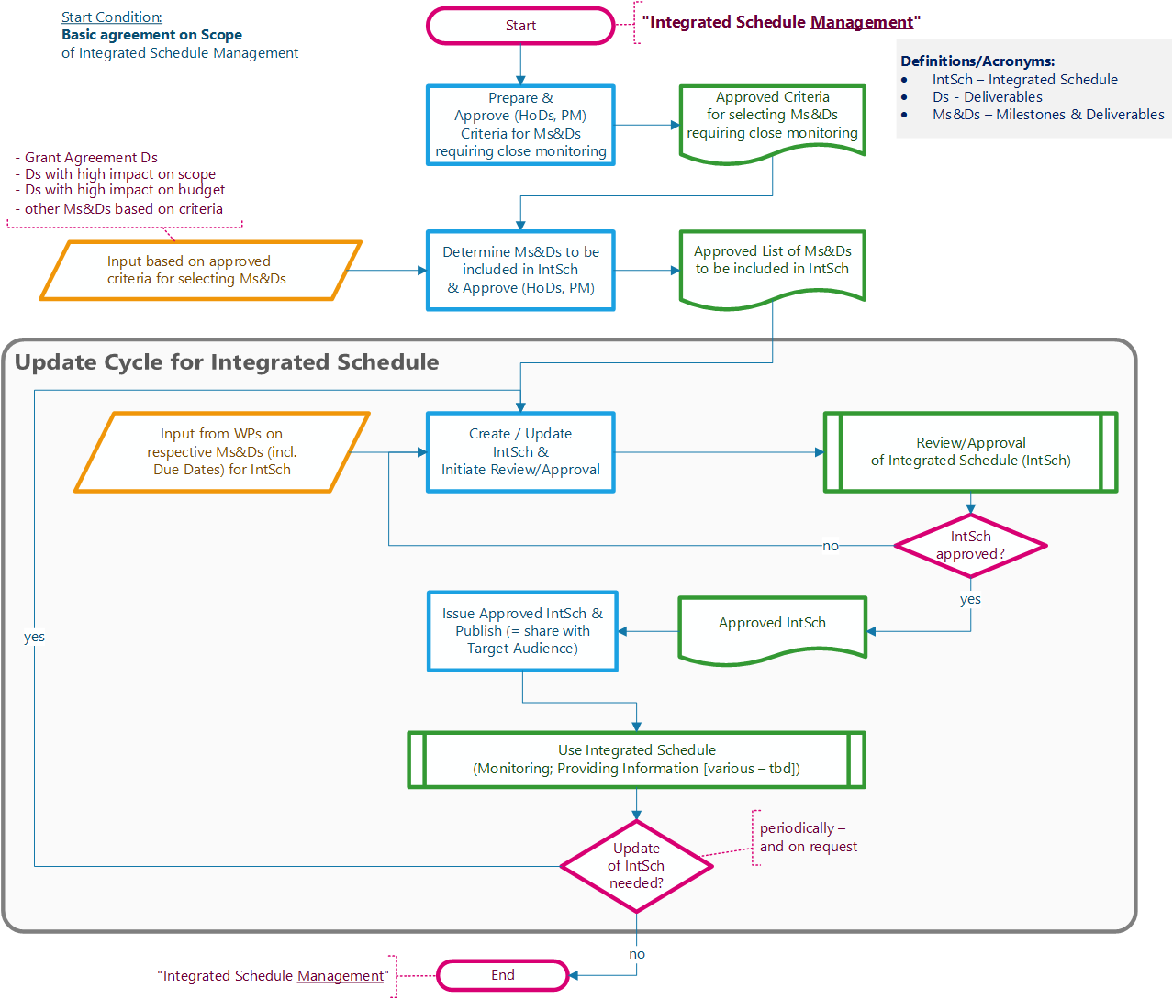
IPS – Integrated Programme Schedule (3)
Definition of Top and Middle layers
Next steps:
Monitoring approach
Definition of interface to WPs
Tool selection

Slide 8
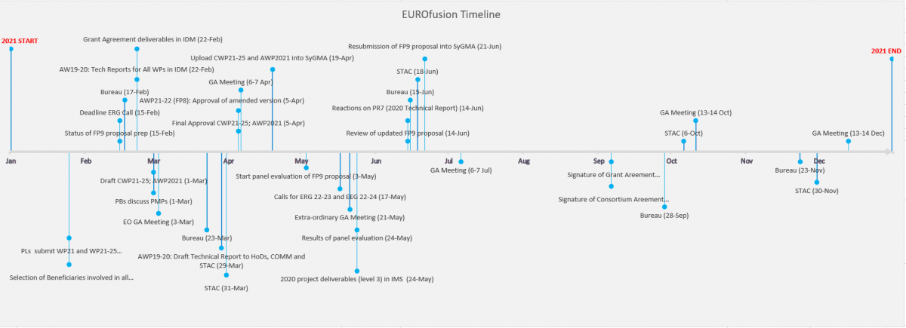
Timeline
Goal: display high level information with main events and actions
PMO as the owner of the file
will maintain the file with input from HoDs
will publish the updated file regularly
Next steps:
Split between actions and events
Display in Indico under evaluation
Link to Wiki

Slide 10
PMP/PEP & other Documents – Dependence & Sequence
CWP (2021-25)
including all Work Packages (WP)
limited level of detail for each WP
Annual Update for 2022:
PEP(provisional) is good basis:
- most information already included
- in a structured way
reduced effort for:
- creating 2022-version of PMP
- including updates (details) for 2022
AWP (2021):
Organisation & Scope for 2021
details (limited) on execution plan
PEP (provisional)
(for use in 2021)
2021
IMS (2021): Definition of
Task Specifications for 2021
(WP) Deliverables (Level-3)
PMP/PEP
central and single point of reference (i.e. one single repository of WP information); specific for WP
under responsibility of respective PL/TFL
to be approved by respective "Board"
covers 5 years (consistent with CWP)
Including WBS & Planning (for 5 years)
→ Deliverables (defined in line with WBS)
→ more details for each upcoming year
Use of existing
sections from
approved PMP
(annual update)
AWP (2022, …):
→ Information from PH (Updates)
→ Information from PEP for 2022, …
2022, …
IMS (2022, …): Definition of
Task Specifications for 2022
Deliverables for 2022, … (Level-3)
New Templates will allow easy extraction of dedicated sections for use in other documents (e.g. AWP)

Slide 11
Hierarchy of Documents in EUROfusion
Contractual / EC
CWP
Consortium Work Plan (CWP) [part of Grant Agreement]:
describing the Programme's scope and objectives
covering 5 years
including all Work Packages (WP)
Project Management
(EUROfusion / PMU)
PMP (→ WPEP)
WP Execution Plan (WPEP) [part of PMP Portfolio]:
detailing how to achieve the objectives of the project
covering 5 years (consistent with CWP)
dedicated WPEP for each Work Package (WP)
more detailed information for each upcoming year → basis for respective AWP
Contractual / EC
AWP
Annual Work Plans (AWP):
outlining annual goals, objectives & activities of Programme
each covering 1 year
based on WPEP for respective (upcoming) year

Slide 12
Consistent PM-approach for FP9: Basis → “PMP Portfolio”
FP9: "Project Management Plan Portfolio"
consisting of 3 PARTS
two parts with the main contents as per Chapter 4 (3.2.2): Project Execution Plan (PEP) and Project Handbook (PH)
further part = "Project Management Handbook" (PMH): General procedures / guidelines applicable for all WPs
will be provided by PMO (foreseen for summer 2021)
meant to be referenced in "Project Handbook" (→ only for WP-specific procedures, adjustments/detailing as needed
name adjustments (generalization): "Work Package" instead of "Project"
Project Handbook (PH) → Work Package Handbook (WPH) (= PART-2 of PMP Portfolio; template by PMO)
Project Execution Plan (PEP) → Work Package Execution Plan (WPEP) (= PART-3 of PMP Portfolio; template by PMO)
CWP (2021-25)
AWP (2021)
WPEP (2022)
WPEP (2023)
WPEP (2024)
WPEP (2025)
PEP(prov) (2021)
AWP (2022)
AWP (2023)
AWP (2024)
AWP (2025)
2021
2022
2023
2024
2025

